Slide 1
RECEIVING THE IN-BREAKING OF HEAVEN
Putting Jesus In The Center
Sermon For LifeGate
Sunday, November 12, 2023

Slide 2
Psalm 85 and Radical God Consciousness
Restore us again, O God our Savior, and put away Your displeasure toward us. ⁵ Will you be angry with us forever? Will You prolong Your anger through all generations? ⁶ Will You not revive us again, that Your people may rejoice in You? ⁷ Show us Your unfailing love, O LORD, and grant us Your salvation. ⁸ I will listen to what God the LORD will say; He promises peace to His people, His saints-- but let them not return to folly (foolishness). ⁹ Surely His salvation is near those who fear Him, that His glory (weighty presence) may dwell (abide, remain, inhabit) in our land. ¹⁰ Love and faithfulness meet together; righteousness and peace kiss each other. ¹¹ Faithfulness springs forth from the earth, and Righteousness looks down from heaven. ¹² The LORD will indeed give what is good, and our land will yield its harvest. Psalm 85:4-12 (NIV)

Slide 3
Out of a Problem Guarding God’s Priorities
In those days when the number of disciples was increasing, the Grecian Jews among them complained against the Hebrew Jews because their widows were being overlooked in the daily distribution of food. 2 So the Twelve gathered all the disciples together and said, "It would not be right for us to neglect the ministry of the word of God in order to wait on tables. 3 Brothers, choose seven men from among you who are known to be full of the Spirit and wisdom. We will turn this responsibility over to them 4 and will give our attention to prayer and the ministry of the word." Acts 6:1 - 4

Slide 4
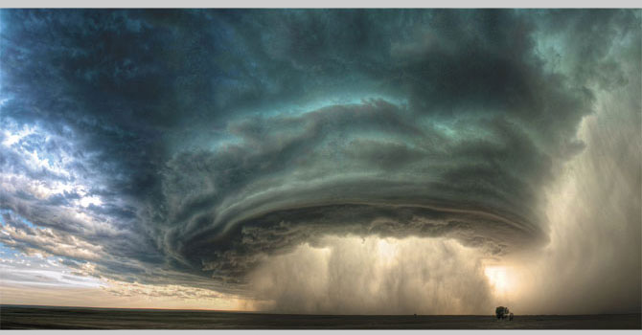
How Many Perfect Storms
Can One Generation Encounter?
Since, then, we know what it is to fear the Lord, we try to persuade men.2 Corinthians 5:11

Slide 5
God Is Preparing Us For The
Glory Of This Next Season
We are in a transition where we cannot afford to bring into the next season the STUFF from our past.
The loose ends and the things that trip us up and have not been fully dealt with - God is purging from us - because the next three and a half years will be some of the most critical years we're probably going to live through. Therefore, we cannot bring into this next season the issues; the weirdness; and moodiness; and quirkiness that comes because of our flesh that hasn’t be crucified by the grace of God. We need to die a thousand deaths and we need to be victorious, through faith, so that we can run without hindrance the race marked out for us.

Slide 6
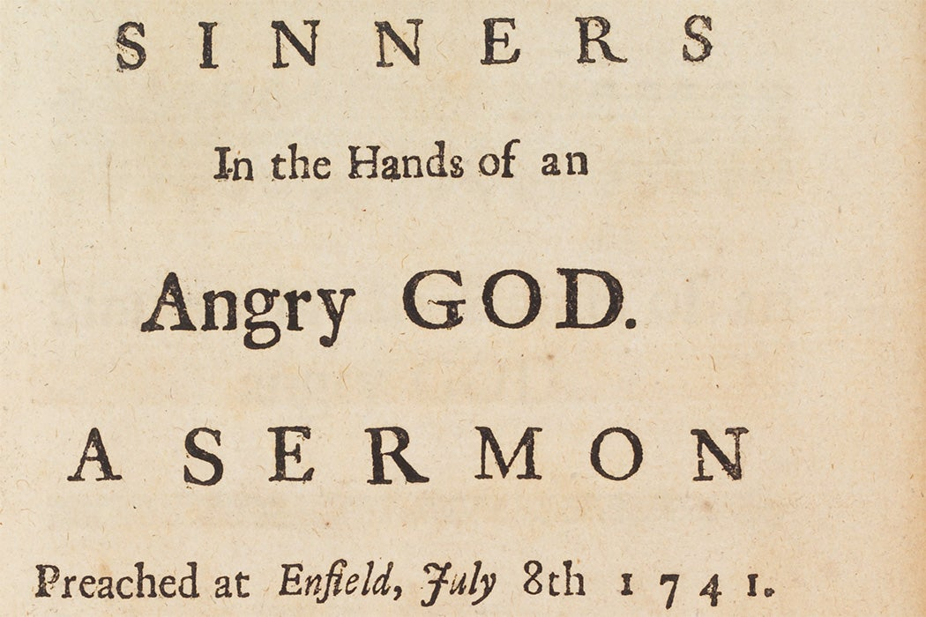
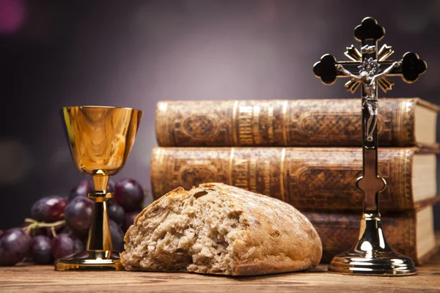
The Private Story of Jonathan Edwards
And An Atmosphere of God Consciousness
“It was the best of times and the most challenging of times.”
“I desire your prayers, that I may take a suitable notice of the frowns of Heaven on me and this people, between whom there once was so great a union; that these troubles may sanctify me; that God would overrule the event for His own glory (in which doubtless many adversaries will rejoice and triumph).”

Slide 7
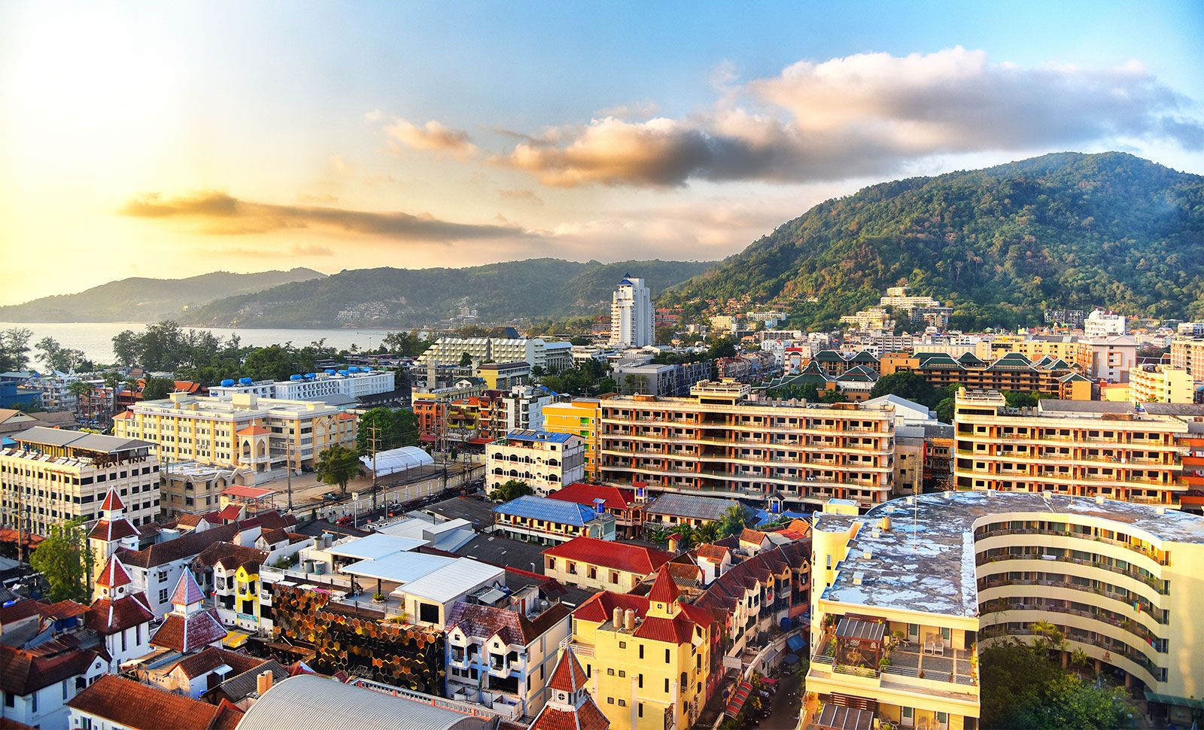
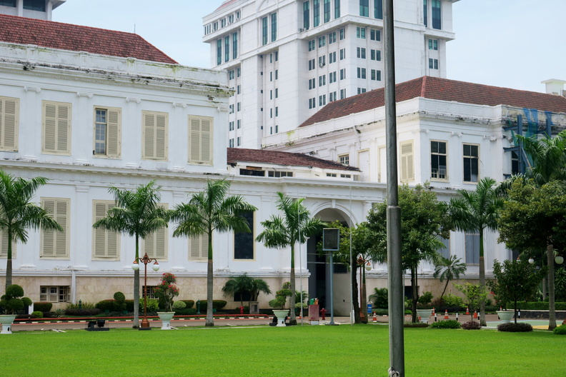
The Ice Cream Cart - Story
Phuket Thailand

Slide 8
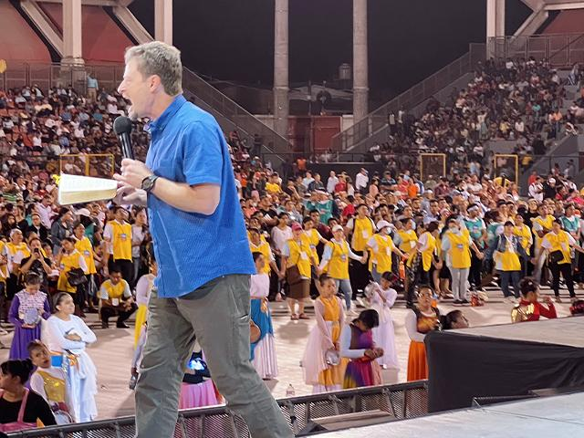
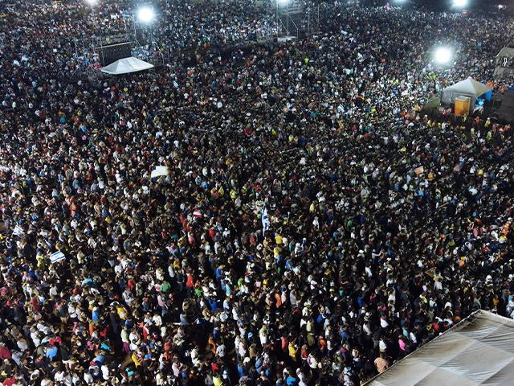
Strategic Shift IN NICARAGUA
In 2023
Britt Hancock
He told me, 'Son, I've decided to do something in
Nicaragua, and if you'll just say, 'Yes,' you're
going to watch me do something,'

Slide 9
We Are All Part Of A Bigger Story
We are Living Out Four Stories or narratives all at Once
1 - We are Living our personal Story – personal journey saying YES to God – doing the next thing in front of us.
2 - We are Living a collective story with our families, Churches, communities and nation - shared experiences –
3 - We are Living a generational story from the history of our family, communities and nation and world
4 - We are Living in God’s Story – His purpose and plans are the only reason we exist – He is always working all things together “according to the council of His will” – Acts 17:26 - Philippians 3:21 - Ephesians 1:11 - We enter into His sufferings as well as HIS VICTORY.

Slide 10
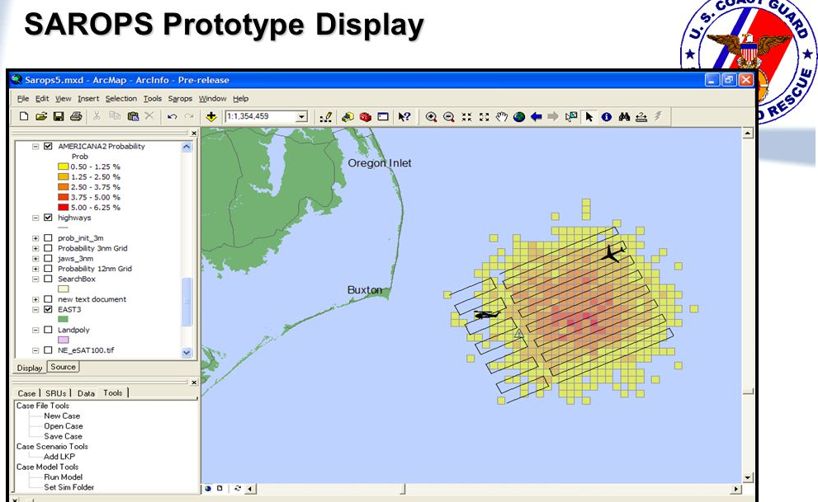
A Personal Story – Rescued
By A Miracle
Search And Rescue Optimal Planning System

Slide 11
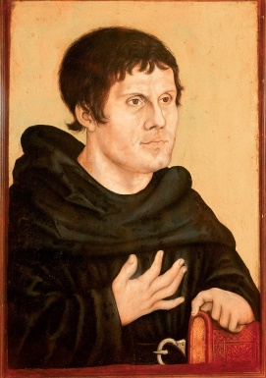
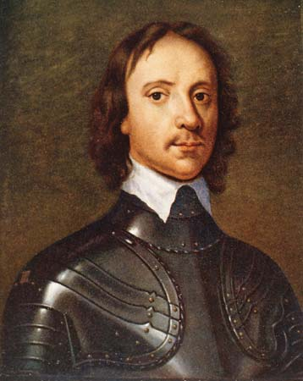
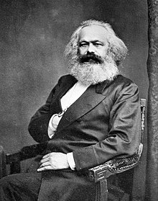
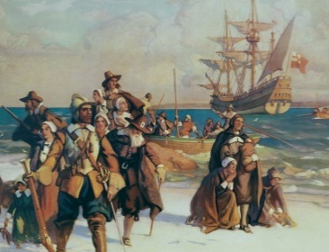
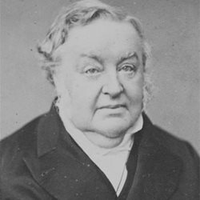
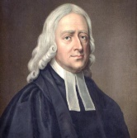
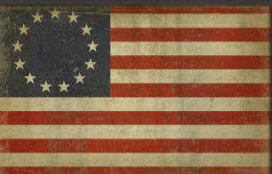
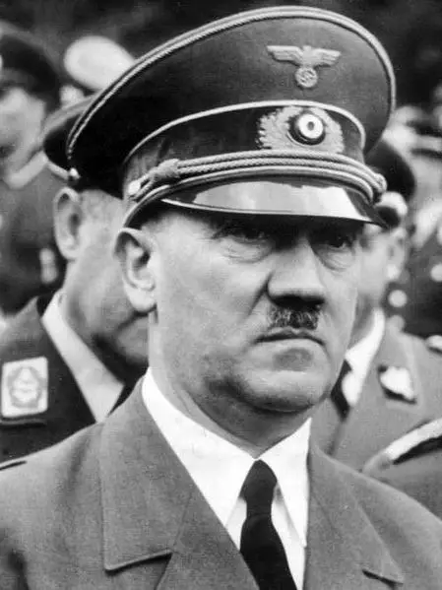
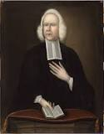
Here Is A Snapshot of Europe’s Generational Story
1620
Puritans Fled England – went to Holland and then left Holland For
North America
English Civil War 1639-1653
Cromwell
1517
Martin Luther
Reformation
Marx
Friedrich
Nietzsche
1844 - 1900
1792-1815
French Revolution
Nepoleonic Wars
Wesley
American Revolution
1776
NIHILISM - Nietzsche, saw there is no objective order or structure in the world except what we give it.
Johann
Blumbthart
1843
The European Church left the Gates of Influence to rationalism and secularism
1933 Hitler
Whitefield

Slide 12
Psalm 85 Was Sadly Fulfilled
He promises peace to His people, His saints–
But let them not return to folly.
For although they knew God, they neither glorified him as God nor gave thanks to him, but their thinking became futile and their foolish hearts were darkened. ²² Although they claimed to be wise, they became fools ²³ and exchanged the glory of the immortal God for images made to look like mortal man and birds and animals and reptiles. Romans 1:21-23 (NIV)

Slide 13
OUR SHARED NATIONAL STORY - PROPHETIC WORD ABOUT AMERICA 1944
“I the Lord gave America skilled workers and inventors smart and industrious scientific professors, Statesman financiers and many cunning devices of every type were invented. Steamers plowed the waters locomotives with trains went from Shore to Shore. Automobiles raced below and airplanes above. Factories were filled and it's cities were lighted as it harnessed the power of electricity. They are a blessed people Greatest of all was my concern for the spiritual welfare of this people and I've shown this by sending to them many anointed Ministers of the Gospel speaking in my Spirit with the enduement of power persuading men and women to turn to the Lord and promoting great and far-reaching revivals. These seasons of Awakening often transformed communities from sinful to a God-fearing. Seeley Kinne

Slide 14
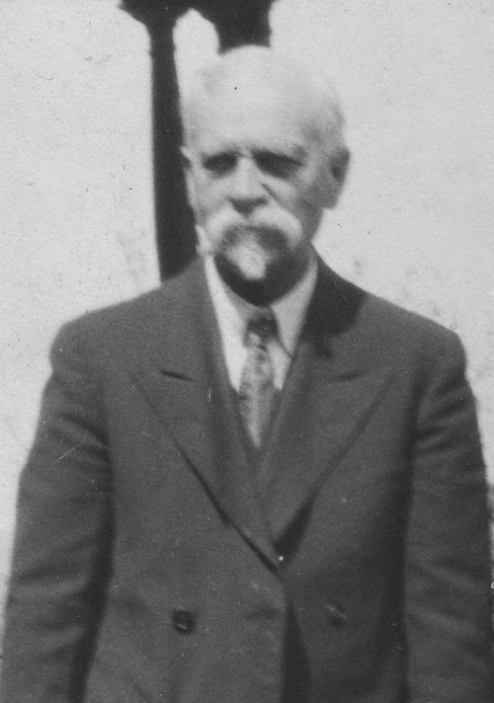
“Now therefore consider this, America if I destroyed ancient Nations like Canaan and Egypt and Assyria and Empires like Babylon even now you are being refined- almost the whole nation is turned to prosecuting this world war and fighting for its very existence. Millions upon millions of dollars are being spent thousands of lives are being sacrificed. Where are those who will stand in the gap and make a hedge for your nation otherwise how shall you escape the Divine judgment that is in this hour. Pray for the mercy of God to be shown you. Pray for a wave of divine power that shall bring repentance to your people and Revival and salvation instead of judgment upon Your Land.”
Seeley Kinne

Slide 15
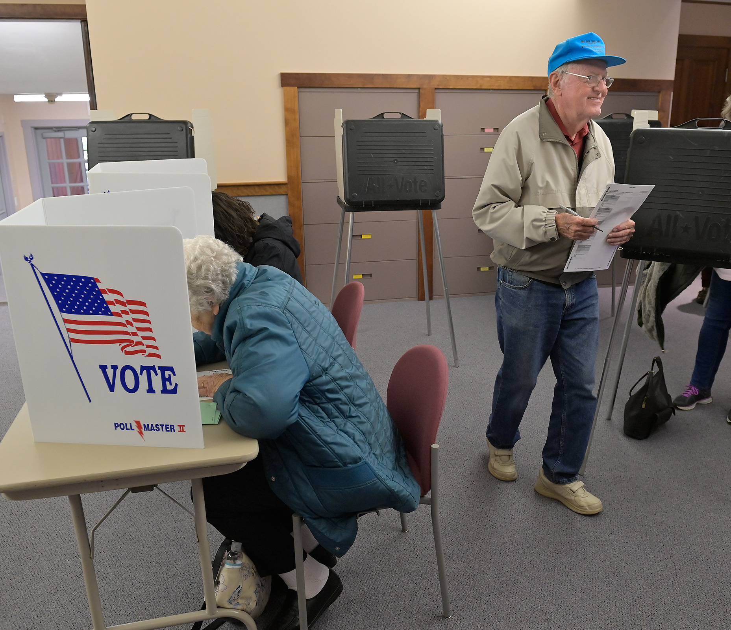
Our Community Story

Slide 16
Elections Have become very Important AND VERY MESSY in the Last Seven Years
Yes – HALLELUJAH - we celebrate the victory of this past School Board Election on Tuesday – But it is a victory based on Proverbs 31
The horse is made ready for the day of battle, but victory rests with the LORD. Proverbs 21:31
So, As God’s People We Have To Still Live Out The Heart And Wisdom Of God Even In The Messiness.
Our prayer is that God will overrule any of the negatives that can occur when our personal EXPECTATIONS OR STRATEGIES CLASH in our collective story
so that God can sill bring forth His story
as we stand, in faith, at the gates of influence.

Slide 17
In those days when the number of disciples was increasing, the Grecian Jews among them complained against the Hebrew Jews because their widows were being overlooked in the daily distribution of food. 2 So the Twelve gathered all the disciples together and said, "It would not be right for us to neglect the ministry of the word of God in order to wait on tables. 3 Brothers, choose seven men from among you who are known to be full of the Spirit and wisdom. We will turn this responsibility over to them
A Problem Became An
Opportunity TO PRESS DEEPER INTO GOD’S PRESENCE
The knew they had to PROTECT THE ANOINTING
AND HOST HIS PRESENCE !!!

Slide 18
Our Community Story Gets TESTED
Just Like Acts Chapter six
I am convinced that the Lord will help us protect the freedoms and the liberties we have here in America that are under attack. If we PRESS IN FOR HIS PRESENCE and stay engaged in our community.
And in those days, when the number of the disciples was multiplied, there arose a murmuring
Unfortunately, we who are fighting the hardest for Truth and Liberty sometimes get sucked up into our own differences and we have to overcome all of this through patience and love - prayer and a tender heart that is full of unwavering faith in God.

Slide 19
DO NOT GO ANYWHERE THE HOLY SPIRIT
WILL NOT FOLLOW YOU.
Most often we grieve the Holy Spirit by personal decisions and by failing to saturate ourselves with His Presence and following His persistent leading prompting us to miss His perfect will and purpose.
But sometimes we grieve the Holy Spirit by being swept up into decisions others make that causes us to be in a current that is not where the Holy Spirit is going. This is either through an overemphasis on something or a fear the Holy Spirit will ask us to do something weird or an outright deception. All of these keep us in a limited work of the Holy Spirit and when He is quenched He will not give us the full effectual anointing and power that we need to invade a community.

Slide 20
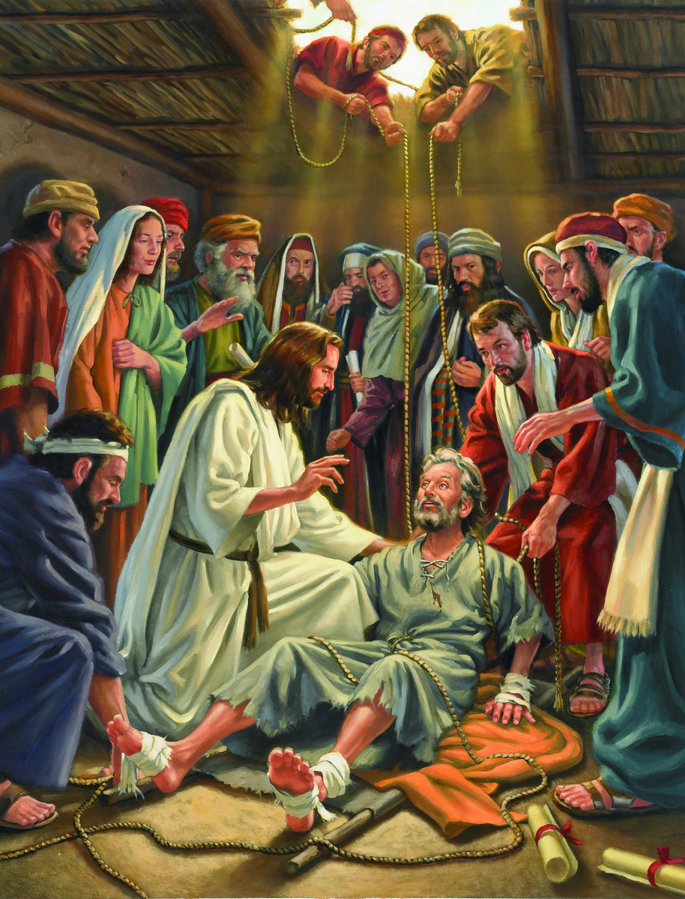
Faith IN GOD - Moves God
When Jesus saw their faith, He said to the paralytic, "Son, your sins are forgiven."
Mark 2:5 (NIV)

Slide 21
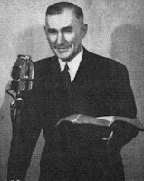
WHY DID PEOPLE LIKE PETER – JAMES AND JOHN AND PAUL AND EDWARDS, WHITEFIELD AND FINNEY HAVE CROWDS RESPOND?
By Their Devotion To God They Created An Intensified Atmosphere Of Faith In The Living God
At Iconium Paul and Barnabas went as usual into the Jewish synagogue. There they spoke so effectively that a great number of Jews and Gentiles believed. ² But the Jews who refused to believe stirred up the Gentiles and poisoned their minds against the brothers. ³ So Paul and Barnabas spent considerable time there, speaking boldly for the Lord, who confirmed the message of his grace by enabling them to do miraculous signs and wonders. Acts 14:1-3 (NIV)
Doctor
Thomas Wyatt 1953
In Lystra there sat a man crippled in his feet, who was lame from birth and had never walked. ⁹ He listened to Paul as he was speaking. Paul looked directly at him, saw that he had faith to be healed ¹⁰ and called out, "Stand up on your feet!" At that, the man jumped up and began to walk. Acts 14:8-10

Slide 22
THE ANTIOCH MIRACLE WAS AMAZING
THINGS WENT TO ANOTHER LEVEL
When he (Barnabas) arrived and saw the evidence of the grace of God, he was glad and encouraged them all to remain true to the Lord with all their hearts. ²⁴ He was a good man, full of the Holy Spirit and faith, and a great number of people were brought to the Lord. Acts 11:23-24 (NIV)
As they ministered to the Lord, and fasted, the Holy Spirit said, Separate to me Barnabas and Saul for the work whereunto I have called them. ³ And when they had fasted and prayed, and laid their hands on them, they sent them away. Acts 13:2-3 (KJV)

Slide 23
WHAT DOES GOD CONSCIOUSNESS
LOOK LIKE
When Jacob awoke from his sleep, he thought, "Surely the LORD is in this place, and I was not aware of it." ¹⁷ He was afraid and said, "How awesome is this place! This is none other than the house of God; this is the gate of heaven." ¹⁸ Early the next morning Jacob took the stone he had placed under his head and set it up as a pillar and poured oil on top of it. ¹⁹ He called that place Bethel, Genesis 28:16-19
When this became known to the Jews and Greeks living in Ephesus, they were all seized with fear, and the name of the Lord Jesus was held in high honor. ¹⁸ Many of those who believed now came and openly confessed their evil deeds. ¹⁹ A number who had practiced sorcery brought their scrolls together and burned them publicly. ²⁰ In this way the word of the Lord spread widely and grew in power. Acts 19:17-20

Slide 24
We MUST AVOID Tragic UNAWARENESS
Samson stopped hosting the presence and power of God when He despised His Consecrated Vow to not cut His hair and allowed the secret of HIS POWER to be revealed and defiled .
Then she (Delilah) called, "Samson, the Philistines are upon you!" He awoke from his sleep and thought, "I'll go out as before and shake myself free." But he did not know that the LORD had left him. ²¹ Then the Philistines seized him, gouged out his eyes and took him down to Gaza. Binding him with bronze shackles, they set him to grinding in the prison. ²² But the hair on his head began to grow again after it had been shaved. Judges 16:20-22 (NIV)

Slide 25
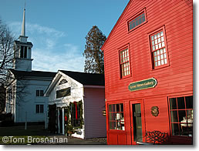
Great Awakening 1735-1745
Pastor Jonathan Parson in 1735 observed that "… a deep and general concern came upon the minds of the Church. It was a time of weeping, and sobs." Yielding to the requests of the congregation, Pastor Parsons began writing three sermons per week and preaching from old sermons. Sick of "vain Mirth and foolish Amusements" by April 1735, the inhabitants of Lyme, Connecticut formed spiritual societies within the existing church, studied the Bible, and conversed about faith. In lieu of the traditional feasting, dancing, music, and games on Election Day, May 14 (1735), the Congregationalists requested a sermon. Parson's audience reacted with deep anguish, and outcries: women were broken and several stout men fell "as though a cannon had been discharged, they were pierced through their hearts." After both George Whitefield and Gilbert Tennent preached at the church in Lyme, the congregation continued to grow through the 1740s. Between June 1741 and February 1742 there were 150 conversions, primarily among the youth.
Lyme
Connecticut

Slide 26
Spiritual Demand for the Presence of the Lord
Will Increase in the Last Days
This is what the LORD Almighty says: "Many peoples and the inhabitants of many cities will yet come, 21 and the inhabitants of one city will go to another and say, 'Let us go at once to entreat the LORD and seek the LORD Almighty. I myself am going.' 22 And many peoples and powerful nations will come to Jerusalem to seek the LORD Almighty and to entreat him." “In those days ten men from all languages and nations will take firm hold of one Jew by the hem of his robe and say, 'Let us go with you, because we have heard that God is with you.'" Zechariah 8:20-23 (NIV)

Slide 27
WHERE DOES THIS LEAVE US
1 - Learn from our battles our disappointments and even our mistakes – love each other and never quit AND ALWAYS BRING JESUS INTO THE PROBLEM .
Brothers, I do not consider myself yet to have taken hold of it. But one thing I do: Forgetting what is behind and straining toward what is ahead, ¹⁴ I press on toward the goal to win the prize for which God has called me heavenward in Christ Jesus. Philippians 3:13-14 (NIV)
The Prize is JESUS – but it is also to LOOK LIKE JESUS when I arrive from my earthly tour.

Slide 28
WHERE DOES THIS LEAVE US
2 – We must fan the flames of intensified devotion to the Lord and promote an atmosphere of FAITH by saying YES to God personally and collectively and not despise our source of power which is intimacy with Jesus Christ through the Holy Spirit.
Sow for yourselves righteousness, reap the fruit of unfailing love, and break up your unplowed ground; for it is time to seek the LORD, until he comes and showers righteousness on you. Hosea 10:12 (NIV)
But you will receive power when the Holy Spirit comes on you; and you will be my witnesses in Jerusalem, and in all Judea and Samaria, and to the ends of the earth." Acts 1:8

Slide 29
WHERE DOES THIS LEAVE US
3 – We need to personally STEP OUT IN OBEDIENCE where ever He leads us – put our faith in action.
But without faith it is impossible to please him: for he that cometh to God must believe that he is, and that he is a rewarder of them that diligently seek him. Hebrews 11:6 (KJV)
No weapon that is formed against thee shall prosper; and every tongue that shall rise against thee in judgment thou shalt condemn. This is the heritage of the servants of the LORD, and their righteousness is of me, saith the LORD. Isaiah 54:17 (KJV)

Slide 30
WHERE DOES THIS LEAVE US
4 – We need to collectively PRIORITIZE waiting on the Lord- realizing that without His presence we will only be clanging cymbals and tinkling brass.
Then Moses said to him, "If your Presence does not go with us, do not send us up from here. ¹⁶ How will anyone know that you are pleased with me and with your people unless you go with us? What else will distinguish me and your people from all the other people on the face of the earth?" Exodus 33:15-16 (NIV)
As they ministered to the Lord, and fasted, the Holy Ghost said, Separate me Barnabas and Saul for the work whereunto I have called them. Acts 13:2 (KJV)

Slide 31
LET US DECLARE BY FAITH
So we willingly EMBRACE that we are those who are able to host the presence of God, in spite of all the drama, and receive the summoning influence of the Holy Spirit where God draws an entire community to Himself by the sovereign spiritual in-breaking of Heaven requested and appropriated by a praying and believing Church.

