Slide 1
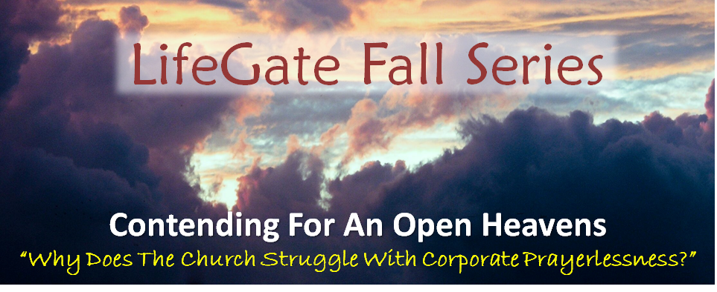
THANKING GOD FOR HIS GLORY AND
HIS KINGDOM OBSERVABLE
Sermon For LifeGate
Sunday, November 19, 2023

Slide 2
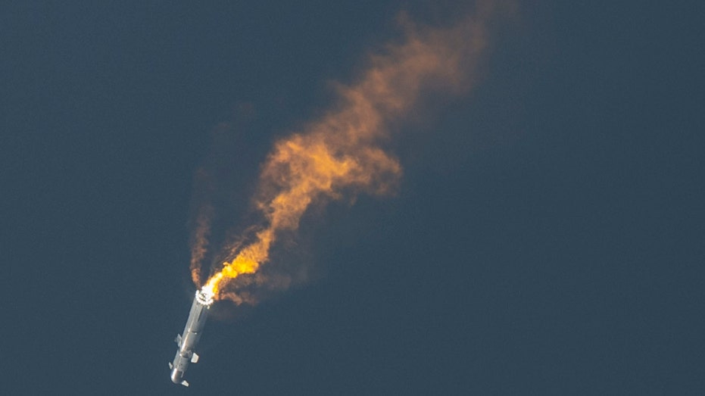
Rapid Unscheduled Disassembly

Slide 3
While they were ministering to the Lord and fasting, the Holy Spirit said, "Set apart for Me Barnabas and Saul for the work to which I have called them." Acts 13:2 (NASB)
Do not be anxious about anything, but in everything, by prayer and petition, with thanksgiving, present your requests to God. Philippians 4:6
But thanks be to God! He gives us the victory through our Lord Jesus Christ. 1 Corinthians 15:57 (NIV)
Thanks be to God for his indescribable gift! 2 Corinthians 9:15 (NIV)
always giving thanks to God the Father for everything, in the name of our Lord Jesus Christ. Ephesians 5:20 (NIV)
Give thanks in all circumstances, for this is God's will for you in Christ Jesus. 1 Thessalonians 5:18 (NIV)
They were saying: "Amen! Praise and glory and wisdom and thanks and honor and power and strength be to our God for ever and ever. Amen!" Revelation 7:12 (NIV)

Slide 4
Thanking God For Making His Kingdom
So Real – That It Invades The Earth
One of those days Jesus went out to a mountainside to pray, and spent the night praying to God. Luke 6:12 (NIV)
A large crowd of his disciples was there and a great number of people from all over Judea, from Jerusalem, and from the coast of Tyre and Sidon, ¹⁸ who had come to hear him and to be healed of their diseases. Those troubled by evil spirits were cured, ¹⁹ and the people all tried to touch him, because power was coming from him and healing them all. Luke 6:17-19

Slide 5
Strengthened In Faith
Overflowing With Thankfulness
So then, just as you received Christ Jesus as Lord, continue to live in Him, ⁷ rooted and built up in Him, strengthened in the faith as you were taught, and overflowing with thankfulness. Colossians 2:6-7 (NIV)

Slide 6
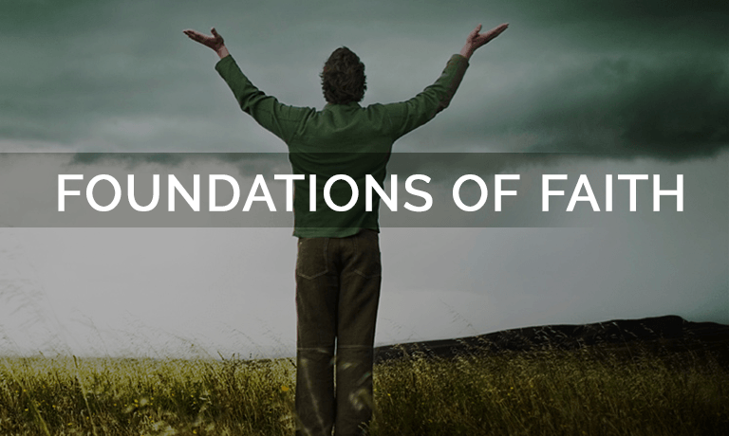
Where the Father gets all the glory
Jesus is Central (Christ-centric ministry)
The Holy Spirit is Essential
The Word of God is Foundational
Intercession is Indispensable
Bringing in the Harvest through God’s awakening presence and signs and wonders is Transformational.

Slide 7
God Provides The Rain and the Increase
To Supernatural
Kingdom and receiving the Rain
From Man-made religion and effort
The land you are entering to take over is not like the land of Egypt, from which you have come, where you planted your seed and irrigated it by foot as in a vegetable garden. 11 But the land you are crossing the Jordan to take possession of is a land of mountains and valleys that drinks rain from heaven. 12 It is a land the LORD your God cares for; the eyes of the LORD your God are continually on it from the beginning of the year to its end. Deuteronomy 11:10-12 (NIV)

Slide 8
Bringing The Unavoidable
Observable Kingdom To Your Commiunity
Daily Impact of Our Life on Others
Dear friends, I urge you, as aliens and strangers in the world, to abstain from sinful desires, which war against your soul. ¹² Live such good lives among the pagans that, though they accuse you of doing wrong, they may see your good deeds and glorify God on the day he visits us. 1 Peter 2:11-12 (NIV)
Manifest Presence and Working of The Holy Spirit
He (Paul) took the disciples with him and had discussions daily in the lecture hall of Tyrannus. ¹⁰ This went on for two years, so that all the Jews and Greeks who lived in the province of Asia heard the Word of the Lord. ¹¹ God did extraordinary miracles through Paul, ¹² so that even handkerchiefs and aprons that had touched him were taken to the sick, and their illnesses were cured and the evil spirits left them. -- and the name of the Lord Jesus was held in high honor. 18 Many of those who believed now came and openly confessed their evil deeds. 20 In this way the Word of the Lord spread widely and grew in power. Acts 19:9 – 12,17-20 (NIV)

Slide 9
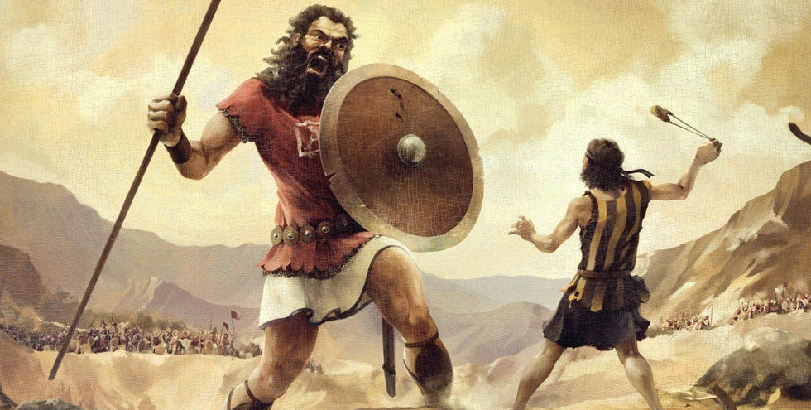
DEMONSTRATED FAITH
INCREASES FAITH FOR MORE BREAKTHROUGHS
So David prevailed over the Philistine with a sling and with a stone, and smote the Philistine, and slew him; but there was no sword in the hand of David. ⁵¹ Therefore David ran, and stood upon the Philistine, and took his sword, and drew it out of the sheath
thereof, and slew him 1 Samuel 17:50-52
In still another battle (twenty five years later), which took place at Gath, there was a huge man with six fingers on each hand and six toes on each foot--twenty-four in all. He also was descended from Rapha. ²¹ When he taunted Israel, Jonathan son of Shimeah, David's brother, killed him. ²² These four were descendants of Rapha in Gath, and they fell at the hands of David and his men. 2 Samuel 21:20-22 (NIV)

Slide 10
DEMONSTRATED FAITH
INCREASES FAITH FOR MORE BREAKTHROUGHS
And the people all tried to touch him, because power was coming from Him and healing them all. Luke 6:19
Just then a woman who had been subject to bleeding for twelve years came up behind him and touched the edge of his cloak. ²¹ She said to herself, "If I only touch his cloak, I will be healed." ²² Jesus turned and saw her. "Take heart, daughter," he said, "your faith has healed you." And the woman was healed from that moment. Matthew 9:20-22 (NIV)
And when the men of that place had knowledge of him, they sent out into all that country round about, and brought unto him all that were diseased; ³⁶ And besought him that they might only touch the hem of his garment: and as many as touched were made perfectly whole. Matthew 14:35-36 (KJV)

Slide 11
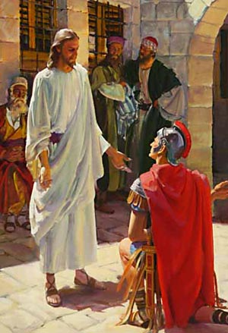
It’s Challenging Praying For Something
That Is not Yet Manifested Right Now
We Have To Shift our Faith To A Higher Level
There a centurion's servant, whom his master valued highly, was sick and about to die. ³ The centurion heard of Jesus and sent some elders of the Jews to him, asking him to come and heal his servant. ⁴ When they came to Jesus, they pleaded earnestly with him, "This man deserves to have you do this, ⁵ because he loves our nation and has built our synagogue." ⁶ So Jesus went with them. He was not far from the house when the centurion sent friends to say to him: "Lord, don't trouble yourself, for I do not deserve to have you come under my roof. ⁷ That is why I did not even consider myself worthy to come to you. But say the word, and my servant will be healed. ⁸ For I myself am a man under authority, with soldiers under me. I tell this one, 'Go,' and he goes; and that one, 'Come,' and he comes. I say to my servant, 'Do this,' and he does it." ⁹ When Jesus heard this, he was amazed at him, and turning to the crowd following him, he said, "I tell you, I have not found such great faith even in Israel." ¹⁰ Then the men who had been sent returned to the house and found the servant well. Luke 7:2-10 (NIV)

Slide 12
Answering The Theological Rebuttal That Faith In God
Is Not To Be Observable -
²⁰ Asked by the Pharisees when the kingdom of God would come, He replied to them by saying, The kingdom of God does not come with signs to be observed or with visible display, ²¹ Nor will people say, Look! Here it is! or, See, it is there! For behold, the kingdom of God is within you [in your hearts] and among you
[surrounding you]. Luke 17:20-21 (AMP)
We live by faith, not by sight. 2 Corinthians 5:7 (NIV)
I keep asking that the God of our Lord Jesus Christ, the glorious Father, may give you the Spirit of wisdom and revelation, so that you may know him better. ¹⁸ I pray also that the eyes of your heart may be enlightened in order that you may know the hope to which he has called you, the riches of his glorious inheritance in the saints, ¹⁹ and his incomparably great power for us who believe. That power is like the working of his mighty strength, Ephesians 1:17-19 (NIV)

Slide 13
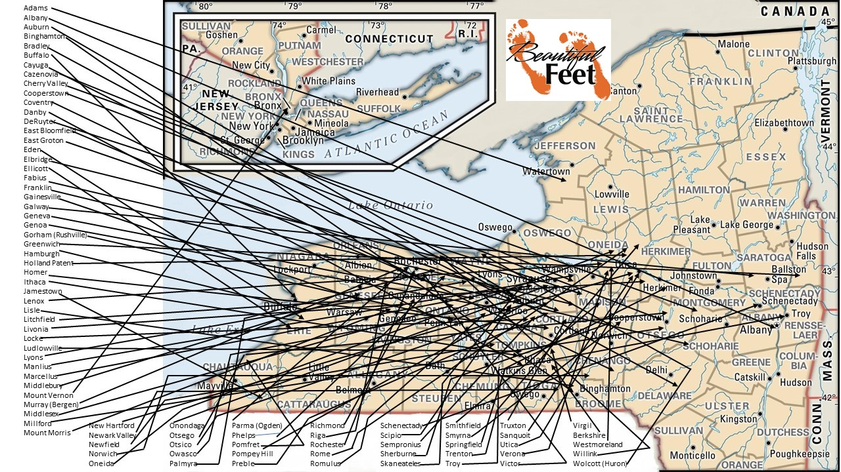
Moves Of God In New York State
1815-1840

Slide 14
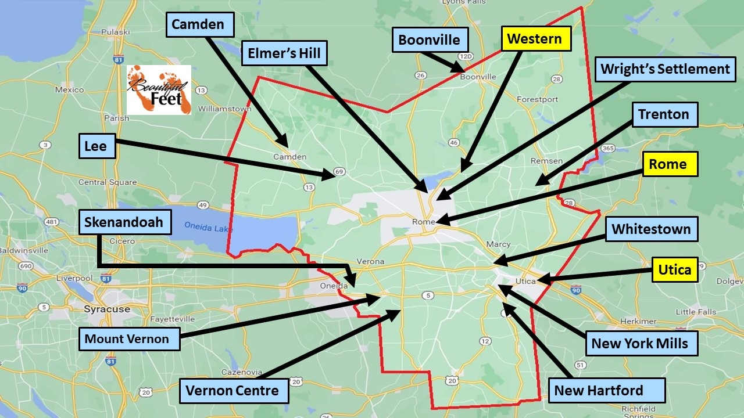

Slide 15
Heaven Invades ICONIUM
AND Rochester New York
¹ At Iconium Paul and Barnabas went as usual into the Jewish synagogue. There they spoke so effectively that a great number of Jews and Gentiles believed. ² But the Jews who refused to believe stirred up the Gentiles and poisoned their minds against the brothers. ³ So Paul and Barnabas spent considerable time there, speaking boldly for the Lord, who confirmed the message of his grace (IN WHICH THE LORD GAVE TESTIMONY TO THE WORD)by enabling them to do miraculous signs and wonders. Acts 14:1-3 (NIV)
"The whole community was stirred. Religion was the topic of conversation in the house, in the shop, in the office and on the street…Grog shops were closed, the Sabbath was honored, the sanctuaries were thronged with happy worshippers…There was a wonderful falling off of crime. The courts had little to do, and the jail was nearly empty for years afterward."

Slide 16
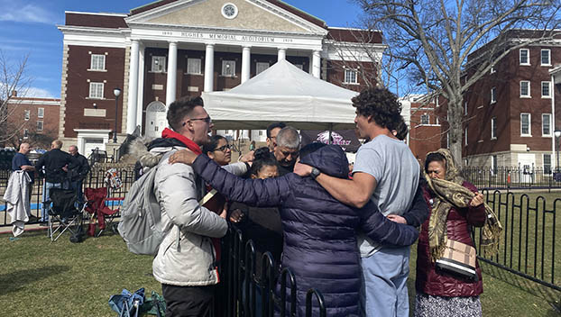
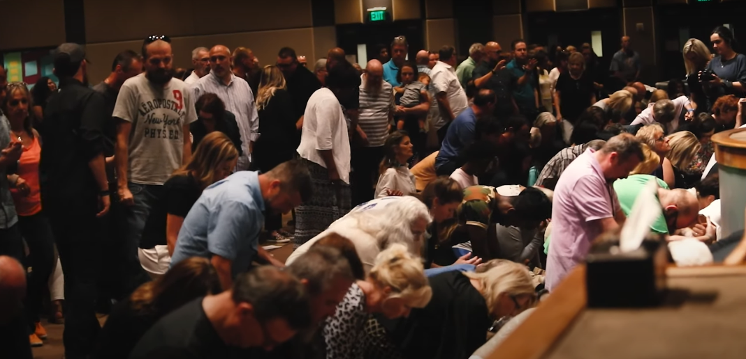
THE DANGER OF THE NOT ALLOWING
OUR FAITH TO STAY IGNITED
That the Church would Charish – protect - and fan the flame of every Evidence of the glory of God coming into the earth and would meet the conditions to enter into the river themselves
Asbury – February 9 2023
North Georgia Move of God – 2018- 2023

Slide 17
WHEN THE GLORY OF GOD’S PRESENCE COMES – PEOPLE WANT TO GATHER
¹³ No one else dared join them, even though they were highly regarded by the people. ¹⁴ Nevertheless, more and more men and women believed in the Lord and were added to their number. ¹⁵ As a result, people brought the sick into the streets and laid them on beds and mats so that at least Peter's shadow might fall on some of them as he passed by. ¹⁶ Crowds gathered also from the towns around Jerusalem, bringing their sick and those tormented by evil spirits, and all of them were healed. Acts 5:13-16 (NIV)

Slide 18
The Greatest Mystery Is That God will Not Force You To Want His Presence He Will Allow You
To Quickly Plateau As A Religious Person
The laborer's appetite works for him; his hunger drives him on. Proverbs 16:26 (NIV)
Now, Lord, consider their threats and enable your servants to speak your word with great boldness. ³⁰ Stretch out your hand to heal and perform miraculous signs and wonders through the name of your holy servant Jesus." ³¹ After they prayed, the place where they were meeting was shaken. And they were all filled with the Holy Spirit and spoke the word of God boldly. Acts 4:29-31 (NIV)
Remember this: Whoever sows sparingly will also reap sparingly, and whoever sows generously will also reap generously. 2 Corinthians 9:6 (NIV)

Slide 19
TO HOST HIS PRESENCE YOU CANNOT BE CONSUMERS AND SPECTATORS
I will give you the keys of the kingdom of heaven; whatever you bind on earth will be bound in heaven, and whatever you loose on earth will be loosed in heaven." Matthew 16:19
Stewarding intercession and prayer: is the ability to identify the eternal Kingdom strategy of God that He is using to thwart the advance of the enemy and to exploit God’s power and promises to bless nations with spiritual deliverances and breakthroughs. These interventions ultimately justify God’s means of severe corrections that makes HIS PEOPLE DESPERATE for His presence and results in the release of the captives and bringing in the HARVEST. Don Lamb 2020

Slide 20
Spiritual Demand for the Presence of the Lord
Will Increase in the Last Days
This is what the LORD Almighty says: "Many peoples and the inhabitants of many cities will yet come, 21 and the inhabitants of one city will go to another and say, 'Let us go at once to entreat the LORD and seek the LORD Almighty. I myself am going.' 22 And many peoples and powerful nations will come to Jerusalem to seek the LORD Almighty and to entreat him." “In those days ten men from all languages and nations will take firm hold of one Jew by the hem of his robe and say, 'Let us go with you, because we have heard that God is with you.'" Zechariah 8:20-23 (NIV)

Slide 21
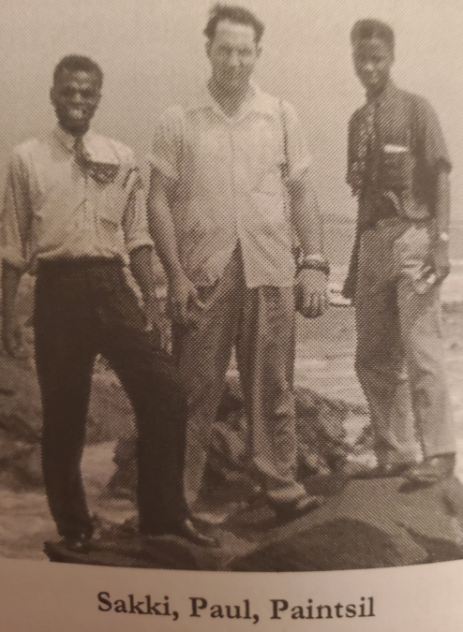
Pressing Through Into God’S Presence For A Life Time
HYMN – I WOULD NOT BE DENIED
As Jacob in the days of old,
I wrestled with the Lord;
And instantly with a courage bold,
I stood upon His Word.
Chorus:
I would not be denied,
I would not be denied,
Till Jesus came and made me whole,
I would not be denied.
Old Satan said my Lord was gone
And would not hear my prayer,
But praise the Lord the work is done,
And Christ the Lord is here.
58 years old
Gets attacked
Thyroid
Cancer
Paul E. Cannon
1953 22 yrs old
Sees the Glory of God
In Ghana and Nigeria
57 years old
Gets attacked with
Hodgkin's disease

Slide 22
WHERE DOES THIS LEAVE US
Having therefore obtained the help of God, I continue unto this day, witnessing both to small and great, saying no other things than those which the prophets and Moses did say should come: Acts 26:22 (KJV)

Slide 23
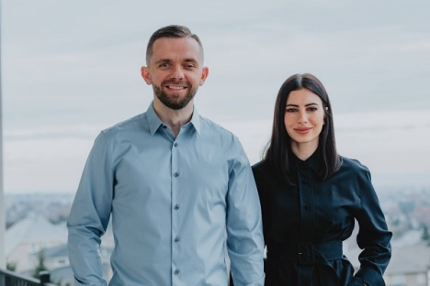
1. Make Peace With the Process Of Intervention The key during seasons of waiting is not to be conquered by the circumstances but to surrender to God’s will and purpose. 2. Don’t Surrender to Your Surroundings The Bible tells us to humble ourselves under God’s mighty hand, not our situations (1 Peter 5:6). Don’t stop trusting God just because time is passing by. 3. Prayer is How We Don’t Waste the Wait Instead of focusing solely on life goals like marriage or having children, as Christians, our primary focus should be the Lord. Waiting will always feel like a waste of time when we’re not praying. 4. God Answers Us With a Promise Before We See the Miracle When you’re waiting, you’re hoping for a miracle, but when God gives you a promise, you know you already have the miracle.

