Slide 1
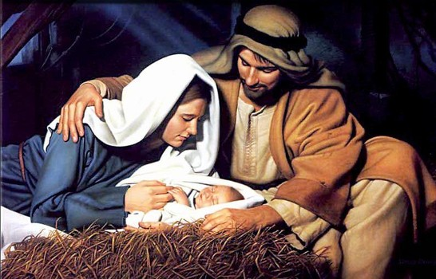
Christmas Message 2023
Sermon For LifeGate
Sunday, December 31, 2023

Slide 2
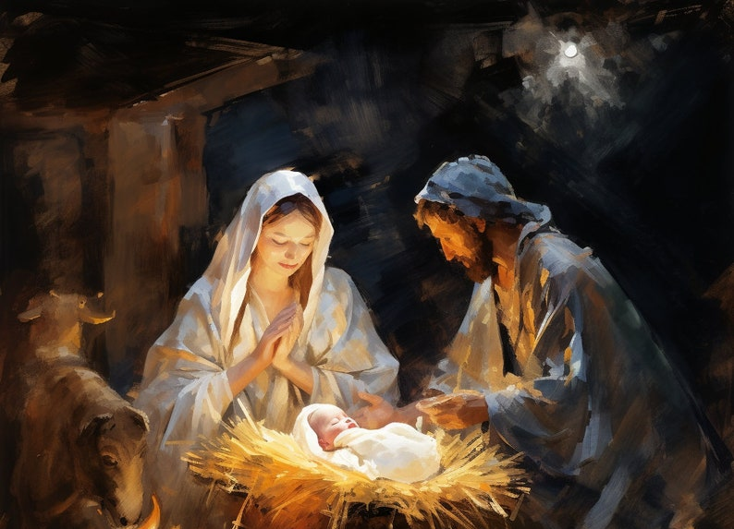
Therefore the Lord Himself shall give you a sign; Behold, a virgin shall conceive, and bear a son, and shall call His name Immanuel. Isaiah 7:14

Slide 3
Another Familiar Christmas Passage
For unto us a Child is born, unto us a Son is given: and the government shall be upon His shoulder: and His name shall be called Wonderful, Counsellor, The mighty God, The everlasting Father, The Prince of Peace. 7 Of the increase of His government and peace there shall be no end, upon the throne of David, and upon His kingdom, to order it, and to establish it with judgment and with justice from henceforth even for ever. The zeal of the LORD of hosts will perform this. Isaiah 9:6-7 (KJV)

Slide 4
Jesus Fulfills Multiple Prophesies
in His Birth and Early Childhood
"But you, Bethlehem Ephrathah, though you are small among the clans of Judah, out of you will come for me one who will be ruler over Israel, whose origins are from of old, from ancient times." Micah 5:2 (NIV)
Nevertheless, there will be no more gloom for those who were in distress. In the past he humbled the land of Zebulun and the land of Naphtali, but in the future He will honor Galilee of the Gentiles, by the way of the sea, along the Jordan-- ² The people walking in darkness have seen a great light; on those living in the land of the shadow of death a light has dawned. Isaiah 9:1-2 (NIV)

Slide 5
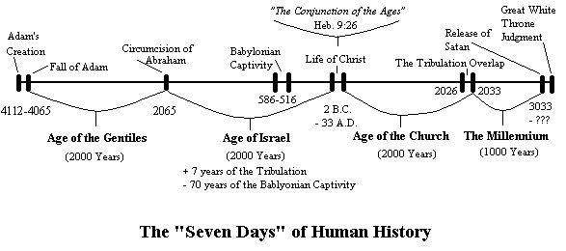
The Providential Timing and Order of God
Abraham
14 Gen.
David
14 Gen.
Exile
14 Gen.
Jesus
Matthew 1:17

Slide 6
How Did The Magi Figure Out The Date
490 yrs.
David/ Solomon – 1st Temple
490 yrs.
490 yrs.
7
yrs.
Exodus
Exile – rebuilt
Second Temple
Jesus
1. Seven weeks, that is, forty-nine years.
2. Sixty-two weeks, that is, four hundred and thirty-four years.
3. One week, that is, seven years. (Daniel 9:20-27)

Slide 7
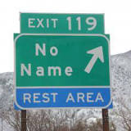
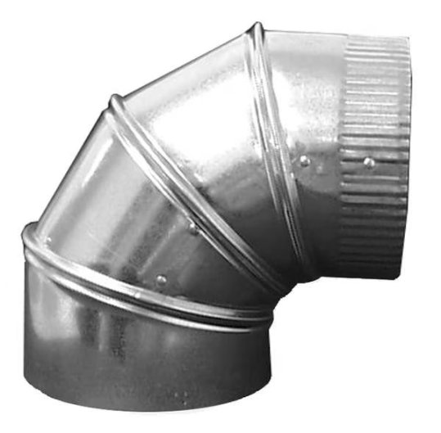
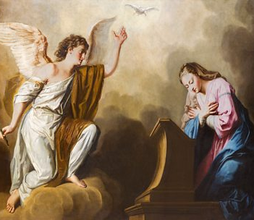
Out of This Precision – God Invades A
Random – No Name Town Looking For
Conduits To use for His Providential Fulfillment
In Glenwood Canyon
Colorado is a small village
In the sixth month, God sent the angel Gabriel to Nazareth, a town in Galilee, ²⁷ to a virgin pledged to be married to a man named Joseph, a descendant of David. The virgin's name was Mary. ²⁸ The angel went to her and said, "Greetings, you who are highly favored! The Lord is with you." Luke 1:26-28 (NIV)

Slide 8
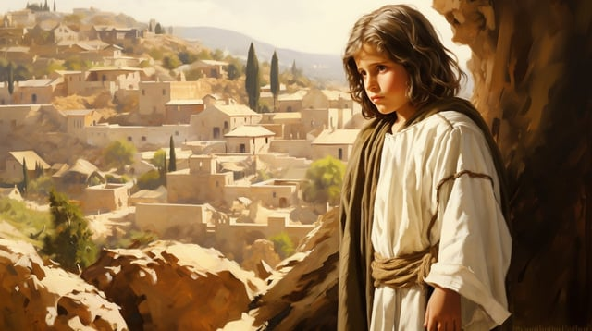
Jesus is Born In a Prestigious Town (Town of David) - But Raised in a Backwater Town
Backwater - a place or condition in which no development or progress is taking place.
When Joseph and Mary had done everything required by the Law of the Lord, they returned to Galilee to their own town of Nazareth. ⁴⁰ And the child grew and became strong; he was filled with wisdom, and the grace of God was upon him. Luke 2:39-40

Slide 9
Out of an Unknown Town – God Raises His own Son up to Redeem not Only Nazareth
But the WHOLE WORLD
Nazareth (population 650) was set in a small basin surrounded by hills and wasn't very accessible. It did have a water supply from what is called today Mary's Well, and there is evidence of some limited terraced agriculture, as well as pasture fields.
19 Miles to Galilee
90 Miles to Bethlehem
36 Miles to Bethsaida

Slide 10
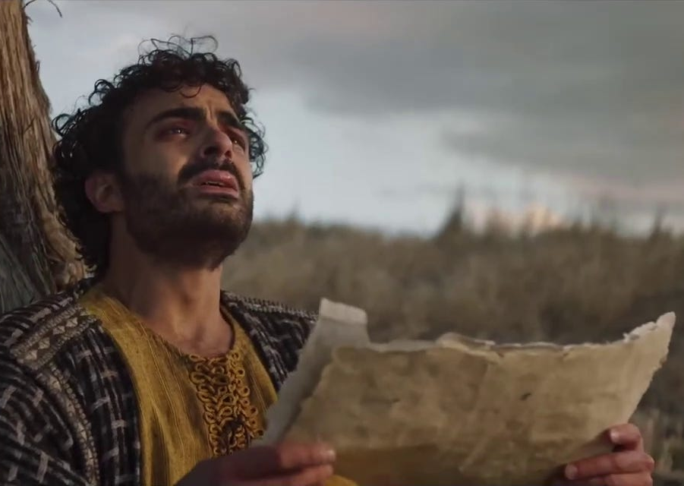
Can Anything Good Come Nazareth?
Philip, like Andrew and Peter, was from the town of Bethsaida. ⁴⁵ Philip found Nathanael and told him, "We have found the one Moses wrote about in the Law, and about whom the prophets also wrote--Jesus of Nazareth, the son of Joseph." ⁴⁶ "Nazareth! Can anything good come from there?" Nathanael asked. "Come and see," said Philip. John 1:44-46 (NIV)
Come and See!

Slide 11
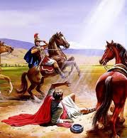
The Creator Invades And Ministers Out of This
Humble Town and it gets Connected to Him
Pilate had a notice prepared and fastened to the cross. It read: JESUS OF NAZARETH, THE KING OF THE JEWS. John 19:19 (NIV)
"About noon as I came near Damascus, suddenly a bright light from heaven flashed around me. ⁷ I fell to the ground and heard a voice say to me, 'Saul! Saul! Why do you persecute me?' ⁸ "'Who are you, Lord?' I asked. "'I am Jesus of Nazareth, whom you are persecuting,' he replied. Acts 22:6-8 (NIV)

Slide 12
Jesus Identifies with The Nobodies
Of The World
The LORD builds up Jerusalem; He gathers the outcasts of Israel. Psalm 147:2
He came and preached peace to you who were far away and peace to those who were near. ¹⁸ For through him we both have access to the Father by one Spirit. Ephesians 2:17-18 (NIV)

Slide 13
Jesus Is No Longer A Baby In A Manger
He Still Comes To No Name Towns
And He Comes To The Rebels To Win Them
¹ Now all the tax collectors and the sinners were coming near Him to listen to Him. ² Both the Pharisees and the scribes began to grumble, saying, "This man receives sinners and eats with them." ³ So He told them this parable, saying, ⁴ "What man among you, if he has a hundred sheep and has lost one of them, does not leave the ninety-nine in the open pasture and go after the one which is lost until he finds it? ⁵ "When he has found it, he lays it on his shoulders, rejoicing. ⁶ "And when he comes home, he calls together his friends and his neighbors, saying to them, 'Rejoice with me, for I have found my sheep which was lost!' ⁷ "I tell you that in the same way, there will be more joy in heaven over one sinner who repents than over ninety-nine righteous persons who need no repentance. Luke 15:1-7 (NASB)

Slide 14
God Is Still Looking For Obedience
And Surrendered Servants
"I am the Lord's servant," Mary answered. "May it be to me as you have said." Then the angel left her. Luke 1:38 (NIV)
When Joseph woke up, he did what the angel of the Lord had commanded him and took Mary home as his wife. Matthew 1:24 (NIV)

