Slide 1
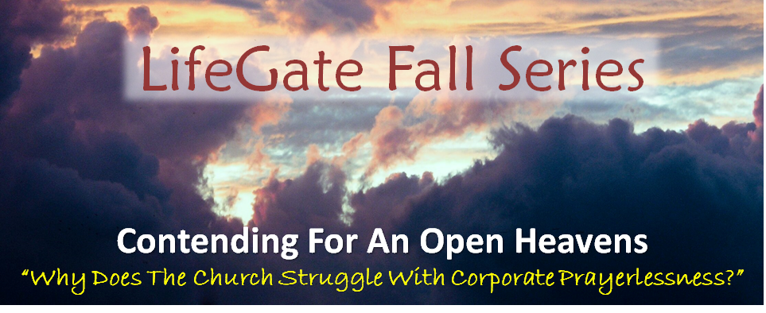
PREPARING FOR THE NEW YEAR
Breaking Out Of Fierce Individualism (Survivor)
Sermon For LifeGate
Sunday, December 31, 2023

Slide 2
God Is Still Looking For Obedience
And Surrendered Servants
That Give God Their YES!!!
"I am the Lord's servant," Mary answered. "May it be to me as you have said." Then the angel left her. Luke 1:38 (NIV)
When Joseph woke up, he did what the angel of the Lord had commanded him and took Mary home as his wife. Matthew 1:24 (NIV)

Slide 3
The Oddities of Cats

Slide 4
The Whispers Of God
I sensed the Lord whispered to me recently,
“I will take care of the finances of LifeGate if you host My Presence.”
“I blessed LifeGate with this beautiful addition as a reward for your pressing in for more of My Kingdom – but you will have to GO DEEPER.”

Slide 5
God IS Working IN Places You Don’t
Even Know About
Whiteclay, Nebraska

Slide 6
God Is STILL Moving in The Earth
There was a great Revival before the Civil War. Don't conclude that revival means judgment has passed! The moral condition of the USA is that of a brothel! It is a giant whore house with perversion unabated. Even the weights and measures of the food you buy is deceptive. Lying is everywhere. Deception is from the highest public official, right down to the man on the street. But the Good News is, that the Righteous have stood up and said, "Enough is enough" " This is the Lord's doing! Don't be mad at the Lord, like Jonah, when the Lord did not destroy Nineveh! Rejoice because the people are Repenting…and join them! Amen!
Author Unknown 2009

Slide 7
God Is Active and Overseeing All of Our Battles and Burdens
"We must exercise the greatest care to be utterly obedient to Him Who sees all the battlefield all the time. It is only He who can put each person in the place where their life can count for the most. Above all the strife of battle the intercessor can see the great Commander whom he is following so implicitly.” Missionary to India 1912

Slide 8
We Are Grieved By The Gaza
War – BUT WE HAVE TO PRAY MUSLIMS
THE GREAT FUNDAMENTAL FLAW
IN THE MUSLIM IDEAL IS THIS
ISLAM TEACHES SUBMISSION AND WORKS
CHRISTIANITY TEACHES LOVE AND FAITH
Love will cause you to operate in submission
Submission does not mean that you love
THERE IS A HUGE DIFFERENCE BETWEEN SUBMISSION AND LOVE

Slide 9
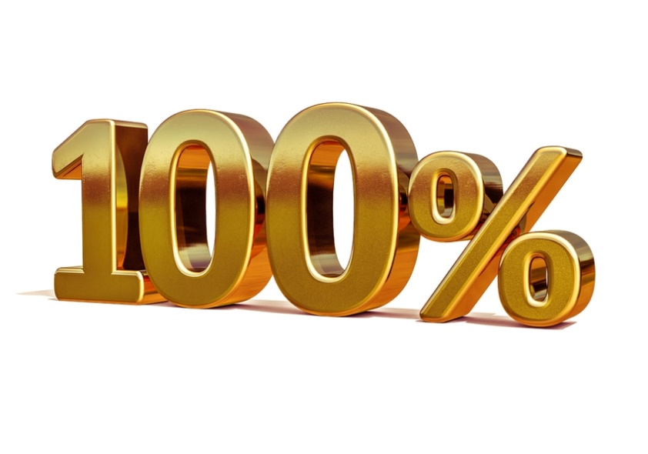
What would this world look like if God’s
People would be 100 Percenters
“What would it look like if we would give 100 percent obedience to the next thing God tells us to do? Instead of self-editing it down to 80 percent - or 50 percent or lower.” Pete Ogilvie

Slide 10
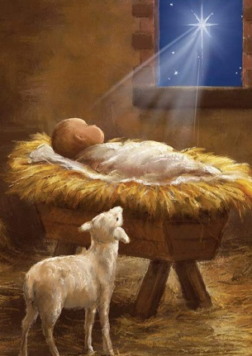
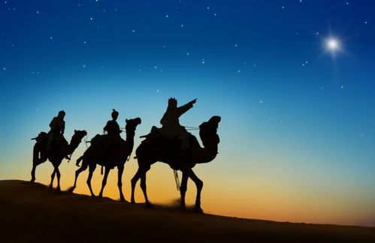
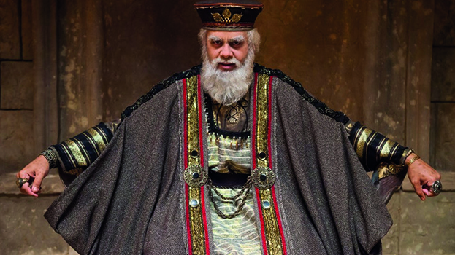
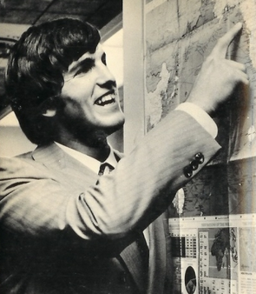
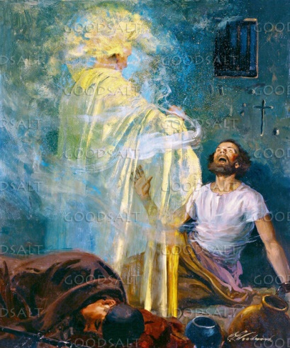
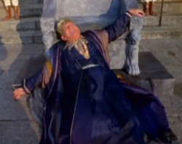
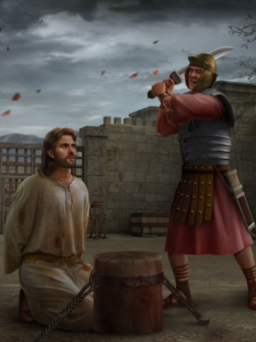
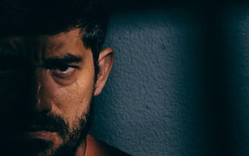
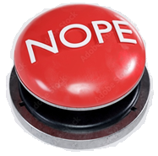
God Never Set’s Aside Our Freewill – But He Can Interrupt it if We Go Against His Strategic Eternal Plan
Magi Follow
The Star
Find Jesus
God uses them as
A sign to that
Unbelieving generation
Evil King Herod the great Throws a fit and kills all the baby boys in Bethlehem Under two - dies 1BC
Herod Antipas (Son of Herod the Great)
Had John the Baptist killed
Jesus
Born In
Bethlehem
through a Virgin
Sergei
Kourdakov
God Judges Herod
Agrippa 1st – he dies
Of worms Acts 12:23
King Herod Agrippa 1st
Jails Peter and James
And kills James
God sends an angel
To Set Peter Free
God allows evil when He wisely can’t interrupt it without
Injuring His eternal law of freewill.

Slide 11
God’s Precision in Jesus’ Birth Reflects
His Passion To Bring Us Into His Confidence
God doesn’t do things by accident
That God would come to a place where a shepherd
Boy was born 28 generations back
Who became a King (David) is by design and promise
God is precise in His plans
Jesus showed up – at the exact place God
The Father wanted Jesus to show up (Bethlehem).
This story we are in - is by His design.
There is a precision in the work of God – in His plans –
His purposes and His timing.
And you are part of the precision of God’s story
He has chosen to reveal His goodness to you that you would be blown away about what He has done to win your life.
David Engelhardt 2023

Slide 12
The Path Of The Kingdom-Minded
“It was an unconditional surrender I moved into and the Holy Spirit entered into my life in His fullness and began to lead me into the love and joy and peace - a knowledge surpassing anything that I had ever experienced before. There came to my heart a deep quietness. The Word of God opened up to me in marvelous
depth, becoming food for my soul.
"In the years that have followed I have again and again been brought to places where two ways opened; one was the way of the ordinary Christian life, the other the way which seemed to show the bloodstained marks of the Savior's footsteps; and He called me to follow Him-the slain Lamb. It has meant the way of the cross; but it has also meant living fellowship with Christ."

Slide 13
The Power of Our Inheritance of the Saints
And we pray this in order that you may live a life worthy of the Lord and may please Him in every way: bearing fruit in every good work, growing in the knowledge of God, 11 being strengthened with all power according to His glorious might so that you may have great endurance and patience, and joyfully 12 giving thanks to the Father, who has qualified you to share in the inheritance of the saints in the kingdom of light. 13 For He has rescued us from the dominion of darkness and brought us into the kingdom of the Son He loves, 14 in Whom we have redemption, the forgiveness of sins. Colossians 1:10-14

Slide 14
What Does It Mean To Be Qualified to share in the Inheritance of the Saints?
( GREEK – Hick an- AH-oe – To make fit or able)
Opened the door (through Jesus) to partake of that which was previously inaccessible.
Rendered you willing to receive it by faith.
Literally enabled you to take hold of His offered salvation. (moving you to exercise love and faith and repentance)
Making you judicially CLEARED to receive God’s undeserving blessings and hungry to appropriate their functioning realty.

Slide 15
Like Esau - don’t sell Your
Inheritance for a bowl of soup
“Help us to recognize when our flesh is cutting us out of our inheritance.”
Sonya Pena
“Give us the power for helping us give up lesser visions – visions that protect our comfort our religious enjoyments our selfish interests but don’t fully release Your kingdom.” Ray Hock

Slide 16
God Is Preparing Us For The
Glory Of This Next Season
We are in a transition where we cannot afford to bring into the next season the STUFF from our past.
The loose ends and the things that trip us up and have not been fully dealt with - God is purging from us - because the next three and a half years will be some of the most critical years we're probably going to live through. Therefore, we cannot bring into this next season the issues; the weirdness; and moodiness; the addictions; and quirkiness that comes because of our uncrucified flesh that hasn’t been mastered by the grace of God. We need to die a thousand deaths and we need to be victorious, through faith, so that we can run without hindrance
the race marked out for us.

Slide 17
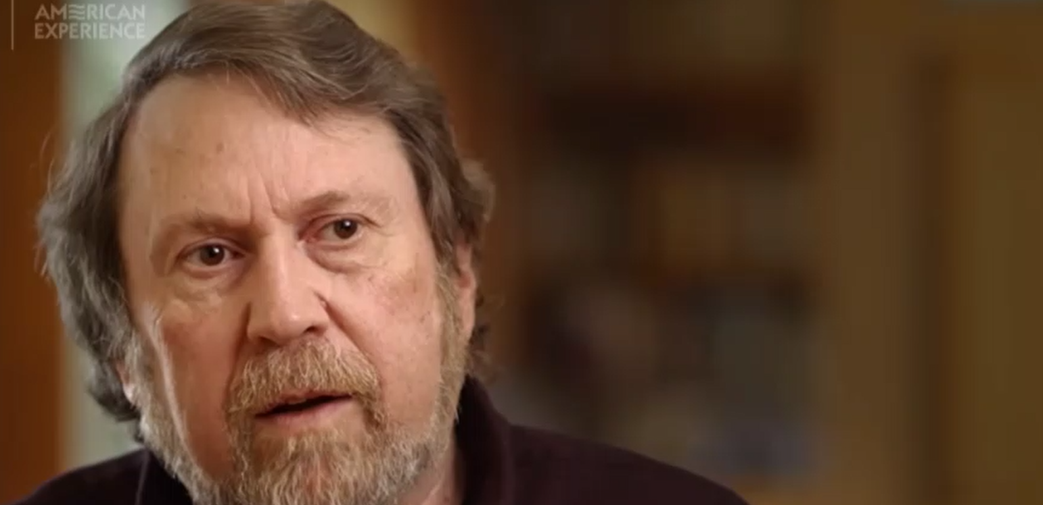
We have to become Part of A Greater Mission
Joe Rantz
Daniel
James Brown
Author
The Boys In The Boat

Slide 18
The Enemies Agenda is To Shut Down
The Corporate Prayer Meeting
Therefore, if I were the devil, I would use my best deceptive tools to keep CHURCH AND Christians from praying in transformational ways–and especially to
keep them from praying together.
I would keep them busy and isolated from one another. I would do everything possible to keep them distracted and disinterested in Biblical, balanced, revival-style Spirit-filled prayer gatherings. To accomplish this, I would do the following: First, fuel the spirit of rugged individualism.

Slide 19
The Enemies Agenda is To Shut Down
The Corporate Prayer Meeting
By keeping Christians independent of each other, I would keep them independent from God. I would keep them frustrated in their personal prayer lives by preventing them from learning to pray together corporately.
Second, I would help them dig deep ruts of boring prayer. When they did try to pray together, I would make sure the prayer meetings were based more on human needs than on God’s power. I would do everything possible to encourage boredom and gossip in these gatherings so that most people would stay away from these passionless “prayer” times.

Slide 20
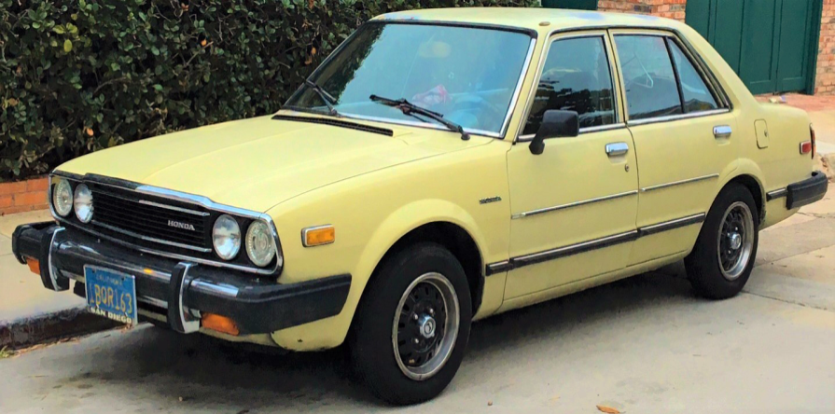
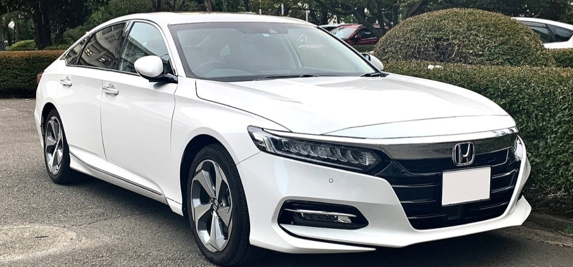
They Were Altogether In One Accord Acts 2:1
1977 Honda Accord
2021 Honda Accord
Greek – means one passion, fierceness
These all continued with one accord in prayer and supplication, with the women, and Mary the mother of Jesus, and with His brothers. Acts 1:14

Slide 21
We are moving from just the anointing on teaching - to the invasion
of the holy spirit as well
But Saul increased the more in strength, and confounded the Jews which dwelt at Damascus, proving (literally to force a conclusion through instruction) that Jesus is the Christ. Acts 9:22
Oh that thou would rend the heavens, that thou would come down, that the mountains might flow down at Your presence, to make Your Name known to Your adversaries, that the nations may tremble at Your presence! Isaiah 64:1-2 (KJV)
Since, then, we know what it is to fear the Lord, we try to persuade (To convince by argument to believe and have confidence in) men. 2 Corinthians 5:11
While Peter was still speaking these words, the Holy Spirit came upon all who heard the message. Acts 10:44

Slide 22
January
2-8, 2024
Tuesday January 2nd
Monday January 8th
Prevailing in prayer for revival in our families, churches, communities
"Is not this the kind of fasting I have chosen: to loose the chains of injustice and - to set the oppressed free and break every yoke?
Isaiah 58:6
Pray that Hearts would be rendered willing to repent and receive salvation and revival by faith.
Pray that the Church would be enabled to take hold of His promises and appropriate the breakthroughs needed.
Pray that the Holy Spirit would invade our lives and churches to impact our families and communities.

Slide 23
LET US DECLARE BY FAITH
So we willingly EMBRACE that we are those who are able to host the presence of God, in spite of all the drama, and receive the summoning influence of the Holy Spirit where God draws an entire community to Himself by the sovereign spiritual in-breaking of Heaven requested and appropriated by a praying and believing Church.

