Slide 1
Partnering with God to bring His Influence into our region…
Healthy families/ homes
Strong vibrant youth and young adults
Healthy communities with low crime
Sound schools with honorable values
Flourishing businesses and economy
Churches engaged in positive community involvement and support
Open Heavens

Slide 2
The foundation we stand on…..
1) God’s plans and purposes supersede ours……
(Anything outside of God’s will, is going to fail!)
2) Honoring the Lord with our time and worship must be
valued and applied no matter what our situation….
( There will always be more tasks to do, then time to do them.)
3) Inviting God into journey each day, requires intentional
conversation (prayer), infusion of truth (bible), and
connected fellowship with like minded believers.
4) Standing up against the darkness – realizing that each
day we can impose the Spiritual victory of Christ into
our life experience and community. (Binding the Strong Man)
The distractions of Life will try to burn you out !

Slide 3
At the end of the day, there is nothing more precious than enjoying the company of God joining you in your day……..
¹⁰ You will have such a surplus of crops that you will need to clear out the old grain to make room for the new harvest! ¹¹ I will live among you, and I will not despise you. ¹² I will walk among you; I will be your God, and you will be my people. ¹³ I am the Lord your God, who brought you out of the land of Egypt so you would no longer be their slaves. I broke the yoke of slavery from your neck so you can walk with your heads held high. Lev. 26:10 -13
⁵ “If you love me, obey my commandments. ¹⁶ And I will ask the Father, and he will give you another Advocate, who will never leave you. ¹⁷ He is the Holy Spirit, who leads into all truth. But you know him, because he lives with you now and later will be in you. ²⁰ When I am raised to life again, you will know that I am in my Father, and you are in me, and I am in you. Jesus replied, “All who love me will do what I say. My Father will love them, and we will come and make our home with each of them. John 14: 15-17, 20, 23
Having the company God where ever you go.

Slide 4
The Lord is wanting to show up in our lives, communities and Churches!! We don’t have to arm twist Him to want to bring His Glory!! We just have to participate…..
Keep learning how to “host” the presence of God….
Keep Walking in humble obedience to please the Holy Spirit. Follow His leading and deepen the occurring reviva
Engage in corporate activities that spread the presence of God in our region. (youth events, prayer gatherings, civic engagement, practical aid to the physical and spiritually suffering.)
Putting out the Welcome Mat for God to show up in our region

Slide 5
Look at Four things today:
a) Satan’s ultimate plan is to unravel humanity. He hates anything that brings glory to God.
( Hamas vrs. the tamed down fun side of party life)
b) How we can defend better against enemy’s personal attacks here in region and our homes.
c) Part of the vicious attacks in the past months is
to sideline the potential LifeGate and others might
have in seeing spread of the influence of God.
d) Each of us are on a slightly different path, and have different gifts and abilities.

Slide 6
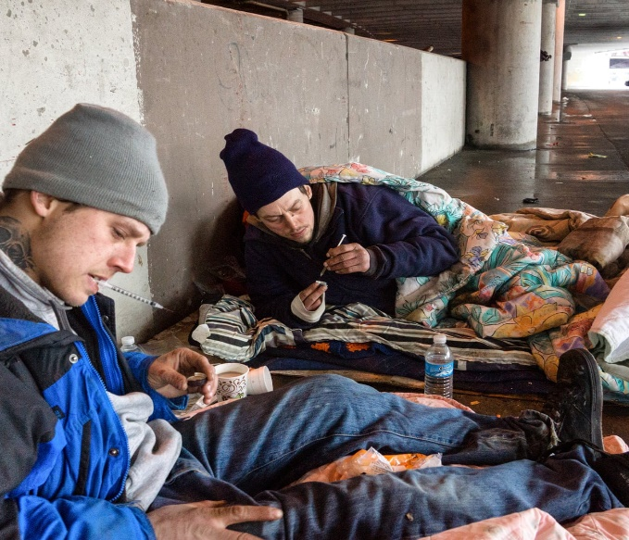
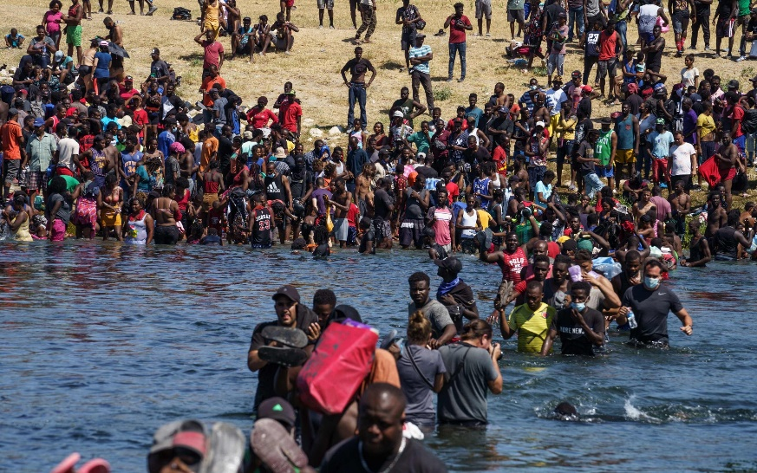
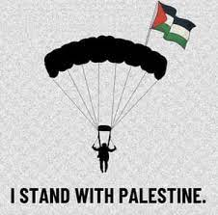
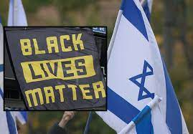
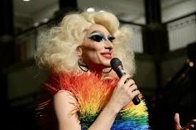
Satan is out to destroy Humanity….. And attack anyone that tries to stand up for righteousness!

Slide 7
God passionately loves everyone! There is not one individual He is not trying to
bring into the His Kingdom!!
But the institutions behind it He is dismantling!!!
Anarchist - Pro Abortion - Pro Crime
Anti- Jew - Pro Sex trafficking - Pro Pornographic books - Satanist clubs
Injustice in courts systems - Pro drag queens
Pro- recreational drugs - DEI Anti- Christian
We look for justice, but it never comes. We look for rescue, but it is far away from us. ¹² For our sins are piled up before God and testify against us. Yes, we know what sinners we are. ¹³ We know we have rebelled and have denied the Lord. We have turned our backs on our God. We know how unfair and oppressive we have been, carefully planning our deceitful lies. ¹⁴ Our courts oppose the righteous, and justice is nowhere to be found. Truth stumbles in the streets, and honesty has been outlawed. ¹⁵ Yes, truth is gone, and anyone who renounces evil is attacked. Isa. 59: 11-15

Slide 8
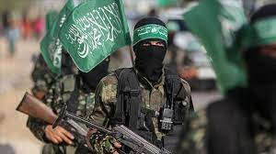
Jesus exposed the enemy’s strategy in John 10 …
- Steal, Kill and destroy ……..
Yes, I am the gate. Those who come in through me will be saved.^{[a]} They will come and go freely and will find good pastures. ¹⁰ The thief’s purpose is to steal and kill and destroy. My purpose is to give them a rich and satisfying life. John 10: 9-10
Hamas vrs. the tamed down fun side of party life/Satan has a plan…
Satan never reveals his ultimate plan, little by little he will pull you away from God and destroy your hopes and dream!

Slide 9
How to defend against the enemy’s personal attacks
here in the region and our homes.
Standing against the enemy , all alone is never a good idea!
It needs to be in unity of other believers, and with good
relationship in the church.
¹¹ Now these are the gifts Christ gave to the church: the apostles, the prophets, the evangelists, and the pastors and teachers. ¹² Their responsibility is to equip God’s people to do his work and build up the church, the body of Christ. ¹³ This will continue until we all come to such unity in our faith and knowledge of God’s Son that we will be mature in the Lord, measuring up to the full and complete standard of Christ.
¹⁴ Then we will no longer be immature like children. We won’t be tossed and blown about by every wind of new teaching. We will not be influenced when people try to trick us with lies so clever they sound like the truth. ¹⁵ Instead, we will speak the truth in love, growing in every way more and more like Christ, who is the head of his body, the church. ¹⁶ He makes the whole body fit together perfectly. As each part does its own special work, it helps the other parts grow, so that the whole body is healthy and growing and full of love. Eph. 4: 11 – 16
Living in a positive community of believers is thestarting point in defeating the enemy’s schemes.

Slide 10
Our battle is not with human beings, but spiritual authorities.
³ For though we live in the world, we do not wage war as the world does. ⁴ The weapons we fight with are not the weapons of the world. On the contrary, they have divine power to demolish strongholds. ⁵ We demolish arguments and every pretension that sets itself up against the knowledge of God, and we take captive every thought to make it obedient to Christ. 2 Cor. 10: 3 – 5
Satan has been doing this for a long time! He knows how to
distract, undermine, discourage and defeat us.
¹² If you think you are standing strong, be careful not to fall. ¹³ The temptations in your life are no different from what others experience. And God is faithful. He will not allow the temptation to be more than you can stand. When you are tempted, he will show you a way out so that you can endure. I Cor. 10: 12 – 13

Slide 11
Satan is going to attacking you in several key areas of your life: He likes to add to already stressful situations…..wants to make it worst!
Emotionally and Mentally - bring worry, anxiety, depression, fear…….
Interfere in relationships - bring disunity, confusion, contention, anger
Financially – bring attack against resources, inspire over spending, even
have banking and fraud issues, addictions and bondage.
Sexually/ morally – temptations, disruption in marriage relationships,
set ups for moral failure.
5) Physically – chronic illness to drag you down, migraines, cancer, heart
issues, tiredness.
6) Weirdness and disruptions - neighbors arguing with you, cars breaking down, law suits, government issues, insurance issues….
Life is going to come at you regardless. The notion that, when I
become a Christian, everything is going to get better….is myth.
But, the good news is I’m on the winning side and God is going to take what the enemy meant for evil and turn it around for my good.

Slide 12
The enemy’s whole point is to get you discouraged,
Frustrated with God, disappointed and waver in your faith.
Eph. 6 - Armor of God and the power of prayer!
¹⁰ A final word: Be strong in the Lord and in his mighty power. ¹¹ Put on all of God’s armor so that you will be able to stand firm against all strategies of the devil. ¹² For we are not fighting against flesh-and-blood enemies, but against evil rulers and authorities of the unseen world, against mighty powers in this dark world, and against evil spirits in the heavenly places.
¹³ Therefore, put on every piece of God’s armor so you will be able to resist the enemy in the time of evil. Then after the battle you will still be standing firm. ¹⁴ Stand your ground, putting on the belt of truth and the body armor of God’s righteousness. ¹⁵ For shoes, put on the peace that comes from the Good News so that you will be fully prepared. ¹⁶ In addition to all of these, hold up the shield of faith to stop the fiery arrows of the devil. ¹⁷ Put on salvation as your helmet, and take the sword of the Spirit, which is the word of God.
¹⁸ Pray in the Spirit at all times and on every occasion. Stay alert and be persistent in your prayers for all believers everywhere.

Slide 13
The armor of God is a proactive stance of walking in
relationship with God that enhances our protection
against the “attacks” of the enemy. It’s not something
you take off at night and put on in the morning. It’s a lifestyle.
Character areas Disciplines
1. Belt of truth – Honesty/ integrity Tell the truth all the time
2. Breastplate/ Vest Righteousness Live with godly values/ morality
3. Shoes/ boots - Walking with purpose You are always on mission (Gospel)
4. Shield of Faith – Live in dependence God Trust the Lord even when looks bad
5. Helmet of Salvation – Confidence in Christ When you doubt your salvation
Stand on the victory of Christ
6. Sword of Spirit – Use it correctly, not to Study the word to be strong in
Hurt people. walk and defend the faith.

Slide 14
Prayer is the stitching that hold everything together!
¹² For we^{[a]} are not fighting against flesh-and-blood enemies, but against evil rulers and authorities of the unseen world, against mighty powers in this dark world, and against evil spirits in the heavenly places. Eph. 6: 12
¹⁸ Pray in the Spirit at all times and on every occasion. Stay alert and be persistent in your prayers for all believers everywhere.
Eph. 6: 18

Slide 15
The Enemy’s attacks are meant to stifle, Shut down,
Impede, Sideline the effectiveness of the church, our lives and positive change to our communities.
⁵ And you know that Jesus came to take away our sins, and there is no sin in him. ⁶ Anyone who continues to live in him will not sin. But anyone who keeps on sinning does not know him or understand who he is.
⁷ Dear children, don’t let anyone deceive you about this: When people do what is right, it shows that they are righteous, even as Christ is righteous. ⁸ But when people keep on sinning, it shows that they belong to the devil, who has been sinning since the beginning. But the Son of God came to destroy the works of the devil. ⁹ Those who have been born into God’s family do not make a practice of sinning, because God’s life is in them. So they can’t keep on sinning, because they are children of God. I john 3: 5 – 9
When Christians are sucked into the flesh and world, their anointing's and effectiveness to spread revival are compromised. The enemies attacks are far greater in scope than just our personal journey! He wants to keep you from be a blessing to others and especially the growth of the Body of Christ!
Attacks against individual Christians are alwaysmeant to hurt the whole Church!

Slide 16
Each of us are on slightly different paths and have different gifts and roles to play in the “Move of God” here in Elizabethtown.
1) Eph. 4: 7 - But to each one of us grace has been given as Christ apportioned it.
2) 1 Cor. 12: 11 It is the one and only Spirit who distributes all these gifts. He alone decides which gift each person should have.
3) Matt. 25: 28 -30 “Then he ordered, ‘Take the money from this servant, and give it to the one with the ten bags of silver. ²⁹ To those who use well what they are given, even more will be given, and they will have an abundance. But from those who do nothing, even what little they have will be taken away. ³⁰ Now throw this useless servant into outer darkness, where there will be weeping and gnashing of teeth.’
There is great accountability for the blessings and spiritual gifts God imparts to His people. We need to be careful to use them wisely!

Slide 17
Application:
Walk in the Amor of God as a Lifestyle!
Work to see people and situations around you, as attempts from the enemy to distract and discourage you. Don’t attack people directly.
Pray, Pray, Pray - take authority over the strong man in the name of Jesus. (Matt. 18)
Seek the fullness of the Holy Spirit to equip you each day for the challenges and attacks that might come your way.
Do not think that difficulties and trials are in any way related to your making God angry or being a bad Christian. The mature Christians are being sifted as much as the new Christians.
So let us come boldly to the throne of our gracious God. There we will receive his mercy, and we will find grace to help us when we need it most. Heb. 4:16

