Slide 2
The Secret Place

Slide 3
Private Victories Won in the secret Place
^{1 Samuel 17:34-37}
³³ Saul replied, “You are not able to go out against this Philistine and fight him; you are only a young man, and he has been a warrior from his youth.”
³⁴ But David said to Saul, “Your servant has been keeping his father’s sheep. When a lion or a bear came and carried off a sheep from the flock, ³⁵ I went after it, struck it and rescued the sheep from its mouth. When it turned on me, I seized it by its hair, struck it and killed it.

Slide 4
Private Victories Won in the secret Place
³⁶ Your servant has killed both the lion and the bear; this uncircumcised Philistine will be like one of them, because he has defied the armies of the living God.
³⁷ The Lord who rescued me from the paw of the lion and the paw of the bear will rescue me from the hand of this Philistine.”
Saul said to David, “Go, and the Lord be with you.”

Slide 5
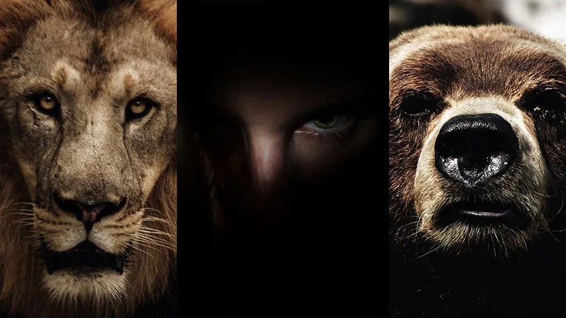
You can’t kill a giant unless you are a lion and bear killer!

Slide 6
What are the “Lions” and “Bears” that you need to beat in order to make you ready to face the Giants?
… And What are the “Giants?”

Slide 7
Are your works Flammable or Fireproof?
1 Corinthians 3:11-14
¹¹ For no one can lay any foundation other than the one already laid, which is Jesus Christ. ¹² If anyone builds on this foundation using gold, silver, costly stones, wood, hay or straw, ¹³ their work will be shown for what it is, because the Day will bring it to light. It will be revealed with fire, and the fire will test the quality of each person’s work. ¹⁴ If what has been built survives, the builder will receive a reward. ¹⁵ If it is burned up, the builder will suffer loss but yet will be saved—even though only as one escaping through the flames.

Slide 8
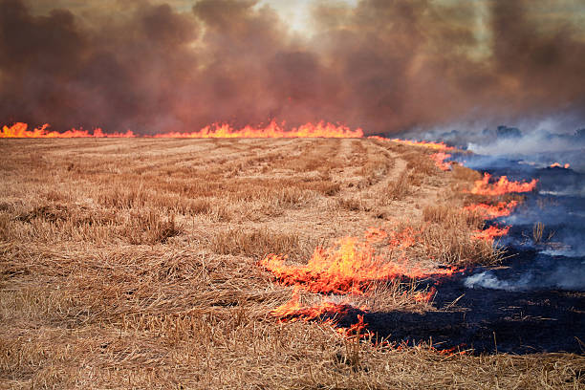
With What Material are you building your_______?
Under ground and no one can see it
Found in small quantities (Rare)
You have to work/dig to get it
Unlimited in value
Above ground, Everyone can see it
Found in large quantities (easy to find)
Doesn’t cost you anything Limited value
Big in the eyes of men, small in the eyes of God

Slide 9
Are your works Flammable or Fireproof?
¹¹ For no one can lay any foundation other than the one already laid, which is Jesus Christ. ¹² If anyone builds on this foundation using gold, silver, costly stones, wood, hay or straw, ¹³ their work will be shown for what it is, because the Day will bring it to light. It will be revealed with fire, and the fire will test the quality of each person’s work. ¹⁴ If what has been built survives, the builder will receive a reward. ¹⁵ If it is burned up, the builder will suffer loss but yet will be saved—even though only as one escaping through the flames.

Slide 10
Fire makes you precious to the possessor.
If you’re building your life on Gold, Silver, Precious Stones, you would become pure, not left like you’ve got nothing to give to God and to others.

Slide 11
Question:
Is what I’m building,
rare,
Underground (not visible),
valuable
taking time to do?
To build my life upon and with Jesus?

Slide 12
Building happens in the secret place so that when these happen, you’re ready!
Trouble
Persecution
Hardships
Health Issues
Trials
Attacks

Slide 13
What are the “Lions” and “Bears” that you need to beat in order to make you ready to face the Giants?
… And What are the “Giants?”

Slide 14
Jesus is saying to his followers “You are going to have to slay these three Enemies in your life which are designed to destroy your spiritual growth.
Here are three lethal stones to use that will prepare you (refine you and make you precious to the possessor) to live this life in VICTORY”.

Slide 15
Victories are developed in the Secret Place
Discipline of Giving Matt.6:1-4
Discipline of Prayer Matt. 6:5-15
Discipline of Fasting Matt. 6:16-18

Slide 16
Victories are developed in the Secret Place
Discipline of Giving Matt.6:1-4
“Be careful not to practice your righteousness in front of others to be seen by them. If you do, you will have no reward from your Father in heaven.
² “So when you give to the needy, do not announce it with trumpets, as the hypocrites do in the synagogues and on the streets, to be honored by others. Truly I tell you, they have received their reward in full.”

Slide 17
Victories are developed in the Secret Place
Discipline of Giving Matt.6:1-4
³ But when you give to the needy, do not let your left hand know what your right hand is doing, ⁴ so that your giving may be in secret. Then your Father, who sees what is done in secret, will reward you.
The Enemy you slay with this stone is Greed.

Slide 18
Jesus’ Model
Mark 14:33-38
³² They went to a place called Gethsemane, and Jesus said to his disciples, “Sit here while I pray.” ³³ He took Peter, James and John along with him, and he began to be deeply distressed and troubled. ³⁴ “My soul is overwhelmed with sorrow to the point of death,” he said to them. “Stay here and keep watch.”

Slide 19
Jesus’ Model
³⁵ Going a little farther, he fell to the ground and prayed that if possible the hour might pass from him. ³⁶ “Abba, Father,” he said, “everything is possible for you. Take this cup from me. Yet not what I will, but what you will.”
³⁷ Then he returned to his disciples and found them sleeping. “Simon,” he said to Peter, “are you asleep? Couldn’t you keep watch for one hour? ³⁸ Watch and pray so that you will not fall into temptation. The spirit is willing, but the flesh is weak.”

Slide 20
Victories are developed in the Secret Place
Discipline of Prayer Matt. 6:5-15
⁵ “And when you pray, do not be like the hypocrites, for they love to pray standing in the synagogues and on the street corners to be seen by others. Truly I tell you, they have received their reward in full.
⁶ But when you pray, go into your room, close the door and pray to your Father, who is unseen. Then your Father, who sees what is done in secret, will reward you.
⁷ And when you pray, do not keep on babbling like pagans, for they think they will be heard because of their many words.
⁸ Do not be like them, for your Father knows what you need before you ask him.

Slide 21
Victories are developed in the Secret Place
Discipline of Prayer Matt. 6:5-15
⁹ “This, then, is how you should pray:
“‘Our Father in heaven, hallowed be your name, ¹⁰ your kingdom come, your will be done, on earth as it is in heaven.
¹¹ Give us today our daily bread. ¹² And forgive us our debts, as we also have forgiven our debtors. ¹³ And lead us not into temptation, but deliver us from the evil one.’

Slide 22
Victories are developed in the Secret Place
Discipline of Prayer Matt. 6:5-15
¹⁴ For if you forgive other people when they sin against you, your heavenly Father will also forgive you. ¹⁵ But if you do not forgive others their sins, your Father will not forgive your sins.

Slide 23
Victories are developed in the Secret Place
Discipline of Prayer Matt. 6:5-15
The Enemy you slay with this stone is Pride
The main reason we don’t pray is not because we’re busy, but because we’re too proud.
“We can handle this without God.”

Slide 24
Victories are developed in the Secret Place
Discipline of Fasting Matt. 6:16-18
¹⁶ “When you fast, do not look somber as the hypocrites do, for they disfigure their faces to show others they are fasting. Truly I tell you, they have received their reward in full. ¹⁷ But when you fast, put oil on your head and wash your face, ¹⁸ so that it will not be obvious to others that you are fasting, but only to your Father, who is unseen; and your Father, who sees what is done in secret, will reward you.

Slide 25
Victories are developed in the Secret Place
Discipline of Fasting Matt. 6:16-18
The Enemy you slay with this stone is Lust.
Anything sensual that you think you can’t live without. (Food, Sex, sleep, etc.)

Slide 26
Victories are developed in the Secret Place
Discipline of Fasting Matt. 6:16-18
The Enemy you slay with this stone is Lust.
1 John 2:15
¹⁵ Do not love the world or anything in the world. If anyone loves the world, love for the Father is not in them. ¹⁶ For everything in the world—the lust of the flesh, the lust of the eyes, and the pride of life—comes not from the Father but from the world. ¹⁷ The world and its desires pass away, but whoever does the will of God lives forever.

Slide 27
The secret place is the fuel for your spiritual life
Fasting is not just when you are in crisis, it’s a lifestyle
We have an adulterous relationship with food.
Is our “stomach our god?”
We don’t need comfort foods. He have a Comforter, the Holy Spirit.
When you give up your secret, you lose your power (Samson)

Slide 28
Victories are developed in the Secret Place
Today’s secret sin is tomorrow’s scandal
Today’s flirtation with sin is tomorrow’s sexual addiction.
Secret hidden sins will become known.

Slide 29
Achin. Book of Joshua
Achin
Promising Future
Hid forbidden things
Was Killed
Brought Death to his family
Disgrace to his family line
And it was wiped out.

Slide 30
Victories are developed in the Secret Place
Today’s Secret place with the Father, is today’s and tomorrow’s supernatural!
Jeremiah 33:2,3 ² “This is what the Lord says, he who made the earth, the Lord who formed it and established it—the Lord is his name: ³ ‘Call to me and I will answer you and tell you great and unsearchable things you do not know.’

Slide 31
Victories are developed in the Secret Place
Today’s Prayer is tomorrow’s Power!

Slide 32
Victories are developed in the Secret Place
Today’s Prayer is tomorrow’s Power!
Today’s submission is Tomorrow’s success! (Fruit)

Slide 33
John 15:7,8
⁷ If you remain in me and my words remain in you, ask whatever you wish, and it will be done for you. ⁸ This is to my Father’s glory, that you bear much fruit, showing yourselves to be my disciples.

Slide 34
Victories are developed in the Secret Place
Today’s Prayer is tomorrow’s Power!
Today’s submission is Tomorrow’s success!
Today’s fasting is tomorrow‘s Glory

Slide 35
Isaiah 58:8,9
⁸ Then your light will break forth like the dawn, and your healing will quickly appear; then your righteousness will go before you, and the glory of the Lord will be your rear guard.
⁹ Then you will call, and the Lord will answer; you will cry for help, and he will say: Here am I.

Slide 36
Victories are developed in the Secret Place
Today’s Prayer is tomorrow’s Power!
Today’s submission is Tomorrow’s success!
Today’s fasting is tomorrow‘s Glory
Today’s Purity is tomorrow’s pleasure!

Slide 37
Rahab vs. Achin Book of Joshua
Achin
Promising Future
Hid forbidden things
Was Killed
Brought Death to his family
Disgrace to his family line
And it was wiped out.
Rahab:
Prostitute
Faced certain doom
Hid the spies
Was Saved
Saved her Family
Lineage of Jesus (Salmon)

Slide 38
Your life tomorrow is determined by what you’re hiding today.
We either live in the secret place or in the secret sin.

Slide 40
Colossians 1:9,10
⁹ For this reason, since the day we heard about you, we have not stopped praying for you. We continually ask God to fill you with the knowledge of his will through all the wisdom and understanding that the Spirit gives, ¹⁰ so that you may live a life worthy of the Lord and please him in every way: bearing fruit in every good work, growing in the knowledge of God,

Slide 41
Genesis 1:11 “Let the earth produce Vegetation….. Vegetation dies without the Earth
Genesis 1:20 “ Let the waters abound with fish… Fish Die without Water
Genesis 1:26 “Let us make man in our image…… Man dies without God

