Slide 1
2024Year of The
OPEN DOOR
LifeGate Sermon
January, 7 2024

Slide 2
Seven Mountains of Influence
MEDICAL MOUNTAIN
Awakening Evangelism Discipleship Healing | Marriages Youth Ministry CPOW | Engage Public Education Resist indoctrination | Engage for Godly Leaders Work for the Freedom of our nation | Writing Podcasts Live Stream |  | Support our local businesses

Slide 3
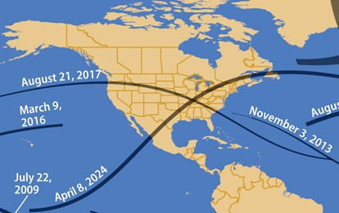
Signs In The Heavens In 2024

Slide 4
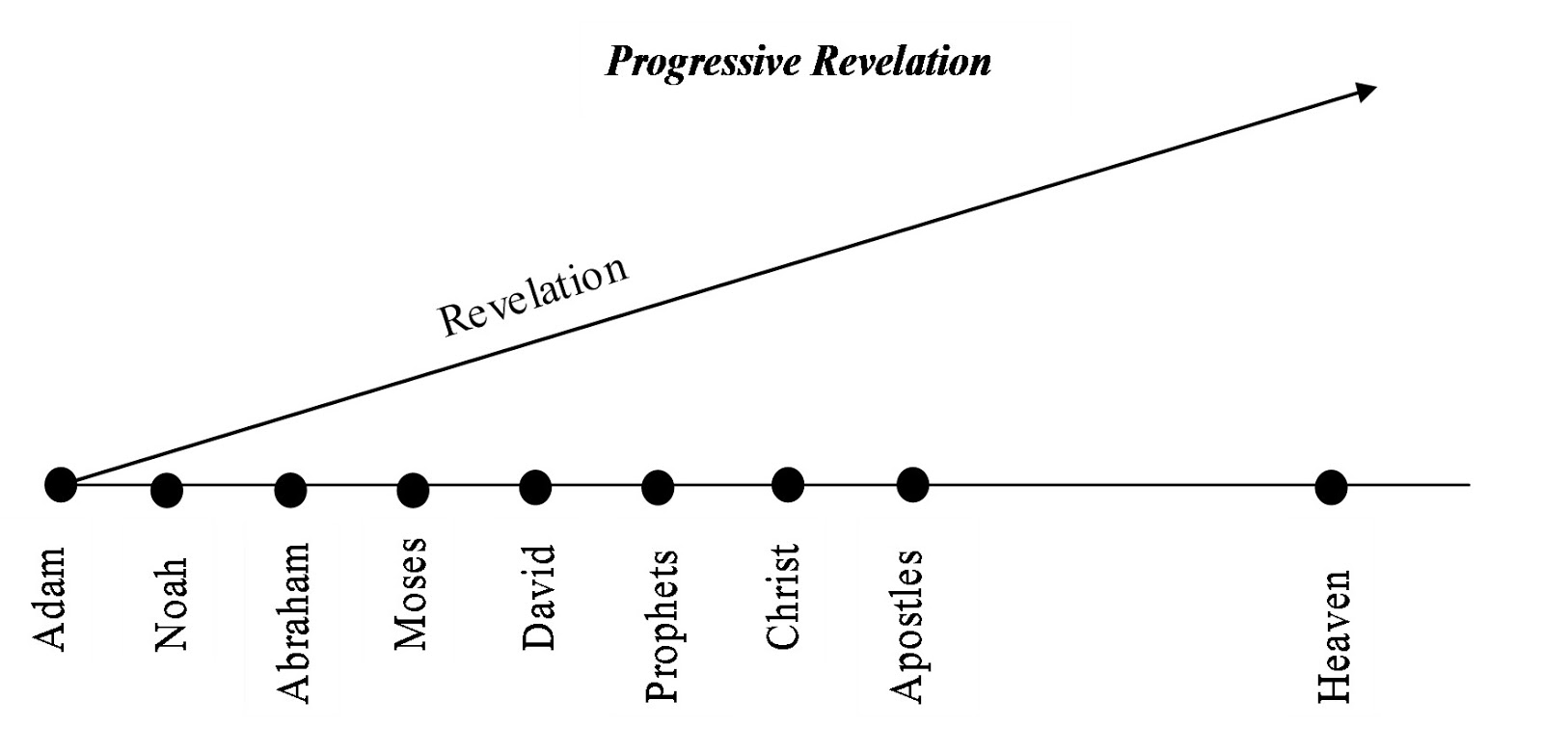
To Open Doors In Each Generation
God Has brought Forth Progressive Revelation
In the past God spoke to our forefathers through the prophets at many times and in various ways, ² but in these last days He has spoken to us by His Son, whom He appointed Heir of all things, and through whom He made the universe. ³ The Son is the radiance of God's glory and the exact representation of His being, sustaining all things by His powerful Word. After He had provided purification for sins, He sat down at the right hand of the Majesty in heaven. Hebrews 1:1-3 (NIV)

Slide 5
To Open Doors In Each Generation
God Has brought Forth Progressive Revelation
Old Testament
New Testament
Noah
Revelation
Of The
Messiah
Jesus
Christ
THE
GOOD NEWS
GOD
REDEEMS
MANKIND MUST
REPENT
GOD
FORGIVES
Instrument of Grace | Jesus Christ | Holy Spirit | Church
Covenant | Last Adam – Prophet greater than Moses – Before Abraham – He existed | The promise of the Father | Under the covenant of Lamb of God – has all the covenant promises and privileges needed to bring the Good news to ALL NATIONS and change the world through transformation
Instrument of Grace | Adam (First) | Abraham | Moses / Birthing a Nation
Type of | Christ | Father | Law
Covenant | Protect the Garden and don’t Eat of the Tree of Knowledge of Good and evil | Of faith and circumcision | Blood of the Lamb - Passover

Slide 6
Jesus Is The One Who Opens and Closes Doors
I will place on His shoulder the key to the house of David; what He opens no one can shut, and what He shuts no one can open. ²³ I will drive him like a peg into a firm place; He will be a seat of honor for the house of his father. ²⁴ All the glory of His family will hang on Him: its offspring and offshoots--all its lesser vessels, from the bowls to all the jars. Isaiah 22:22-24 (NIV)
"To the angel of the church in Philadelphia write: These are the words of him who is holy and true, who holds the key of David. What He opens no one can shut, and what he shuts no one can open. ⁸ I know your deeds. See, I have placed before you an open door that no one can shut. I know that you have little strength, yet you have kept my word and have not denied my name. Revelation 3:7-8 (NIV)

Slide 7
High Level Expectation For God To Open Doors
and Open The Heavens
This is what the LORD says-- he who made you, who formed you in the womb, and who will help you: Do not be afraid, O Jacob, my servant, Jeshurun, whom I have chosen. ³ For I will pour water on the thirsty land, and streams on the dry ground; I will pour out my Spirit on your offspring, and my blessing on your descendants. Isaiah 44:2-3 (NIV)

Slide 8
A Glorious Description Of Jesus Christ
“Words certainly are inadequate to describe Christ’s attributes, abilities, intellect, and accomplishments. He is breathtaking, yet calming. All-powerful but gentle, unsearchably wise though humble, and awe-inspiring while completely approachable. Perfection defines Him, intrigue surrounds Him, and eternity is in Him. He is boundless love, everlasting joy, and the Prince of Peace. Oxymorons are necessary to describe Jesus since He is the God-man, both human and divine. Incredibly, He’s the Ancient of Days, yet forever new, existing in a super time. His nature contradicts every natural law of time, space, and physics. When Moses asked Him His name, He simply said, ‘I AM.’ Words fail. Dean Sheets – Father of Dutch Sheets

Slide 9
The Kingdom Of God Revealed In The New Testament
KINGDOM OF GOD (72 times)
KINGDOM OF HEAVEN (33 times)
KINGDOM OF THE FATHER – Matthew 13:43;26:29; Ephesians 5:5
KINGDOM OF CHRIST – Ephesians 5:5 – 2 Peter 1:11; Revelation 19:16
KINGDOM OF THE SON – Colossians 1:13
KINGDOM OF LIGHT – Colossians 1:12
KINGDOM OF OUR FATHER DAVID Mark 11:10

Slide 10
Ever Wonder Why Isaiah Recorded
The Seraphim Crying Out Holy Holy Holy?
In the year that King Uzziah died, I saw the Lord seated on a throne, high and exalted, and the train of His robe filled the temple. ² Above Him were seraphs, each with six wings: With two wings they covered their faces, with two they covered their feet, and with two they were flying. ³ And they were calling to one another: "Holy, holy, holy is the LORD Almighty; the whole earth is full of His glory (weighty splendor)." ⁴ At the sound of their voices the doorposts and thresholds shook and the temple was filled with smoke. ⁵ "Woe to me!" I cried. "I am ruined! For I am a man of unclean lips, and I live among a people of unclean lips, and my eyes have seen the King, the LORD Almighty." Isaiah 6:1-5 (NIV)

Slide 11
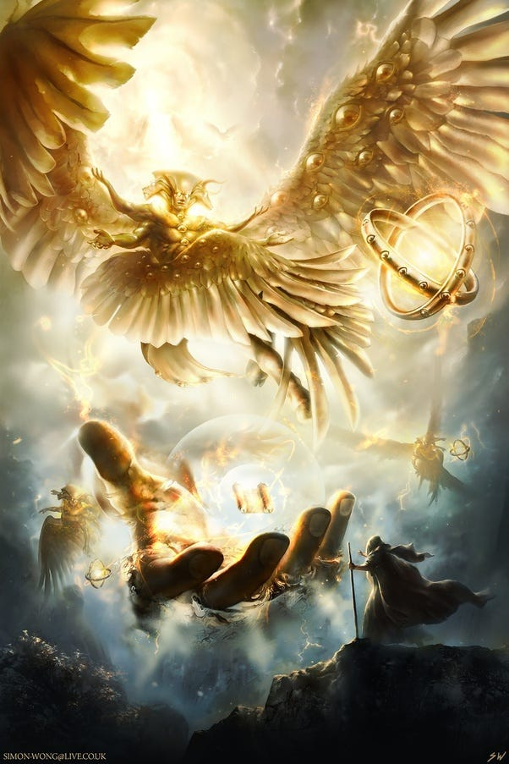
This is Actually Repeated In Revelation Chapter 4
Each of the four living creatures had six wings and was covered with eyes all around, even under his wings. Day and night they never stop saying: "Holy, holy, holy is the Lord God Almighty, Who was, and is, and is to come." Revelation 4:8 (NIV)

Slide 12
A Holy Holy Holy GodHead – Calls Us To Holiness
I am the LORD your God; consecrate yourselves and be holy, because I am holy. Do not make yourselves unclean by any creature that moves about on the ground. ⁴⁵ I am the LORD who brought you up out of Egypt to be your God; therefore be holy, because I am holy. Leviticus 11:44-45 (NIV)
For thus saith the high and lofty One that inhabits eternity, whose name is Holy; I dwell in the high and holy place, with him also that is of a contrite and humble spirit, to revive the spirit of the humble, and to revive the heart of the contrite ones. Isaiah 57:15 (KJV)
But just as He who called you is holy, so be holy in all you do; ¹⁶ for it is written: "Be holy, because I am holy." ¹⁷ Since you call on a Father who judges each man's work impartially, live your lives as strangers here in reverent fear. 1 Peter 1:15-17 (NIV)

Slide 13
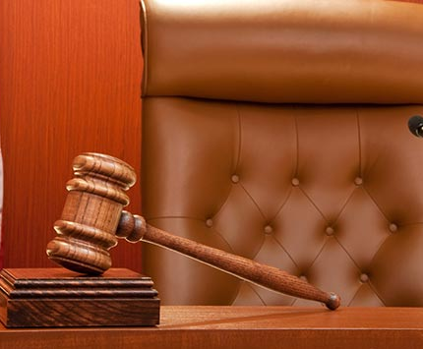
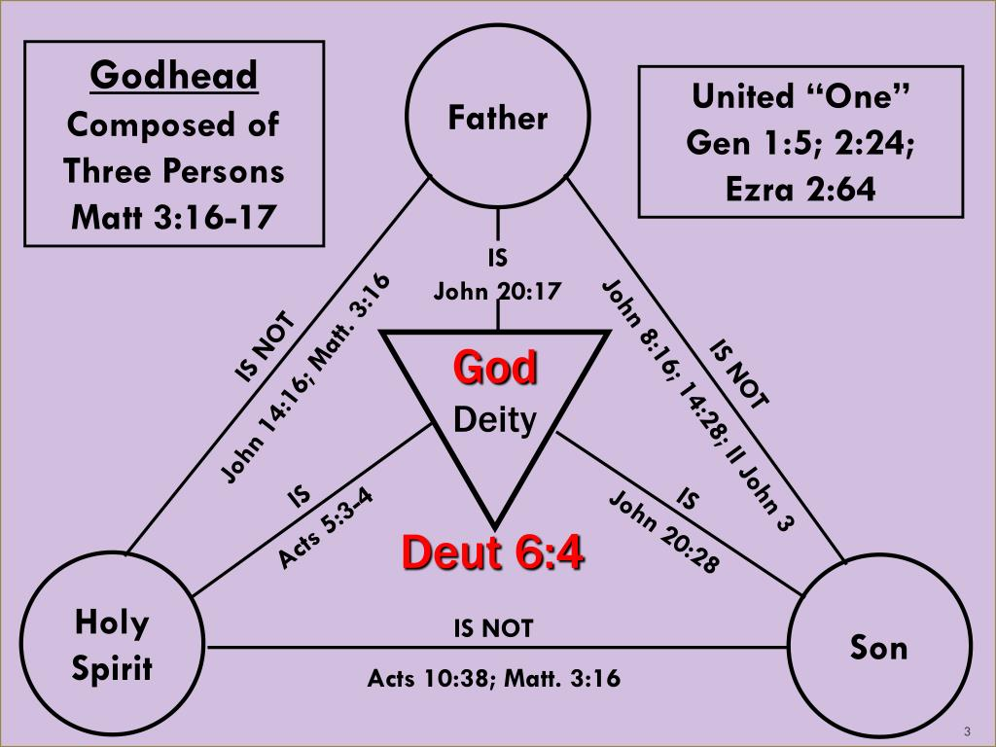
The Glory of the GodHead – The Holy Trinity
Provider
Two of The Godhead
Are Kings –
FATHER – Matt. 13:43
SON – Colossians 1:13:
2 Peter 1:11
For the LORD is our Judge, the LORD is our Lawgiver, the LORD is our King; He will save us. Isaiah 33:22 (KJV)
Executive
Two of The Godhead
Are Judges –
FATHER - 1 Peter 1:17
SON – John 5:22; Romans 2:16
Two of The Godhead
Are Intercessors –
SON - Romans 8:34; Hebrews 7:25
HOLY SPIRIT – Romans 8:26,27
BORN OF
THE SPIRIT
John 3:5
Legislative
Savior
Judicial
Comforter

Slide 14
Jesus Does The Amazing Blending of Two Offices
Tell him this is what the LORD Almighty says: 'Here is the man whose name is the Branch, and he will branch out from his place and build the temple of the LORD. ¹³ It is He who will build the temple of the LORD, and He will be clothed with majesty and will sit and rule on His throne. And He will be a priest on His throne. And there will be harmony between the two.' Zechariah 6:12-13 (NIV)
¹ The point of what we are saying is this: We do have such a high priest, who sat down at the right hand of the throne of the Majesty in heaven, ² and who serves in the sanctuary, the true tabernacle set up by the Lord, not by man. Hebrews 8:1-2 (NIV)

Slide 15
WAIT – The High Impact Ministries of the Holy Spirit
Will Draw the Unsaved Sinner to Jesus
Will Convict Both Unbelievers and Believers
Will Regenerate Our Human Spirits
Will Draw Us Closer to the Lord
Will Sanctify Us in the Lord
Will Help Us With Our Prayer Life (Groaning faith – Spirit tongues)
Will Guide Us Into All Truth
Will Teach Us All Things
Will Anoint Us With His Divine Power
Will Be Our Helper and Comforter in This Life
The 9 (some say 16) Gifts of the Holy Spirit
The 9 Fruits of the Holy Spirit

Slide 16
The Glory of All This Is That The Godhead Makes us Part of Something Bigger than Ourselves
So neither he who plants nor he who waters is anything, but only God, who makes things grow. ⁸ The man who plants and the man who waters have one purpose, and each will be rewarded according to his own labor. ⁹ For we are God's fellow workers (CO-LABORERS); you are God's field, God's building. 1 Corinthians 3:7-9 (NIV)

Slide 17
God Reveals How He Works – To Inspire Faith – to Seek Him To Open the Doors of Heaven
and Open Doors in The Earth
The LORD will open the heavens, the storehouse of his bounty, to send rain on your land in season and to bless all the work of your hands. You will lend to many nations but will borrow from none. ¹³ The LORD will make you the head, not the tail. If you pay attention to the commands of the LORD your God that I give you this day and carefully follow them, you will always be at the top, never at the bottom. Deuteronomy 28:12-13 (NIV)
Bring the whole tithe into the storehouse, that there may be food in my house. Test me in this," says the LORD Almighty, "and see if I will not throw open the floodgates of heaven and pour out so much blessing that you will not have room enough for it. ¹¹ I will prevent pests from devouring your crops, and the vines in your fields will not cast their fruit," says the LORD Almighty. ¹² "Then all the nations will call you blessed, for yours will be a delightful land," says the LORD Almighty. Malachi 3:10-12 (NIV)

Slide 18
The Door Will Be Opened
"So I say to you: Ask and it will be given to you; seek and you will find; knock and the door will be opened to you. ¹⁰ For everyone who asks receives; he who seeks finds; and to him who knocks, the door will be opened. ¹¹ "Which of you fathers, if your son asks for a fish, will give him a snake instead? ¹² Or if he asks for an egg, will give him a scorpion? ¹³ If you then, though you are evil, know how to give good gifts to your children, how much more will your Father in heaven give the Holy Spirit to those who ask him!" Luke 11:9-13 (NIV)
But I will stay on at Ephesus until Pentecost, ⁹ because a great door for effective work has opened to me, and there are many who oppose me. 1 Corinthians 16:8-9 (NIV)

Slide 19
The human soul is ever lazy toward God, and no one generation has seemed to be able to travel very far on its way back to God and His standard from which the early Church fell without falling back. It is true that human error or darkened understanding continually satisfies itself with a part instead of the whole, but the real fact is that men are not willing to pay the full price to come back fully to God’s standard, to be all the Lord’s. Frank Bartleman 1925

Slide 20
The early Church came forth from the “upper room” fresh in her “first love,” (Rev.2:4) baptized with the Holy Spirit, filled with God, possessing both the graces and gifts of the Spirit, and with a one hundred percent consecration to God. This was the secret of her power. She was all for God, and God was all for her. This principle will apply in all ages, both individually and collectively.
No sacrifice on the altar means no fire. The fire of God never falls on an empty altar. The greater the sacrifice, the more the fire. Frank Bartleman

Slide 21
Understanding There Are More and More
Measures of the Spirit – And More Doors
That Can Be Opened And Portals That Can Be Closed
Give, and it will be given to you. A good measure, pressed down, shaken together and running over, will be poured into your lap. For with the measure you use, it will be measured to you." Luke 6:38 (NIV)
For if you possess these qualities in increasing measure (increasingly abound), they will keep you from being ineffective and unproductive in your knowledge of our Lord Jesus Christ. 2 Peter 1:8 (NIV)

Slide 22
LET US DECLARE BY FAITH
So we willingly CONFESS and EMBRACE that we are those who are able to host the presence of God, in spite of all the drama, and receive the summoning influence of the Holy Spirit where God draws an entire community to Himself by the sovereign spiritual in-breaking of Heaven requested and appropriated by a praying and believing Church.

Slide 23
Revival is raging in my spirit. I don’t want to remain on neutral ground until the devil comes and steals what I have, making me just a nominal preacher one step away from not even preaching on prayer anymore. If fasting and praying in tongues will cause my impurities to surface, so be it. If the progression to power includes intense intercession and praying in tongues to edify me up above a carnal, sense-dominated world, then let’s get on with it. If the more excellent way to attain God’s highest and best is to seek after Agape, then go ahead, God of grace, purge everything out of me that keeps me from walking in faith and love! If it takes letting me suffer until I can see the problem, I don’t mind, because I want to be established, strengthened, and settled. I want to experience even greater waves of God’s glory! Dave Roberson 1999

Slide 24
Application
1. Persist in faith and lay hold of God and His promises through fervent intercession as He is a willing partner Who will open doors of cleaning salvation and revival in your life. These open doors will lead to A/ spiritual, B/ relational, C/ financial, and regional and national impact and transformation.
2. Help others open there doors by standing in the gap for their battles. Don’t just open your own doors – help others open theirs.

