Slide 1
Urgent Prayer
Romans 8
Spirit To spirit Contact
With The Living God
Getting Past Our Brain
LifeGate Sermon
January 21, 2024

Slide 2
God Inhabits (Or is Enthroned upon)
The Praises of His People
Yet You are holy, O You Who are enthroned upon (inhabits) the praises of Israel. Psalm 22:3 (NASB)
From one man He made every nation of men, that they should inhabit the whole earth; and He determined the times set for them and the exact places where they should live. ²⁷ God did this so that men would seek Him and perhaps reach out for Him and find Him, though He is not far from each one of us. Acts 17:26-27 (NIV)
FEEL – AFTER HIM – GREEK - Say –La – Fah- Oe – to reach or search for – to verify by contact (Isaiah 65:1 – Romans 10:20)

Slide 3
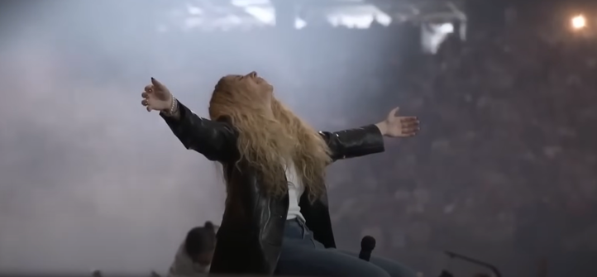
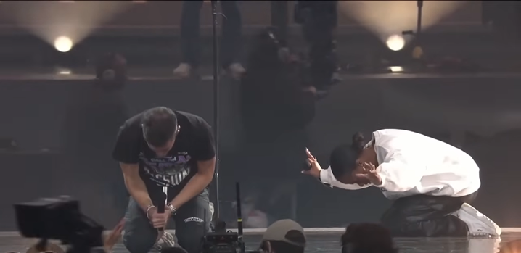
The only Two Postures In Heaven

Slide 4
The Word of The Hour
DIVINE URGENCY
AWAKEN MY WARRIORS
THEY MUST BE MOBILIZED FROM THE SIDELINES TO THE FRONTLINES
THERE’S NO TIME FOR DETOUR OR DELAY - Bobby Conner 2023
I will give them a heart to know me, that I am the LORD. They will be my people, and I will be their God, for they will return to me with all their heart. Jeremiah 24:7 (NIV)

Slide 5
Why Does God Always Wait To the 11th Hour
IN A TIME WHEN EVIL PEOPLE HAVE BEEN ABLE TO HIJACK MOST OF THE DEMOCRACIES OF THE WORLD AND THEN USE THE SYSTEMS OF COMMUNICATION AND UNELECTED BUREAUCRATS TO PUT THEIR PEOPLE UNDER MASS HYPNOSIS – WE ARE ASKING BOLDLY FOR THE MERCY OF GOD TO BRING THE ASCENDENCY OF THE WORKING OF THE HOLY SPIRIT TO BREAK THE VEIL THAT IS OVER THE MASSES. Don Lamb 2020

Slide 6
What Do You Bring To The Fight?
Yes every God-fearing Christian in America needs to ask what do I bring to this spiritual fight in America through the Holy Spirit?
What grace and effectual power has God given me and my Church to overcome the enemy in this storm? What do I possess through God’s Word and Spirit to shatter the cultural mindsets and the atmosphere of spiritual strongholds in high places that need to be torn down. How can I stand in the gap against the voices that are corrupting the truth in the streets – that are trying to protect the closed loops of evil empires. I believe there is a twenty first century Holy Spirit anointing to receive the awakening of the masses so they can see clearly that Jesus Christ is the most glorious, rescuing, daring, sacrificing, and amazing Savior in the universe. Don Lamb 2021

Slide 7
We are not waiting for something big in the earth to start an invasion from heaven. God has already invaded from heaven. Something big happened two thousand years ago and is still working. Yes we can underutilize the privileges, power and authority of that first invasion by Jesus Christ and secondly when He sent the full glory of the Holy Spirit.
It is proven beyond any doubt that God can pour out His extraordinary presence and convicting grace through genuine revival any time His people humble themselves and seek His face and repent of their entanglements with Jezebel, the world, and dead religion, and their own pansy flesh.

Slide 8
Therefore, God is waiting on the Church to rise up. He is waiting on intercessors to press in, contend, and decree, and receive the abundant answers He has promised. He is waiting on bold determined obedient warriors of faith in action.
Economic collapse is not required to bring or hinder revival. War is not going to bring or hinder revival. An EMP attack with no electricity is not required to bring or hinder revival. Another world-wide medical fiasco is not required to bring or hinder spiritual awakening. In short, outward circumstances do not bring spiritual breakthrough in the earth The church obeys, LIVES ABOVE THE CHAOS and receives the promises and HEAVEN RELEASES THE ALREADY PAID FOR VICTORY.

Slide 9
Three Phases of Urgent Prevailing Prayer
1/ REVELATION OF THE PROMISE ,TIMING, AND PROVISION OF GOD (A/ Word B/ Providence
C/ Direct Spirit Revelation) “In the first year of Darius son of Xerxes (a Mede by descent), who was made ruler over the Babylonian kingdom-- ² in the first year of his reign, I, Daniel, understood from the Scriptures, according to the word of the LORD (WITH THE HELP OF THE SPIRIT) given to Jeremiah the prophet, that the desolation of Jerusalem would last seventy years. ³ So I turned to the Lord God and pleaded with him in prayer and petition, in fasting, and in sackcloth and ashes. Daniel 9:1-3 (NIV)
2/ “BIRTHING” - Now, our God, hear the prayers and petitions of your servant. For your sake, O Lord, look with favor on your desolate sanctuary. ¹⁸ Give ear, O God, and hear; open your eyes and see the desolation of the city that bears your Name. We do not make requests of you because we are righteous, but because of your great mercy. ¹⁹ O Lord, listen! O Lord, forgive! O Lord, hear and act! For your sake, O my God, do not delay, because your city and your people bear your Name." Daniel 9:17-19 (NIV)
3/ BREAKTHROUGH ANSWER - While I was speaking and praying, confessing my sin and the sin of my people Israel and making my request to the LORD my God for his holy hill-- ²¹ while I was still in prayer, Gabriel - came to me in swift flight about the time of the evening sacrifice. ²² He instructed me and said to me, "Daniel, I have now come to give you insight and understanding. ²³ As soon as you began to pray, an answer was given, which I have come to tell you, for you are highly esteemed. Therefore, consider the message and understand the vision: Daniel 9:20-23 (NIV)

Slide 10
Evangelicals Are Good At The Word
At Repentance At Seeking To Impact The Community
But They Have Little FREEDOM IN THE HOLY SPIRIT
If the ministry that condemns men is glorious, how much more glorious is the ministry that brings righteousness! ¹⁰ For what was glorious has no glory now in comparison with the surpassing glory. ¹¹ And if what was fading away came with glory, how much greater is the glory of that which lasts! ¹² Therefore, since we have such a hope, we are very bold. ¹³ - ¹⁶ But whenever anyone turns to the Lord, the veil is taken away. ¹⁷ Now the Lord is the Spirit, and where the Spirit of the Lord is, there is freedom. ¹⁸ And we, who with unveiled faces all reflect the Lord's glory, are being transformed into His likeness with ever-increasing glory, which comes from the Lord, who is the Spirit. 2 Corinthians 3:9-13 – 16- 18 (NIV)

Slide 11
REVIEW - The Ministries of The Holy Spirit
Before we are saved the HOLY SPIRIT IS WITH US – to convict us
When He comes, He will convict the world of guilt in regard to sin and righteousness and judgment: John 16:8 (NIV)
When we get saved the HOLY SPIRIT COMES IN US – to teach us
But the Counselor, the Holy Spirit, whom the Father will send in My name, will teach you all things and will remind you of everything I have said to you. John 14:26 (NIV)
When we get FILLED with the HOLY SPIRIT HE COMES UPON US – to empower us for service and ministry and overcome battles and trials
But you shall receive power, after that the Holy Ghost is come upon you: and you shall be witnesses unto Me both in Jerusalem, and in all Judaea, and in Samaria, and unto the uttermost part of the earth. Acts 1:8 (KJV)

Slide 12
Every Gift of The Holy Spirit Reveals
The Character Of Christ (And Jesus Operated In Them)
For he is sent by God. He speaks God’s words, for God gives him the Spirit without limit. John 3:34
Apostle - Extraordinary power to bear witness to the Gospel and shepherd the Church
Prophet/ Prophecy – Edify by NOW WORDS – a greater faith and revelations of God
Evangelists – Power to share the Gospel through all means necessary
Pastor/ Teacher - A great anointing to communicate the Word of God and teach others
Word of Knowledge/ Wisdom – Share a direct download from God to help some in life
Gifts of healing – Bring heaven to earth through Divine healing
Faith – Stir up faith and operate in faith when everyone sees failure
Mercy – Go into the trenches of hurt and despair and comfort and lift up the wounded
Tongues – intercession – Cross-cultural communication – Pray without ceasing – groan over souls
Interpretation of tongues - Take the Spirit groanings and translate their meaning for others
Distinguishing between spirits/ discernment – Discerning what is really going on in people’s hearts
Giving- Being a generous person gifted with means to bless others
Miracles – Being gifted with faith to call forth INTERVENTIONS and breakthroughs
Leadership/ Administration/ - A gift to oversee and organize and mentor others into maturity
Helps/ Serving – A gift to find practical ways to meat people’s needs and bless others

Slide 13
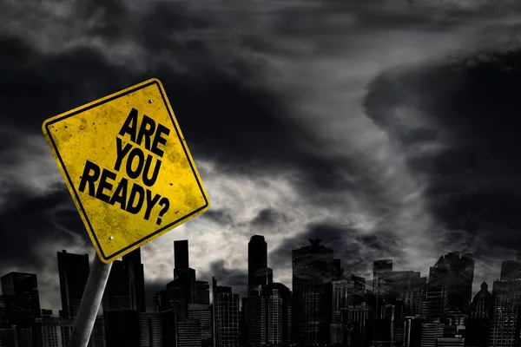
The Last Days Battles Will Require
Urgently Praying In The Spirit
But, dear friends, remember what the apostles of our Lord Jesus Christ foretold. ¹⁸ They said to you, "In the last times there will be scoffers who will follow their own ungodly desires." ¹⁹ These are the men who divide you, who follow mere natural instincts and do not have the Spirit. ²⁰ But you, dear friends, build yourselves up in your most holy faith and pray (earnestly, supplicate) in the Holy Spirit. ²¹ Keep yourselves in God's love as you wait for the mercy of our Lord Jesus Christ to bring you to eternal life. Jude 1:17-21 (NIV)

Slide 14
It Is Guaranteed that You Will Need Deeper
Fillings of the Holy Spirit To Live In These Last Days
Because you will need to pray your way through:
Significant challenges – temptations – distractions – trials
Significant opportunities – promotions – problems with people
Significant harvest – discipleship – revival – (ego strokes – will require humility – discernment

Slide 15
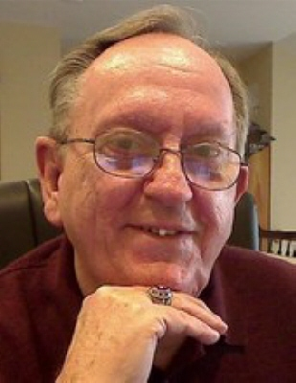
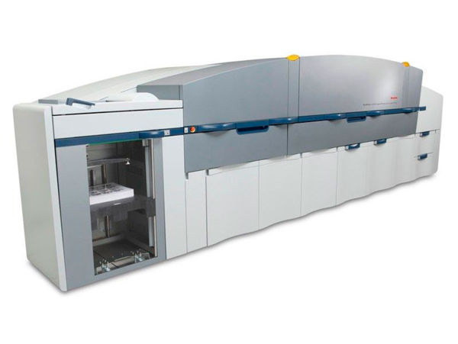
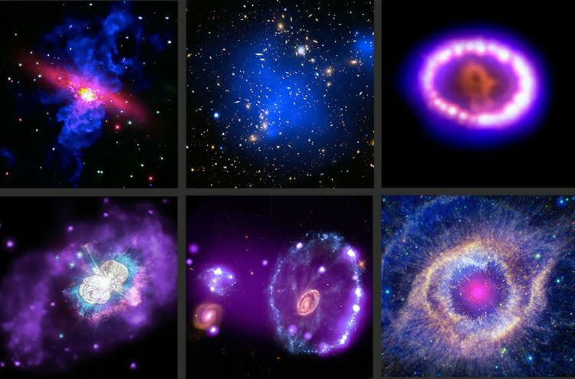
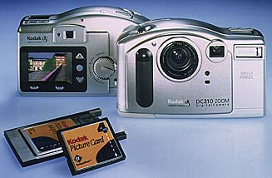
The Holy Spirit Helps Us
Work In The World We Live In
KODAK
First digital camera – 1991 – 1.3 mega pixel
1991 - First digital Color copier
1997 – first digital camera under $1000
Roy Libby
Passed away 2021
Roy worked Eastman Kodak Co in Rochester, NY for 34 years as a Senior Reliability Engineer in the Space Systems Division and was on the team that developed the Chandra Observatory for NASA (1999).

Slide 16
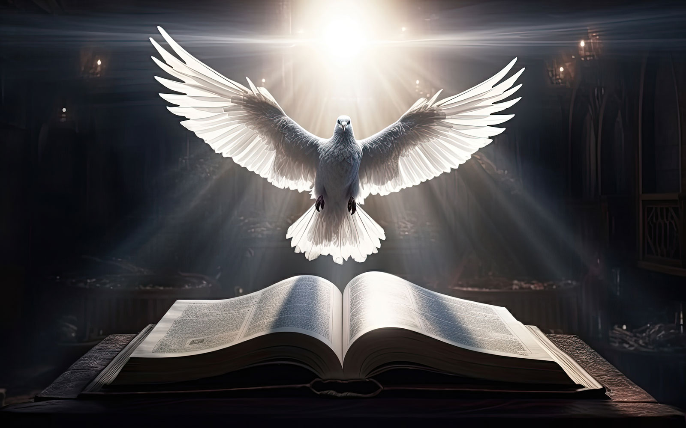
Testimony of A Holy Spirit- Averse Pastor
Gain confidence
Solidify skills

Slide 17
Urgent Prevailing Prayer Can Only Be Sustained
By The Help and Influence Of The Holy Spirit
In the same way, the Spirit helps us in our weakness. We do not know what we ought to pray for, but the Spirit himself intercedes for us with groans that words cannot express. ²⁷ And he who searches our hearts knows the mind of the Spirit, because the Spirit intercedes for the saints in accordance with God's will. Romans 8:26-27 (NIV)

Slide 18
There Is A Difference Between
Speaking Publically in Spirit Tongues
And Praying In Tongues or the Spirit
For this reason anyone who speaks in a tongue should pray that he may interpret what he says. ¹⁴ For if I pray in a tongue, my spirit prays, but my mind is unfruitful. ¹⁵ So what shall I do? I will pray with my spirit, but I will also pray with my mind; I will sing with my spirit, but I will also sing with my mind. 1 Corinthians 14:13-15 (NIV)

Slide 19
The Profound Revelation Of The GodHead Filling the Church Again and Again with the Promise of the Spirit
Now, Lord (FATHER) , consider their threats and enable your servants to speak your word with great boldness. 30 Stretch out your hand to heal and perform (BE DONE – COME – ARISE – CONTINUE) (HOLY SPIRIT) miraculous signs and wonders through the name of your holy servant Jesus (THE SON) ." 31 After they prayed, the place where they were meeting was shaken. And they were all filled with the Holy Spirit and spoke the word of God boldly. Acts 4:27-31 (NIV)

Slide 20
So Many Verses Show Us God Directly Connects
Because we know that suffering produces perseverance; ⁴ perseverance, character; and character, hope. ⁵ And hope does not disappoint us, because God has poured out His love into our hearts by the Holy Spirit, whom He has given us. Romans 5:3-5 (NIV)
The KEY to this DIRECT Spirit to spirit connectivity is that when we touch God directly something changes in us – We WANT TO SPEND ETERNITY with this glorious Person – And we want to FIND OUT WHAT WE CAN DO TO PLEASE HIM. We don’t want to continue to SIN AGAINST HIM. (Hebrews 10:26)

Slide 21
God Initiates – But We Must Respond
I will betroth you in faithfulness, and you will acknowledge the LORD. ²¹ "In that day I will respond," declares the LORD-- "I will respond to the skies, and they will respond to the earth; ²² and the earth will respond to the grain, the new wine and oil. Hosea 2:20-22a (NIV)
Fan or kindle or stir up the gift (2 Timothy 1:6)
Court or host the presence of God (Malachi 3:10)
To welcome and accommodate the Spirit of God (Exodus 20:24)

Slide 22
Carried Along In The Spirit
Stay In Step With The Spirit
Live by the Spirit and Stay In Step With The Spirit (Galatians 5:25)
Be Carried Along In The Spirit (2 Peter 1:21)
Pray In The Spirit (Jude 1:18)
Walk In The Spirit (Galatians 5:16)
Compelled or Bound by The Spirit (Acts 20:22)

Slide 23
Every Time There Is A Fresh Filling / Deluge Of The Spirit
The Revelation of Jesus Increases (Ephesians 1:17)
Increased confidence and BOLDNESS in the Lord (Acts 4:31)
A Greater Heart/ Burden For Souls around us (Acts 17:16)
Deeper Measures of the Fruit of the Spirit (Galatians 5:22)
Greater Radiating of the Character of Christ (Acts 4:13)
Now when they saw the boldness of Peter and John, and perceived that they were unlearned and ignorant men, they marvelled; and they took knowledge of them, that they had been with Jesus. Acts 4:13 (KJV)

Slide 24
Application
Allow God to Get through your PERSONAL COMFORT ZONES AND FIREWALLS.
Turn to the Lord and let the veils of intellectual hindrances come off your spiritual vision for life.
Since you have been filled with the Spirit – ASK THE FATHER FOR MORE OF THE SPIRIT – ask for the release of the Gift of praying in tongues in your life.
Pray for LifeGate to Continue to Pioneer with other churches to OCCUPY until He comes and STAY spiritually aligned with God’s purposes and use all the GIFTS AND FRUITS OF THE HOLY SPIRIT.

Slide 25
Prayer For Inviting More of The Holy Spirit
Father I thank you that through the blood of Jesus Christ and His finished work on the cross I am Your son and You have adopted me.
I derive my name from You and I receive my mission and calling from You. I recognize that You have given me Your Son for salvation and Your Holy Spirit for revelation and anointing power to accomplish my purpose on earth.

Slide 26
Prayer For Inviting More of The Holy Spirit
I thank You that You desire me to be filled and endued with the Holy Spirit so that I may have powerful intimacy with Your Son and also receive the ability to intensely pray to You in my mother tongue but also heavenly tongues. Though a mystery, I gladly receive this gift through faith as I did my salvation.
Father, I know it is Your will for me to live in all the fullness You provide. So again, I ask You to fill me and baptize me afresh with Your Holy Spirit and keep me from fearing the mysteries of His ministry.

Slide 27
Prayer For Inviting More of The Holy Spirit
Thank You Holy Spirit for being God and I welcome Your fillings and revelations and groanings through my heart and mouth and spirit. I receive all you have for me in Jesus Name. Help me to use my MIND through Your leading and not just operate in human INTELLECTUALISM – help my mind to be superseded in seasons through Your direct control.
And right now I place faith in You Father to activate the Romans chapter eight GIFT of Holy Spirit groanings in me for Your glory in Jesus name amen.

