Slide 1
Introduction and Chapter One
LifeGate Sermon
February 4, 2024

Slide 2
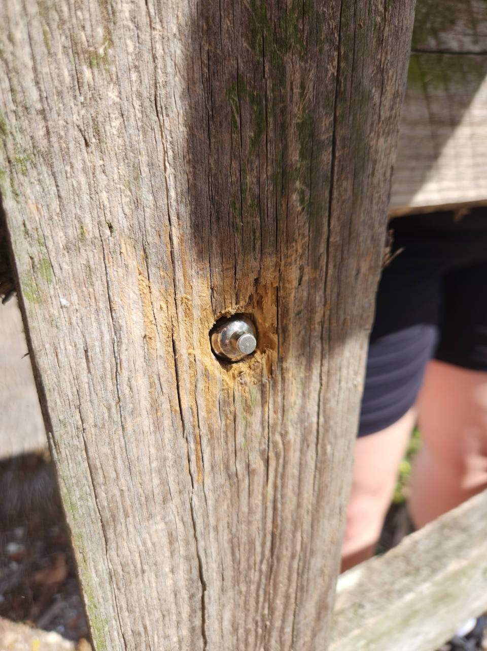
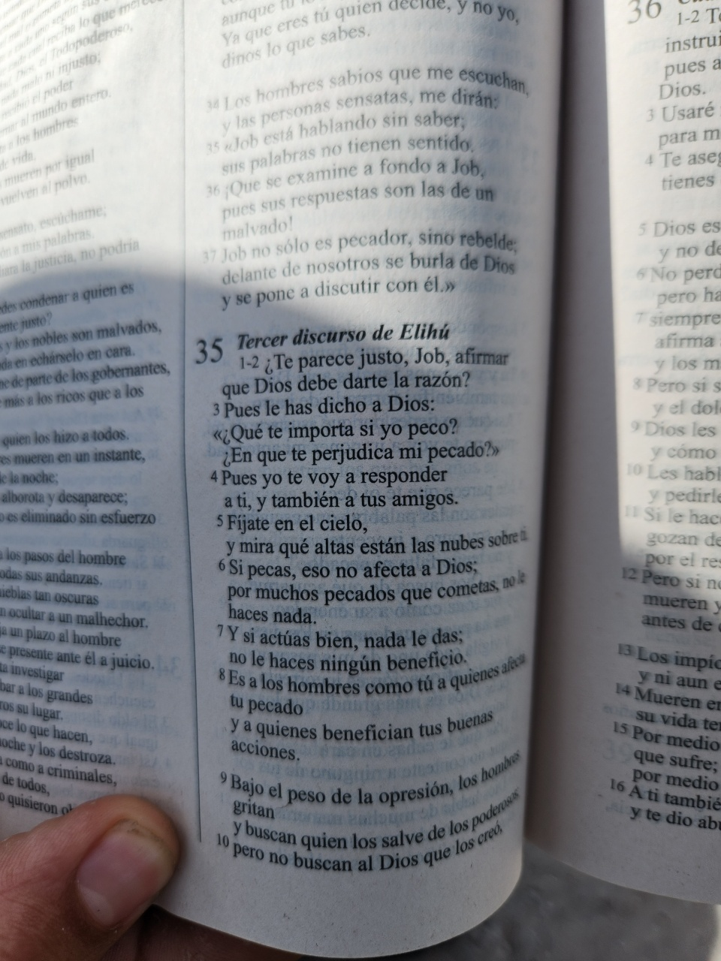
DIVINE APPOINTMENTS

Slide 3
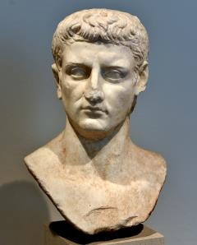
THE EARLY CHURCH AND
THE CLIMATE OF ANTI- JEWISH
AND CHRISTIAN RELIGIONS
Tiberius and Caligula
14 AD – 41 AD
Claudius
AD 41–54
There he met a Jew named Aquila, a native of Pontus, who had recently come from Italy with his wife Priscilla, because Claudius had ordered all the Jews to leave Rome. Paul went to see them, ³ and because he was a tentmaker as they were, he stayed and worked with them. ⁴ Every Sabbath he reasoned in the synagogue, trying to persuade Jews and Greeks. Acts 18:2-4 (NIV)
Claudius was concerned with the spread of eastern mysticism within the city and searched for more Roman replacements. He emphasized the Eleusinian Mysteries, which had been practiced by so many during the Republic. He expelled foreign astrologers, and at the same time rehabilitated the old Roman soothsayers as a replacement. He was especially hard on Druidism, because of its incompatibility with the Roman state religion and its proselytizing activities

Slide 4
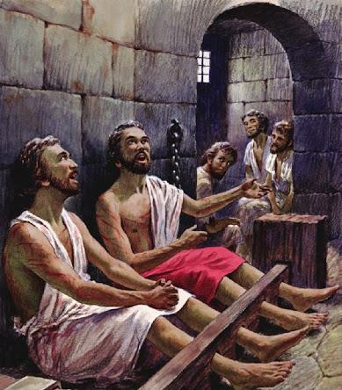
THE JOURNEY OF PAUL TO PHILIPPI
Greek city 200 BC – made into a Roman colony around 31 B.C.
Built up by Retiring Roman legions -
In the Time of Paul was a large city of 10,000
Paul arrives with Silas around 49 AD
Paul and Silas minister about 3 months
Paul writes Philippians around 62 AD – From Rome
All the saints send you greetings, especially those who belong to Caesar's household. Philippians 4:22 (NIV)

Slide 5
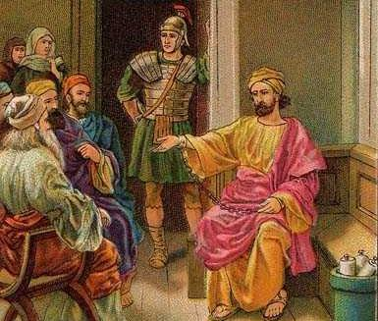
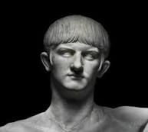
THE THEMES OF PHILIPPIANS
COMES FROM A MAN UNDER THE HOLY SPIRIT
WHILE LIVING UNDER HOUSE ARREST
When we got to Rome, Paul was allowed to live by himself, with a soldier to guard him. Acts 28:16
For this reason I have asked to see you and talk with you. It is because of the hope of Israel that I am bound with this chain." Acts 28:20
For two whole years Paul stayed there in his own rented house and welcomed all who came to see him. ³¹ Boldly and without hindrance he preached the kingdom of God and taught about the Lord Jesus Christ. Acts 28:30-31 (NIV)
And I am confident in the Lord that I myself will come soon. Philippians 2:24 (NIV)
Nero takes power at age 16

Slide 6
THE TOPICS COVERED IN
PHILIPPIANS
CHAPTER Followed By verse total | Verses Written to Everyday Believers About Living by Faith | Verses Written About Relationship Essentials | Verses Written For Guiding Leadership | Verses written For The unsaved | Verses On Theology, the Character of God, and Plan of Salvation | Verses on Poetry, Prophecy, History or Paul’s Personal Testimony Or Greeting
1 (30) | 7 | 5 | 2 | 2 | 2 | 19
2 (30) | 5 | 8 | 8 | 5 | 11 | 7
3 (21) | 10 |  | 3 | 2 | 11
4 (23) | 10 | 5 | 2 |  | 1 | 11
Total 104 | 32 | 18 | 15 | 9 | 25 | 37
Percentage | 30% | 17% | 14% | 8% | 24% | 35%

Slide 7
PHILIPPIANS GIVES US SIX PROFOUND PROMISES FROM THE NEW TESTAMENT
PROMISE ONE
Being confident of this very thing, that He (FATHER) which hath begun a good work in you will perform (FULFILL FURTHER - carry forward to completion) it until the day of Jesus Christ: Philippians 1:6 (KJV)
PROMISE TWO
For I know that this shall turn to my salvation through your prayers, and the supply of the Spirit of Jesus Christ, According to my earnest expectation and my hope, Philippians 1:19-20 (KJV)
PROMISE THREE
For it is God which works in you both to will and to do of His good pleasure. Philippians 2:13 (KJV)

Slide 8
PHILIPPIANS GIVES US SIX PROFOUND PROMISES FROM THE NEW TESTAMENT
PROMISE FOUR
But our citizenship is in heaven. And we eagerly await a Savior from there, the Lord Jesus Christ, who, by the power that enables Him to bring everything under his control, will transform our lowly bodies so that they will be like His glorious body. Philippians 3:20-21 (NIV)
PROMISE FIVE
And the peace of God, which transcends all understanding, will guard your hearts and your minds in Christ Jesus. Philippians 4:7 (NIV)
PROMISE SIX
And my God will meet all your needs according to His glorious riches in Christ Jesus. Philippians 4:19 (NIV)

Slide 9
THE WHOLE TRAJECTORY OF
PHILIPPIANS IS THE CENTRALITY
OF CHRIST AND HOW HE CHANGES
OUR ATTITUDE AND OUR RELATIONSHIP WITH GOD AND OTHERS
Family
World

Slide 10
In This Radical Vertical God
Changes Four Major Areas of our Life
VERY INTERESTING – GOD SAYS – “IN YOUR HEART”
Heart - Kardia – Middle - Latin – COR - thoughts – feelings –shows up 105 times in NT (Mind – 56 times ) – center – Affections/
It is right for me to feel this way about all of you, since I have you in my heart; for whether I am in chains or defending and confirming the gospel, all of you share in God's grace with me. ⁸ God can testify how I long for all of you with the affection of Christ Jesus. Philippians 1:7-8 (NIV)
Our motives
Our choices
Our attitudes
Our affections
The former preach Christ out of selfish ambition, not sincerely. Philippians 1:17 (NIV)

Slide 11
THE GIANT PROMISE OF GOD COMPLETING THE WORK HE HAS BEGUN IN EACH OF US
Being confident of this very thing, that He (FATHER) which hath begun a good work in you will perform (FULFILL FURTHER - carry forward to completion) it until the day of Jesus Christ: Philippians 1:6 (KJV)

Slide 12
THE SYNERGY OF THE POWER OF GOD TO FINISH
THE GOOD WORK HE BEGAN AND OUR SURRENDER
God abandons nothing that He undertakes. There are no unfinished worlds or systems; no half-made and forsaken works of His hands. There is no evidence in His works of creation of change of plan, or of having forsaken what He began from disappointment, or lack of power to complete them. Why should there be in the salvation of the soul? Albert Barnes
This is the word that came to Jeremiah from the LORD: ² "Go down to the potter's house, and there I will give you my message." ³ So I went down to the potter's house, and I saw him working at the wheel. ⁴ But the pot he was shaping from the clay was marred in his hands; so the potter formed it into another pot, shaping it as seemed best to him. ⁵ Then the word of the LORD came to me: ⁶ "O house of Israel, can I not do with you as this potter does?" declares the LORD. "Like clay in the hand of the potter, so are you in my hand, O house of Israel. Jeremiah 18:1-6

Slide 13
THE WAX OF INSINCERITY
NEEDS TO BE REMOVED
⁹ And this I pray, that your love may abound yet more and more in knowledge and in all judgment; ¹⁰ That you may approve things that are excellent; that you may be sincere and without offence till the day of Christ; ¹¹ Being filled with the fruits of righteousness, which are by Jesus Christ, unto the glory and praise of God. Philippians 1:9-11 (KJV)
GREEK – eilikrinēs - judged by sunlight, i.e. tested as genuine.
GREATEST BATTLE WITH BEING INSINCERE – IS THAT WE CAN LIE TO OURSELVES

Slide 14
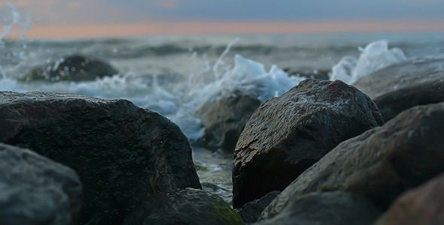
WE MUST LET THE RUSHING TORRENTS OF THE SPIRIT OF CHRIST WASH THE BOULDERS OF
DECEPTION AND STRONGHOLDS OUT

Slide 15
FAITH DECLARATION FROM PHILIPPIANS
“Heavenly Father, I declare that I have repented of my sins and received true pardon from the grace lavished on me at the Cross of Your Son Jesus Christ. In His finished work, I ALREADY have Your favor today. I declare that I am, by Your Holy Spirit strong and well able to fulfill my God-given calling through grace. I know You are fighting my battles and FINISHING YOUR GOOD WORK IN ME as I stand in faith.”
“I declare that all my days were ordained for me before I was born. That my mission is to do the works you have prepared for me to accomplish. Your success is upon my RELATIONSHIPS, my labors and I expect to succeed in my vertical mission of FAITH and horizontal relationships of LOVE.”
“Father, I thank You for causing me to make good decisions with a clear mind and changed heart. Thank You that You work in me what is well pleasing in Your sight so that I can do all things through Christ who strengthens me.”

Slide 16
FAITH DECLARATION FROM PHILIPPIANS
“Forgive me, when I HINDER THE WORK YOU ARE BRINGING TO COMPLETION IN ME by become obsessed with my needs and problems over the HEART OF GOD and the BLESSING OF MY FAMILY AND COMMUNITY. Forgive me when I stop seeking FIRST Your Kingdom and righteousness by prayer and by sharing the spiritual wealth you gave me.”
“I thank You for Your favor today not JUST because of who I am, but because of YOU. I am a child of the Most High God, the Creator of the whole universe. I commit this season to You. I have been saved, and adopted. NOW HELP ME PARTNER WITH YOU AS YOU COMPLETE THE GOOD WORK YOU HAVE BEGUN – I SURRENDER TO YOUR HOLY SPIRIT to be transformed, filled, and given the opportunity to shine Your love and truth into the world.”

