Slide 1
Chapter One – PART TWO
LifeGate Sermon
February 11, 2024

Slide 3
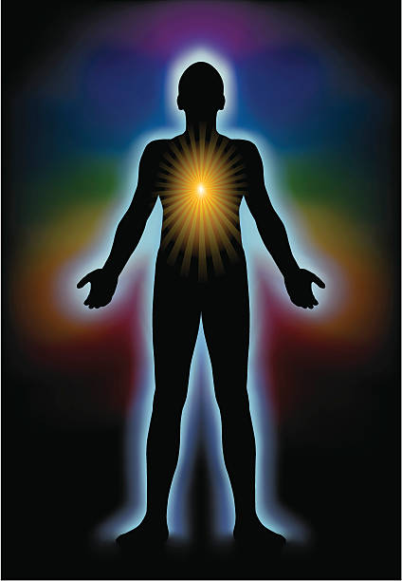
GOD CREATED REPERCUSSIONS TO OUR DECISIONS IN LIFE NOT EVOLUTION AND CHANCE
GOD IS THE ONE WHO MADE US SPIRITUAL BEINGS SURROUNDED BY A PHYSICAL BODY – AND A NATURAL WORLD WITH CONSEQUENCES TO OUR CHOICES

Slide 4
What Are The Things That Come At You That Take You Out Of Sync with God and Others?
Relationship Conflict

Slide 5
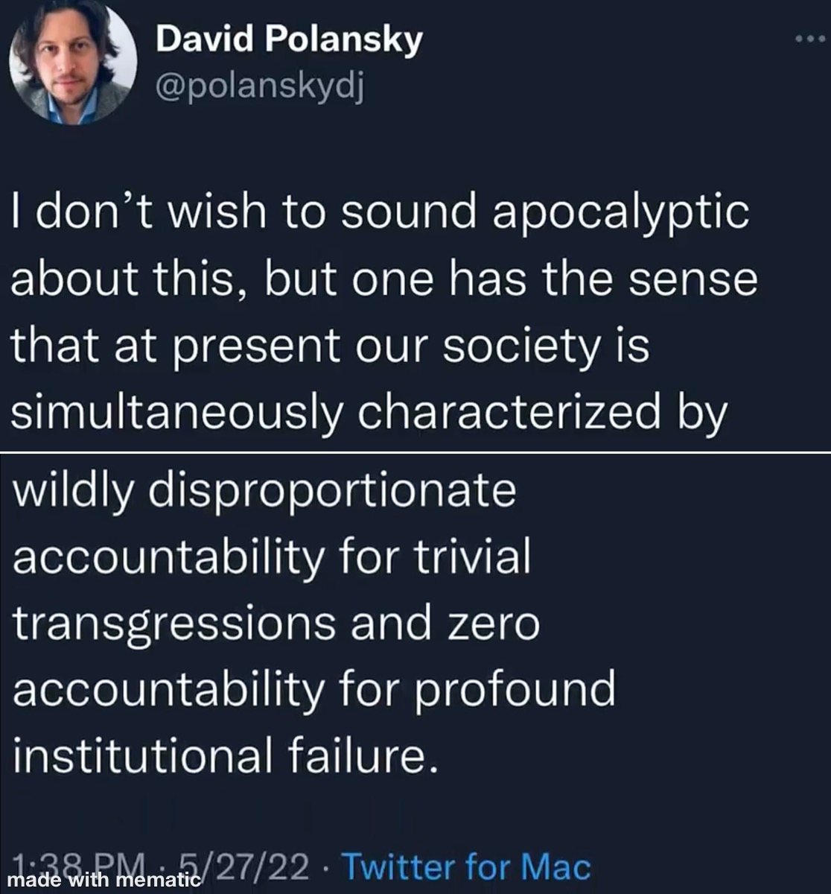

Slide 6
Key Verses of Chapter One
And this is my prayer: that your love may abound more and more in knowledge and depth of insight, ¹⁰ so that you may be able to discern what is best and may be pure and blameless until the day of Christ, ¹¹ filled with the fruit of righteousness that comes through Jesus Christ--to the glory and praise of God (the Father).
Philippians 1:9-11 (NIV)
Now I want you to know, brothers, that what has happened to me has really served to advance the gospel. ¹³ As a result, it has become clear throughout the whole palace guard and to everyone else that I am in chains for Christ. ¹⁴ Because of my chains, most of the brothers in the Lord have been encouraged to speak the word of God more courageously and fearlessly. Philippians 1:12-14 (NIV)
For I know that this will turn to my salvation (rescue, deliverance) through your prayers, and the supply (bountiful, fully aided, furnished, contribute) of the Spirit of Jesus Christ, Philippians 1:19 (KJV)

Slide 7
Let’s Look At Paul’s Life and See How These
Events Prepared Him For Seeing The Fruit
Of Righteousness In The Midst of Crazy Situations
I have worked much harder, been in prison more frequently, been flogged more severely, and been exposed to death again and again. ²⁴ Five times I received from the Jews the forty lashes minus one. ²⁵ Three times I was beaten with rods, once I was stoned, three times I was shipwrecked, I spent a night and a day in the open sea, ²⁶ I have been constantly on the move. I have been in danger from rivers, in danger from bandits, in danger from my own countrymen, in danger from Gentiles; in danger in the city, in danger in the country, in danger at sea; and in danger from false brothers. ²⁷ I have labored and toiled and have often gone without sleep; I have known hunger and thirst and have often gone without food; I have been cold and naked. ²⁸ Besides everything else, I face daily the pressure of my concern for all the churches. 2 Corinthians 11:23-28 (NIV)

Slide 8
Paul Is Having Influence Even In The Palace of Nero
It's true that some here preach Christ because with me out of the way (by being imprisoned) , they think they'll step right into the spotlight. But the others do it with the best heart in the world. ¹⁶ One group is motivated by pure love, knowing that I am here defending the Message, wanting to help. ¹⁷ The others, now that I'm out of the picture, are merely greedy, hoping to get something out of it for themselves. Their motives are bad. They see me as their competition, and so the worse it goes for me, the better—they think—for them. ¹⁸ So how am I to respond? I've decided that I really don't care about their motives, whether mixed, bad, or indifferent. Every time one of them opens his mouth, Christ is proclaimed, so I just cheer them on! And I'm going to keep that celebration going ¹⁹ because I know how it's going to turn out. Through your faithful prayers and the generous response of the Spirit of Jesus Christ, everything he wants to do in and through me will be done. ²⁰ I can hardly wait to continue on my course. I don't expect to be embarrassed in the least. On the contrary, everything happening to me in this jail only serves to make Christ more accurately known, regardless of whether I live or die. They didn't shut me up; they gave me a pulpit! ²¹ Alive, I'm Christ's messenger; dead, I'm his bounty. Life versus even more life! I can't lose. ²² As long as I'm alive in this body, there is good work for me to do. If I had to choose right now, I hardly know which I'd choose. ²³ Hard choice! The desire to break camp here and be with Christ is powerful. Some days I can think of nothing better ²⁴ . But most days, because of what you are going through, I am sure that it's better for me to stick it out here. ²⁵ So I plan to be around awhile, a companion to you as your growth and joy in this life of trusting God continues. ²⁶ You can start looking forward to a great reunion when I come visit you again. We'll be praising Christ, and enjoying each other. Philippians 1:15-26 (MSG)

Slide 9
The JOURNEY of Overcoming the Negative Hits
As we discern what is going on around us through the HELP OF THE HOLY SPIRIT we can identify how God is going to overcome the NEGATIVES in our life for the furtherance of His CHARACTER in us – and the Gospel around us.
We begin to realize that the SURFACE things are not always accurate. God takes us deeper into the DEPTHS OF HIS INSIGHT – to grow and learn through the challenges how to let the righteousness of Christ come into our situations by surrender and obedience.
True sustained intercession can impact the impossibilities around us. We can pray open doors that look closed.

Slide 10
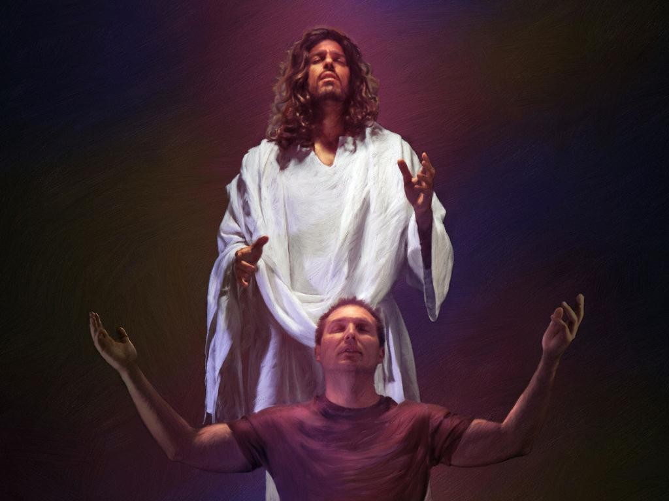
We Can Simply Want God To Fix Our
Problems without Changing Our Hearts
This is Where Prayer Changes Our Heart and Then
Our Circumstances
God Wants To Move In Our Life and Family and Nation – But He also wants to CHANGE US along the way.
And the God of all grace, who called you to his eternal glory in Christ, after you have suffered a little while, will himself restore you and make you strong, firm and steadfast. 1 Peter 5:10 (NIV)

Slide 11
The Challenge To Keep A Biblical Balance
Concerning The Sovereignty of God and Prayer
Haphazard Sovereignty of God We have to wait till He decides to randomly show up – we have no way of influencing Him. | Biblical Faith in A Dynamic Responding God Who makes us promises and then invites us to lay hold of Him For Our Impossibilities | Quick Fix Agenda God is almost like a Genie In A Bottle - He should always answer once we figure out the FORMULA
Excited when God comes forth but don’t really know how to regularly enter into His promises: Everything is on a DIVINE CLOCK nothing we can do to change that. Faith is STUNTED. |  | Trying to always find a better FORMULA that can be used to GET GOD to fix our problems – even making deals with God. Faith is FLAKY
 | Covenant prayer warriors who know they already have God’s favor but need to press through the delays and hindrances until the answer is manifested – this may require deeper consecration and fasting – Faith is TESTED but PREVAILS

Slide 12
How Could Paul Say, “For Me To Live Is Christ to Die is Gain?”
The earnest desire and hope which Paul had was not, primarily, that he might be released; but it was that, in all circumstances, he might be able to honor the gospel, living or dying. To that he looked, at representing Christ as a much more important matter than to save his life. Albert Barnes 1840

Slide 13
PAUL WALKS IN EXPECTATION FOR CONTINUED LIFE AND MINISTRY WHILE WAITING FOR A TRIAL BEFORE CAESAR (Nero)
THINGS WERE DONE BY OTHERS TO MAKE HIS LIFE MORE MISERABLE BUT HE STILL SAW THE UPSIDE OF THE EVENTS BECAUSE THE GOSPEL STILL WENT FORWARD
HE WAS BLESSED BY THOSE CONCERNED FOR HIS WELL BEING

Slide 14
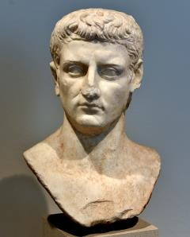
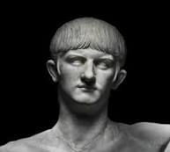
Paul Was Acquitted At His First Trial
“It is, therefore, recorded that Paul was beheaded in Rome itself, and that Peter likewise was crucified under Nero. This account of Peter and Paul is substantiated by the fact that their names are preserved in the cemeteries of that place even to the present day.” Eusebius 325 AD
Tiberius and Caligula
14 AD – 41 AD
Claudius
AD 41–54
Nero takes power AD 54 - at age 16
At my first defense, no one came to my support, but everyone deserted me. May it not be held against them. ¹⁷ But the Lord stood at my side and gave me strength, so that through me the message might be fully proclaimed and all the Gentiles might hear it. And I was delivered from the lion's mouth. ¹⁸ The Lord will rescue me from every evil attack and will bring me safely to His heavenly kingdom. To Him be glory for ever and ever. Amen. 2 Timothy 4:16-18 (NIV)

Slide 15
PROFOUND PROMISES FROM PHILIPPIANS
PROMISE ONE
Being confident of this very thing, that He (FATHER) which hath begun a good work in you will perform (FULFILL FURTHER - carry forward to completion) it until the day of Jesus Christ: Philippians 1:6 (KJV)
PROMISE TWO
For I know that this shall turn to my salvation through your prayers, and the supply of the Spirit of Jesus Christ, According to my earnest expectation and my hope, Philippians 1:19-20 (KJV)
PROMISE THREE
For it is God which works in you both to will and to do of His good pleasure. Philippians 2:13 (KJV)

Slide 16
In This Radical Vertical God
Changes Four Major Areas of our Life
God has to put us through a lot of challenges to get to our CORE motives and attitudes exposed and refined. This season of refinement is very dangerous to our souls – because we can give up.
It is right for me to feel this way about all of you, since I have you in my heart; for whether I am in chains or defending and confirming the gospel, all of you share in God's grace with me. ⁸ God can testify how I long for all of you with the affection of Christ Jesus. Philippians 1:7-8 (NIV)
Our motives
Our choices
Our attitudes
Our affections

Slide 17
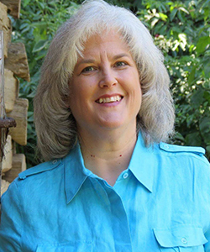
THE POSTURE OF PAUL WAS TO STAND
IN HOPE NOT TO COWER IN FEAR
”I will know that you stand firm in one spirit, contending as one man for the faith of the gospel ²⁸ without being frightened in any way by those who oppose you. This is a sign to them that they will be destroyed, but that you will be saved--and that by God. Philippians 1:27b-28 (NIV)
“I hear a resounding call echoing from the throne room of God to the heart of His true warriors, “Shake off distractions and disappointments. Set your face like a flint toward Me. Do not be moved (away from faith) by what you see happening around you! It’s temporary. There is a turning in the works. I have told you ahead of time, and now is the time! I have called you for this moment. Believe My promises. Remember My Word! DO NOT DOUBT IT, and do not fear.”
Gina Ghoslton

Slide 18
What Does It Mean To Conduct Yourselves Worthy?
Whatever happens, conduct yourselves in a manner worthy of the gospel of Christ. Philippians 1:27(NIV)
No woman is judged by any one particular moment in her life. She earns her reputation not by her best or worst day but rather because of the sum of all of her days. God will give you another and another and another chance, that said all the news isn't good news. Struggling and especially messing up isn't easy though, you may repent and say you're sorry and confess you didn't mean it and admit that you goofed up. But you can't guarantee that everyone will always forgive you. Some people will never stop remembering every mistake that you made. You could get mad tell them to be a better person but remember you did it. Sometimes a woman just has to live with that. However, God is not here to just embarrass us He is here to give us a life of victory and a life of deliverance and we are blessed to enter into this healing process through the Gospel. Dr. Alyn E. Waller / Don Lamb

Slide 19
Standing In Faith For The Supply of The Spirit
“Heavenly Father, I declare that I have repented of my sins and received true pardon from the grace lavished on me at the Cross of Your Son Jesus Christ. In His finished work, I ALREADY have Your favor today. I declare that I am, by Your Holy Spirit an Ester – a Deborah – a Princess of Your Kingdom to bring life – light and hope to my home – church and community. I know You are fighting my battles and FINISHING YOUR GOOD WORK IN ME as I stand in faith.”
“I declare that all my days were ordained for me before I was born. That my mission is to do the works you have prepared for me to accomplish. Your success is upon my RELATIONSHIPS, my labors and I expect to succeed in my vertical mission of FAITH and horizontal relationships of LOVE.”
“Father, I thank You for causing me to make good decisions with a clear mind and changed heart. Thank You that You work in me what is well pleasing in Your sight so that I can do all things through Christ who strengthens me.”

Slide 20
FAITH DECLARATION FROM PHILIPPIANS
“I declare victory and transformation over my emotions.”
“I declare victory and transformation over my marriage (household).”
“I declare victory and transformation over my children.”
“I declare victory and transformation over my church, community, and nation.”
“NOW HELP ME PARTNER WITH YOU AS YOU COMPLETE THE GOOD WORK YOU HAVE BEGUN – I SURRENDER TO YOUR HOLY SPIRIT to be transformed, filled, and given the opportunity to shine Your love and truth into the world.”

