Slide 1
Chapter Three – Verses 1 -11
THAT I MAY KNOW CHRIST
LifeGate Sermon
March 3, 2024

Slide 2
GOD KEEPS BREAKING INTO
OUR CRAZY WORLD

Slide 3
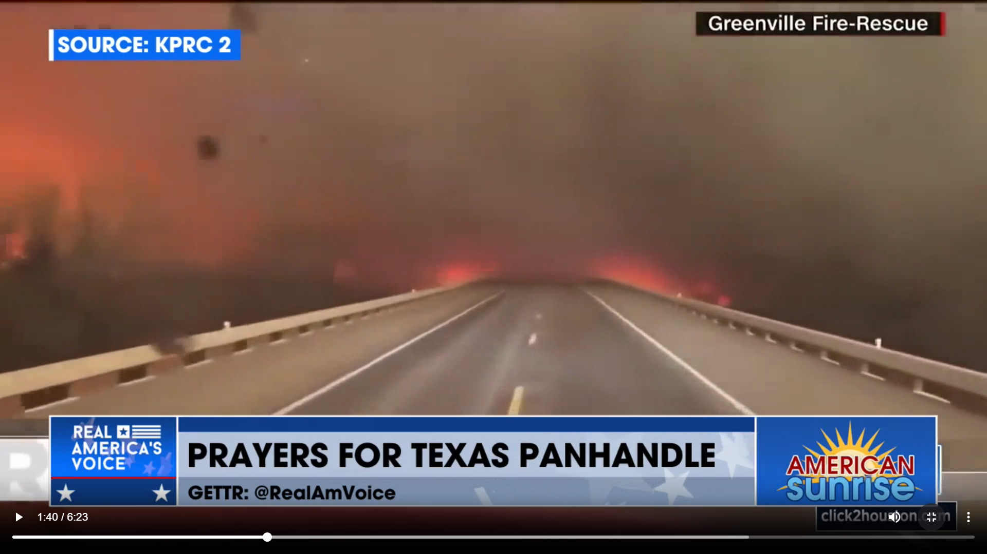
Brian Gibson
There was a warning grace on them – “WE NEED TO PRAY NOW – not fully knowing what was about to happen.”
The Church in AMERICA needs to pray for RAIN to help put out the fires of hell – that urgency is upon us.

Slide 4
This is a season of stretching and wilderness for many as He is preparing for some major moves of glory and waves of outpouring. How humbling that He picked us to be alive for such a time as this. The challenge for us all is yesterdays grace is not enough to get us over todays battles and stretching. He's asking for more of us. He's asking us to make room. And when we do - we can't even fathom the plans He has and the way He will lead us. The hour is upon us to lean in and buckle up like never before - to spend more time in our prayer closets - to purify and cleanse - and to be the Body He's called us to be.
Joe Christine

Slide 5
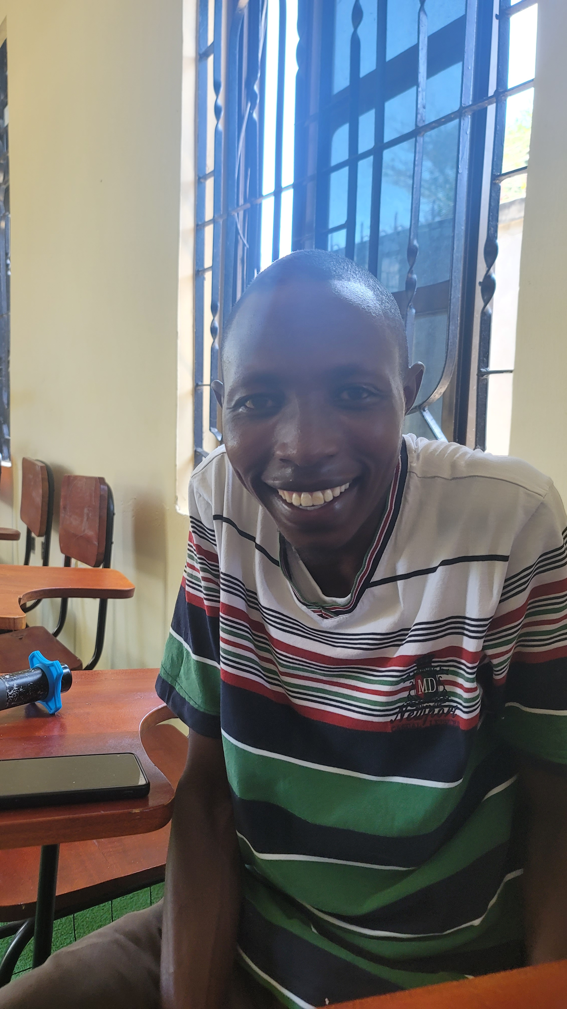
Robert Chetkwony
The Bold Passion Of God’s
Humble Leaders

Slide 6
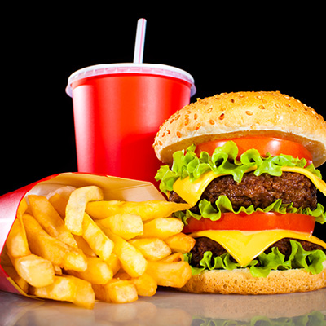
LifeGate Is A Teaching Kitchen
A Chef Training Center – Where You Get To
Eat while You train to cook for yourself
Take heed therefore unto yourselves, and to all the flock, over which the Holy Ghost has made you overseers, to feed the church of God, which he has purchased with His own blood. Acts 20:28 (KJV)
Feed the flock of God which is among you,
1 Peter 5:2 (KJV)

Slide 7
Finally, my brothers, rejoice (ten times in Phil.) in the Lord! It is no trouble for me to write the same things to you again, and it is a safeguard for you. (joy – 6 times)
Philippians 3:1
YOU MAY BE IN CIRCUMSTANCES THAT PROVOKE YOU TO COMPLAIN AND GRUMBLE – BUT REALLY YOU ARE BLESSED – YOU ARE VERY SPECIAL AND YOU ARE FAVORED – FOCUS ON THE BLESSINGS

Slide 8
Watch out for those dogs, those men who do evil, those mutilators of the flesh. Philippians 3:2
PAUL SAYS – “I ONCE WAS A MYOPIC LAW-ORIENTED AGENT OF THE SPIRIT OF RELIGION FOCUSED SO NARROWLY ON THE LAW – I MISSED THE CREATOR REDEEMER.”
Circumcision was once a faith action that was part of the Old Covenant - it has spiritual significance – but not saving merit.
“YOU’RE NOT SPIRITUAL ENOUGH IN THE FINISHED WORK OF CHRIST – YOU NEED TO DO THIS (THING) TO BECOME COMPLETE AND HOLY.”
THERE ARE ALWAYS THESE UNUSUAL LEADERS WHO MYOPICALLY WITH TUNNEL VISION FOCUS ON A MINUTE TRUTH THAT DISTORTS REALITY AND THEY SPIT OUT THE GNAT AND
THERE IS SOMETHING IN THE SPIRIT OF A PERSON WHO IS LEGALISTIC – LAW-ORIENTED – THEY MAKE “DOING SOMETHING” SPIRITUAL
NOTHING CAN ADD TO YOUR SALVATION THROUGH FAITH IN CHRIST

Slide 9
THE CHALLENGE WITH LEGALISM IS WHERE DO YOU STOP – SOMEONE CAME UP WITH THE FIRST DECEPTION – SO YOU KEEP USING DECEPTION TO COVER OVER THE FIRST DECEPTION
For it is we who are the circumcision, we who worship by the Spirit of God, who glory (boast) in Christ Jesus, and who put no confidence in the flesh (Philippians 3:3)
Do not be carried away by all kinds of strange teachings. It is good for our hearts to be strengthened by grace, not by ceremonial foods, which are of no value to those who eat them. ¹⁰ We have an altar from which those who minister at the tabernacle have no right to eat. Hebrews 13:9-10
TO THE DEGREE THAT YOU FOLLOW LEGALISM AND STRANGE TEACHINGS WILL BE THE DEGREE THAT YOU CUT OFF THE GLORY OF THE GOSPEL AND THE HOLY SPIRIT IN YOUR LIFE
THEREFORE, WE DO NOT GLORY IN OUR THEOLOGY – IN OUR VERSION OF THE BIBLE – IN OUR HERITAGE – IN OUR STREAM OF CHRISTIAN EMPHASIS - WE GLORY IN CHRIST JESUS.

Slide 10
OK – IF YOU WANT TO GO DOWN THE RABBIT HOLE OF LEGALISTIC PEDIGREE – AND QUALIFICATIONS - BUDDY – HOW ABOUT THIS
Though I myself have reasons for such confidence. If anyone else thinks he has reasons to put confidence in the flesh, I have more: 5 circumcised on the eighth day, of the people of Israel, of the tribe of Benjamin, a Hebrew of Hebrews; in regard to the law, a Pharisee; 6 as for zeal, persecuting the church; as for legalistic righteousness, faultless. (Philippians 3:4-6)
PAUL DID ACKNOWLEDGE THE ADVANTAGES OF THE PROMISES – THE COVENANT AND THE PATRIARCHS – HE USED THE PHRASE – JEWS FIRST –
HOWEVER – GOD JUST FULFILLED SCRIPTURE IN CHRIST AND THESE ADVANTAGES WERE NOW SUPERSEDED BY SALVATION THROUGH FAITH IN CHRIST – THE MOSAIC LAW WAS NOW OUTDATED AND FULFILLED BY CHRIST DYING ON THE CROSS AND TAKING AWAY OUR SINS FROM FAILING TO OBEY THE LAW.

Slide 11
But whatever former things I had that might have been gains to me, I have come to consider as [one combined] loss (detriment) for Christ's sake. Philippians 3:7 (AMP)
The very credentials these people are waving around as something special, I'm tearing up and throwing out in the trash—along with everything else I used to take credit for. And why? Because of (knowing) Christ. Philippians 3:7 (MSG)
THINK OF EVERYTHING YOU ACCOMPLISHED IN LIFE THAT WAS OF ANY VALUE – BEFORE YOU CAME TO KNOW CHRIST AS YOUR GLORIOUS REDEEMER – WHAT DOES IT MATTER OR MEAN – YES GOD CAN USE YOUR TESTIMONY – BUT COMPARED TO FINDING JESUS THE PEARL OF GREAT PRICE – IT IS MEANINGLESS AND WORTHLESS
Jesus Christ is the sum and substance. I have thrown away all things—I have made a voluntary choice of lifting up Christ, His cross, His poverty, and His reproach; and for these I have freely sacrificed - Adam Clarke

Slide 12
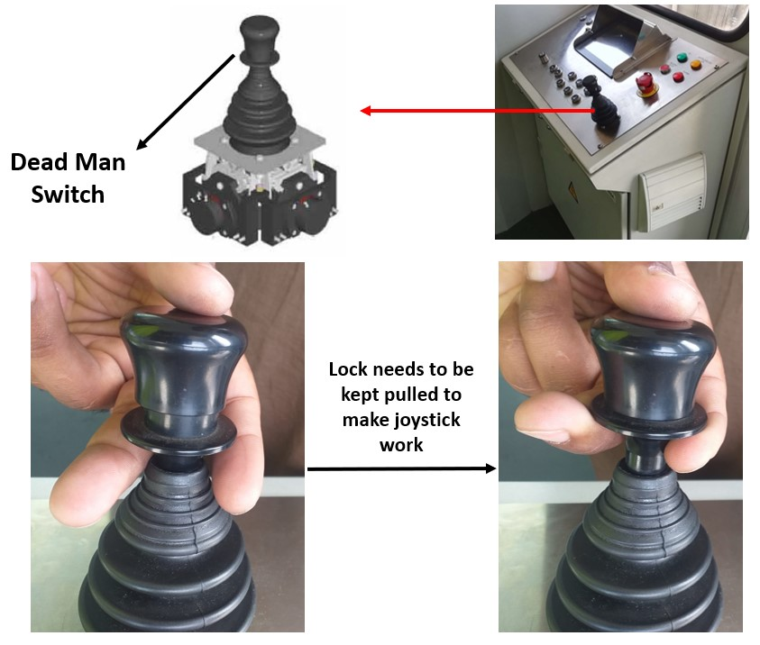
TO KNOW HIM – CHRIST
Gnosis
And to know the love of Christ, which passes knowledge, Ephesians 3:19 (KJV)
Jet Bridge Training Manual
⁸ Yes, furthermore, I count everything as loss compared to the possession of the priceless privilege (the overwhelming preciousness, the surpassing worth, and supreme advantage) of knowing Christ Jesus my Lord and of progressively becoming more deeply and intimately acquainted with Him [of perceiving and recognizing and understanding Him more fully and clearly]. For His sake I have lost everything and consider it all to be mere rubbish (refuse, dregs), in order that I may win (gain) Christ (the Anointed One), Philippians 3:8 (AMP)

Slide 13
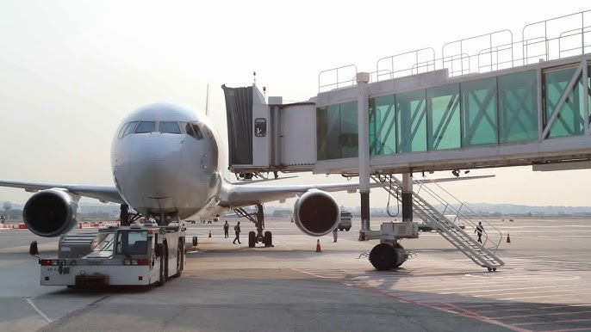
TO KNOW HIM – CHRIST
Ginoskoe
And knew her not till she had brought forth her firstborn son: and he called His name JESUS. Matthew 1:25 (KJV)
That I may know Him [that I may progressively become more deeply and intimately acquainted with Him, perceiving and recognizing and understanding the wonders of His Person more strongly and more clearly], and that I may in that same way come to know the power outflowing from His resurrection [which it exerts over believers], and that I may so share His sufferings as to be continually transformed [in spirit into His likeness even] to His death, [in the hope] Philippians 3:10 (AMP)

Slide 14
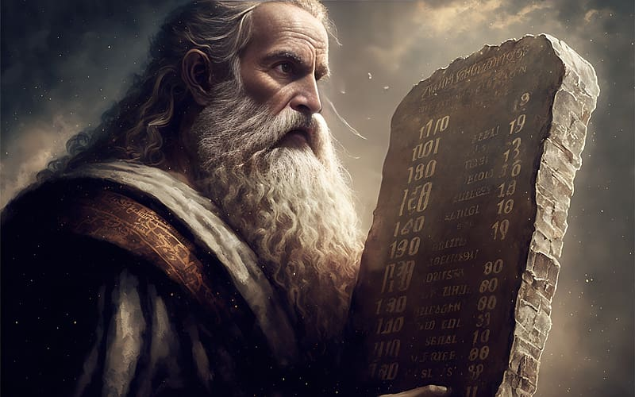
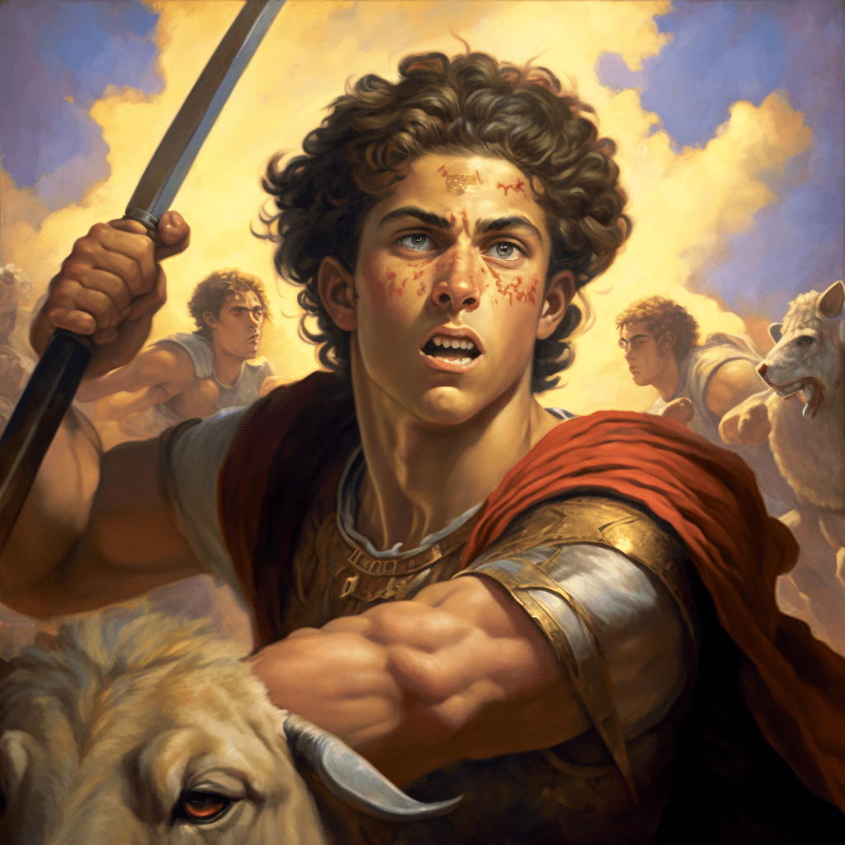
Old Testament Equivalent Cry To Know Him
Then Moses said, "Now show me your glory." Exodus 33:18 (NIV)
Show me your ways, O LORD, teach me your paths; ⁵ guide me in your truth and teach me, for you are God my Savior, and my hope is in you all day long. Psalm 25:4-5 (NIV)

Slide 15
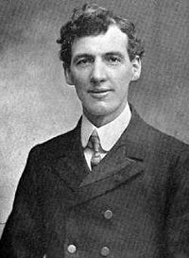
EVAN ROBERTS WANTED TO KNOW GOD
HE HAD BEEN PRAYING TEN YEARS FOR A HEAVENLY INVASION OF GOD – NOT KNOWING FULLY WHAT THAT MEANT
Oh! it seemed such a failure such a failure and I prayed and prayed, but nothing seemed to give me any relief. But one night, after I had been in great distress praying about this, I went to sleep, and at one o'clock in the morning suddenly I was awakened up out of my sleep, and I found myself with unspeakable joy and awe in the very presence of the Almighty God. And for the space of four hours I was privileged to speak face to face with Him as a man speaks face to face with a friend. At five o'clock it seemed to me as if I again returned to earth.”
Evan Roberts
"On Christmas Day 1904 practically the whole of Wales was on its knees. Probably every chapel in the principality was open, and was filled.

Slide 16
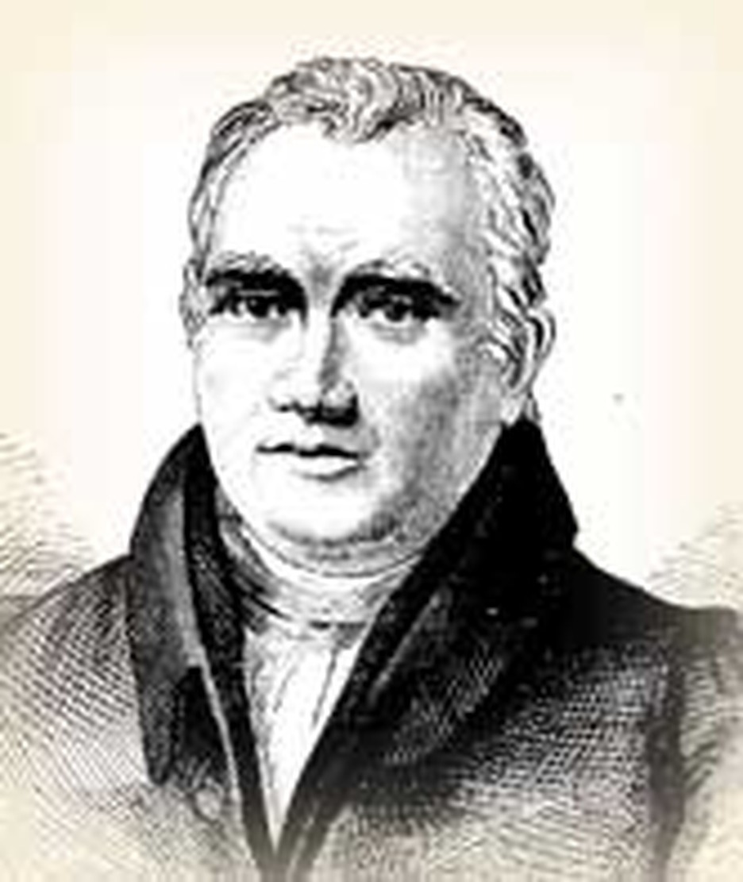
Somehow Attaining The Resurrection
Of The Dead (Philippians 3:11)
And so, somehow, to attain to the resurrection from the dead. Philippians 3:11 (NIV)
Earliest English translation – Wycliffe – 1395
“If in some manner I may come to the resurrection that is from death.”
Adam Clarke
Yes we can only “attain” to the resurrection through the MERITS and PROVISION of Jesus Christ and the righteousness that is by faith.
αναστασις (anah’stasis) signifies the resurrection in general, both of the just and unjust.
εξαναστασις (ex- anah’-stasis) may signify that of the blessed only (Possibly perhaps peculiarly glorious in the case of martyrs.

Slide 17
FAITH DECLARATION FROM PHILIPPIANS
Lord we want to go beyond the first light of revelation through basic Word knowledge of You and Your Kingdom. We want to know You with deep intimacy and connection from our hearts to Your heart – from our spirit to Your Spirit.
Lord we lay down any strange teachings or legalism that would want us to go beyond the Scriptures and worshipping you in Spirit and truth – somehow deceiving us that we are not spiritual enough through the FINISHED work of Christ– inferring that we have to add something to His work. WE CONFESS THAT WE ARE COMPLETE IN CHRIST and will follow Him with all of our hearts.
Lord we purpose to push aside the distractions and temptations of this wicked generation and COUNT ALL THINGS LOSS COMPARED TO KNOWING YOU. Thank You for the CROSS that purchased our salvation and the cutting off of our flesh so we can live in freedom and holiness by Your motivating GRACE and through the Power of the Holy Spirit.

Slide 18
APPLICATION
1. Be joyful and thankful in the storm – don’t complain and grumble – God is with you and will bring you through – (REMEMBER JESUS IS IN THE CAR WITH YOU)
2. Don’t let anyone deceive you about having to add anything to the GRACE of God for you to be complete – YOU ARE ALREADY COMPLETE IN CHRIST – LEVERAGE THIS FULLNESS.
3. Be completely – totally – HEAD OVER HEALS IN LOVE WITH JESUS – thirst for KNOWING HIM – not just the battle you face – not the mountain of influence you are contending for – COUNT EVERYTHING LOSS – EXCEPT KNOWING HIM.

