Slide 1
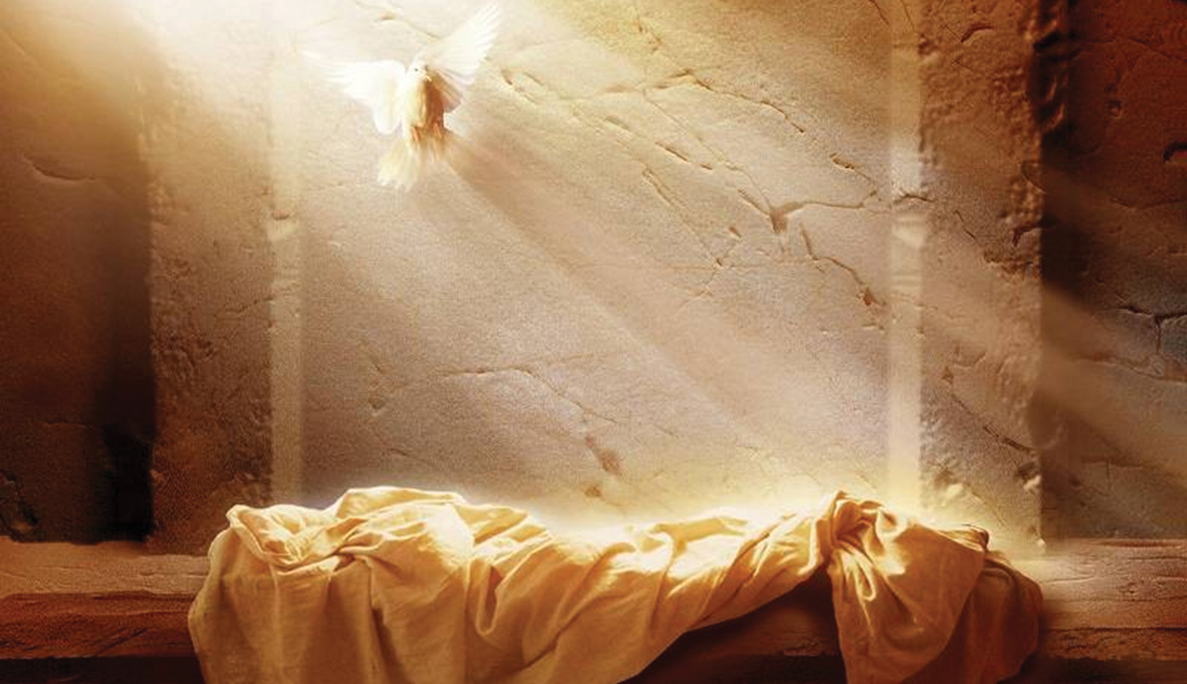
Easter 2024
LifeGate Sermon
March 31, 2024

Slide 2
But thanks be to God! He gives us the victory through our Lord Jesus Christ.
1 Corinthians 15:57 (NIV)

Slide 3
Because Christ Is The Victor
It Puts Me In A Position To Stand In The Gap
For My Family, My Church, And My Nation
Moreover, as for me, God forbid that I should sin against the LORD in ceasing to pray for you: but I will teach you the good and the right way: But be sure to fear the LORD and serve Him faithfully with all your heart; consider what great things He has done for you. 1 Samuel 12:23-24 (KJV/ NIV)

Slide 4
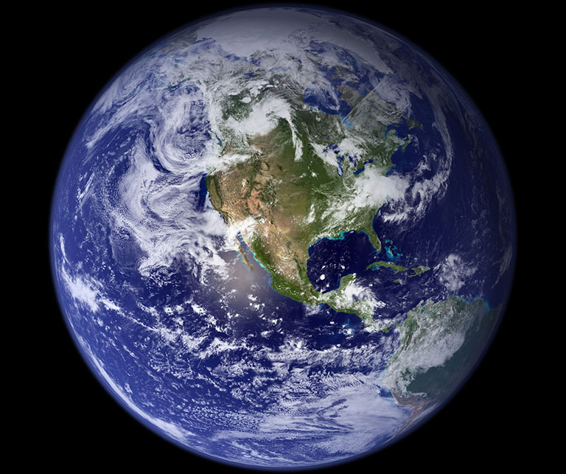
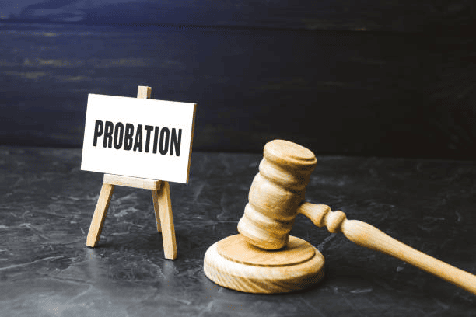
Our Life Is A Precious Gift That We Screwed Up
That’s Why We need Intervention From Heaven
FREE WILL
IS DANGEROUS
AND MUST
BE TESTED
BEFORE GOD
BRINGS US
HOME
If only for this life we have hope in Christ, we are to be pitied more than all men. 20 But Christ has indeed been raised from the dead, the first-fruits of those who have fallen asleep. 1 Corinthians 15:19-20

Slide 5
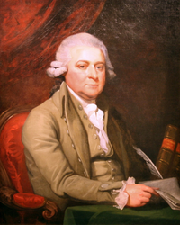
Even John Adams Couldn’t wrap His Head Around The Gospel
Adams's beliefs synthesized Puritan, deist, and humanist concepts. (Unitarian)
John Adams, the esteemed founding father, and second president was not an evangelical Christian. In a letter, he writes to Jefferson, criticizing the Europeans who were “infected with confessions of faith. They all believe that the Great (Creator) which has produced this boundless universe….came down to this little ball, to be spit upon by Jews and Gentiles. And until this awful blasphemy is got rid of, there never will be any liberal science in the world.” In other words, he considered it great blasphemy to believe that God could come to earth as the Son of Man, to be crucified, spit upon, and to pay the price for our sins. (Vaughn Martin)

Slide 6
THE “LORD HAS A WORK
TO DO IN BABYLON (Earth)”
“I set a trap for you, O Babylon, and you were caught before you knew it; you were found and captured because you opposed (strive, contend) the LORD. The LORD has opened His arsenal (storehouse) and brought out the weapons (prepared vessels) of His indignation, for the Sovereign LORD Almighty has work to do in the land of the Babylonians.” Jeremiah 50:24-25 (NIV)
The LORD shall open unto you His good treasure (storehouse) the heaven to give the rain unto your land in His season, and to bless all the work of your hand: Deuteronomy 28:12 (KJV)

Slide 7
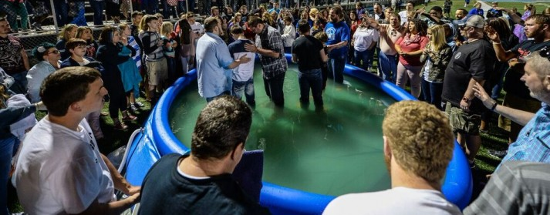
So How Does God Set A Trap For Lost Souls?
He makes freewill dangerous without His leadership
He makes sin destructive because it cuts off righteous perspectives and protections
He makes every other love “a mere shadow” compared to His.
“Prayer, plus desperation, have paved the way for this spiritual breakthrough, especially among the young people. “It’s a climatic time,” he said. “I think the many years of creating a spiritual vacuum inside of kids by not teaching them the true reality that there’s a (Creator and a) destiny in God — has produced a vacuum on the inside of these kids. I think when they hear a message of hope it really speaks to them because they’re kind of hanging in a spiritual limbo,” he added. “And they press into it quickly because they know that’s the truth.” Mitch Bias Church of God in Delbarton, WV 2016

Slide 8
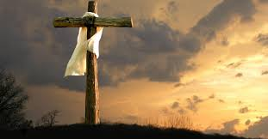
Jesus Is The Arsenal of Heaven
When you were dead in your sins and in the uncircumcision of your sinful nature, God made you alive with Christ. He forgave us all our sins, having canceled the written code, with its regulations, that was against us and that stood opposed to us; He took it away, nailing it to the cross. And having disarmed the powers and authorities, He made a public spectacle of them, triumphing over them by the cross.
Colossians 2:13-15 (NIV)

Slide 9
Scripture Works In Total Continuity
Yet, Sometimes The Unspoken or Inferred Part
Of The Word is A Very Powerful Part of The Text
Story of the Ten Lepers
(In Me)
Then He said to him, "Rise and go; your faith
has made you well." Luke 17:19 (NIV)
By faith in the name of Jesus, this man whom you see and know was made strong. It is Jesus' name and the faith that comes through Him that has given this complete healing to him, as you can all see. Acts 3:16 (NIV)

Slide 10
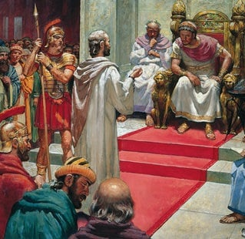
Paul Says Something Very Interesting In A Discourse
With King Agrippa and Governor Festus
(Grace and peace) from Jesus Christ, who is the faithful witness, the firstborn from the dead, and the Ruler of the kings of the earth. To Him who loves us and has freed us from our sins by His blood, Revelation 1:5 (NIV)
Adam
Abraham
Job
Joseph
Moses
David
Elijah
Daniel
But I have had God's help to this very day, and so I stand here and testify to small and great alike. I am saying nothing beyond what the prophets and Moses said would happen ²³ that the Christ would suffer and, as the first to rise from the dead would proclaim light to His own people and to the Gentiles."
Acts 26:22-23 (NIV)
(As a sinless man)

Slide 11
Jesus Is The First Fruits
The Church Is The Crop of Mercy
The Rebellious will raise to Judgement
But each in his own turn: 1/ Christ, the first-fruits; then, when He comes, 2/ those who belong to Him. ²⁴ Then the end will come, 3/ when He hands over the kingdom to God the Father after he has destroyed all dominion, authority and power. ²⁵ For he must reign until he has put all his enemies under his feet. ²⁶ The last enemy to be destroyed is death. 1 Corinthians 15:23-26 (NIV)

Slide 12
Everyone Is Going To Rise Again
To Face The Consequences Of
Their Response To Jesus
“I tell you the truth, a time is coming and has now come when the dead will hear the voice of the Son of God and those who hear will live (resurrect). Do not be amazed at this, for a time is coming when all who are in their graves will hear His voice 29 and come out--those who have done good will rise to live (eternal life with God), and those who have done evil will rise to be condemned.” John 5:25, 28-29

Slide 13
The Glory And Power OF Jesus Taking the Keys From Satan
Therefore it is said, When He ascended on high, He led captivity captive [He led a train of vanquished foes] and He bestowed gifts on men. Ephesians 4:7-8 (AMP)

Slide 14
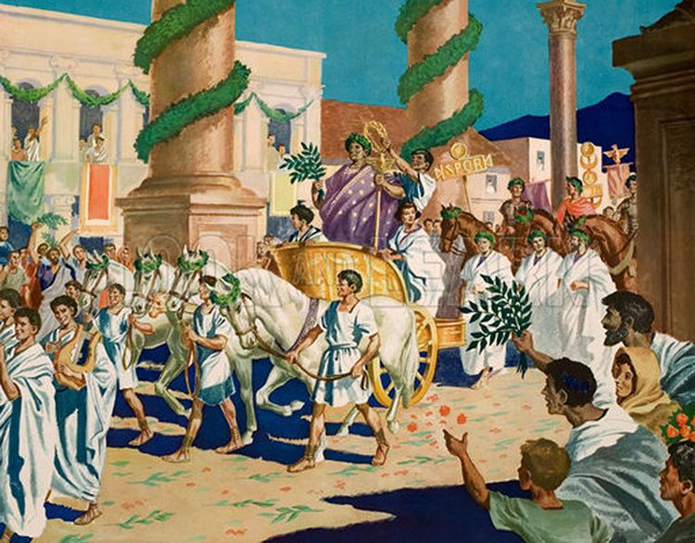
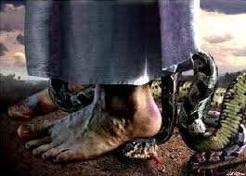
Taking Captivity Captive
We are His Captives – His Love Slaves
Walking In Resurrection FREEDOM and LIFE
Jesus breaks the power of the enemy and of sin and death and conquers it with total

Slide 15
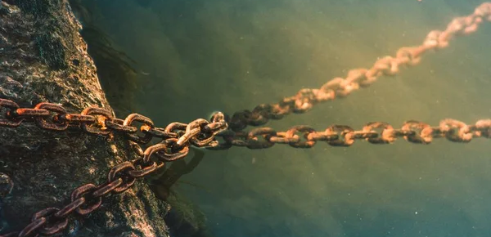
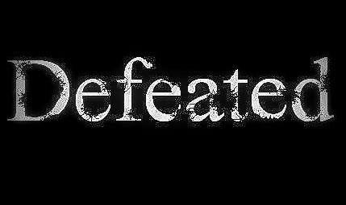
Taking Captivity Captive
Pulling Off from the Souls on Earth The Permanent Power and curse of sin, Satan’s dominion, death, sickness, addiction, orphaned living, and Lies.
Column
Curse
I will give you the keys of the kingdom of heaven; whatever you bind on earth will be bound in heaven, and whatever you loose on earth will be loosed in heaven." Matthew 16:19 (NIV)
I am the Living One; I was dead, and behold I am alive for ever and ever! And I hold the keys of death and Hades. Revelation 1:18 (NIV)

Slide 16
We Decree The Victory Of Jesus Over Our Lives – Our Families – Our Churches and Our Nation
If you return to the Almighty, you will be restored: If you remove wickedness far from your tent ⁻ then the Almighty will be your gold, the choicest silver for you. ²⁶ Surely then you will find delight in the Almighty and will lift up your face to God. ²⁷ You will pray to him, and Hhe will hear you, and you will fulfill your vows. ²⁸ You shall decree a thing and it shall be ESTABLISHED, and light will shine on your ways. Job 22:23-28 (NIV/ KJV)

Slide 17
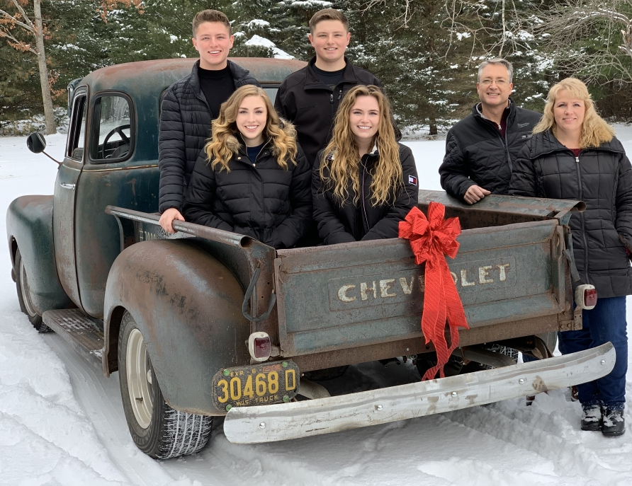
Bruce Van Natta
His Resurrection
Sweet Bread Ministries

Slide 18
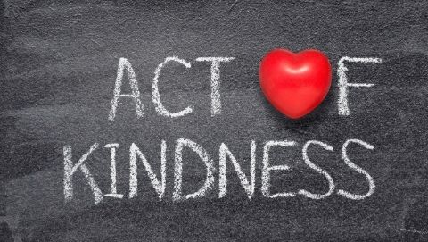
What is the nicest thing anyone has ever done for you?
No One Ever Did for You and Me What Jesus Did

Slide 19
Because Christ Is The Victor
It Puts Me In A Position To Stand In The Gap
For My Family, My Church, And My Nation
Moreover, as for me, God forbid that I should sin against the LORD in ceasing to pray for you: but I will teach you the good and the right way: But be sure to fear the LORD and serve Him faithfully with all your heart; consider what great things He has done for you. 1 Samuel 12:23-24 (KJV/ NIV)

Slide 20
APPLICATION
LET GOD’S KINDNESS LEAD YOU TO REPENTANCE
LEVERAGE THE VICTORY OF JESUS
NEVER CEASE PRAYING - STAND AND DECREE HIS RESURRECTION POWER OVER YOUR LIFE – YOUR FAMILY – YOUR CHURCH – YOUR NATION
TURN EVERY VEXATION INTO VICTORY
TURN EVERY BURDEN INTO BREAKTHROUGH
TURN EVERY SORROW INTO SUCCESS
TURN EVERY FAILURE INTO FRUITFULNESS

Slide 21
Prayer Of Faith
Lord Jesus,
I believe with all my heart in your Coming To Save me from myself
I believe with all my heart You died because of MY SINS
I believe with all my heart You took the keys of DEFEAT from Satan
I believe with all my heart You rose from the dead
I believe with all of my heart that You are seated at the Father’s right hand
I give you the drivers wheel of my life – take control
Forgive me of my sins and addictions and stubborn rebellion
Make my heart NEW
Cause me to join YOU WHERE YOU ARE WORKING
Help me to bring Your VICTORY into every situation
In the name of the Father, Son and Holy Spirit AMEN!!!!!

Slide 22
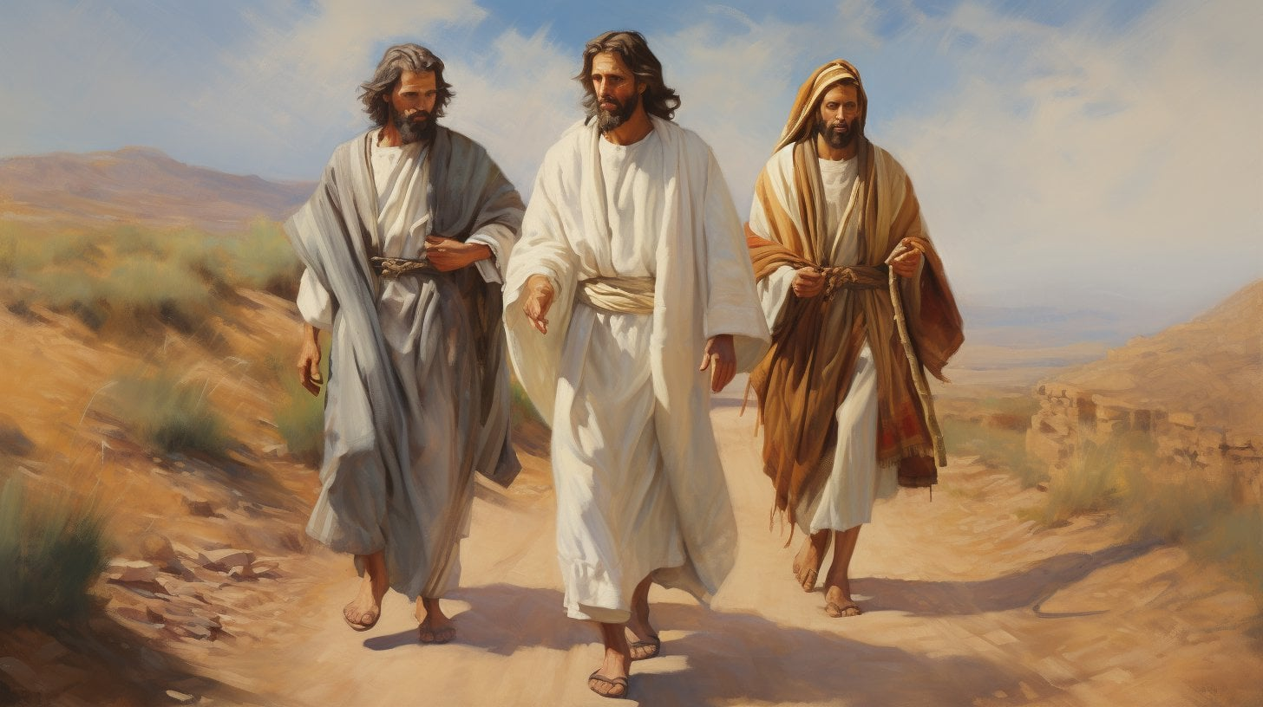
God Is Not Upset That We Get Disappointed at the Setbacks In Life
Now that same day two of them were going to a village called Emmaus

