Slide 1
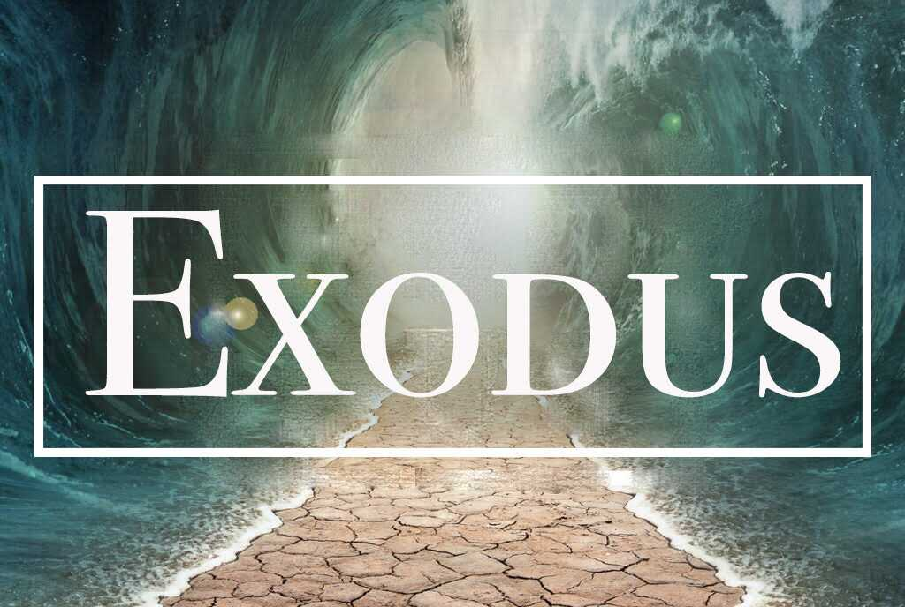
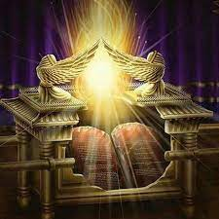
The Last Days Exodus And Ark Moment
LifeGate Sermon On David and Psalms 68
April 7, 2024

Slide 2
There is This Interesting Human
Trait in Each of Us
We feel is positive or we sense reward or benefit from
From whatever we fear or don’t want to be around.
What Does This Mean?
God has to find a way to motivate us to keep walking toward HIM – and even at times RUN after HIM for salvation to happen.
It means that many times – positive things like TRUST and CHARACTER take a long time to build in our lives and can be lost in a MOMENT – people run from us when we fail.

Slide 3
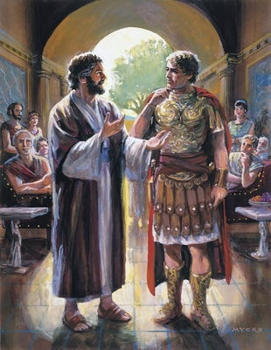
One of The Most Profound Shifts Ever
"As I began to speak, the Holy Spirit came on them as he had come on us at the beginning, -- who was I to think that I could oppose God?" ¹⁸ When they heard this, they had no further objections and praised God, saying, "So then, God has granted (brought forth – worked in) even the Gentiles repentance unto life." Acts 11:15-18
Whereof I am made a minister, according to the dispensation of God which is given (granted – brought forth) to me for you, to fulfil the Word of God; Colossians 1:25 (KJV)
Peter with Cornelius
The Lord is not slow in keeping his promise, - He is patient with you, not wanting anyone to perish, but everyone to come to repentance. 2 Peter 3:9 (NIV)
And I gave her space to repent of her (sins) fornication; and she repented not. Revelation 2:21 (KJV)

Slide 4
Make That Shift Personal
And you, estranged as you once were and even hostile in your minds, amidst your evil deeds, (BUT BY THE WORK JESUS HAS DONE)
He (Jesus) has now, in His human body, reconciled (you) to God (Father) by His death, to bring you, holy and faultless and irreproachable, into His presence; ²³ if, indeed, you are still firmly holding to faith as your foundation, without ever shifting from your hope that rests on the Good News that you have heard, Colossians 1:21-23 (WEY)

Slide 5
Minimally An Eclipse is a Marker In Time
What happened in the last seven years?
MONDAY -
August 21, 2017
April 8, 2024
346 Weeks
Total - 2422 Days
Massive exposing of hidden evil begins to emerge in the MEDIA and GOVERNMENT realm with Trump Derangement Syndrome - to exposing sin in the CHURCH and MEDICAL planned Pandemics, and stolen elections, and weak Church leaders who don’t see well prophetically.
Three major mountains of Influence MEDIA – GOVERNMENT - MEDICAL began to dominate and oppress the narrative of daily life for those who CARE and want to MAKE A DIFFERENCE. And the SHRIEKERS and the SCREAMERS – attack those who want to push back against the controlled narrative.
PROBLEMS TAKE THE OXYGEN OUT
OF THE PUBLIC DISCOURSE
AWAKENS
Out of grief and desperation seeks the face of God – engages in the culture – gets involved in the MESSY mountains of influence – CRIES OUT FOR REVIVAL.

Slide 6
EASTER APPLICATION
LET GOD’S KINDNESS LEAD YOU TO REPENTANCE
LEVERAGE THE VICTORY OF JESUS
NEVER CEASE PRAYING – STANDING, AND DECREEING, AND AGREEING WITH GOD RECEIVING HIS RESURRECTION POWER (Phil. 3:10) OVER YOUR LIFE – YOUR FAMILY – YOUR CHURCH – AND YOUR NATION
TURN EVERY VEXATION INTO VICTORY
TURN EVERY BURDEN INTO BREAKTHROUGH
TURN EVERY SORROW INTO SUCCESS
TURN EVERY FAILURE INTO FRUITFULNESS
TURN EVERY ANGUISH INTO ADORATION
TURN EVERY OUTRAGE INTO OUTPOURINGS

Slide 7
THE “LORD HAS A WORK
TO DO IN BABYLON (Earth)”
“I set a trap for you, O Babylon, and you were caught before you knew it; you were found and captured because you opposed (strive, contend) the LORD. The LORD has opened His arsenal (storehouse) and brought out the weapons (prepared vessels) of His indignation, for the Sovereign LORD Almighty has work to do in the land of the Babylonians.” Jeremiah 50:24-25 (NIV)

Slide 8
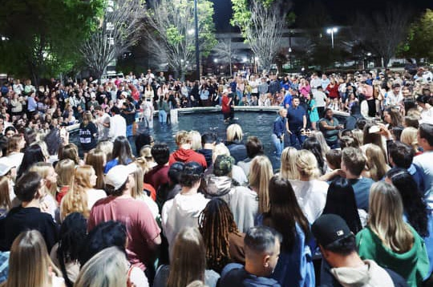
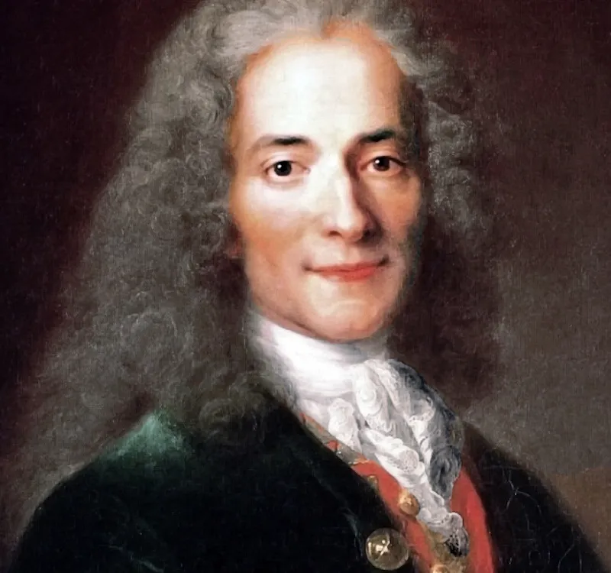
So How Does God Set A Trap For Lost Souls?
He makes freewill dangerous
He makes sin destructive
He makes every other love “a mere shadow” compared to His.
He allows the enemies of the Church to think that this is all the Church can operate in (Programized – nominal – presence-less very weak Christianity) – so they develop all their hate strategies from this perspective of weakness – prayerlessness – and ineffective Christian ministry.
“The Bible. That is what fools have written, what imbeciles commend, what rogues teach and young children are made to learn by heart” (Voltaire 1764)

Slide 9
WHAT DOES THIS LOOK LIKE?
When God’s People Awake – A Shift Takes Place
Before that time - No one could go about his business safely because of his enemy, for I had turned every man against his neighbor. 11 But now I will not deal with the remnant of this people as I did in the past," declares the LORD Almighty. 12 "The seed will grow well, the vine will yield its fruit, the ground will produce its increase, (produce) crops, and the heavens will drop their dew. I will give all these things as an inheritance to the remnant of this people. 13 As you have been an object of cursing among the nations, O Judah and Israel, so will I save you, and you will be a blessing. Do not be afraid, but let your hands be strong." Zechariah 8:10-13 (NIV)

Slide 10
King David Not Only Walked Towards
God – He Also Ran Toward God
It is very clear David encountered God deeper than a mere confession of faith – He had a Spirit-filled connectivity that drew Him to God more and more.
O God, You are my God, earnestly I seek You; my soul thirsts for You, my body longs for You, in a dry and weary land where there is no water. ² I have seen You in the sanctuary and beheld Your power (majesty, strength) and Your glory. ³ Because Your love is better than life, my lips will glorify You. Because You have been my help, therefore in the shadow of Your wings will I rejoice. ⁸ My soul follows hard after You: Your right hand upholds me. Psalm 63: 1-3; 7-8 (NIV/ KJV)

Slide 11
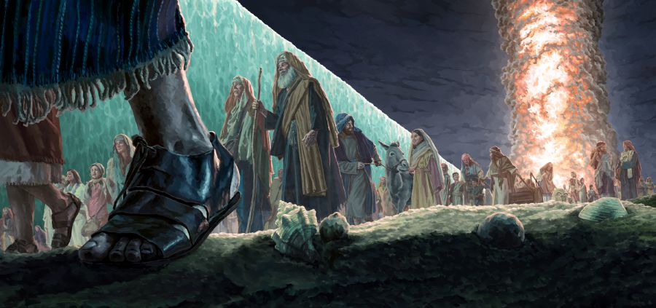
Because the LORD kept vigil that night to bring them out of Egypt, on this night all the Israelites are to keep vigil to honor the LORD for the generations to come. Exodus 12:42 (NIV)

Slide 12
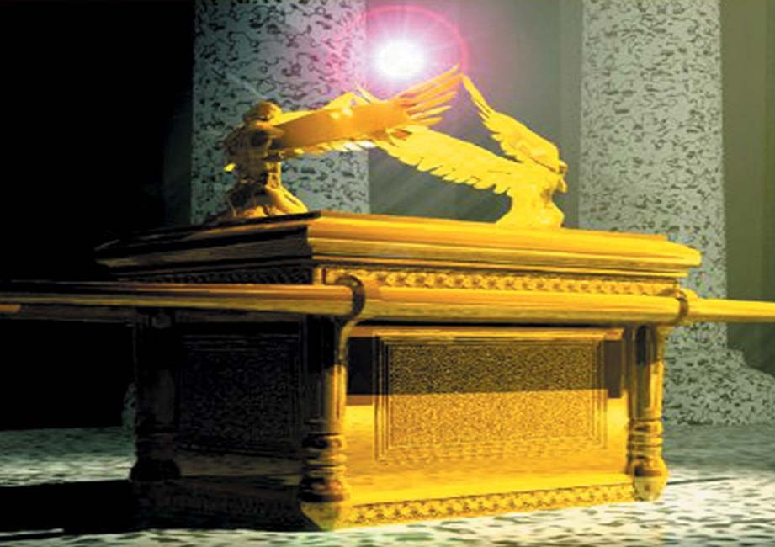
The Pillar of Fire By Night Cloud By Day
What Did The Ark Represent?
Shekinah Glory– Holy Spirit
Cherubim – ANGELS
John 20:12
Mercy Seat – Blood of
Jesus Sprinkled for the
Forgiveness of sin
Rod of Aaron that budded – God sovereignly Chose
Jesus to be our High Priest
Tablets of LAW – Word of God
Golden jar of Manna – Jesus being the
Bread of Heaven
Made of Pure Gold – Glory of the Father
There, above the cover between the two cherubim that are over the ark of the Testimony, I will meet with you and give you all my commands for the Israelites. Exodus 25:22 (NIV)

Slide 13
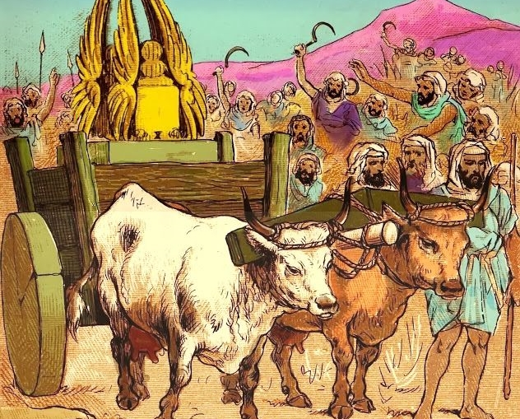
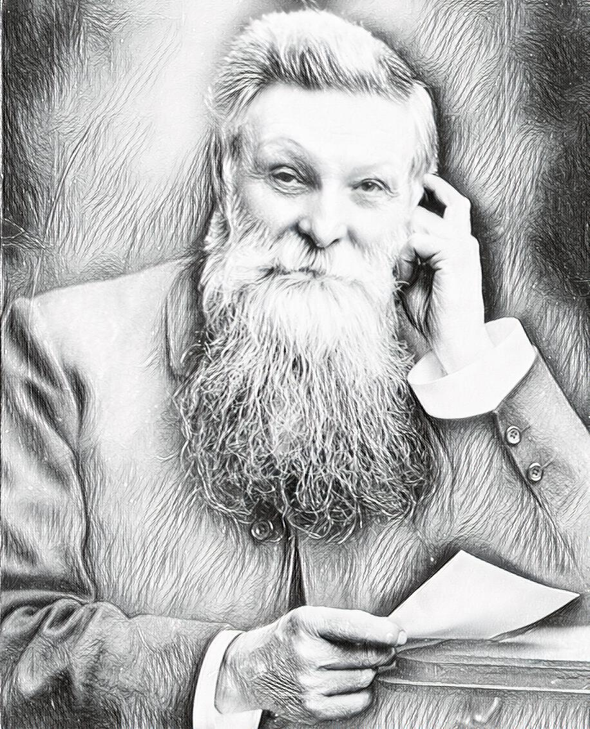
David Got It
He Wanted More of God’s Presence
When was the first inflatable rubber tire invented?
Scottish Inventor
John Dunlop 1888

Slide 14
The Context Of David
Bringing Up The Ark To Jerusalem
(SO MUCH TO LEARN FROM THIS)
David again brought together out of Israel chosen men, thirty thousand in all. He and all his men set out from Baalah (Masters) of Judah to bring up from there the ark of God, which is called by the Name, the name of the LORD Almighty, who is enthroned between the cherubim that are on the ark. They set the ark of God on a new cart and brought it from the house of Abinadab, which was on the hill. ----. ⁸ Then David was angry because the LORD's wrath had broken out against Uzzah, and to this day that place is called Perez Uzzah. ⁹ David was afraid of the LORD that day and said, "How can the ark of the LORD ever come to me?" ¹⁰ He was not willing to take the ark of the LORD to be with him in the City of David. Instead, he took it aside to the house of Obed-Edom the Gittite. their homes. 2 Samuel 6:1-10 (NIV)

Slide 15
The Context Of David
Bringing Up The Ark To Jerusalem
(SO MUCH TO LEARN FROM THIS)
The ark of the LORD remained in the house of Obed-Edom the Gittite for three months, and the LORD blessed him and his entire household. ¹² Now King David was told, "The LORD has blessed the household of Obed-Edom and everything he has, because of the ark of God." So David went down and brought up the ark of God from the house of Obed-Edom to the City of David with rejoicing. ¹³ When those who were carrying the ark of the LORD had taken six steps, he sacrificed a bull and a fattened calf. ¹⁴ David, wearing a linen ephod, danced before the LORD with all his might, ¹⁵ while he and the entire house of Israel brought up the ark of the LORD with shouts and the sound of trumpets. -- ¹⁷ They brought the ark of the LORD and set it in its place inside the tent that David had pitched for it, and David sacrificed burnt offerings and fellowship offerings before the LORD. ¹⁸ After he had finished sacrificing the burnt offerings and fellowship offerings, he blessed the people in the name of the LORD Almighty. ¹⁹ Then he gave a loaf of bread, a cake of dates and a cake of raisins to each person in the whole crowd of Israelites, both men and women. And all the people went to their homes. 2 Samuel 6:11-19 (NIV)

Slide 16
Most Likely David Wrote Psalm 68 For The
Bringing Up of the Ark Into Jerusalem
May God arise, may His enemies be scattered; may His foes flee before Him. Psalm 68:1 (NIV)
When You went out before Your people, O God, when You marched through the wasteland, Selah ⁸ the earth shook, the heavens poured down rain, before God, the One of Sinai, before God, the God of Israel. ⁹ You gave abundant showers, O God; you refreshed Your weary inheritance. Psalm 68:7-9 (NIV)
Praise be to the Lord, to God our Savior, who daily bears our burdens. Selah Psalm 68:19 (NIV) - Or as the Vulgate, Septuagint, "Blessed be the Lord daily, our God who makes our journey prosperous.”

Slide 17
David Wrote Psalm 68 For The
Bringing Up of the Ark Into Jerusalem
The chariots of God are tens of thousands and thousands of thousands; the Lord [has come] from Sinai into His sanctuary. ¹⁸ When you ascended on high, you led captives in your train; you received gifts from men, even from the rebellious-- that you, O LORD God, might dwell there. Psalm 68:17-18 (NIV)
²⁴ Your procession has come into view, O God, the procession of my God and King into the sanctuary. ²⁵ In front are the singers, after them the musicians; with them are the maidens playing tambourines. ²⁶ Praise God in the great congregation; praise the LORD in the assembly of Israel. Psalm 68:24-26 (NIV)
Summon your power, O God; show us your strength, O God, as you have done before. Psalm 68:28 (NIV)

Slide 18
Let’s Pull This All Together
Even so, when you see all these things, you know that it is near, right at the door. ³⁴ I tell you the truth, this generation will certainly not pass away until all these things have happened. Matthew 24:33-34 (NIV)
1- We are in the Last Days Exodus Moment ( A HUGE SHIFT) – God is bringing SOULS out of Egypt before the great and dreadful DAY OF THE LORD – Pray He works in you and your family and city REPENTANCE unto LIFE.
2 - God is using His Church – (Moses and Aaron) to be the vessels of obedience to lead people into the promised land – SALVATION IN CHRIST
3 - God is going to BACK UP HIS PEOPLE with His Presence and glory (HE IS STANDING VIGIL over this hour in history) – Pillar of Fire by night and cloud by day through the FINISHED WORK of Jesus and the deep work of the Holy Spirit.

Slide 19
What Bible Promise Tells Us We Are
Able To Tap Into The Lord’s Deliverance?
'And afterward, I will pour out my Spirit on all people. Your sons and daughters will prophesy, your old men will dream dreams, your young men will see visions. ²⁹ Even on my servants, both men and women, I will pour out my Spirit in those days. ³⁰ I will show wonders in the heavens and on the earth, blood and fire and billows of smoke. ³¹ The sun will be turned to darkness and the moon to blood before the coming of the great and dreadful day of the LORD. ³² And everyone who calls on the name of the LORD will be saved; for on Mount Zion and in Jerusalem there will be deliverance Joel 2:28-32 (NIV)

Slide 20
Lord We Are Desperate For You
⁸ Taste and see that the LORD is good; blessed is the man who takes refuge in Him. Psalm 34:8 (NIV)
NO – WEA RE NOT SEEKING AN EXPERIENCE – YES FAITH IS INVISIBLE – YET LIVING AND VIBRANT – ACTIVE FAITH INVITES A LIVING GOD TO CONTINUALLY REVEAL HIMSELF TO US AND BREAK THE DISCONNECT OF INTELLECTUALISM AND THIS FLESHLY LIFE THROUGH INTENSIFIED SPIRIT-FILLED CONNECTIVITY .
Therefore, rid yourselves of all malice and all deceit, hypocrisy, envy, and slander of every kind. ² Like newborn babies, crave pure spiritual milk, so that by it you may grow up in your salvation, ³ now that you have tasted that the Lord is good. 1 Peter 2:1-3 (NIV)

Slide 21
Pray That On Our Watch –
In Our Families and Churches – In Our Region We Would be a Bubble of Glory Against the Retrograde of Faith
At that time many will turn away from the faith and will betray and hate each other, ¹¹ and many false prophets will appear and deceive many people. ¹² Because of the increase of wickedness, the love of most will grow cold, ¹³ but he who stands firm to the end will be saved. ¹⁴ And this gospel of the kingdom will be preached in the whole world as a testimony to all nations, and then the end will come. Matthew 24:10-14

Slide 22
APPLICATION
The ARK of the Covenant is with you – It’s Jesus – It’s the Holy Spirit – It’s the Glory of Your Heavenly Father – (YOUR WHOLE HOUSEHOLD IS BLESSED) let Him motivate you to bring all into the Storehouse – So that He can throw open the floodgates of Heaven and bless your household. (Malachi 3:10)
Pray for the unfulfilled and unrealized promises of God to be RELEASED in this hour.
NEVER CEASE PUTTING YOUR FAITH IN ACTION AND PRAYING - STAND AND DECREEING HIS RESURRECTION POWER OVER YOUR LIFE – YOUR FAMILY – YOUR CHURCH – YOUR NATION

