Slide 1
Our Spiritual Diet Is Strategic
“Being Partakers Of Our Heavenly Inheritance”
LifeGate Sermon
April 21, 2024

Slide 2
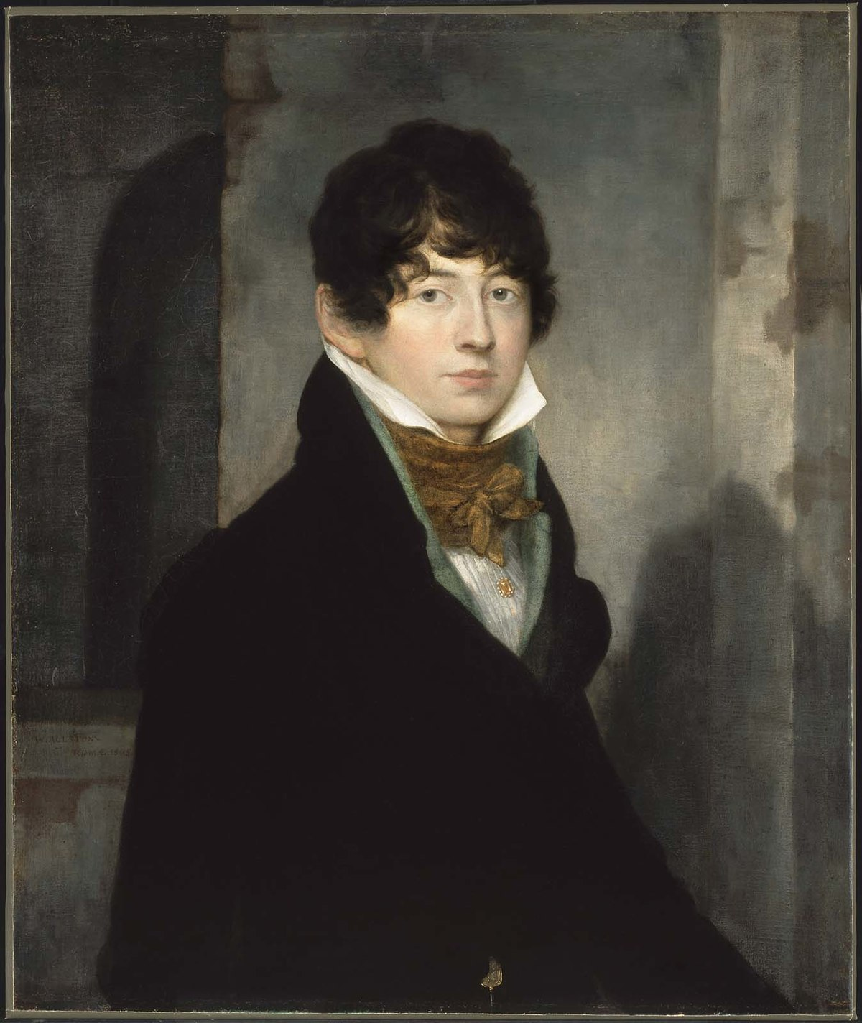
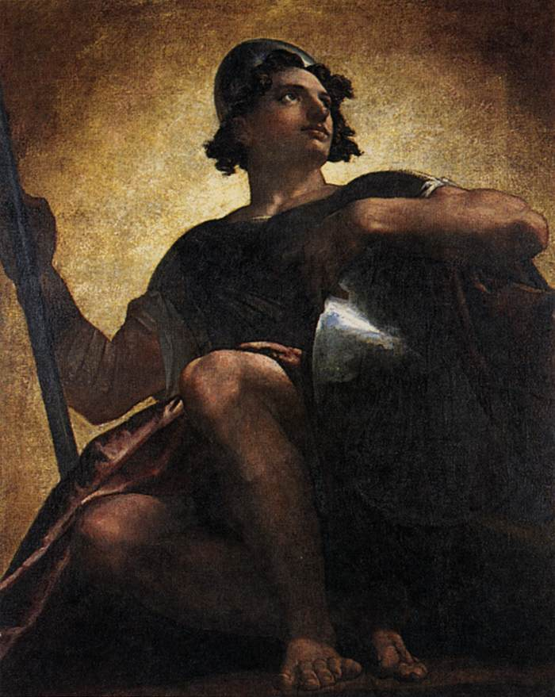
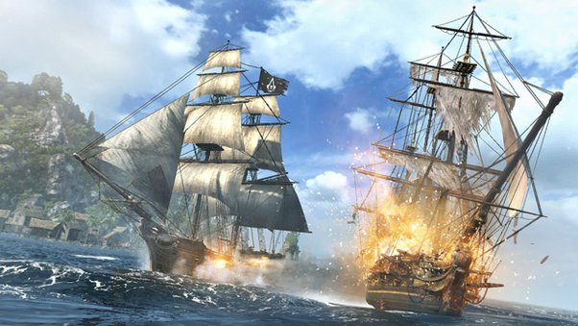
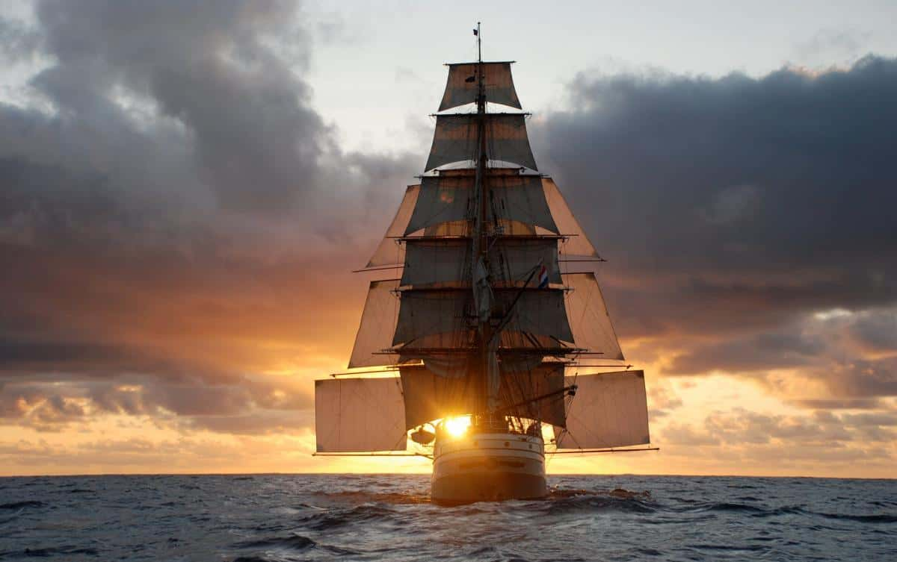
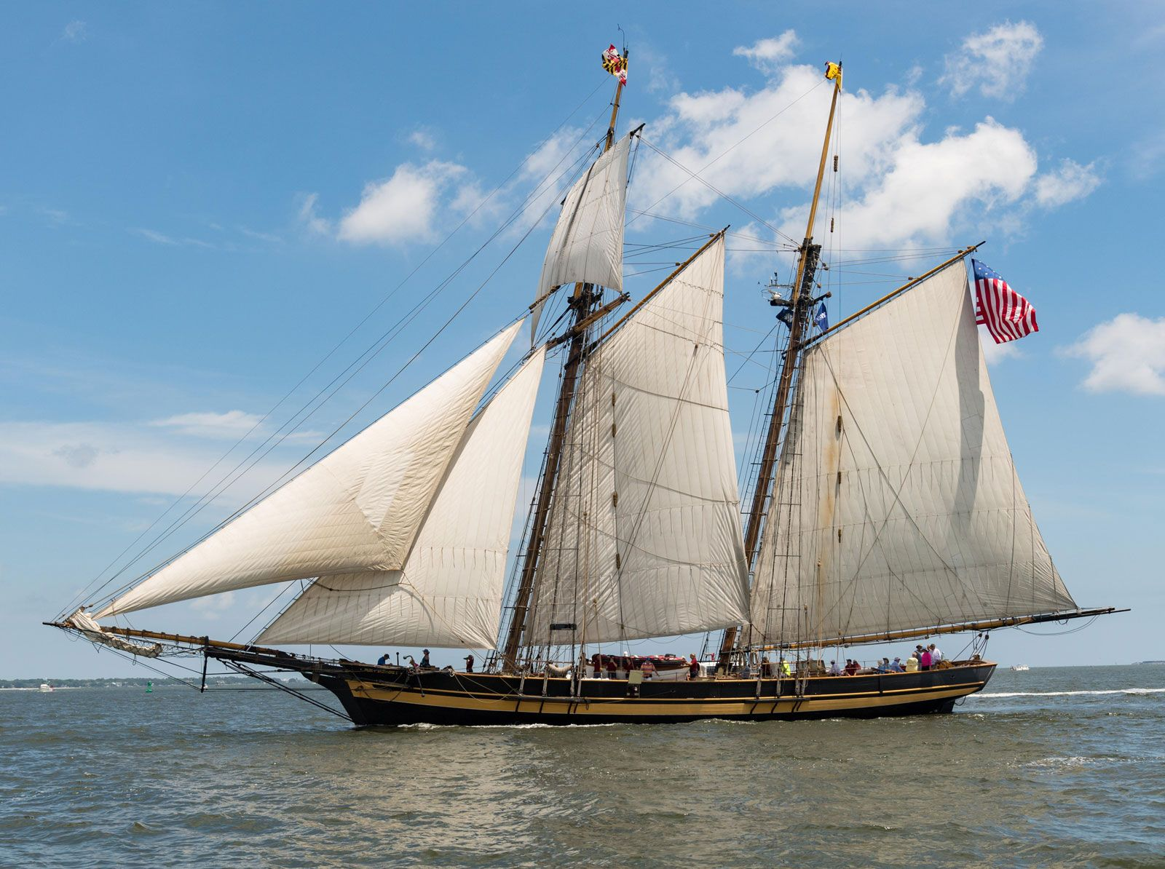
Powerful Answers To Prayer
On a Ship Britannia Going
To St. Thomas In 1814
Book in 1882 Called “Ebenezers –
Record of Prevailing Prayer”
Washington Allston English Artist
Painted Angel Uriel," which had won the prize at the exhibition of the Royal Academy.
Saved by Invisible Forces Fighting for The Moravians

Slide 3
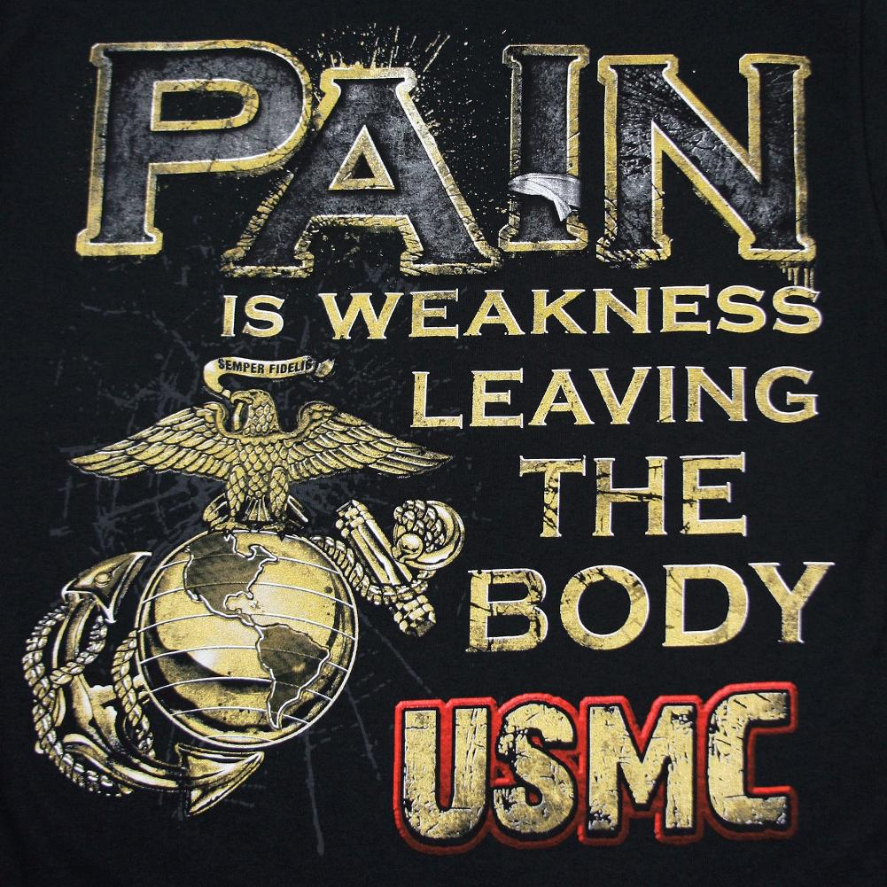
THE REALITY OF
OUR FLESH
THE CRYBABY SCREAM OF YOUR FLESH IS SELF-WILL LEAVING YOUR BODY

Slide 4
Food For Thought
Sometimes the greatest weakness we feel – is that IT IS ALWAYS A BATTLE FOR THE MIND – USING WORDS TO CONVINCE CONFUSED MINDS FEELS FUTILE AT TIMES
What Is The Difference Between?
NOT KNOWING
LIVING IN IGNORANCE
INTENTIONAL STUPIDITY
You don’t know something exists at all
You don’t want to put any effort into finding truth
You don’t care about the consequences

Slide 5
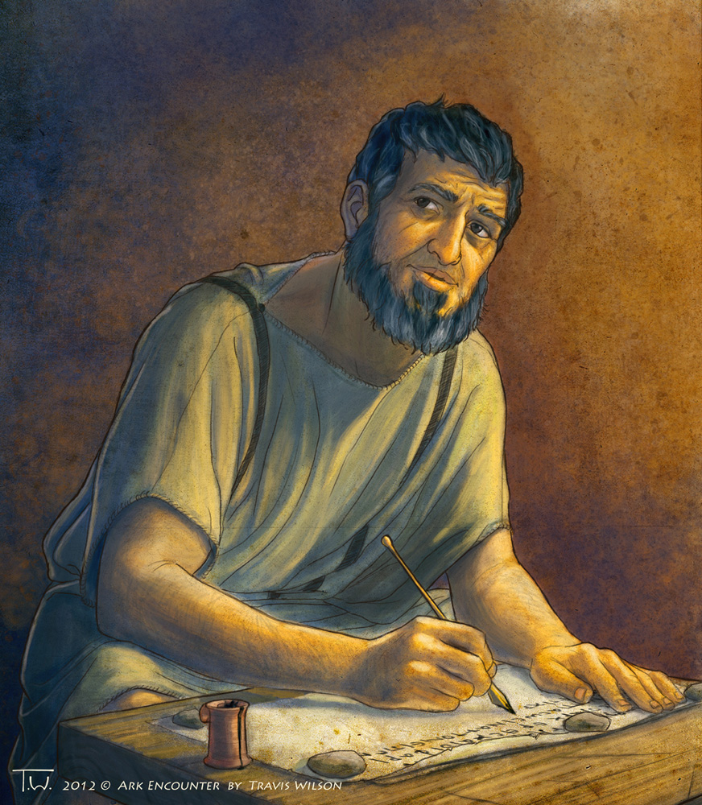
VERY MUCH AMAZED AT THESE OPENING VERSES FROM THE APOSTLE PETER – HE LIVED IN THE GLORY OF THE FIRST WAVES OF TRANSFORMATION AND OPEN HEAVENS IN THE NEW TESTAMENT DISPENSATION
THINGS WILL GET WHACKY BUT YOU WILL BE SHIELDED
YOU GET A REWARD FOR STANDING FOR THE LORD
YOU HAVE A GREAT JUICY STEAK EVERY DAY IN THE REVELATION OF YOUR GLORIOUS SAVIOR JESUS CHRIST AND IT FEEDS YOUR SOUL – IT GIVES YOU JOY IN SPITE OF THE ANGUISH, BURDENS, AND TRIALS
GOD SOVEREIGNLY PLANNED THIS DISPENSATION TO HAVE THE HOLY SPIRIT SENT DOWN FROM HEAVEN WORKING IN POWER - BUT YOU WILL HAVE TO LIVE ABOVE THE DRAMA – LIVE ABOVE THE CHAOS – LIVE ABOVE THE EASILY BESETTING SINS OF YOUR CULTURE.

Slide 6
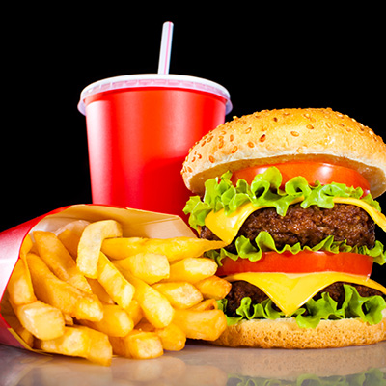
LifeGate Is A Teaching Kitchen
A Chef Training Center – Where You Get To
Eat while You are trained to cook for yourself
Take heed therefore unto yourselves, and to all the flock, over which the Holy Spirit has made you overseers, to feed the church of God, which He has purchased with His own blood. Acts 20:28 (KJV) DL
Feed the flock of God which is among you,
1 Peter 5:2 (KJV)

Slide 7
Jesus Said Feed My Sheep
Jesus said, "Feed my sheep. John 21:17
HOW DO WE DO THIS?
Jesus said, "Go home to your family and tell them how much the Lord has done for you, and how he has had mercy on you." Mark 5:19 (NIV) DL
"Go, stand in the temple courts," he said, "and tell the people the full message of this new life. (ALL THE WORDS OF LIFE) " Acts 5:20 (NIV)
Paul said we partake we take our spiritual nourishment from Jesus Christ and His finished work
Because there is one loaf (Jesus), we, who are many, are one body, for we all partake of the one Loaf (Bread). 1 Corinthians 10:17

Slide 8
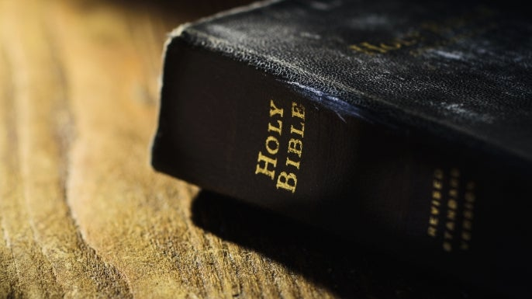
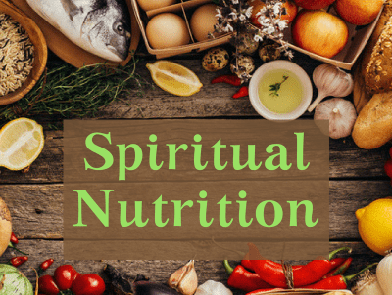
The Revelation of Jesus Is Spiritual food
In fact, you need someone to teach you the elementary truths of God's word all over again. You need milk, not solid food! Hebrews 5:12 (NIV)
Anyone who lives on milk, being still an infant, is not acquainted with the teaching about righteousness. ¹⁴ But solid food (meat) is for the mature, who by constant use have trained themselves to distinguish good from evil. Hebrews 5:13-14 (NIV)

Slide 9
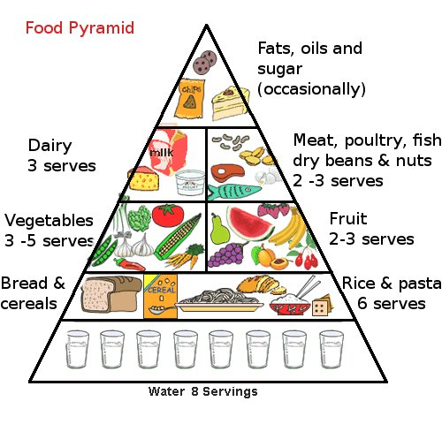
Natural Food

Slide 10
Every Believer Needs A Healthy Spiritual Diet
Milk – The basics of the Gospel and the Love of God and the Word of God to build us up and strengthen us – not very heavy.
Bread – Higher levels of the spiritual growth being filled with the Holy Spirit – devotion and purity, accountability - exercising the gifts of the Spirit .
Meat – Excellencies of Jesus as The “Juicy Steak/ Roast Chicken” of righteous SPIRITUAL NOURISHMENT that feeds us at the DEEPEST LEVEL – also the deeper understandings of the promises concerning the teachings of the LAST DAYS and spiritual warfare and DELIVERANCE and the sovereignty of God.
Liver and Kale and Artichokes – The heavier truths and STRATEGIC PROMISES that equip us to fight back against TYRANNY and Anti-Christ Agendas and to carry the burdens in a LIFE-GIVING way – so as not to GROW WEARY IN WELL-DOING.

Slide 11
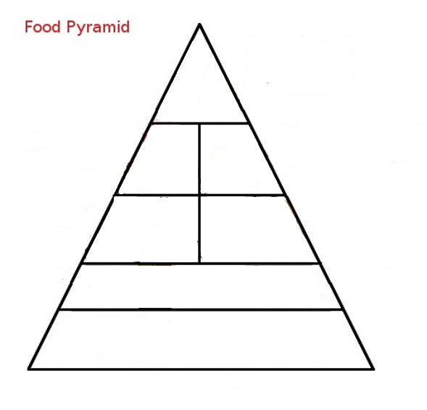
Spiritual Food Pyramid
Yea doubtless, and I count all things but loss for the excellency of the knowledge of (surpassing greatness of knowing) Christ Jesus my Lord Philippians 3:8
Power
Foods
Heavy necessary
truths to stand in the battle
Spiritual
Warfare
Deliverance
Holiness
Deeper
Revelation Of Jesus
Meat
Fruits of The Spirit
Gospel repentance
Fruits and
Vegetables
Bread of Life
Soaking In The Word
Fillings Of The Spirit
Be Filled With the Holy Spirit Eph. 5:18

Slide 12
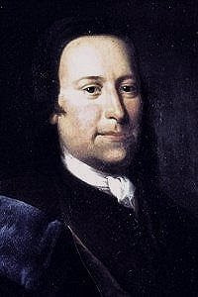
Count Nicholas Zinzendorf
"Our method of proclaiming salvation is this: to point out to every heart the loving Lamb, who died for us, and although He was the Son of God, offered Himself for our sins ... by preaching His innocent blood, and His love unto death, even the death on the cross, never, either in discourse or in argument, to digress for more than fifteen minutes from the loving Lamb:
To name no virtue except in Jesus, to preach no commandment except faith in Him; no pardon except that He atoned for us; no sanctification but the privilege to sin no more; no other happiness but to be near Him and know Him and do His pleasure; no calamity but to displease Him; no other life but in Him." - Count Zinzendorf

Slide 13
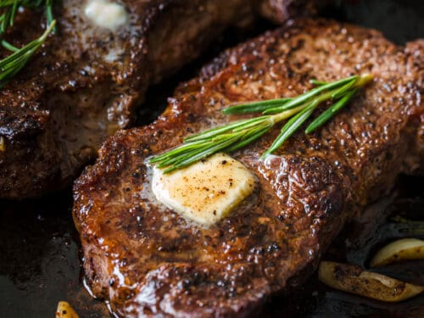
The “Juicy Steak/ Roast Chicken” of Jesus Christ
- A Revelation That Will Nourish Your Heart and Soul.
During the days of Jesus' life on earth, He offered up prayers and petitions with loud cries and tears to the One who could save Him from death, and He was heard because of His reverent submission. 8 Although He was a (SINLESS) son, He learned obedience from what He suffered and, once made perfect, He became the source (Author – Cause) of eternal salvation for all who obey Him (Hebrews 5:7-9 (NIV)

Slide 14
THE GLORY OF JESUS IS THAT HE WAS A COEQUAL WITH THE FATHER FOR ALL ETERNITY AND THEY CAME UP WITH THIS EXPERIMENT TO MAKE PEOPLE IN THEIR IMAGE – THEY WERE AWARE OF THE CONSEQUENCES – THEY STILL WENT THROUGH WITH IT – KNOWING THE COST.
TO DO THIS - JESUS WALKED AWAY FROM HIS FULL DIVINITY IN TOTALITY AND BECAME A MAN – AND IN THAT SEASON HE HAD TO PRAY TO THE FATHER JUST LIKE WE NEED TO. HE WAS DEPENDENT ON THE FATHER FOR EVERYTHING.
WHEN IN ETERNITY BEFORE THIS SEASON OF HIS EXISTENCE – HE ALWAYS INTERACTED WITH THE FATHER IN A CO-EQUAL FELLOWSHIP. NOW ON HIS EARTHLY MISSION HE WAS IN A SUBMITTED FELLOWSHIP – BEING UNITED BUT NOT FULLY EQUAL – UNTIL HE FINISHED THE WORK AND ROSE AGAIN TO BE SEATED AGAIN AS A CO-EQUAL.

Slide 15
The Power of Our Inheritance of the Saints
And we pray this in order that you may live a life worthy of the Lord and may please Him in every way: bearing fruit in every good work, growing in the knowledge of God, 11 being strengthened with all power according to His glorious might so that you may have great endurance and patience, and joyfully 12 giving thanks to the Father, who has qualified you to share (partake) in the inheritance of the saints in the kingdom of light. 13 For He has rescued us from the dominion of darkness and brought us into the kingdom of the Son He loves, 14 in Whom we have redemption, the forgiveness of sins. Colossians 1:10-14

Slide 16
What Does It Mean To Be Qualified to share in the Inheritance of the Saints?
( GREEK – Hick an- AH-oe – To make fit or able)
Opened the door (through Jesus) to partake of that which was previously inaccessible.
Making you judicially CLEARED to receive God’s undeserving blessings and hungry to appropriate their functioning realty.
Rendered you willing to receive it by faith.
Literally enabled you to take hold of His offered salvation. (moving you to exercise love and faith and repentance)

Slide 17
Very Powerful Word Revelation
In The New Testament
PARTAKER – 1/ Co-participant – 2/ A portion or share in - a participation - 3/ to accept – eat (nourish) – receive - 4/ one who shares – associates – partners - 5/ A sharer – companion – partner – fellowship
Partakers of: | Verse
We are made partakers of Christ | Hebrews 3:14
You all are partakers of grace | Philippians 1:7
You are partakers of the heavenly calling | Hebrews 3:1
Partakers of His promise in Christ by the Gospel | Ephesians 3:6
Partakers of the inheritance of the saints | Colossians 1:12
Partakers of the Holy Spirit | Hebrews 6:4
You are partakers of Christ's sufferings | 1 Peter 4:13
That we might be partakers of His holiness | Hebrews 12:10
By These You might be partakers of the divine nature | 2 Peter 1:4

Slide 18
Let’s Pull This All Together
Your SPIRITUAL NOURISHMENT is critical – every generation either matures or stagnates according to how they feed on Christ THE BREAD OF HEAVEN.
Don’t be lazy and eat FAST FOOD from other’s only – LEARN TO FEED ON CHRIST YOURSELF – you will be healthier.
Pray for the unfulfilled and unrealized promises of God to be RELEASED in this hour YOU ARE A PARTAKER OF HIS GRACE, KINGDOM, AND DIVINE NATURE.
BE CAREFUL NOT TO OVERDO THE POWER FOODS of heavy things going on in the world. You can become overburdened as a willing WATCHMAN ON THE WALL – Get your juicy steak of the REVELATION OF JESUS to grow up into Him the HEAD OF THE CHURCH.

Slide 20
APPLICATION
The ARK of the Covenant is with you – It’s Jesus – It’s the Holy Spirit – It’s the Glory of Your Heavenly Father – (YOUR WHOLE HOUSEHOLD IS BLESSED) let Him motivate you to bring all into the Storehouse – So that He can throw open the floodgates of Heaven and bless your household. (Malachi 3:10)
Pray for the unfulfilled and unrealized promises of God to be RELEASED in this hour.
NEVER CEASE PUTTING YOUR FAITH IN ACTION AND PRAYING - STAND AND DECREEING HIS RESURRECTION POWER OVER YOUR LIFE – YOUR FAMILY – YOUR CHURCH – YOUR NATION

Slide 21
Grace Brings Life
Source | God/ Grace | Self/ Flesh/ Enemy
Seed | Faith/ Love/ Purpose | Fear/ Lust/ Pleasure
Condition | Turn to God/ Surrender/ Trust | Reject Truth/ love Self/ Disobey/ Doubt
Outcome/Birth | Salvation/ revival/ Ultimate meaning | Discontent/ hardness of heart/ void and empty
Fruit | Blessings | Curses
This day I call heaven and earth as witnesses against you that I have set before you life and death, blessings and curses. Now choose life, so that you and your children may live ²⁰ and that you may love the LORD your God, listen to His voice, and hold fast to Him. For the LORD is your life, and He will give you many years in the land - Deuteronomy 30:19-20 (NIV)

Slide 22
David Wrote Psalm 68 For The
Bringing Up of the Ark Into Jerusalem
The stone (JESUS) which the builders refused is become the head stone of the corner. ²³ This is the LORD'S doing; it is marvelous in our eyes. ²⁴ This is the day which the LORD hath made; we will rejoice and be glad in it. ²⁵ Save now, I beseech thee, O LORD: O LORD, I beseech thee, send now prosperity. ²⁶ Blessed be he(JESUS) that cometh in the name of the LORD: Psalm 118:22-26 (KJV)

Slide 23
Pray That On Our Watch –
In Our Families and Churches – In Our Region We Would be a Bubble of Glory Against the Retrograde of Faith
At that time many will turn away from the faith and will betray and hate each other, ¹¹ and many false prophets will appear and deceive many people. ¹² Because of the increase of wickedness, the love of most will grow cold, ¹³ but he who stands firm to the end will be saved. ¹⁴ And this gospel of the kingdom will be preached in the whole world as a testimony to all nations, and then the end will come. Matthew 24:10-14

Slide 24
Preach the Worthiness Of Christ
Preach The Appropriate response to His Worthiness
In his heart a man plans his course, but the LORD determines his steps. Proverbs 16:9 (NIV)
A MAN’S PRIMARY DRIVER IS PLEASURE AND ADVENTURE
A WOMAN’S PRIMARY DRIVER IS NURTURING AND SECURITY

Slide 25
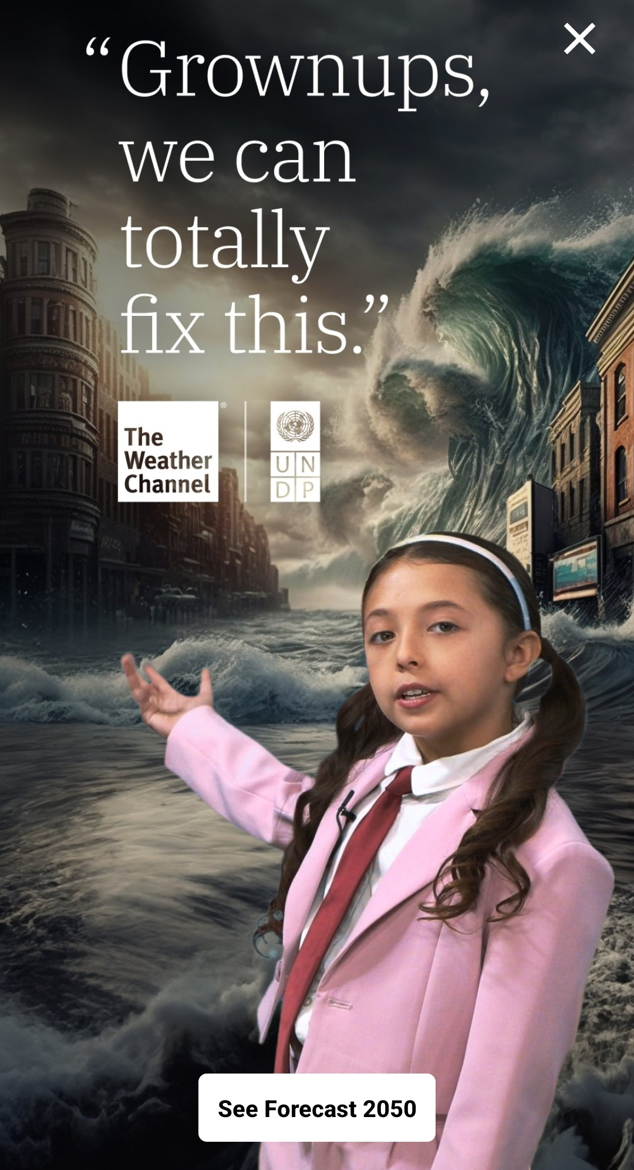
Every Generation Believes In Hoaxes – We Simply Have The Most

Slide 26
Profound Shifts Still Happen
“The oppressor will come to an end, and destruction will cease; the aggressor will vanish from the land.” Isaiah 16:4 (NIV)
People prayed, and many visited from outside the neighborhood to receive the blessing. The revival increased with 1,250 added to the church in the first year. Bramwell visited eight or ten families in the early part of the day; he would ascertain their spiritual condition, pray for each of them and implore blessings on them. If anyone was not truly converted it was thought that he would discern it.
One witness to the revival wrote, ‘…for if ever I was conscious, as far as a human spirit can be, of the presence of supernatural powers, that was this time. Many felt and possessed unutterable things. It seemed that there was but a thin veil between us and the invisible world, and that Satan, for a season, was bound in chains…’

Slide 27
Make That Shift Personal
THE CONTINUITY OF SCRIPTURE – YOUR FAITH MUST PRODUCE OBEDIENCE OR IT IS INCOMPLETE
21 Was not our ancestor Abraham considered righteous for what he did when he offered his son Isaac on the altar? 22 You see that his faith and his actions were working together, and his faith was made complete by what he did. 23 And the scripture was fulfilled that says, "Abraham believed God, and it was credited to him as righteousness," and he was called God's friend. 24 You see that a person is justified by what he does and not by faith alone. James 2:21-24 (NIV)
THE GREATER DANGER IN THE AMERICAN CHURCH IS NOT STRIVING FOR OUR SALVATION IN DEAD WORKS – AS IT IS IN LIVING IN A FALSE PROFESSION OF INCOMPLETE FAITH THROUGH A COUNTERFEIT REPENTANCE.

Slide 28
How Do We Reach The Core Of The Church?
The greater danger in the American church is not striving for our salvation in dead works – as it is in living in a false profession of incomplete faith through a counterfeit repentance.
What is the greatest danger in the church today? Not legalism or judgmentalism. It is disconnected passionless Christian living through cheap “grace-licensed” unconvicting Western theology.” Don Lamb

Slide 29
WHAT DOES THIS LOOK LIKE?
God is refining His Church
The enemy uses exposure – try to burn down the whole house – destroy the good things that people can do – even though they fail.
A lot of people throw the baby out with the bath water

Slide 30
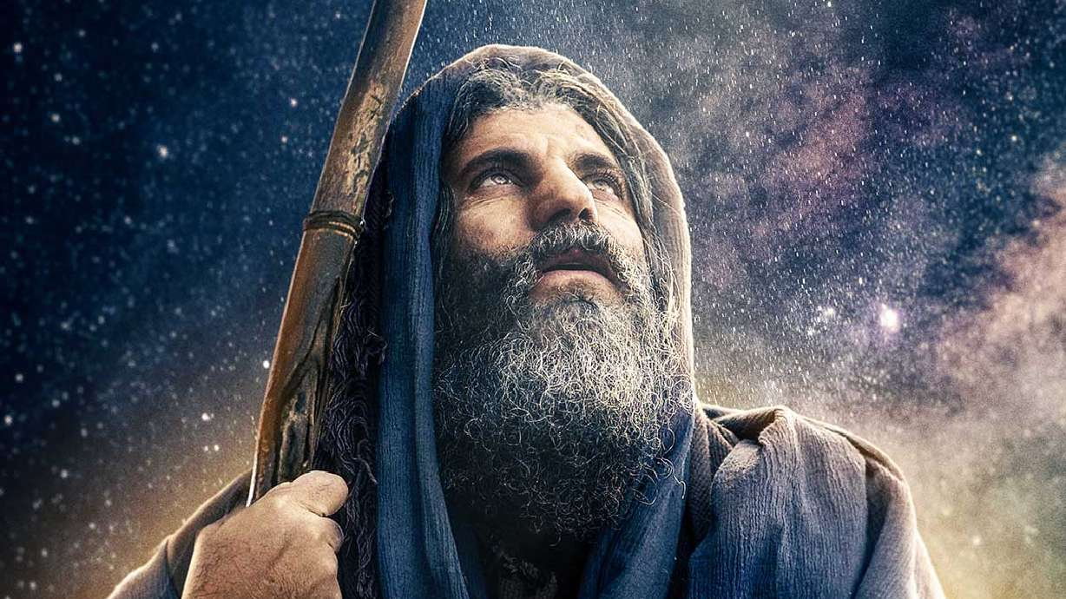
Traditional Dispensationalism
Hinge Point
Of Human
History
2000 B.C.

Slide 31
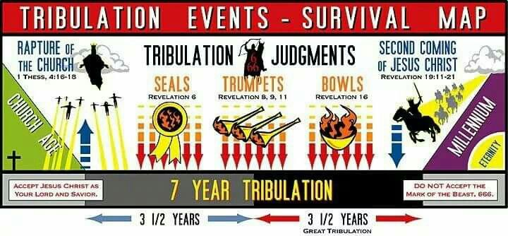
Traditional Dispensationalism
Hinge Point
Of Human
History

Slide 32
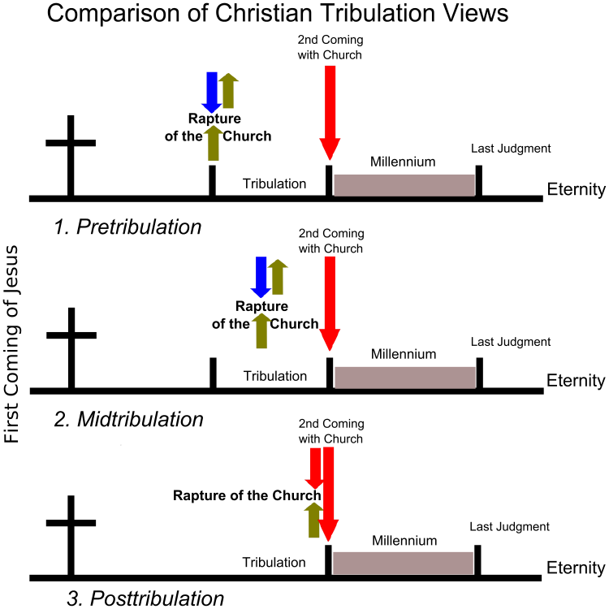
Traditional Dispensationalism
DANIEL’S AMAZING ENCOUNTER
"Know and understand this: From the issuing of the decree to restore and rebuild Jerusalem until the Anointed One, the ruler, comes- 483 YEARS,' the Anointed One will be cut off and will have nothing. The people of the ruler who will come will destroy the city and the sanctuary. (Titus 70 AD) The end will come like a flood: War will continue until the end, and desolations have been decreed. ²⁷ He (ANTI-CHRIST) will confirm a covenant with many for one 'seven.' In the middle of the 'seven' he will put an end to sacrifice and offering. And on a wing [of the temple] he will set up an abomination that causes desolation, until the end that is decreed is poured out on him". Daniel 9:25-27 (NIV)

Slide 33
Don’t Be Insecure Visionary’s
True servant of the Lord has to stay saturated in the Holy Spirit and rise above the things that trigger them. Lance Wallnau
Don’t shut down because someone says something they don’t like about your vision – maybe God is refining your vision through them.

Slide 34
I LOVE THE TEACHINGS ON IDENTITY
But Sometimes It Annoys Me.
Likewise reckon yourselves to be dead indeed unto sin, but alive unto God through Jesus Christ our Lord. Romans 6:11 (KJV)
Identity still has “I” in it – it can be healthy or it can be idolatry.
Surrender has no “I” in it – Reckon yourself dead – has no “I” in it.
WHEN WE BECOME FOLLOWERS OF JESUS – WE LAY DOWN THESE DEMANDING APPETITES AND SINS AT THE CROSS – BUT WE PICK UP SOMETHING FROM JESUS THAT HE GIVES US THAT IS FAR GREATER THAN WHAT WE LAID DOWN – WE PICK UP FORGIVENESS AND POWER AND GRACE- AND MOTIVATION AND SELF-CONTROL AND A BURNING DESIRE TO PLEASE THE LORD.

