Slide 1

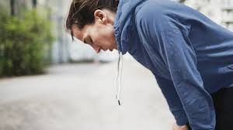
Tapping into the Divine Power Source
A Lifestyle of leaning into the Lord for fellowship and equipping. Choosing to stand up to the trend of anemic Christian growth.

Slide 2
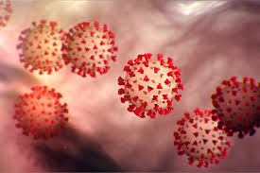
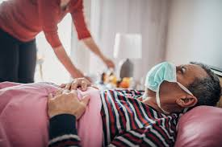
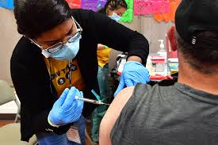
The horrible, not so good illustration of Covid 19

Slide 3
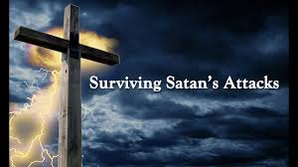
Two major battle grounds –
Satanic lies/ attacks - Flesh/ Old man

Slide 4

The Flesh and Old Man have it easier then ever!

Slide 5
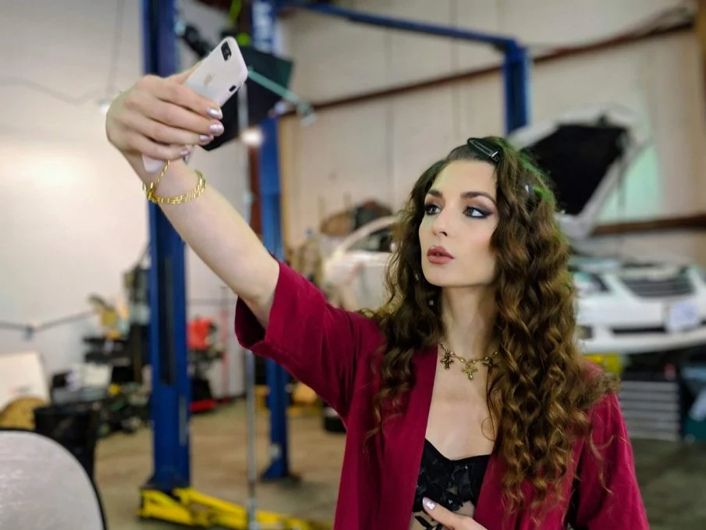
Our world is imploding with self absorption

Slide 6

Satan is looking for your spiritual immune system to be weakened and he’ll attack!
Fear
Tiredness
Anxiety
Distracted
Worn down
Bitterness
Unresolved
issues

Slide 7
Jesus invites us into a place of Fellowship and engagement that activates supernatural
Vitamins and energy into our Spirt Man!!
John 6: 53 – 56 Eat my Flesh and Drink my blood –
Connect with me and let me feed you.
John 15: 4- 7 I am the Vine you are the branches –
            Without my grace flowing into your lives
            you will wither up and die.
Jude 1: 18 – 21 Build yourself up in your most holy faith.
  Intentionally make time to get the Divine
  refreshment needed to sustain your growth

Slide 8
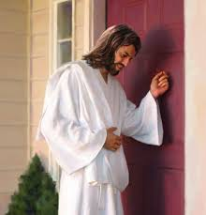
The fact that Jesus and the Holy Spirit are looking to connect with you and pursue the tiem of fellowship, ought to encourage all of us.
John 6: 37 – 38 We come to Christ because He drew us to
himself first!!!
Rev, 3: 20 Jesus stands at our door knocking on those days
    we’re all tied up with other things.

Slide 9
No matter how ugly the battle get’s we’re on the winning team. Stand against the evil one!
1 Cor. 10: 12- 13 No temptation is strong enough to over come any Christian.
1 John 4: 4 Greater is the Spirit that is in us, then the spirit that is in the world!
2 Cor. 10 :3- 5 The Battle we fight comes from the darkness
trying to WEAR us out AND GIVE UP!

Slide 10

Eleanor Isaacson
I can look back now on all I’ve experienced in my childhood, the abandonment, the war, the hunger, the grief and pain and loss…now I can see that those experiences God used to show me how empty my Life was without Him. I have learned to trust God’s purposes in every experience, dark or bright, they became a means to trust further my heavenly Father.”

