Slide 1
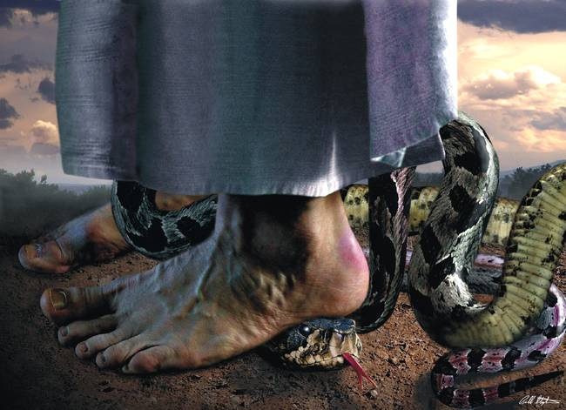
Defense for Deliverance

Slide 2
Mark 16:15-18
¹⁵ He said to them, “Go into all the world and preach the gospel to all creation. ¹⁶ Whoever believes and is baptized will be saved, but whoever does not believe will be condemned. ¹⁷ And these signs will accompany those who believe: In my name they will drive out demons; they will speak in new tongues; ¹⁸ they will pick up snakes with their hands; and when they drink deadly poison, it will not hurt them at all; they will place their hands on sick people, and they will get well.”

Slide 3
What is “Deliverance?”
Deliverance is a truth encounter not a power encounter.
It is God‘s truth versus Satan‘s lies. The only power Satan or any demon has in the believer’s life is the lie. Once the demons are confronted with God‘s truth, they simply cannot stand. When legal permissions have been removed, and Jesus’s name is invoked, they will bend their knee in submission.

Slide 4
Deliverance is about destroying the works of the devil through confession, repentance, denouncing, and renouncing and evil spirits being cast out.
The choice for deliverance is always made by the individual and never against their will.

Slide 5
Deliverance is the Children’s Bread
²⁴ Jesus left that place and went to the vicinity of Tyre.^{[g]} He entered a house and did not want anyone to know it; yet he could not keep his presence secret. ²⁵ In fact, as soon as she heard about him, a woman whose little daughter was possessed by an impure spirit came and fell at his feet. ²⁶ The woman was a Greek, born in Syrian Phoenicia. She begged Jesus to drive the demon out of her daughter.

Slide 6
²⁷ “First let the children eat all they want,” he told her, “for it is not right to take the children’s bread and toss it to the dogs.”
²⁸ “Lord,” she replied, “even the dogs under the table eat the children’s crumbs.”
²⁹ Then he told her, “For such a reply, you may go; the demon has left your daughter.”
³⁰ She went home and found her child lying on the bed, and the demon gone.

Slide 7
Man is a Trinity
“Now may the God of peace himself sanctify you completely, and may your whole spirit, soul and body be preserved blameless at the coming of our Lord Jesus Christ.”
1 Thessalonians 5:23.

Slide 8
It is with his spirit that a man may contact God, true worship comes from the spirit of man.
The conscious and the subconscious minds are part of the soul. This includes the realm of emotions and the will.
Soul gives a man personality, self-awareness, rationality, and natural feeling.

Slide 9
The body is a complex physical creation by which a person relates to this world the other people in the world. We now know that every person‘s body is in large measure a product of their DNA code which exists in every cell of the body to program.
“And the Lord God formed man of the dust of the ground, and breathe into his nostrils, the breath of life; and man became a living soul.” Genesis 2:7

Slide 10
Psalm 139:13
“For you created my inmost being; you knit me together in my mother’s womb.”

Slide 11
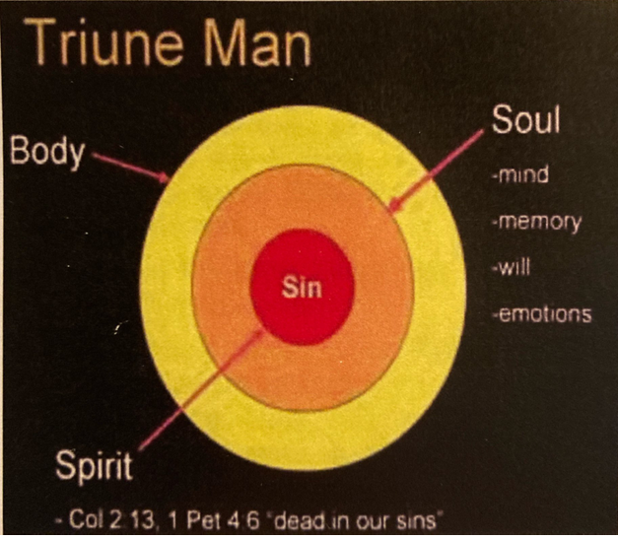

Slide 12
Where Do Demons live in a Believer?
The three areas of the temple correspond to man’s spirit, soul and body. Jesus cleans the temple. He “cast out” all that defiled. Only the outer court needed cleansing. It had become a “den of thieves”. Jesus cleans the temple. He “Cast out” all that defiled.
God’s presence was in the temple – in the Holy of Holies.

Slide 13
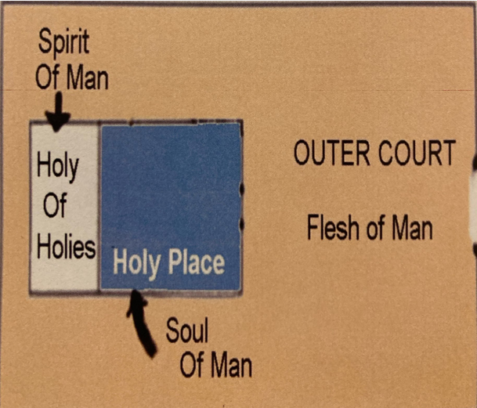

Slide 14
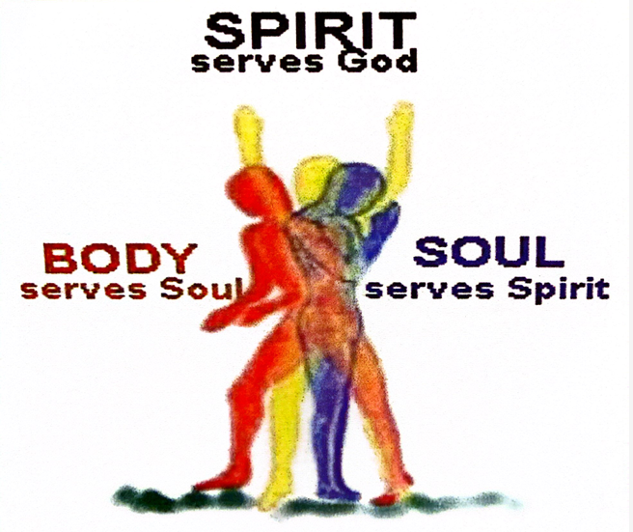

Slide 15
1 Corinthians 6: 19-20
¹⁹ Do you not know that your bodies are temples of the Holy Spirit, who is in you, whom you have received from God? You are not your own; ²⁰ you were bought at a price. Therefore honor God with your bodies.

Slide 16
Can a “Believer” have a Demon?
Matthew 8:16,17 deliverance and healing are provisions of Christ’s atoning blood.
If a Christian cannot have a demon, then neither can he become sick. Nor can he have evil thoughts, or anything else contrary to the Holy Spirit.
It is better to acknowledge that you may have a demon, and cast it out rather than deny you have a demon and keep it.
When in doubt, cast it out!

Slide 17
Matthew 18:23-35
²³ “Therefore, the kingdom of heaven is like a king who wanted to settle accounts with his servants.
²⁴ As he began the settlement, a man who owed him ten thousand bags of gold was brought to him. ²⁵ Since he was not able to pay, the master ordered that he and his wife and his children and all that he had be sold to repay the debt.
²⁶ “At this the servant fell on his knees before him. ‘Be patient with me,’ he begged, ‘and I will pay back everything.’ ²⁷ The servant’s master took pity on him, canceled the debt and let him go.
²⁸ “But when that servant went out, he found one of his fellow servants who owed him a hundred silver coins.He grabbed him and began to choke him. ‘Pay back what you owe me!’ he demanded.

Slide 18
Matthew 18:23-35
²⁹ “His fellow servant fell to his knees and begged him, ‘Be patient with me, and I will pay it back.’
³⁰ “But he refused. Instead, he went off and had the man thrown into prison until he could pay the debt.
³¹ When the other servants saw what had happened, they were outraged and went and told their master everything that had happened.

Slide 19
Matthew 18:23-35
³² “Then the master called the servant in. ‘You wicked servant,’ he said, ‘I canceled all that debt of yours because you begged me to.
³³ Shouldn’t you have had mercy on your fellow servant just as I had on you?’
³⁴ In anger his master handed him over to the jailers to be tortured, until he should pay back all he owed.
³⁵ “This is how my heavenly Father will treat each of you unless you forgive your brother or sister from your heart.”

Slide 20
If You have a Demon, Now what?
1. You either have demons or you don’t.
2. If you do have demons, it must be that they have legal, God-given rights, or “permissions” to your life.
3. There is absolutely no permission a demon can have to a person’s life that cannot be canceled through confession and repentance before the Lord.
4. Once a demon’s rights to a life are canceled, the name of Jesus is absolute authority every time!

Slide 21
Common Demon permissions
1. Generational curse: Demons that are passed down through the sins of ancestors (Exodus 20: 5).
A large percentage of demons encountered in any given deliverance will have come by the legal consequences of ancestral cursed. While the word “curse” not a popular word in today’s society, it is The word God uses to describe this permission. It is found more than 230 times in scripture.
2. Our own own sin: Any disobedience toward God that goes unconfessed is an open invitation for demons to come into our lives. Sin is rebellion against God.

Slide 22
3. Emotional and physical traumas: These, often are the source of negative emotions within each of us, such as anger, fear, terror, grief. If these unpleasant memories are allowed to linger, they can be doorways. If God is blamed or unforgiveness and bitterness build, demons, surely will get a foothold.

Slide 23
4. Unholy soul ties: These most commonly come from illicit sexual relations, but can on rare occasion, come from unhealthy emotional relationships. When people unite their bodies, physically, they also unite their souls. Demon spirits can then be transferred or most likely split into each person. They can become shared spirits. (Genesis 2:24)

Slide 24
5. Surgeries: This is not a common occurrence, but it is seen from time of time and should be considered. Possible reasons can be the trauma associated with the surgery, general anesthesia, fear of the results of the surgery. (what if’s). Blood transfusions and organ/tissue transplants have also been known to be sources of demonic activity.

Slide 25
Please do not think that we are saying that one should not go to the medical community for help. God uses these people in many wonderful ways to help establish healing in the bodies and lives of believers and nonbelievers alike. Pray prior to medical procedures and or once they have been completed, simply renounce any permission the enemy may have obtained and command them to leave.

Slide 26
6. Unforgiveness: Without doubt, the biggest doorways to be dealt with in any deliverance session is unforgiveness. Bitterness and hatred are automatic permissions from the Lord for the demons to torment a believer. (Matthew 18:21-35). The areas of bitterness and unforgiveness are generally in three areas which are detailed below. All must be dealt with, or the demons consent to be there will remain.

Slide 27
Soul-Ties
Soul-Tie- Strong spiritual/emotional connection you have with someone after being intimate with them. (Especially engaging in sexual relationships but not necessarily have to be sexually involved with someone to have developed a soul tie).

Slide 28
Soul-Ties Biblical Examples
Jacob and his son Benjamin.
Genesis 44:30-31
“If the boy is not with us when I go back to your servant, my father, whose life is bound up in the lads life (soul) Sees that the boy isn’t there, he will die.”

Slide 29
Jacob‘s situation was that his wife Rachel died while giving birth to Joseph. This was a situation where fear, which is a common yet unhealthy way that souls are tied together.
She named him Ben-Oni “Son of my trouble”.
Jacob named him, Benjamin- “Son of my right hand”.

Slide 30
You are not the source of your child’s existence!
God is!
You are the means by which God brought this person into the earth.
He died for that child.
He loves that child and he doesn’t want your life bound up.
You can’t live if living means living without them.

Slide 31
Moses’s mom had to release him to God. God preserved him and used him to become her deliverance. Don’t let your child and your affection for him be your bondage like Jacobs was unhealthy.

Slide 32
Jonathan and David
"And it came to pass, when he had made an end of speaking unto Saul, that the soul of Jonathan was knit with the soul of David, and Jonathan loved him as his own soul".

Slide 33
2 Samuel 1:26
I grieve for you, Jonathan my brother;
you were very dear to me.
Your love for me was wonderful,
more wonderful than that of women.

Slide 34
Shechem Genesis 43:4
His soul was strongly attracted to Dinah, the daughter of Jacob. He was tied to her through sexual relations.
Such a strong soul tie, he was willing to adopt another religion upon himself, became circumcised just so he can be with her. He became blind to everything else.
Some relationships are bound up in soul ties due to sexual intimacy, fornication. When you commit sin, the devil wants to use that sexual connection to create a bond, a chain

Slide 35
Genesis 2:22,24
“Man will leave his father and mother and be joined to his wife, and they shall become one flesh.“
Every man/woman is tied with their first emotions and gets Solidified through sexual intercourse.
In divorce, a person Often needs counseling and prayers of renouncing or removing that soul from the spouse that cheated on them and betrayed them. You need to heal, recover, experience, forgiveness, experience deliverance. You need to become disconnected from the person that you are connected to because you were married to them.

Slide 36
When you have a soul tie to someone else so strongly, the soul tie connection to God can’t be that strong.
“Love the Lord, your God with all your heart, soul, mind and strength.”
Examine your heart. Are you knitted in soul to and are you cleaving to the presence of God.?
Holy Spirit will guide you in your relationships with your brothers and sisters, friends, family members, and even your leaders. When you’re crossing the line when you feel bound, trapped, ungodly territory.

Slide 37
Colossians 2:2,19
“That their hearts may be encouraged, being knit together in love, attaining to all the riches of full assurance of understanding, to the knowledge of the mystery of God, both of the father and of Christ. “
2:19 ““And not holding fast to the head from whom all the body nourished and knit together by joints and ligaments grows with the increase that is from God.“

Slide 38
If you have tied yourself to another person so that you cannot move on. Your “life is over.”
That is when you have placed somebody else instead of God.

Slide 39
When this worked
Joshua honored Moses, but when Moses died, Joshua went forward.
Elisha honored Elijah, but when Elijah went to heaven, Elijah moved forward.
The disciples loved Jesus, but when Jesus went to heaven, they went on to build the church and spread the message through the power of the Holy Spirit.

Slide 40
Matthew 22:37
“Jesus said unto them, you shall love the Lord, your God with all your heart, all your soul and with all your mind.“ If you have developed an unhealthy soul-tie, God says I want you to bring your whole soul. I want you to bring that to a loving, affectionate, passionate relationship relationship with me!
Psalm 23:3 says “ he restores my soul.”

Slide 41
Psalm 7:2 “Oh Lord, I take refuge in you. Save and deliver me from all who pursue me, or they will tear my soul like a lion, rending it in pieces while there’s none to deliver.”
The devil cannot take your spirit, but he can shatter your soul.

Slide 42
How to break unhealthy soul-tie:
Confess it. Permission breaking confession. Confess the sinfulness of the arrangement.
Extend forgiveness when necessary.
Unforgiveness is drinking poison and hoping it kills the other person.

Slide 43
Forgiveness is not forgetting.
Forgiveness is not letting them off the hook.
Forgiveness is setting the prisoner free and then realizing you were the prisoner If you hold onto bitterness, you have a bond that remains in your anger. Resentment until you forgive them.

Slide 44
Forgiveness doesn’t make you a victim. It takes a victim and makes them into a victor. Makes you victorious
Forgiveness doesn’t erase the past, it just gives you hope for the future. When you don’t forgive a person, that makes the demons, un-forgiveness, torment, and harassment, and the bond that that relationship will get stronger and you may hate that person. They have a stronger grip over you through un-forgiveness.

Slide 45
Unforgiveness Ties you Up
Matthew 18:23-35
²³ “Therefore, the kingdom of heaven is like a king who wanted to settle accounts with his servants. ²⁴ As he began the settlement, a man who owed him ten thousand bags of gold^{[h]} was brought to him. ²⁵ Since he was not able to pay, the master ordered that he and his wife and his children and all that he had be sold to repay the debt.
²⁶ “At this the servant fell on his knees before him. ‘Be patient with me,’ he begged, ‘and I will pay back everything.’ ²⁷ The servant’s master took pity on him, canceled the debt and let him go.

Slide 46
²⁸ “But when that servant went out, he found one of his fellow servants who owed him a hundred silver coins.^{[i]} He grabbed him and began to choke him. ‘Pay back what you owe me!’ he demanded.
²⁹ “His fellow servant fell to his knees and begged him, ‘Be patient with me, and I will pay it back.’
³⁰ “But he refused. Instead, he went off and had the man thrown into prison until he could pay the debt. ³¹ When the other servants saw what had happened, they were outraged and went and told their master everything that had happened.

Slide 47
³² “Then the master called the servant in. ‘You wicked servant,’ he said, ‘I canceled all that debt of yours because you begged me to. ³³ Shouldn’t you have had mercy on your fellow servant just as I had on you?’ ³⁴ In anger his master handed him over to the jailers to be tortured, until he should pay back all he owed.
³⁵ “This is how my heavenly Father will treat each of you unless you forgive your brother or sister from your heart.”

