Slide 1
For this is what the LORD says-- He who created the heavens, - He who fashioned and made the earth, He founded it; He did not create it to be empty, but formed it to be inhabited-- He says: "I am the LORD, and there is no other. Isaiah 45:18
Our God is Pro-Life
“He is the Author of Life”
LifeGate Sermon
May 5, 2024

Slide 2
How Many Occurrences In The Bible
This day I call heaven and earth as witnesses against you that I have set before you life (fresh strong, springing forth) and death, (ruin) blessings and curses. Now choose (discern, select, join) life, so that you and your children may live Deuteronomy 30:19 (NIV)
591 Times
650 Times
449 Times
299 Times

Slide 3
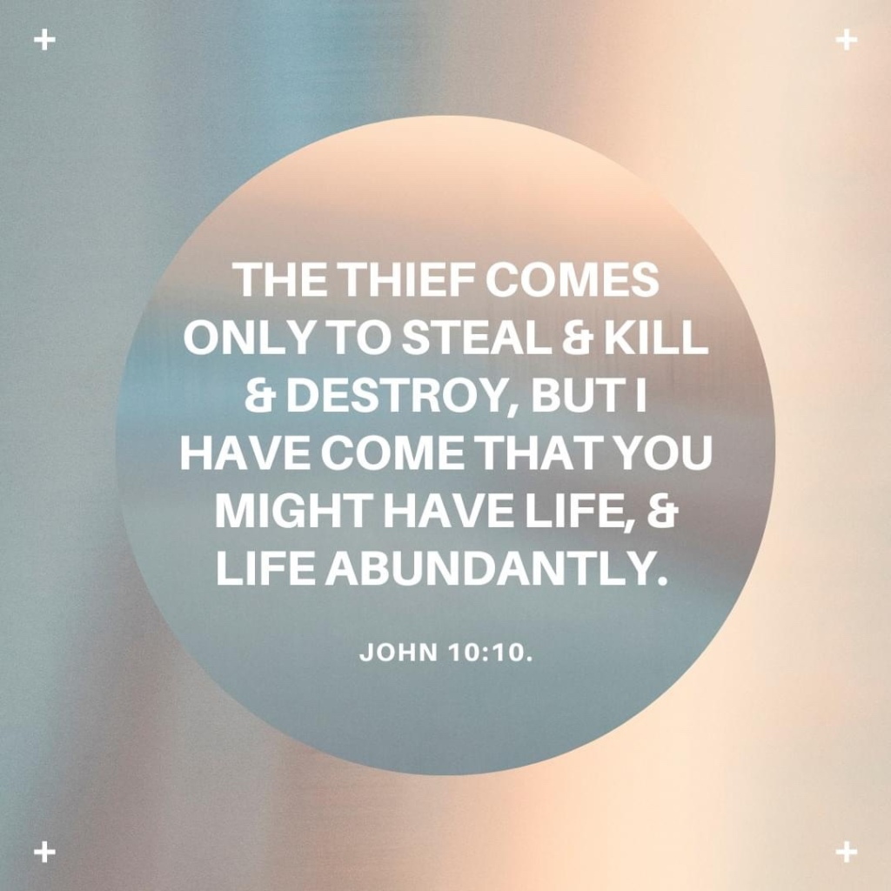

Slide 4
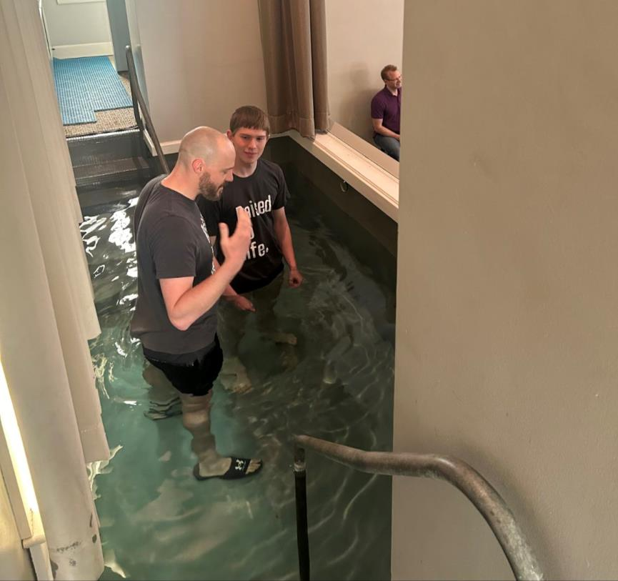
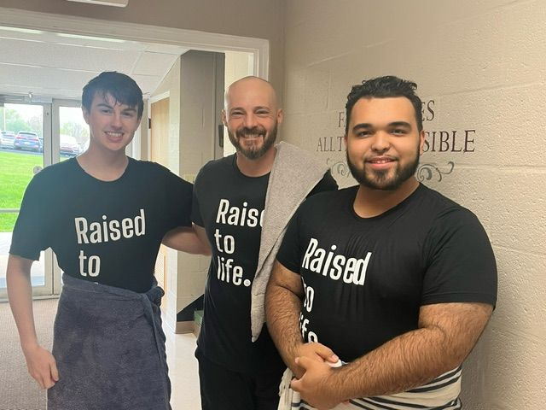
Praise The Lord He Is Working At
E-Town College

Slide 5
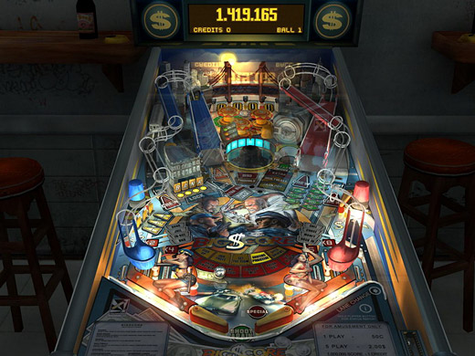
God is Going To Get The
Ball To Go In

Slide 6
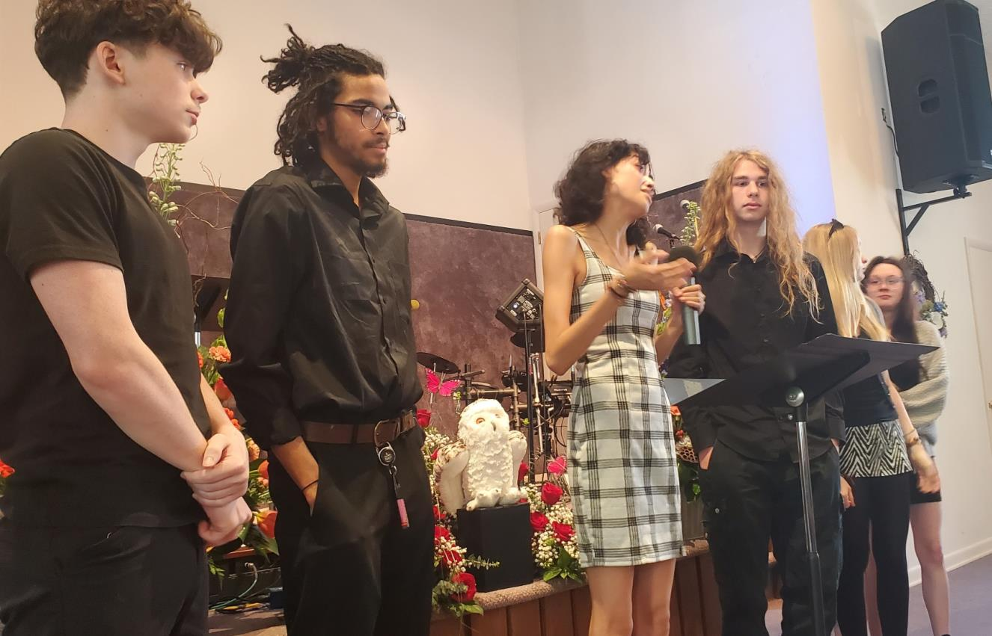
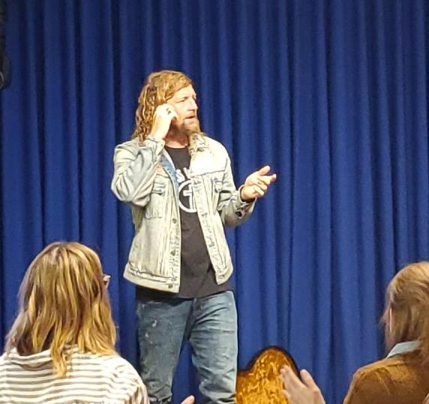
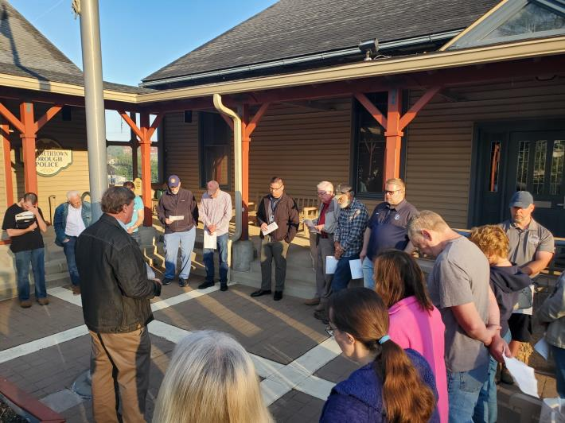
A Week In Review

Slide 7
How Do We Respond To These
Premature - Deaths
TRAUMAS IN LIFE –
FROM THESE BATTLES COMES THE LIES:
WHAT’S IT MATTER IF I LIVE
I’M NOT GOOD ENOUGH
NO ONE LOVES ME
I DON’T FIT IN
NATHAN’S DEATH – SHOWS US WE NEED TO TAKE WARNING TO THE LIES AND VOICES THAT ATTACK US
WE NEED A SAVIOR WHO WILL LIFT US ABOVE THE DEPRESSION OF DISAPPOINTMENTS
SO THE ONLY WAY WE CAN BE SURE WE WILL BE IN HEAVEN WITH JESUS AND THE OTHER SAINTS IS TO HAVE A STRONG FAITH WALK WITH GOD
WE CAN’T HOPE THAT EVERYTHING WILL WORK OUT FINE IF WE DON’T PLACE OUR LIFE IN THE HANDS OF GOD NOW AND EVERYDAY.

Slide 8
Pastor Brian Bailey – Died and Went to Heaven

Slide 9
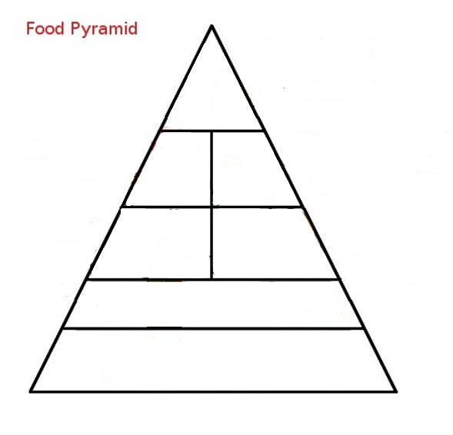
Spiritual Food Pyramid
Yea doubtless, and I count all things but loss compared to the excellency of the knowledge of (surpassing greatness of knowing) Christ Jesus my Lord Philippians 3:8
Power
Foods
Heavy necessary
truths to stand in the battle
Spiritual
Warfare
Deliverance
Holiness
Deeper
Revelation Of Jesus
Meat
Fruits of The Spirit
Gospel repentance
Fruits and
Vegetables
Bread of Life
Soaking In The Word
Fillings Of The Spirit
Be Filled With the Holy Spirit Eph. 5:18

Slide 10
Meat and Potatoes of This Word
I charge you, in the sight of God and Christ Jesus and the elect (Chosen and Holy) angels, to keep these instructions without partiality, and to do nothing out of favoritism. ⁻⁻⁻ do not share in the sins of others. Keep yourself pure. ⁻⁻⁻⁻ ²⁴ The sins of some men are obvious, reaching the place of judgment ahead of them; the sins of others trail behind them. ²⁵ In the same way, good deeds are obvious, and even those that are not cannot be hidden. 1 Timothy 5:21-22, 24, 25 (NIV)
Rescue those being led away to death; hold back those staggering toward slaughter. ¹² If you say, "But we knew nothing about this," does not he who weighs the heart perceive it? Does not he who guards your life know it? Will he not repay each person according to what he has done? Proverbs 24:11-12 (NIV)

Slide 11
For you created my inmost being; you knit me together in my mother's womb. 14 I praise you because I am fearfully and wonderfully made; Your works are wonderful, I know that full well. 15 My frame was not hidden from You when I was made in the secret place. When I was woven together in the depths of the earth, 16 Your eyes saw my unformed body. All the days ordained for me were written in Your book before one of them came to be. 17 How precious to me are Your thoughts, O God! How vast is the sum of them! Psalm 139:13-17 (NIV)
You killed the author of life, but God raised him from the dead. We are witnesses of this.
Acts 3:15 (NIV)

Slide 12
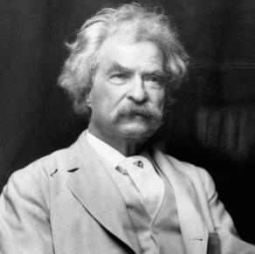
Life Is A Gift That Sin Obscures
“The two most important days in your life are the day you are born and the day you find out why.” – Mark Twain.
Where there is no vision, the people perish: but he that keeps the law, happy is he. Proverbs 29:18 (KJV)

Slide 13
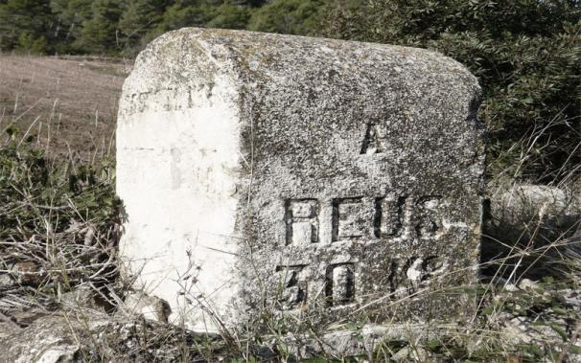
Do Not Move The Ancient Boundaries
Do not move an ancient boundary stone or encroach on the fields of the fatherless, Proverbs 23:10 (NIV)
He will speak against the Most High and oppress his saints and try to change the set times and the laws. The saints will be handed over to him for a time, times and half a time. Daniel 7:25 (NIV)

Slide 14
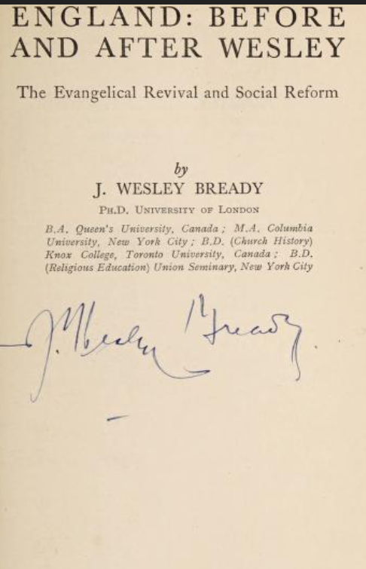
The Battle For Protecting Life
And J. Wesley Bready
“These show that, for example, between 1730-1750, 3 out of 4 of all children, born to all classes in London, died before their 5th birthday. James Hanway, the Christian friend of pauper children, produced scores of statistics, pamphlets, preserved in the British Museum library, revealing his investigations into the treatment and death-rate of the infant poor— death occurring time after time because of murder and the practice of exposing newly born babies to perish in the streets, as well as the placing of unhappy babies with heartless nurses, who would let them starve to death, or turned them into the streets to beg or steal.”
“A civilization is rightly judged by the way it treats people and when people are treated inhumanly they resort to desperate measures to survive.”

Slide 15
Meeting Spiritual and Physical Needs
THE LEADERS DURING WESLEY’S DAY
“Men who have become deeply impacted by a sense of their own immortality and their need for redemption in Christ, become interested in the physical well-being and the eternal welfare of others. It has always been so, and is still true, that men who have not a sense of man's immortal welfare have usually cared but little about his physical interests. Hospitals and churches, orphanages and missionary societies, usually grow out of the same spiritual root.” Author Unknown

Slide 16
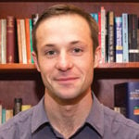
Mankind Always Finds A Way To Excuse Sin
Thou shalt not kill. Exodus 20:13 (KJV)
"'And you took your sons and daughters whom you bore to me and sacrificed them as food to the idols. Was your prostitution not enough? ²¹ You slaughtered my children and sacrificed them to the idols. Ezekiel 16:20-21 (NIV) (Direct Violation of Leviticus 18:21)
“Ethically speaking, is a fetus a person?”
“Ultimately, most people adopt a hybrid view of personhood, according to which an embryo is a non-person, while a late-term fetus is a person. Embryos have no capacity for sentience (yet alone consciousness), whereas a late-term fetus has basic capacities for processing stimuli from the external world.” Xavier Symons

Slide 17
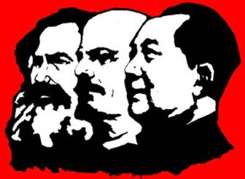
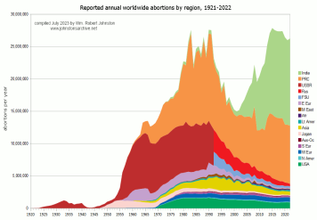
The Sobering Truth of Mankind’s Sinfulness
In the day of great slaughter, when the towers fall, streams of water will flow on every high mountain and every lofty hill. ²⁶ The moon will shine like the sun, and the sunlight will be seven times brighter - Isaiah 30:25-26 (NIV)
Communism killed 94.3 Million
World War 1 and World War 2 Killed 115 Million
World-wide abortions in the 20th Century over 1 Billion

Slide 18
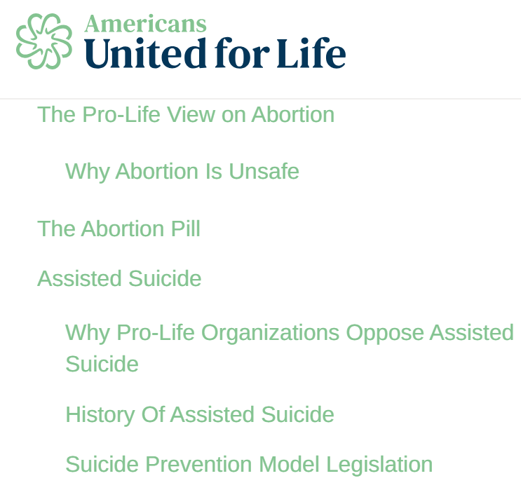
Many Issues Are Pro-Life Issues
The Hippocratic Oath is one of the oldest binding documents in history dating back to the 5th Century B.C. Its principles are held sacred by doctors to this day and still today, most graduating medical-school students swear to some form of the oath. Hippocrates was known as the father of medicine and the famous oath bears his name. One of the best know lines in the oath states: “I will prescribe regimens for the good of my patients according to my ability and my judgment and never do harm to anyone. To please no one will I prescribe a deadly drug nor give advice which may cause his death.”

Slide 19
The Devil Hates Life – And Always Is
Trying To Open The Door Of Slaughter
“American society has never sanctioned suicide or mercy killing. We believe that the practices would be profoundly dangerous for large segments of the population, especially in light of the widespread failure of American medicine to treat pain adequately or to diagnose and treat depression in many cases. The risks would extend to all individuals who are ill..”
This is what the LORD says: "If those who do not deserve to drink the cup must drink it, why should you go unpunished? You will not go unpunished, but must drink it. Jeremiah 49:12 (NIV)

Slide 20
Capturing The Heart Of God
For Every Life – Unborn and Walking This Earth
“GOD IS USING LOVE LIFE TO AWAKEN THE CHURCH. THIS ISN'T PRO LIFE ACTIVISM IT IS CHRISTIANITY 101. IT IS LOVING OUR NEIGHBOR AS WE LOVE OURSELVES. WHOLE FAMILIES ARE BEING MOVED FROM INSIDE THE FOUR WALLS OF THE CHURCH INTO THE FRONTLINES OF THE MISSION FIELD IN THEIR CITIES.” LOVE LIFE
“We are engaged in a great struggle for the soul and future of America. The fall of Roe V Wade didn’t end the fight against abortion: it multiplied it by 50.” America United For Life

Slide 21
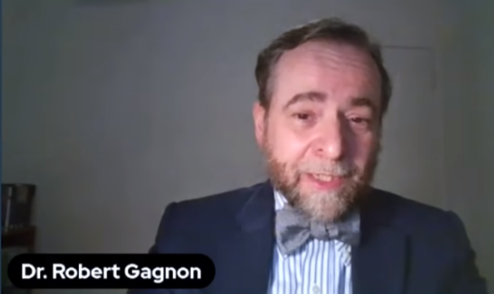
Loving Those Who Oppose You
Without Compromising
Yes it is possible to be sensitive, gentle, and loving without forcing the Church to act as if the lie is the truth.
The Church’s complicity in sexual delusion (Abortion) benefits no one, least of all the offender. Robert Gagnon - 2016
Robert Gagnon
Houston Christian
University
THERE IS A HUGE DIFFERENCE IN PROTECTING THE RIGHTS OF PEOPLE AND SANCTIONING AND PROMOTING THEIR BEHAVIOR – Don Lamb

Slide 22
Believing For The Converting
And Transforming Work Of God
To Still Bring Many To The Lord
In the day of great slaughter, when the towers fall, streams of water will flow on every high mountain and every lofty hill. ²⁶ The moon will shine like the sun, and the sunlight will be seven times brighter, like the light of seven full days, when the LORD binds up the bruises of his people and heals the wounds he inflicted. Isaiah 30:25-26 (NIV)

Slide 23
BE BOLD ABOUT –
Yet To Be Completed Prophecies
Behold, the days come, says the LORD, that the plowman shall overtake the reaper, and the treader of grapes him that soweth seed; and the mountains shall drop sweet wine, t. Amos 9:13 (KJV)
¹¹ The LORD will be terrible against them; He will shrivel all the gods of the earth,. Zephaniah 2:11
For the earth will be filled with the knowledge of the glory of the LORD, as the waters cover the sea. Habakkuk 2:14 (NIV)
One witness to the revival wrote, “…for if ever I was conscious, as far as a human spirit can be, of the presence of supernatural working, that was the time. Many felt and possessed unutterable things. It seemed that there was but a thin veil between us and the invisible world, and that Satan, for a season, was bound in chains…”

Slide 24
To Let Go Of Hope – To Relinquish Our
Covenantal Privileges of Being SALT AND LIGHT
Is To GRIEVE THE HEART OF GOD
⁸ The one who sows to please his sinful nature, from that nature will reap destruction; the one who sows to please the Spirit, from the Spirit will reap eternal life. ⁹ Let us not become weary in doing good, for at the proper time we will reap a harvest if we do not give up. ¹⁰ Therefore, as we have opportunity, let us do good to all people, especially to those who belong to the family of believers. Galatians 6:8-10 (NIV)
We are the John Wesley’s – we are the George Whitefield’s the William Wilberforce’s and Lord Shaftsbury’s – and Charles Finney’s who brought reformation through revival and social impact.

Slide 25
Let’s Pull This All Together
Pray for the pregnant mother’s to be convicted to bring their Children full-term. (ADOPT)
Pray for healing and salvation for those who have had abortions. (THERE IS FORGIVENESS)
Repent for the Church being a confused MESS over the last fifty years and STILL ASLEEP.
Pray for Ministries like LOVE LIFE and others who are on the front lines being one more boundary against evil. (5,700 saved in the last eight years)
Pray for this imminent invasion of heaven to be a wave of salvation through LIBERAL DOCTORS – so save 185,00 Doctors
Pray for 1 Billion person harvest to smack the enemy in the eye for the billion abortions that occurred.

