Slide 1

Mother’s Day Sermon
LifeGate Sermon
May 12, 2024

Slide 2
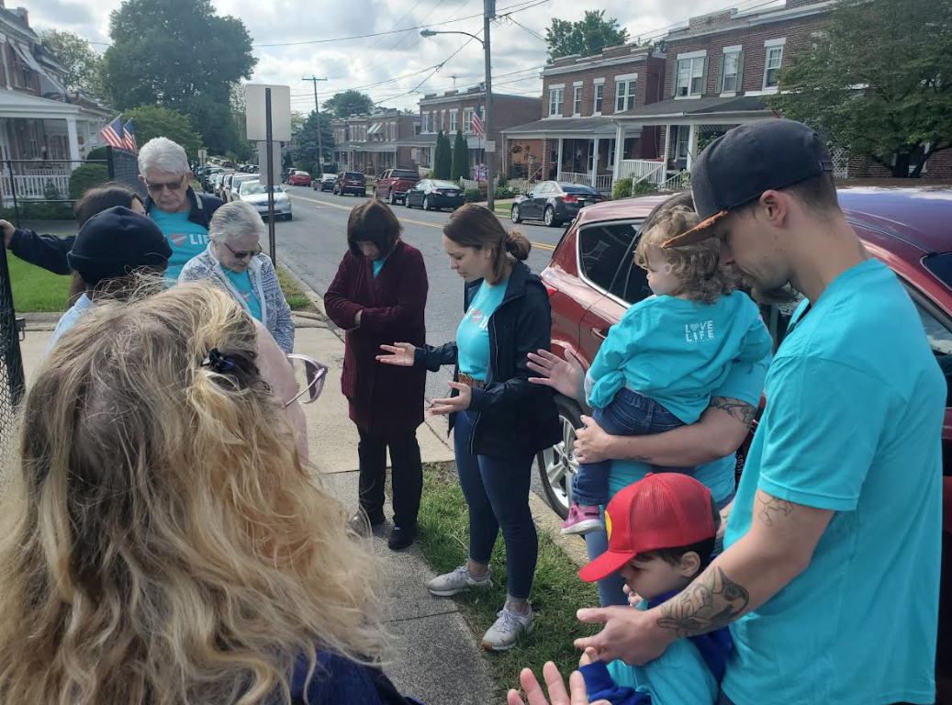
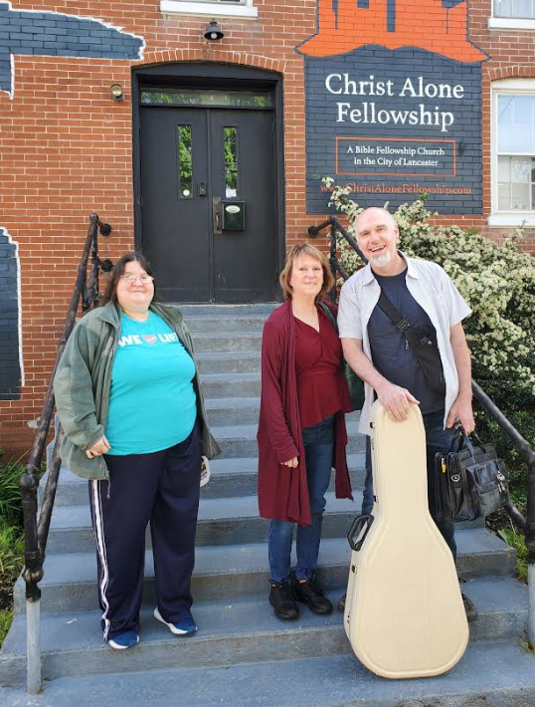

Slide 3
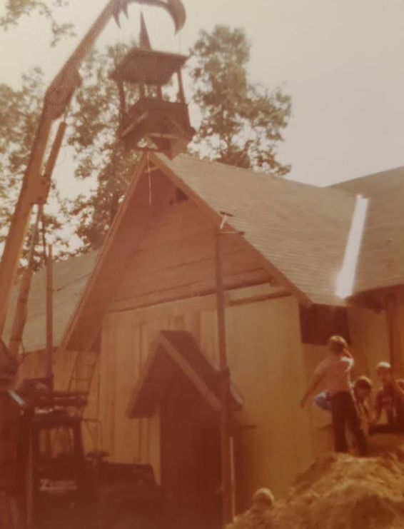
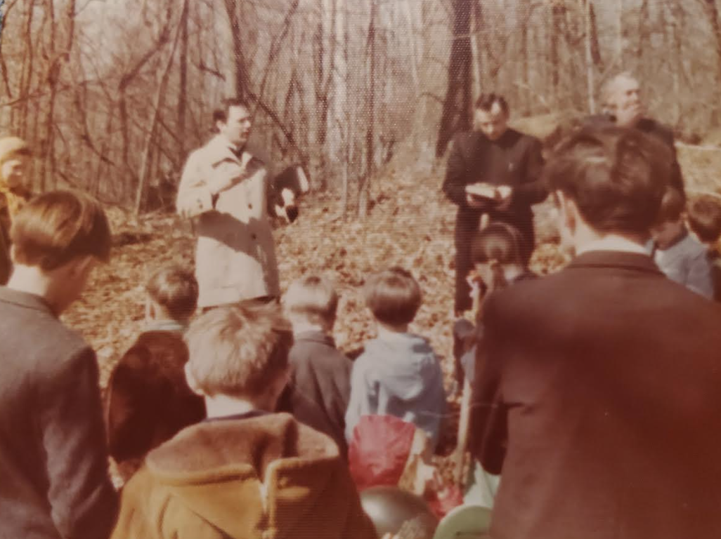
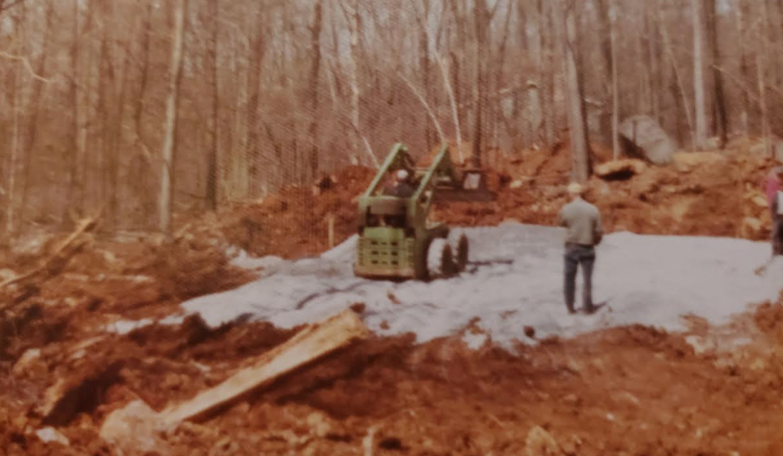
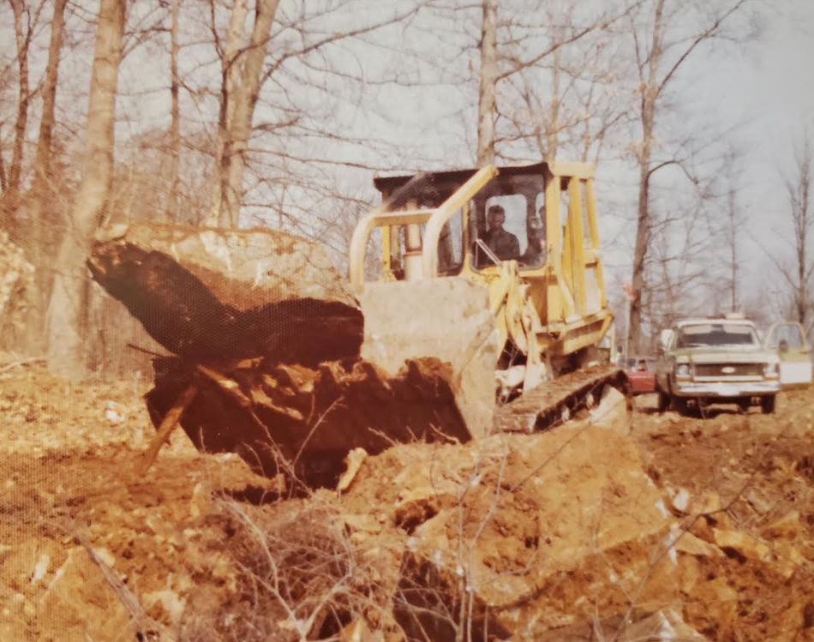

Slide 4
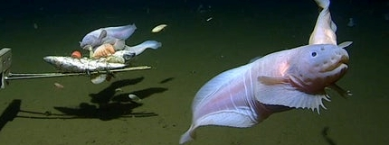
God’s Glorious Creation
This snailfish was found in August 2022 at the bottom of the Izu-Ogasawara Trench (25,000 ft), near the main islands of Japan.
My mouth will speak in praise of the LORD. Let every creature praise His holy name for ever and ever. Psalm 145:21 (NIV)
Praise the LORD from the earth, you great sea creatures and all ocean depths, Psalm 148:7 (NIV)

Slide 5
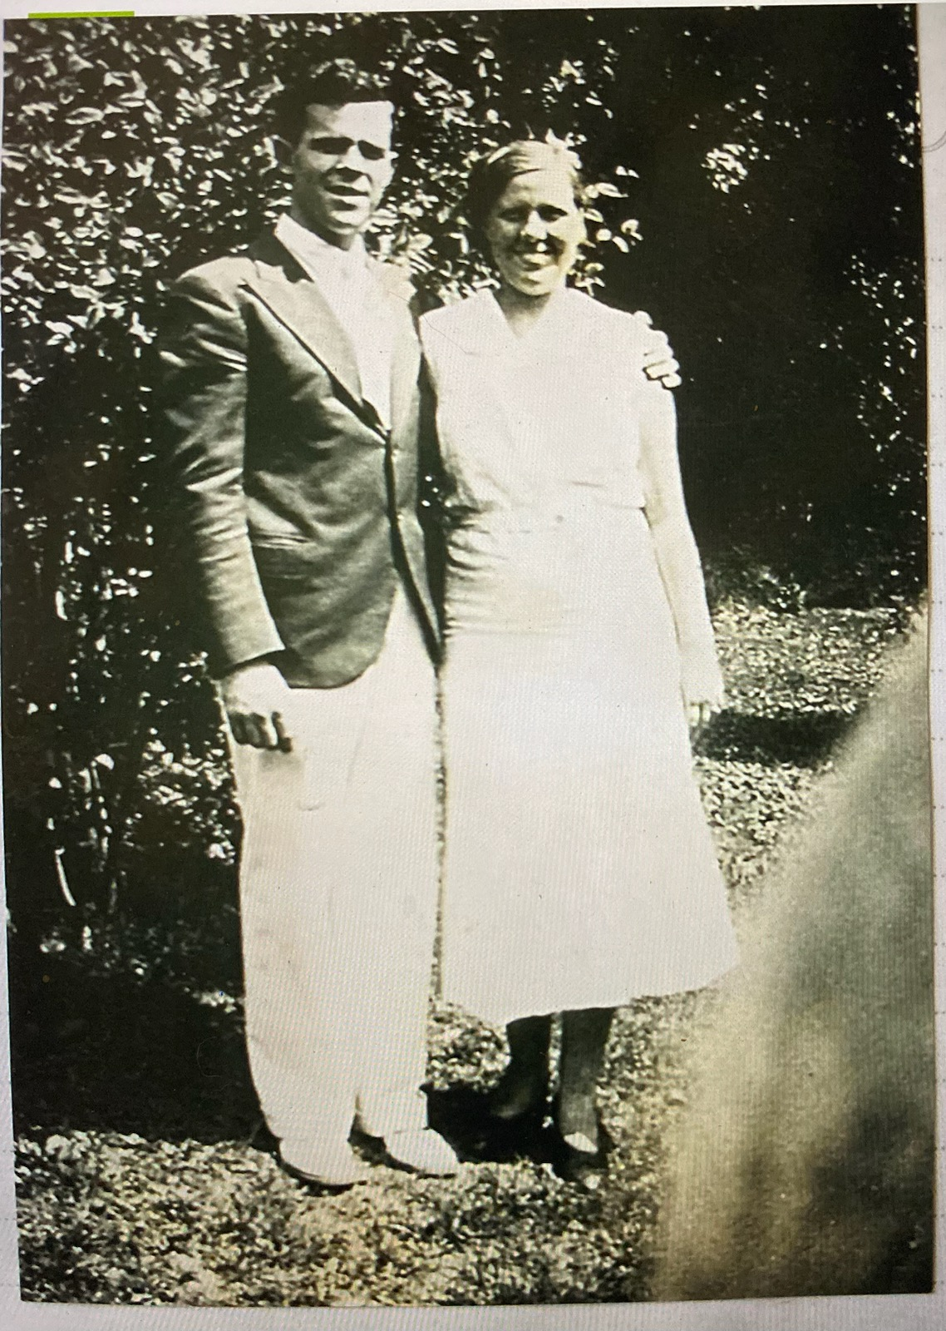
A Tribute to “Mom” Lambert
The LORD spoke to me with His strong hand upon me, warning me not to follow the way of this people. He said: 12 "Do not call conspiracy everything that these people call conspiracy; do not fear what they fear, and do not dread it. 13 The LORD Almighty is the one you are to regard as holy, he is the one you are to fear, he is the one you are to dread, 14 and he will be a sanctuary; but for both houses of Israel he will be a stone that causes men to stumble and a rock that makes them fall. And for the people of Jerusalem he will be a trap and a snare. Isaiah 8:11-14 (NIV)
Augusta Earnestina Raab (Lambert) born in Jownstown, PA. on July 19, 1911.

Slide 6

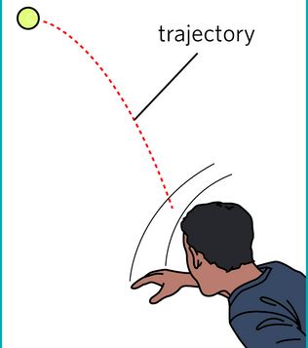
I LOVE THE TEACHINGS ON IDENTITY
But Sometimes It Annoys Me.
In the same way, count yourselves dead to sin but alive to God in Christ Jesus. Romans 6:11 (NIV)
Identity still has “I” in it – it can be
healthy or it can be idolatry.
Set your minds on things above, not on earthly things. ³ For you died, and your life is now hidden with Christ in God. Colossians 3:2-3 (NIV)
Identity
WHEN WE BECOME FOLLOWERS OF JESUS – WE LAY DOWN THESE DEMANDING APPETITES AND SINS AT THE CROSS – BUT WE PICK UP SOMETHING FROM JESUS THAT IS FAR GREATER THAN WHAT WE LAID DOWN – WE PICK UP ADORATION FOR A SACRIFICING KING, FORGIVENESS AND POWER AND GRACE- AND MOTIVATION AND SELF-CONTROL AND A BURNING DESIRE TO PLEASE THE LORD.

Slide 7

God Works to Redeem His Dream
HERE IS THE CRAZY THING – GOD ALLOWS EVIL – HE ALLOWS FREE WILLED PEOPLE TO REBEL AGAINST HIM – AND RUIN HIS BEST LAID PLANS FOR A SEASON – BUT IN A STUNNING DISPLAY OF MERCY OFFERS SALVATION TO REDEEM HIS ORIGINAL DREAM

Slide 8
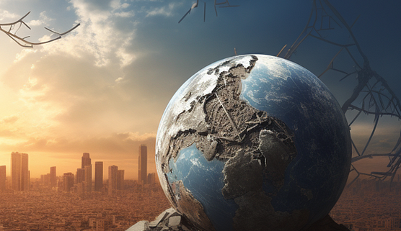
So - God Has Allowed The Earth
To Remain Fallen – For A Season
GOD ALLOWS SUFFERING – BUT HE BRINGS GRACE FOR EACH PROBLEM. HE COMES INTO YOUR SUFFERING. HE COMES INTO YOUR PAIN. HE COMES INTO YOUR LOSS. HE DIDN’T KEEP THE EARTH IN ITS PRISTINE PERFECT CONDITION – ONCE ADAM AND EVE FELL – HE DIDN’T IGNORE IT – AND BRING THE EARTH IMMEDIATELY BACK INTO PERFECTION – HE ALLOWED IT TO REMAIN FALLEN – THAT STUMBLES US – BUT IT IS WHAT HE CHOSE.
BUT THERE IS A PLAN : GOD IS TAKING THE SUFFERING AND THE CRAZINESS AND BRINGING OUT OF IT – A GREATER GLORY
I consider that our present sufferings are not worth comparing with the glory that will be revealed in us.
The creation waits in eager (earnest) expectation for the sons of God to be revealed. 20 For the creation was subjected to frustration, not by its own choice, but by the will of the One who subjected it, in hope 21 that the creation itself will be liberated from its bondage to decay and brought into the glorious freedom of the children of God. Romans 8:18-21

Slide 9

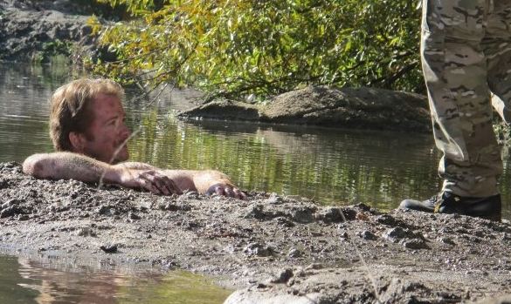
God Delights To
Rescue Us
From This Corrupt
Generation
Grace and peace to you from God our Father and the Lord Jesus Christ, ⁴ who gave himself for our sins to rescue (deliver, pluck, tear out) us from the present evil (hurtful, diseased, vicious, lewd) age, according to the will of our God and Father, ⁵ to whom be glory for ever and ever. Amen. Galatians 1:3-5 (NIV)
In this you greatly rejoice, though now for a little while you may have had to suffer grief in all kinds of trials. 7 These have come so that your faith--of greater worth than gold, which perishes even though refined by fire--may be proved genuine and may result in praise, glory and honor when Jesus Christ is revealed. 1 Peter 1:6-7 (NIV)

Slide 10

The Godhead Is a FAMILY- God wants
A Bigger Family
God Is Blessed and Excited To Make His People
Into the Image of His Son
For whom He did foreknow (foresaw), He also did predestinate to be conformed to the image of His Son, that He (Jesus) might be the firstborn among many brethren. Romans 8:29 (KJV)

Slide 11
God Delights in The Beauty He Has Conformed In You
Husbands, love your wives, just as Christ loved the Church and gave himself up for her ²⁶ to make her holy, cleansing her by the washing with water through the word, ²⁷ and to present her to Himself as a radiant church, without stain or wrinkle or any other blemish, but holy and blameless. Ephesians 5:25-27 (NIV)
But my dove, my perfect one, is unique, the only daughter, the favorite of the one who bore her. -- 10 Who is this that appears like the dawn, fair as the moon, bright as the sun, majestic as the stars in procession? Song of Songs 6:9a-10
WHEN THE FATHER SEES HIS GRACE, THROUGH JESUS, TRANSFORM YOU – EVEN THOUGH YOU HAVE BEEN THROUGH HELL AND HIGH WATER – AND HAVE AT TIMES SINNED AGAINST HIM – BUT ALLOWED YOURSELF TO BE PULLED BACK INTO HIS ARMS THROUGH REPENTANCE AND EXTRACTED FROM THIS SIN-SICK WORLD AND FALL IN LOVE WITH HIM – HE IS DOUBLY BLESSED BY THE BEAUTY YOU HAVE ALLOWED HIM TO WORK IN YOU

Slide 12

Jesus’ Work Of Rescuing
And Purifying His Bride
I will sprinkle clean water on you, and you will be clean; I will cleanse you from all your impurities and from all your idols. 26 I will give you a new heart and put a new spirit in you; I will remove from you your heart of stone and give you a heart of (Living – alive) flesh. 27 And I will put my Spirit in you and move you to follow my decrees and be careful to keep my laws.. Ezekiel 36:25-27 (NIV)
They will be my people, and I will be their God. ³⁹ I will give them singleness of heart and action, so that they will always fear me for their own good and the good of their children after them. ⁴⁰ I will make an everlasting covenant with them: I will never stop doing good to them, and I will inspire them to fear me, so that they will never turn away from me. ⁴¹ I will rejoice in doing them good and will assuredly plant them in this land with all my heart and soul. Jeremiah 32:38-41 (NIV)

Slide 13
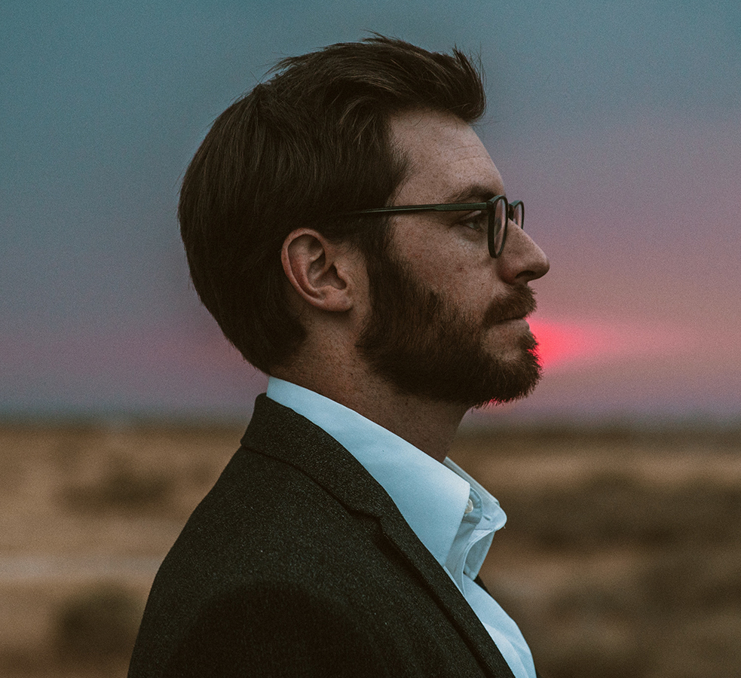

Mankind Is Wired For Pursuing:
The Question Is What Are You Pursuing?
From heaven the LORD looks down and sees all mankind; ¹⁴ from His dwelling place He watches all who live on earth-- ¹⁵ He who forms the hearts of all, who considers everything they do. Psalm 33:13-15 (NIV)
Greatest weapon of deliverance for men is the revelation Jesus Died on the Cross because of their lust – and calls them to leave the flesh through repentance and then find HIS PURPOSE in Christ is a more amazing ADVENTURE then the flesh – and PLEASURE comes through serving HIM.
A MAN’S PRIMARY DRIVER IS PLEASURE AND ADVENTURE
Greatest weapon of deliverance for women is the revelation Jesus is the only LOVER that never manipulated them to get something – And His love comes to save, HEAL - protect and faithfully provide. HE WILL ALWAYS BE FAITHFUL – build on Him and TRUST in HIM.
A WOMAN’S PRIMARY DRIVER IS NURTURING AND SECURITY

Slide 14
THE GLORY OF GOD TO MOTIVATE US
PAST OUR PRIMAL FLESH –TO BECOME LOVERS OF GOD
People will be lovers of themselves, lovers of money, boastful, proud, abusive, disobedient to their parents, ungrateful, unholy, ³ without love, unforgiving, slanderous, without self-control, -- , lovers of pleasure rather than lovers of God
-- ⁵ having a form of godliness but denying its power.. 2 Timothy 3:2-5 (NIV)
It is when we realize His sacrificial love for us and His selflessness (which is so compelling and captivating) that we enter into a life- giving relationship with HIM that we experience the power to overcome the flesh. It is when we hang out with God and it is when we adore and worship this chivalrous daring rescuing FRIEND (Whom we love to follow into battle) that we live in victory and intimacy.
Consequently, when we are drawn completely head over heels into the arms of our Savior, in those moments, the flesh and the world is but a distant annoying whisper of stupidity and of ranting about how it is offended we are ignoring it.

Slide 15
The Upside Down Kingdom
God Takes Us Into A Wilderness To Get Our Attention
"Therefore I am now going to allure (draw, persuade) her; I will lead her into the desert and speak tenderly to her. ¹⁵ --, and will make the Valley of Achor (trouble, tears) (Joshua 7:26) a door of hope (expectancy – the thing longed for). There she will sing as in the days of her youth, as in the day she came up out of Egypt. ¹⁶ "In that day," declares the LORD, "you will call me 'my husband'; you will no longer call me 'my master.' Hosea 2:14-16 (NIV)
Blessed are those whose strength is in you, who have set their hearts on pilgrimage. ⁶ As they pass through the Valley of Baca, (Weeping) they make it a place of springs; the autumn rains also cover it with pools. ⁷ They go from strength (valor) to strength (valor), till each appears before God in Zion. Psalm 84:5-7 (NIV)

Slide 16
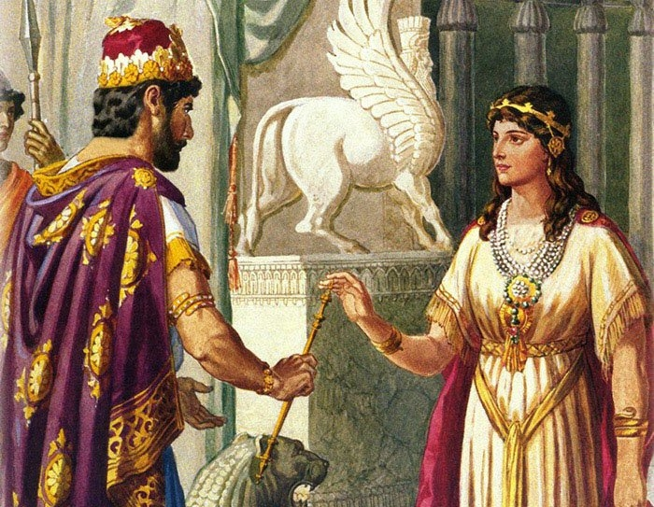
The Story Of Esther
Teaches Broader Picture Of God’s Heart
King Xerxes – was called King of Kings - A TYPE OF THE FATHER IN HEAVEN
Mordecai– was very wise counselor and helper- A TYPE OF THE Holy Spirit
Golden Scepter– was the only way you could see the King - A TYPE OF Jesus Christ – as our Mediator to the Father
Esther – as a beautiful bride is a picture of the Church THE BRIDE OF CHRIST – used to bring righteousness into the earth

Slide 17
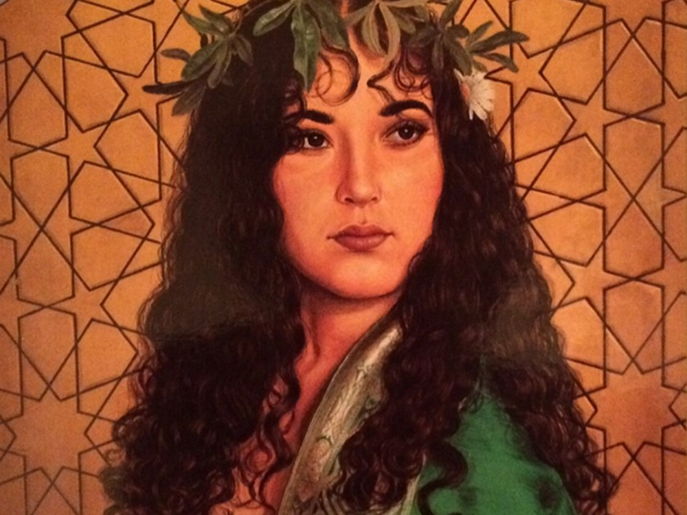
Queen Esther - A Type
Of The Bride of Christ
She was taken to King Xerxes in the royal residence - ¹⁷ Now the king was attracted to Esther more than to any of the other women, and she won his favor and approval more than any of the other virgins. So he set a royal crown on her head and made her queen instead of Vashti. Esther 2:16-17 (NIV)
My dove (BRIDE) in the clefts of the rock, in the hiding places on the mountainside, show me your face, let me hear your voice; for your voice is sweet, and your face is lovely. 15 Catch for us the foxes, the little foxes that ruin the vineyards. Song of Songs 2:14-15 (NIV)

Slide 18
Successfully Recovering Hearts Is Absolutely Marvelous to God
And Jesus Marveled (Mark 6:6 – lack of faith 8:10 - faith )
GOD THINKS ITS MARVELOUS THAT YOU HAVE SURRENDERED TO HIS WORK IN YOU, THROUGH HIS SON, ALLOWING THE BEAUTY OF SON TO COME FORTH EVEN IN THIS FALLEN WORLD
³ This is what the LORD says: "I will return to Zion and dwell in Jerusalem. Then Jerusalem will be called the City of Truth, and the mountain of the LORD Almighty will be called the Holy Mountain." Zechariah 8:3 (NIV)
This is what the LORD Almighty says: "It may seem marvelous (distinguishing wonderful work – great difficulty – to accomplish hard things) to the remnant of this people at that time, but will it seem marvelous (Same as above) to Me?" declares the LORD Almighty. Zechariah 8:6

Slide 19

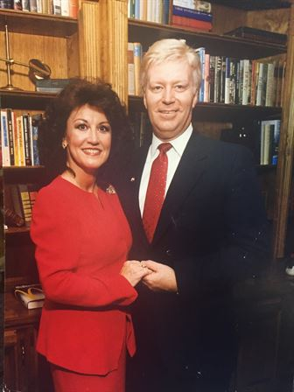
Leaning Into The Purpose Of God
On that day they will say to Jerusalem, "Do not fear, O Zion; do not let your hands hang limp. ¹⁷ The LORD your God is with you, He is mighty to save. He will take great delight in you, He will quiet you with His love, He will rejoice over you with singing." Zephaniah 3:16-17 (NIV)
Former Georgia Senator
Michael Crotts
Established State Constitutional Amendment To protect Traditional Marriage

Slide 20
As the Esther’s In The Land
God Wants You To KNOW HIS HEART -
And then KNOW HE IS PROUD OF YOU
Allowing Him To WORK OUT HIS PURPOSE
Then I heard what sounded like a great multitude, like the roar of rushing waters and like loud peals of thunder, shouting: "Hallelujah! For our Lord God Almighty reigns. ⁷ Let us rejoice and be glad and give him glory! For the wedding of the Lamb has come, and His bride has made herself ready. ⁸ Fine linen, bright and clean, was given her to wear." (Fine linen stands for the righteous acts of the saints.) Revelation 19:6-8 (NIV)

Slide 21
What A Privilege to Love You Lord
1. What a privilege to love You Lord, what a joy to know full surrender
To be brought into the freedom, of confessing You the only King
What an honor to be sold out for You Jesus,
What a tribute to Your heart of mercy
That I’m brought into this fellowship, being saved through Your suffering
Chorus
We’re finding light in spite of the darkness Lord,
We’re gaining peace in spite of the war
You are the center of all we dream,
You are the Source of all we’ll ever be
2. What a privilege to be Your holy Bride,
What a comfort to be dressed in robes of white
To be brought into Your chambers, to know Your passion for the Church
What an honor to be given over for Your mission,
What a blessing to be clothed in Your Spirit
To be moved by Your presence, bringing Your kingdom on the earth
Words and Music by Don Lamb - Copyright 2004

Slide 22
Let’s Pull This All Together
Confess any wounds, unforgiveness – any strongholds where your heart still holds on to resentment of being taken advantage of.
Allow God to ALLURE you to Himself in the desert and in the wilderness - as you put your HOPE in Him HE IS GOING TO HEAL YOU.
Take on the Esther Mind-set – I will RISK EVERYTHING to stand before the King of Kings and see deliverance happen all around me.
Meditate on the EXCITEMENT that God has over you that He is able to captivate your heart and build the image of His Son in you.

