Slide 1

Walking In His Greatness
Grasping That We Are Part Of Something Bigger Than Ourselves
Father’s Day Sermon
LifeGate
June 16, 2024

Slide 2
Thus may the name of our Lord Jesus Christ be glorified and become more glorious through and in you, and may you also be glorified in Him according to the grace of our God and the Lord Jesus Christ.
2 Thessalonians 1:12 (AMP)

Slide 3
It’s Not About Achieving Greatness
It’s About Knowing His Greatness
It’s Not About being true to yourself
And following your heart
It’s about being true to God
And following His heart
It’s not about making yourself happy
It’s about Pleasing the Lord
Only When You Are surrendered to Jesus
Are you truly Part of Something Bigger Than Yourself

Slide 4

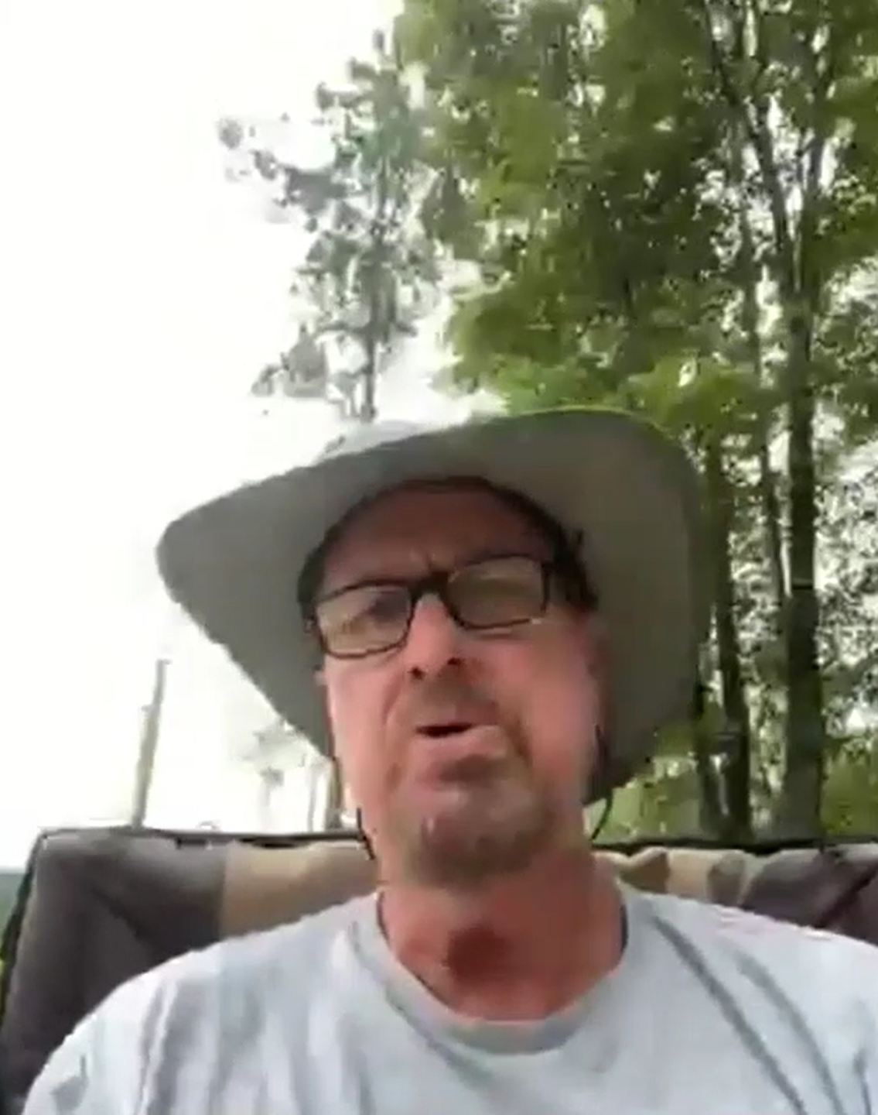
A powerful Video/ Book

Slide 5
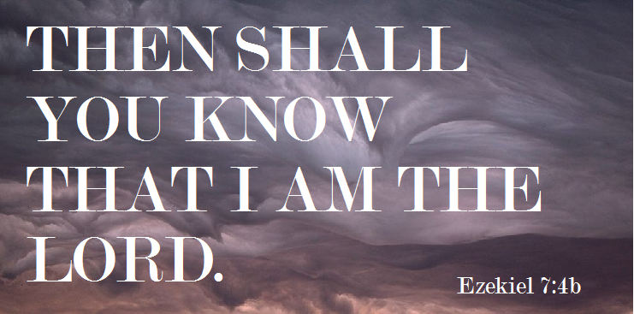
In Spite of How You Feel Emotionally
God Is Working To Come Through Our Impossibilities
Therefore, will I magnify (to make large – exceedingly excellent – lift up) Myself, and sanctify (pronounce holy) Myself; and I will be known (recognized) in the eyes of many nations, and they will know that I am the LORD. Ezekiel 38:23 (KJV)

Slide 6
Thoughts In The Middle of The Turning
“We are in the season where we present problems – but no one agrees to the solutions yet. So it is quite challenging. May God’s grace help us to build on solutions that really work – and sometimes they will go against the national movements that have hidden agendas of manipulation and confusion. We will need persevering leadership as we are embroiled in these disputes. Above all, may we possess the tact, patience, and fairness in dealing with those who oppose our viewpoint.

Slide 7


Mankind Is Wired For Pursuing:
The Question Is What Are You Pursuing?
From heaven the LORD looks down and sees all mankind; ¹⁴ from His dwelling place He watches all who live on earth-- ¹⁵ He who forms the hearts of all, who considers everything they do. Psalm 33:13-15 (NIV)
Greatest weapon of deliverance for men is the revelation Jesus Died on the Cross for their sin – and He calls them to leave their lust through repentance and find PURPOSE IN CHRIST which is more amazing then any sin – and to WALK IN THE ADVENTURE that comes through serving HIM.
A MAN’S PRIMARY DRIVER IS PLEASURE AND ADVENTURE
Greatest weapon of deliverance for women is the revelation Jesus is the only LOVER that never manipulated them to get something – And His love comes to save, HEAL - protect and faithfully provide. HE WILL ALWAYS BE FAITHFUL – build on Him and TRUST in HIM.
A WOMAN’S PRIMARY DRIVER IS NURTURING AND SECURITY

Slide 8

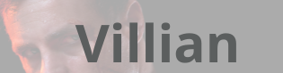


God Is Calling Us To Know Our
Purpose And Mission
John Eldredge's book "Wild at Heart" explores the nature of masculinity and spirituality, offering a provocative perspective on what it means to be a man. Eldredge argues that men are inherently designed for adventure, risk, and a battle to fight, qualities often stifled by societal expectations.

Slide 9
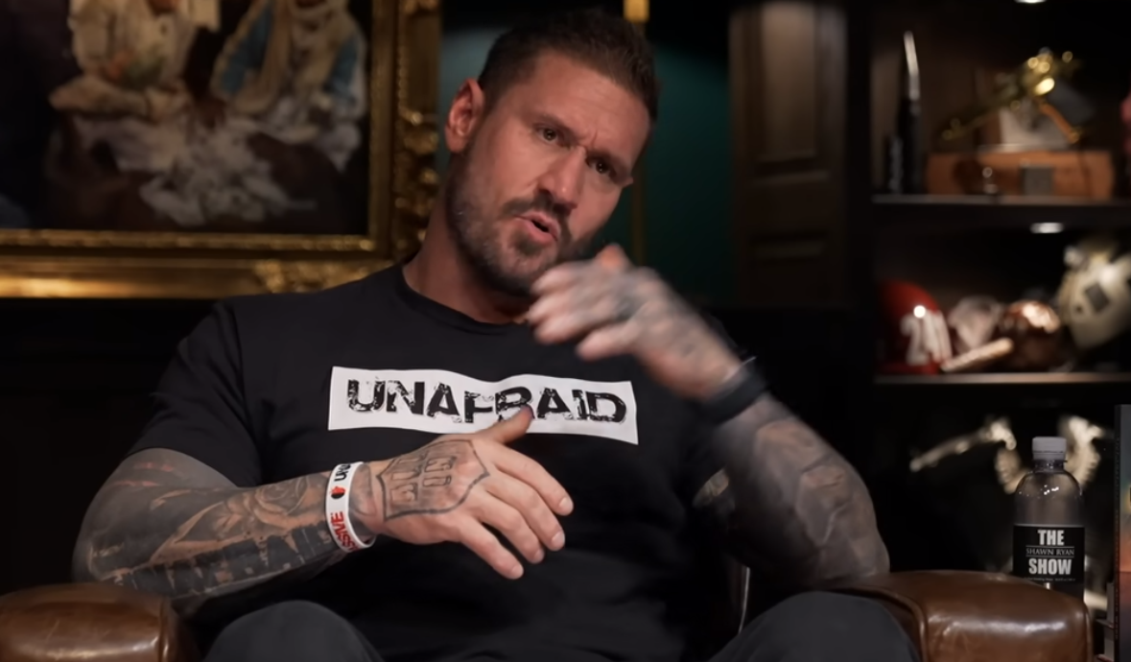
Eddie Penney Seal Team Six
“The church has become weak and we are AFRAID to stand up and be counted. Yes we must embrace love, forgiveness and grace and turn the other cheek. But we have to teach our children how to stand up and not be afraid – to resist evil and overcome.”

Slide 10
Lord Awaken Destiny and Purpose
You were redeemed from the empty (vain- profitless) way of life handed down to you from your forefathers, ¹⁹ but with the precious blood of Christ, a lamb without blemish or defect. 1 Peter 1:18-19 (NIV)
And we know that in all things God works for the good of those who love Him, who have been called according to His purpose (display of His intention). ²⁹ For those God foreknew He also predestined to be conformed to the likeness of His Son, that He might be the firstborn among many brothers. ³⁰ And those He predestined, He also called; those He called, he also justified; those He justified, He also glorified. ³¹ What, then, shall we say in response to this? If God is for us, who can be against us? ³² He who did not spare His own Son, but gave Him up for us all--how will He not also, along with Him, graciously give us all things? Romans 8:28-32 (NIV)

Slide 11
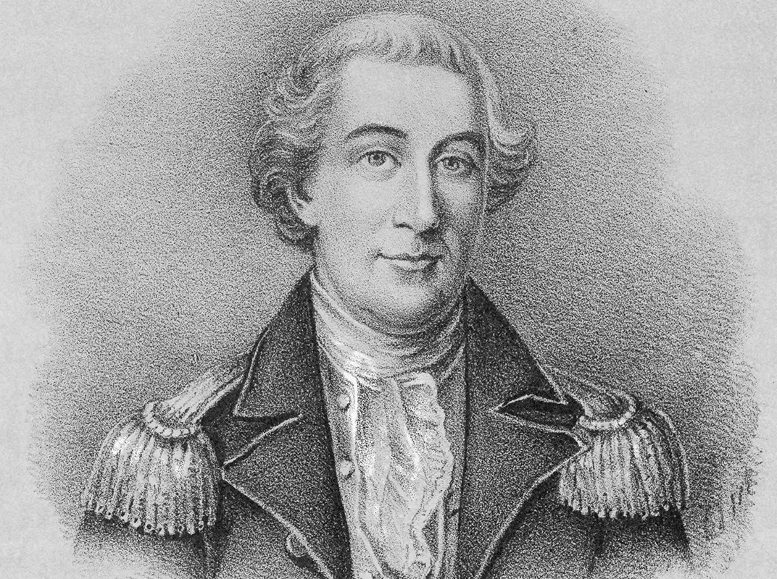
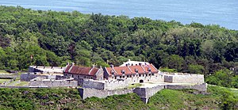
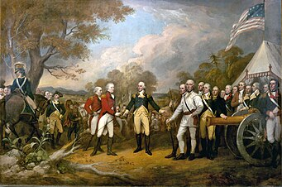
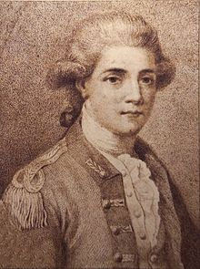
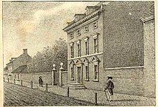
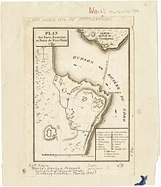
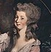
The Tragic Story
Of Benedict Arnold
And The Providence of God
Fort Ticonderoga taken
May 10, 1775 by Ethan Allen and Arnold
Becomes the Hero of The Battle of Saratoga
September – October 1777 injured – out of action
First wife Margaret died on June 19, 1775
Two American rebels (under the command of Colonel James Livingston), and Moses Sherwood, fired on HMS Vulture, (Sept 22, 1780)
Moves to Liberated
Philadelphia Summer 1778
Marries 18 yr old
Peggy Shippen
1780- Spy – British Major John Andre
Offered 5 million dollars for the capture of West Point
André was captured on September 23 by three militiamen, and the information to West Point was found

Slide 12
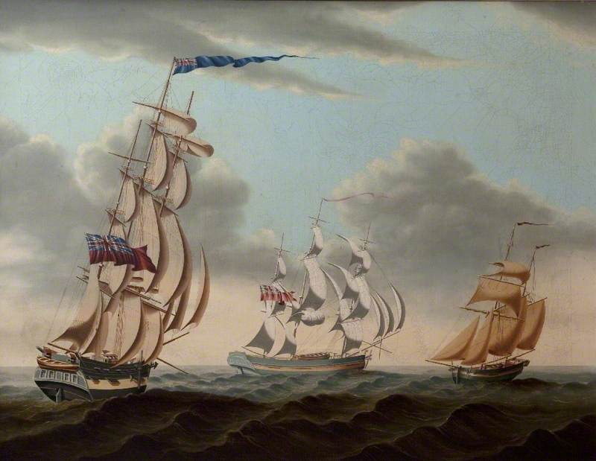
What Happened To Benedict Arnold
According to W. D. Wetherell, he was:
[A]mong the hardest human beings to understand in American history. Did he become a traitor because of all the injustice he suffered, real and imagined, at the hands of the Continental Congress and his jealous fellow generals? Because of the constant agony of two battlefield leg wounds? From psychological wounds received in his Connecticut childhood when his alcoholic father squandered the family's fortunes? Or was it a kind of extreme midlife crisis, or his marriage to the very young, very pretty, very Tory Peggy Shippen (Who was previously dating Major Andre)?
General Arnold wrote to General Greene and “lamented over the "deplorable" and "horrid" situation of the country at that particular moment, citing the depreciating currency, disillusionment of the army, and internal fighting in Congress, while predicting "impending ruin" if things did not change soon. (1779)
Grew up poor from an alcoholic father
He lived extravagantly in Philadelphia
The Revolution
Finalized the loss of his ships

Slide 13
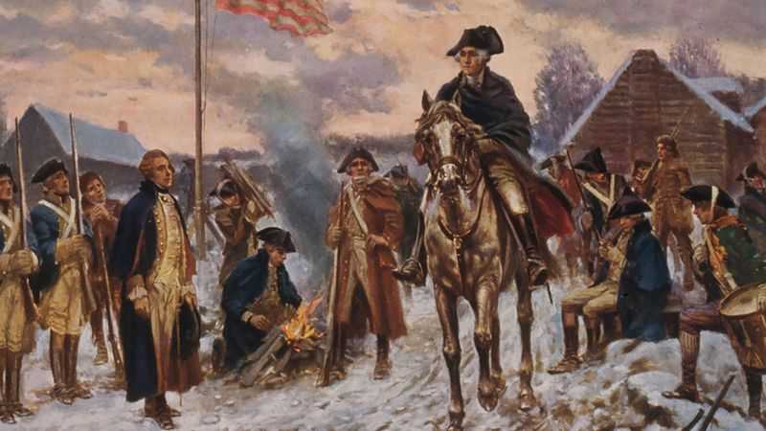
General orders September 26th 1780
(WASHINGTON’S HEADQUARTERS)
A great betrayal has been exposed:
Such an event (if successful) must have given the American cause a deadly wound if not a fatal stab. Happily the treason had been timely discovered to prevent the Fatal Misfortune. The Providential chain of events which led to this discovery affords the most convincing proof that the Liberties of America are the object of Divine protection.

Slide 14
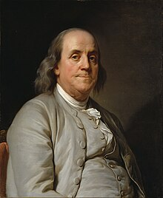
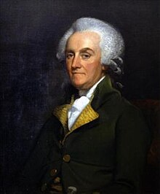
A Father’s Tale of Sorrow
Benjamin Franklin’s Son turned against His dad
Benjamin Franklin
Born January 1706 - last of 15 children to Josiah Franklin
William Franklin Son Of Benjamin Franklin
The last Royal Governor of New Jersey

Slide 15

God Calling Us To Know Our
Purpose And Mission
Beyond Just Salvation
Lance Wallnau
“Suppose God asked you if you wanted the ability to open up heaven with your prayer life so that you could come up into His very presence and discern His plan and His purposes and His detailed blueprint for what you're called to do as a individual or a couple.”
“And then suppose God added to that and said and I'm going to give you the power over every demon and earthly circumstance that gets in your way when you want to administrate that vision I'm going to give you.”

Slide 16



The Unfolding Of Understanding
Of Not Only Our Salvation - But OUR PURPOSE In Salvation
My purpose is that they may be encouraged in heart and united in love, so that they may have the full riches of complete understanding, in order that they may know the mystery of God, namely, Christ, 3 in whom are hidden all the treasures of wisdom and knowledge. Colossians 2:2
We constantly pray for you, that our God may count you worthy of His calling, and that by His power he may fulfill every good purpose of yours and every act prompted by your faith.
2 Thessalonians 1:11 (NIV)

Slide 17
THE POWER OF DECLARING THE WILL OF GOD
FROM A POSITION OF ABIDING IN CHRIST
We have learned in our mission work that we have one great enemy standing against PREVAILING FAITH – It is within us, and IT IS NOT IN OUR CIRCUMSTANCES – but it is our ignorance and unbelief about the invisible power of God. We have learned to DECLARE A THING – AND IT WILL BE ESTABLISHED. (Job 22:28)
“In Jesus' Name we break through the hindering spirits. We declare the prayer of faith, 'That Government or stronghold will give way', 'That area will be opened', 'That money will come', 'Those souls will be saved'. The word, if we are (guided by the Holy Spirit) and rightly abiding in Christ, is spoken in the same power and through the same Person who made the declaration at the dawn of history, 'Let there be light'. It is repeated again and again as occasion arises; not always even as prayer, but many times as praise, of an answer already given, a calling of those things that are not as though they were. (Rom. 4:17) As we do that, the manifestation of the thing believed for comes to pass as surely as the harvest follows the sowing of seed. NORMAN GRUBB

Slide 18
The Ephesians Three Prayer
I bow my knees before the Father of our Lord Jesus Christ, ¹⁵ For Whom every family in heaven and on earth is named - that Father from Whom all fatherhood takes its title and derives its name. ¹⁶ May He grant you out of the rich treasury of His glory to be strengthened and reinforced with mighty power in the inner man by the Holy Spirit indwelling your innermost being and personality. ¹⁷ May Christ, through your faith dwell, abide, make His permanent home in your hearts! May you be rooted deep in love and founded securely on love, ¹⁸ That you may have the power and be strong to apprehend and grasp with all the saints what is the breadth and length and height and depth of God’s love.

Slide 19
The Ephesians Three Prayer
¹⁹ That you may really come to know practically, through experience the love of Christ, which far surpasses mere knowledge; that you may be filled through all your being unto all the fullness of God – and may have the richest measure of the divine Presence, and become a body wholly filled and flooded with God Himself! ²⁰ Now to Him Who, by the action of His power that is at work within us, is able to carry out His purpose and do superabundantly, far over and above all that we dare ask or think - infinitely beyond our highest prayers, desires, thoughts, hopes, or dreams — ²¹ To Him (FATHER) be glory in the Church and in Christ Jesus throughout all generations forever and ever. Amen (so be it). Ephesians 3:14-21 (AMP)

Slide 20
The Height The Length The Breadth
And The Depth Of God’s Love
THE HEIGHT OF HIS LOVE – COULD REPRESENT – UNFATHOMABLE MERCY AND FORGIVENESS – AN UNLIMITED GRACE TO KEEP DRAWING US TO THE FATHER’S HEART – HIGHER THAN THE HIGHEST HEAVENS (Psalm 108:4)
THE LENGTH OF HIS LOVE – COULD BE THE PURSUING LOVE OF GOD GOING TO ANY LENGTH TO RESCUE US FROM OUR REBELLION AND BONDAGE. IT WILL NOT STOP AS LONG AS WE HAVE BREATH IT WILL GIVE US THE LENGTH OF ITS UNLIMITEDNESS TO REACH OUT AND TAKE HOLD OF IT. – IT IS ACCESSIBLE. (Isaiah. 49:16)
THE BREADTH OF HIS LOVE COULD BE THAT IT WILL UNCOVER THE THINGS WE DO NOT WANT TO ADDRESS – IT WILL PURIFY THE THINGS THAT PERSISTENTLY HOLD US IN LIMITATION – IT WILL NOT COMPROMISE WHEN EVERYTHING TRIES TO PUSH GOD’S LOVE INTO A NARROW VIEW OF SENTIMENTALITY – IT WILL STAY UNRESTRICTED – NOT A LICENSE SO EVERYONE CAN GET AWAY WITH THEIR LAWLESS REBELLION
THE DEPTH OF HIS LOVE – IS THE UNENDING DISCOVERY OF THE HOLINESS AND POWER OF THIS LOVE THAT PLUMBS THE DEPTHS OF REVELATION AND UNDERSTANDING BEYOND OUR WILDEST DREAMS. (Romans 8:28-39)

Slide 21
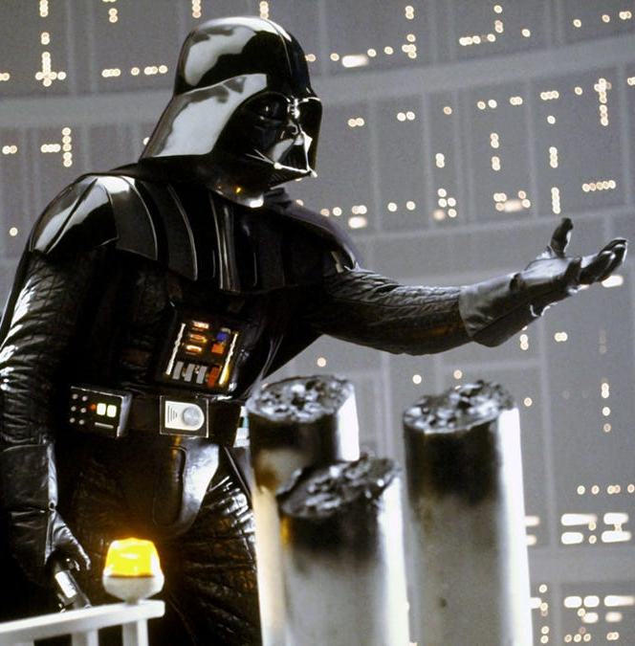

Without Hungering For
More Of The Lord’s Presence
And the Power of the Holy Spirit

Slide 22
Let’s Pull This All Together
Confess any wounds, unforgiveness – any strongholds where your heart wants salvation only –you cannot see any further – you are paralyzed by life’s burdens and you have no greater vision of being PART OF HIS GREATER STORY.
Stretch yourself – push yourself by RELYING ON THE HOLY SPIRIT.
Meditate on the PURPOSE that God has for you that He is able to captivate your heart and build the image of His Son in you.

Slide 23
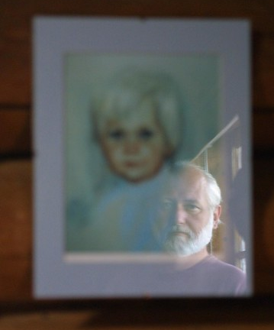
God Delights in The Character He Has Conformed In You
Husbands, love your wives, just as Christ loved the Church and gave Himself up for her ²⁶ to make her holy, cleansing her by the washing with water through the word, ²⁷ and to present her to Himself as a radiant church, without stain or wrinkle or any other blemish, but holy and blameless. Ephesians 5:25-27 (NIV)
WHEN THE FATHER SEES HIS GRACE, THROUGH JESUS, FORMED WITHIN YOU – EVEN THOUGH YOU HAVE BEEN THROUGH HELL AND HIGH WATER – AND HAVE AT TIMES SINNED AGAINST HIM – BUT ALLOWED YOURSELF TO BE PULLED BACK INTO HIS ARMS THROUGH REPENTANCE AND EXTRACTED FROM THIS SIN-SICK WORLD AND FALL IN LOVE WITH HIM – HE IS DOUBLY BLESSED BY THE BEAUTY YOU HAVE ALLOWED HIM TO WORK IN YOU

Slide 24


The Trap In Our Generation
Is That We Are Simply REACTING to Life
And Not Being Guided By God Strategically
Since You are my Rock and my Fortress, for the sake of Your name lead (govern – bring forth straighten) and guide (to flow in such a way as to guide you gently) me. ⁴ Free me (pull me out) from the trap that is set for me, for You are my refuge. Psalm 31:3-4 (NIV)

