Slide 1
SOUL PATROL 2024

Slide 2
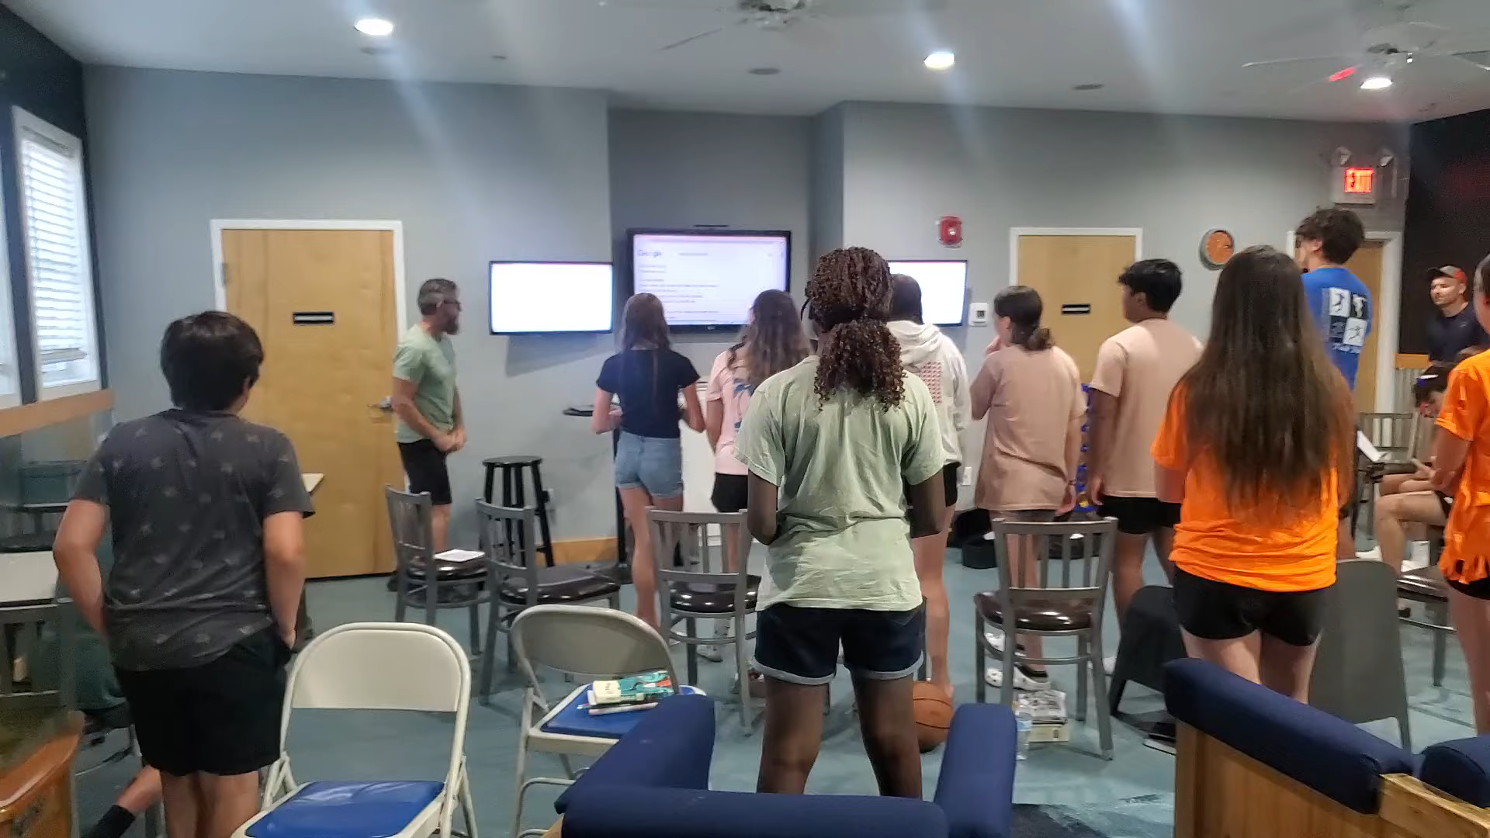

Slide 3


Slide 4


Slide 5


Slide 6


Slide 7
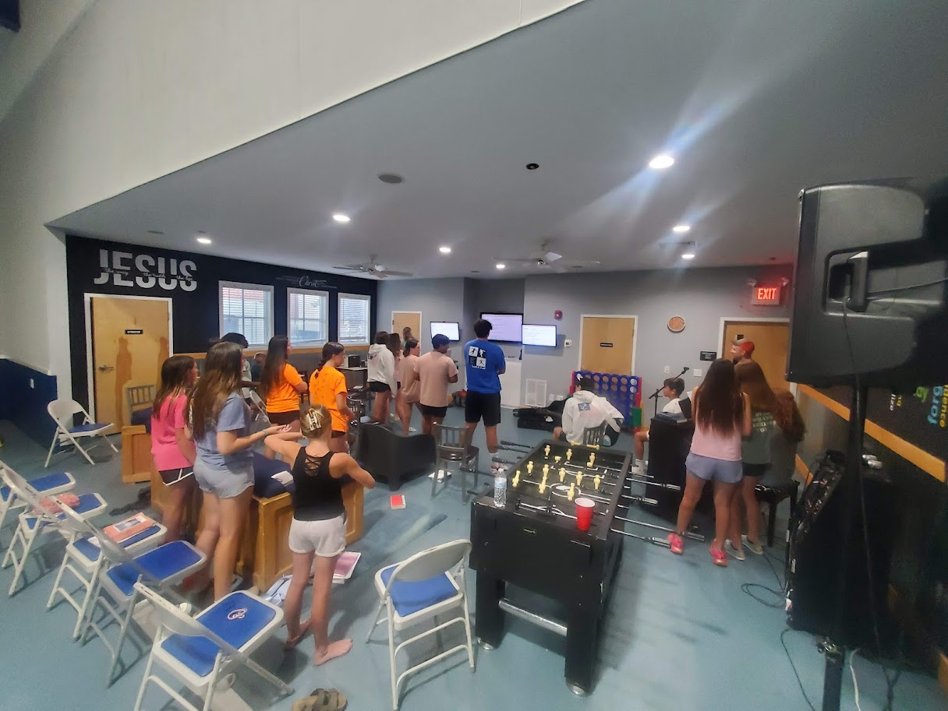

Slide 8


Slide 9


Slide 10
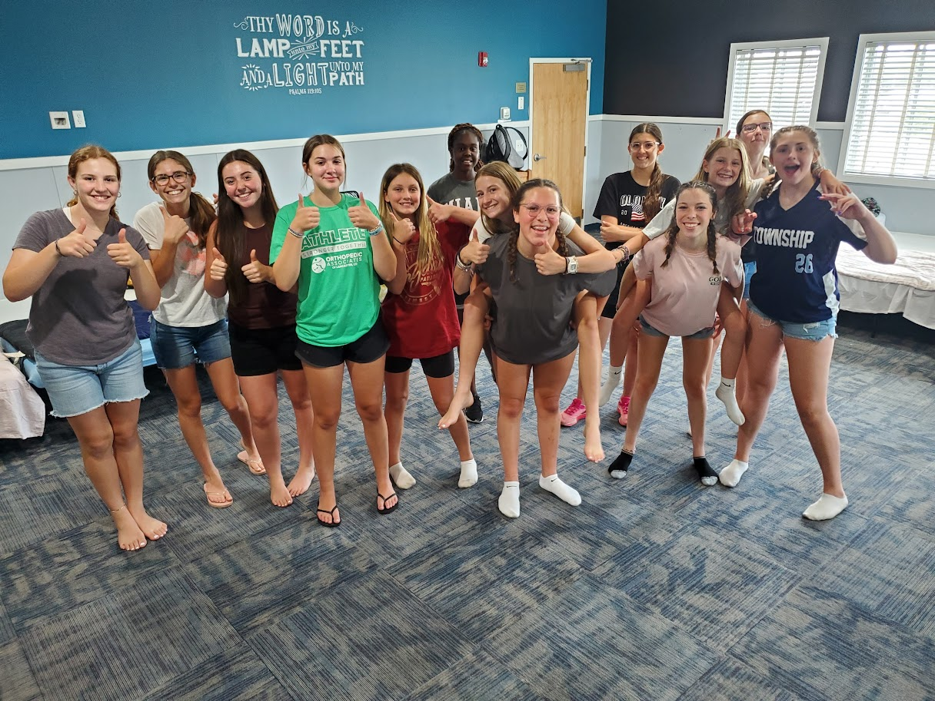

Slide 11
Draw near to God with reverent fear and humility.
Lifegate
7/14/24

Slide 12
James 4:1-10
Submit Yourselves to God
What causes fights and quarrels among you? Don’t they come from your desires that battle within you? 2 You desire but do not have, so you kill. You covet but you cannot get what you want, so you quarrel and fight. You do not have because you do not ask God. 3 When you ask, you do not receive, because you ask with wrong motives, that you may spend what you get on your pleasures.
4 You adulterous people,[An allusion to covenant unfaithfulness; see Hosea 3:1] don’t you know that friendship with the world means enmity against God? Therefore, anyone who chooses to be a friend of the world becomes an enemy of God. 5 Or do you think Scripture says without reason that he jealously longs for the spirit he has caused to dwell in us[Or that the spirit he caused to dwell in us envies intensely; or that the Spirit he caused to dwell in us longs jealously]?

Slide 13
James 4:1-10
6 But he gives us more grace. That is why Scripture says:
“God opposes the proud
but shows favor to the humble.”[Proverbs 3:34]
7 Submit yourselves, then, to God. Resist the devil, and he will flee from you. 8 Come near to God and he will come near to you. Wash your hands, you sinners, and purify your hearts, you double-minded. 9 Grieve, mourn and wail. Change your laughter to mourning and your joy to gloom. 10 Humble yourselves before the Lord, and he will lift you up.

Slide 14
APPROACH MATTERS…
Proverbs 9:10
“The fear of the Lord is the beginning of wisdom,
and knowledge of the Holy One is understanding.” [NIV]
“The [reverent] fear of the Lord [that is, worshiping Him and regarding Him as truly awesome] is the beginning and the preeminent part of wisdom [its starting point and its essence],
And the knowledge of the Holy One is understanding and spiritual insight.” [AMP]

Slide 15
Strongs # 3374 (Prov 9:10)
The translated word for “fear”
The Hebrew word: Yirah
Definition/usage includes reverence
See AMP [“fear… that is worshiping Him”]

Slide 16

Are you are struggling with feeling connected to the Lord?…
does god feel distant?

Slide 17
…Spend time in reverent fear and awe of the Lord
Proverbs 1:28-31
28“Then they will call to me but I will not answer;
they will look for me but will not find me,
29 since they hated knowledge
and did not choose to fear the Lord.
30 Since they would not accept my advice
and spurned my rebuke,
31 they will eat the fruit of their ways
and be filled with the fruit of their schemes.

Slide 18
If you seek understanding and closeness with the Lord, begin with a reverent fear
Proverbs 2:5 AMP (3-11)
5 Then you will understand the [reverent] fear of the Lord [that is, worshiping Him and regarding Him as truly awesome]
And discover the knowledge of God.

Slide 19
Reverent fear of the Lord
Psalms 111:1-10
Praise the Lord!
1 I will give thanks to the Lord with my whole heart, in the company of the upright, in the congregation.
2 Great are the works of the Lord, studied by all who delight in them.
3 Full of splendor and majesty is his work, and his righteousness endures forever.
4 He has caused his wondrous works to be remembered; the Lord is gracious and merciful.
5 He provides food for those who fear him; he remembers his covenant forever.

Slide 20
Psalms 111:1-10
6 He has shown his people the power of his works, in giving them the inheritance of the nations.
7 The works of his hands are faithful and just; all his precepts are trustworthy;
8 they are established forever and ever, to be performed with faithfulness and uprightness.
9 He sent redemption to his people; he has commanded his covenant forever. Holy and awesome is his name!
10 The fear of the Lord is the beginning of wisdom; all those who practice it have a good understanding. His praise endures forever!

Slide 21
Reverence and Awe of the Lord
Psalms 19: 7-14
7 The law of the Lord is perfect, reviving the soul; the testimony of the Lord is sure, making wise the simple;
8 the precepts of the Lord are right, rejoicing the heart; the commandment of the Lord is pure, enlightening the eyes;
9 the fear of the Lord is clean, enduring forever; the rules of the Lord are true, and righteous altogether.
10 More to be desired are they than gold, even much fine gold; sweeter also than honey and drippings of the honeycomb.

Slide 22
Reverence and Awe of the Lord
Psalms 19: 7-14
11 Moreover, by them is your servant warned; in keeping them there is great reward.
12 Who can discern his errors? Declare me innocent from hidden faults.
13 Keep back your servant also from presumptuous sins; let them not have dominion over me! Then I shall be blameless, and innocent of great transgression.
14 Let the words of my mouth and the meditation of my heart be acceptable in your sight, O Lord, my rock and my redeemer.

Slide 23
Humility
The Bible defines Humility as “the fear of the Lord”
Proverbs 22:44 NIV
“Humility is the fear of the Lord;
its wages are riches and honor and life.”
The root of the word humility comes from the Latin word “humas” meaning “of the earth.” To be humble is to bow face down towards/in the dirt, submitting to the authority of another without personal pride.

Slide 24
Humility
From the Latin, “Humas” (of the earth/dirt)
    Humble –face in the dirt
    Human (Latin-homo) —from the dirt
    Genesis 2:7
    “then the Lord God formed the man of dust from the ground and breathed into his nostrils the breath of life, and the man became a living creature.”

Slide 25
Reverent fear leads to understanding and is part of drawing near, and leads to deeper intimacy with the Lord
Fear of the Lord = humility
      →Humility = submitting to Lord/bowing down in humility
      →Submitting to the Lord leads to freedom and greater connection to the Lord
          James 4:6,7,10
          6 But he gives us more grace. That is why Scripture says:
          “God opposes the proud but shows favor to the humble.”[Proverbs 3:34]
          7 Submit yourselves, then, to God. Resist the devil, and he will flee from you. 8 Come near to God and he will come near to you… 10 Humble yourselves before the Lord, and he will lift you up.
          Draw near to the Lord with reverent awe and humility.

