Slide 1

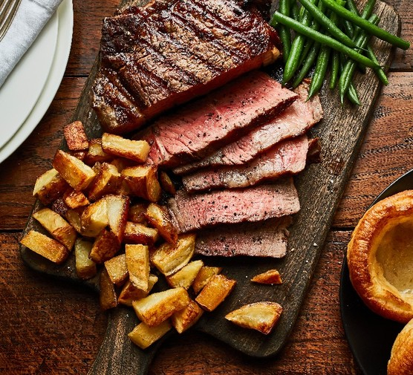
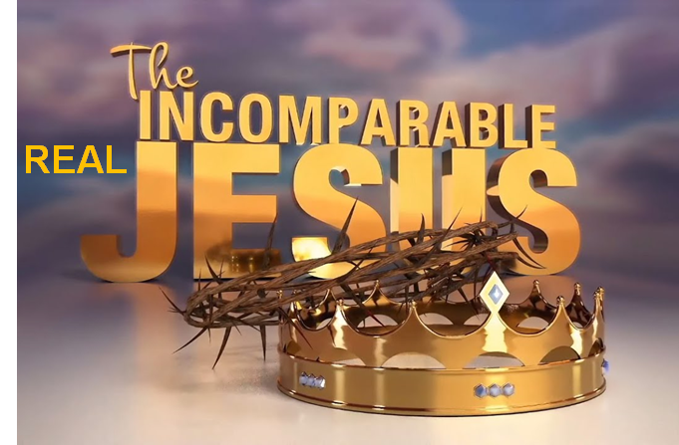

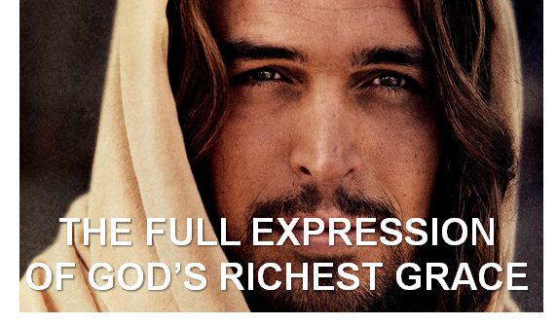
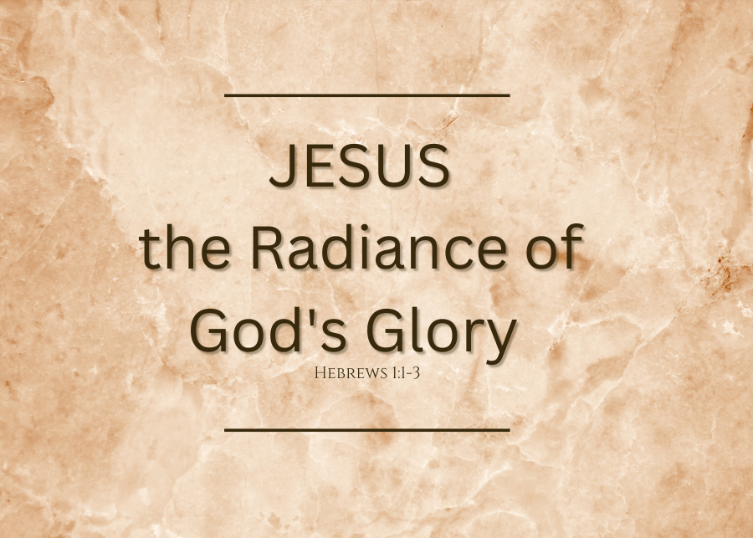
The Four Jesus Steak Meals
Summer 2024
July 21
Colossians
August 4
Romans
September 8
Ephesians
September 29
Hebrews

Slide 2
Taken From Hebrews
LifeGate Sermon
September 29, 2024

Slide 3
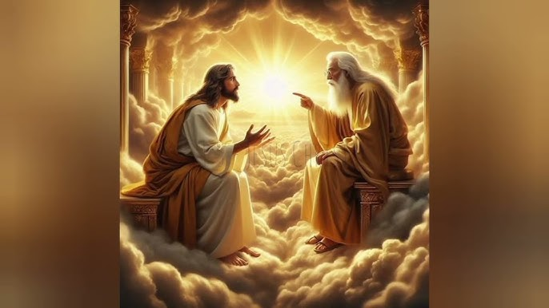
JESUS IS THE EXACT IMAGE
OF THE RADIANCE OF THE FATHER’S GLORY
In the past God spoke to our forefathers through the prophets at many times and in various ways, ² but in these last days He has spoken to us by His Son, whom He appointed Heir of all things, and through Whom He made the universe. ³ The Son is the radiance of God's glory and the exact representation of His being, (perfect imprint of and very image of God) sustaining all things by His powerful word. After He had provided purification for sins, He sat down at the right hand of the Majesty in heaven. Hebrews 1:1-3 (NIV)

Slide 4
WHAT DO WE TAKE AWAY
FROM THIS OPENING GLORIOUS REVELATION
1/ When God created Mankind – He made him with the ability to communicate and hear from Him – and therefore GOD WAS GOING TO SPEAK
2/ The Revelation God spoke to man was PROGRESSIVE – it increased through the ages – First a man – Adam – Noah - Abraham – than a nation – Israel – Then the whole World – Jesus / GOSPEL
3/ There must have been a HUGE DEVIATION IN THE PLAN – Mankind needed purified from sin and Jesus did this and completed it and is right now at the Father’s righthand.

Slide 5
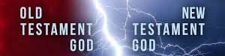
THE PROFOUND UNFOLDING OF GOD’S PLAN AND WHY THE OLD COVENANT WAS ONLY A SHADOW
The law is only a shadow of the good things that are coming--not the realities themselves. For this reason it can never, by the same sacrifices repeated endlessly year after year, make perfect those who draw near to worship. ² If it could, would they not have stopped being offered? For the worshipers would have been cleansed once for all, and would no longer have felt guilty for their sins. ³ But those sacrifices are an annual reminder of sins, ⁴ because it is impossible for the blood of bulls and goats to take away sins. Hebrews 10:1-4 (NIV)

Slide 6
HOW DOES THIS COME ABOUT
FROM LAW TO GRACE?
The oppressor will come to an end, and destruction will cease; the aggressor will vanish from the land. ⁵ In love a Throne will be established; in faithfulness a Man (JESUS) will sit on it-- One from the house of David-- One Who in judging seeks justice and speeds (HASTENS) the cause of righteousness. Isaiah 16:4-5
By oppression and judgment He was taken away. And who can speak of His descendants? For He was cut off from the land of the living; for the transgression of my people He was stricken. ⁹ He was assigned a grave with the wicked, and with the rich (Joseph of Arimathea) in His death, though He had done no violence, nor was any deceit in His mouth. ¹⁰ Yet it was the LORD's will to crush Him and cause Him to suffer, and though the LORD makes His life a guilt offering, He will see His offspring and prolong His days, and the will (PLEASURE) of the LORD will prosper in His hand. Isaiah 53:8-10 (NIV)

Slide 7
JESUS ENDURED OUR SUFFERING
TO BECOME OUR PERFECT HIGH PRIEST
Since the children have flesh and blood, He too shared in their humanity so that by His death he might destroy him who holds the power of death--that is, the devil-- 15 and free those who all their lives were held in slavery by their fear of death. 16 For surely it is not angels he helps, but Abraham's descendants. 17 For this reason He had to be made like his brothers in every way, in order that He might become a merciful and faithful High Priest in service to God, and that He might make atonement for the sins of the people. 18 Because He Himself suffered when He was tempted, He is able to help those who are being tempted. Hebrews 2:14-18 (NIV)
”And put everything under His feet. (Psalm 8)" In putting everything under him, God left nothing that is not subject to him. Yet at present we do not see everything subject to Him. ⁹ But we see Jesus, who was made a little lower than the angels, now crowned with glory and honor because He suffered death, so that by the grace of God He might taste death for everyone. Hebrews 2:8-9 (NIV)

Slide 8
THE MIND-BLOWING IMPACT THAT
GOD CAME TO SAVE THE WHOLE WORLD
CAN YOU IMAGINE THE REVOLUTION THAT TAKES PLACE TO YOU AS A GREEK / ROMAN CITIZEN IN A DECEDENT ROMAN CITY – LIVING UNDER IDOLATRY – NEVER BEING PART OF ANYTHING BIGGER THAN YOUR SELFISH LIMITED WORLD – LIVING DEPRESSED AND HOPELESS AND IN A CAVE OF FEAR AND FLESHLY THINKING - AND THEN A POWERFUL EVANGELIST COMES TO YOUR CITY AND YOU ARE OFFERED TO BE PART OF A FAMILY – YOU ARE TOLD THAT THROUGH A “GOD INTERVENTION” BY JESUS CHRIST YOU CAN PARTICIPATE IN AN ETERNAL DESTINY – JOIN TOGETHER WITH OTHER BELIEVERS ON AN EARTHLY MISSION WITH PURPOSE – JOIN A FAMILY THAT LOVES YOU FOR REAL – THAT SEES YOUR WEAKNESSES YET BUILDS YOU UP AS THEY HOLD YOU TO THE LIFE-GIVING TRUTH AND POWER OF JESUS’ TRANSFORMING GRACE - YOU GO FROM AIMLESS LIVING – MEANINGLESS LIVING – PLEASURE INDUCED SURVIVAL – TO FORGIVENESS - PURPOSE – FREEDOM – AUTHENTICITY – REAL HOPE – WHAT AN AMAZING TRANSFORMATION.
THIS IS THE GREAT EXCHANGE OF JESUS CHRIST ENCOUNTERING US AS ORPHANS BEAT UP BY OUR OWN CHOICES AND PILED ON BY THE UNINVITED ABUSE OF THE ENEMY AND THE FALLEN WORLD. GOD PICKS US UP AND INVITES US INTO HIS HOUSE TO BE HIS CHILD. LOVED – CLEANSED – CAPTURED – CONVERTED - REWIRED – AND GIVEN AN INHERITANCE IN CHRIST. WOW THAT IS STUPENDOUS. THAT IS ASTOUNDING MERCY.

Slide 9
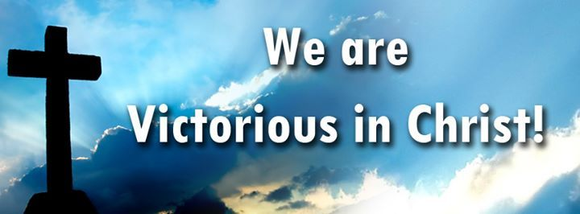
THIS IS ONE OF THE GREATEST PROMISES
IN SCRIPTURE COMING FORTH FROM
THE VICTORIES OF JESUS
Therefore, since we have a great High Priest who has gone through the heavens, Jesus the Son of God, let us hold firmly to the faith we profess. ¹⁵ For we do not have a High Priest who is unable to sympathize with our weaknesses, but we have One who has been tempted in every way, just as we are--yet was without sin. ¹⁶ Let us then approach the throne of grace with confidence, so that we may receive mercy and find grace to help us in our time of need. Hebrews 4:14-16

Slide 10
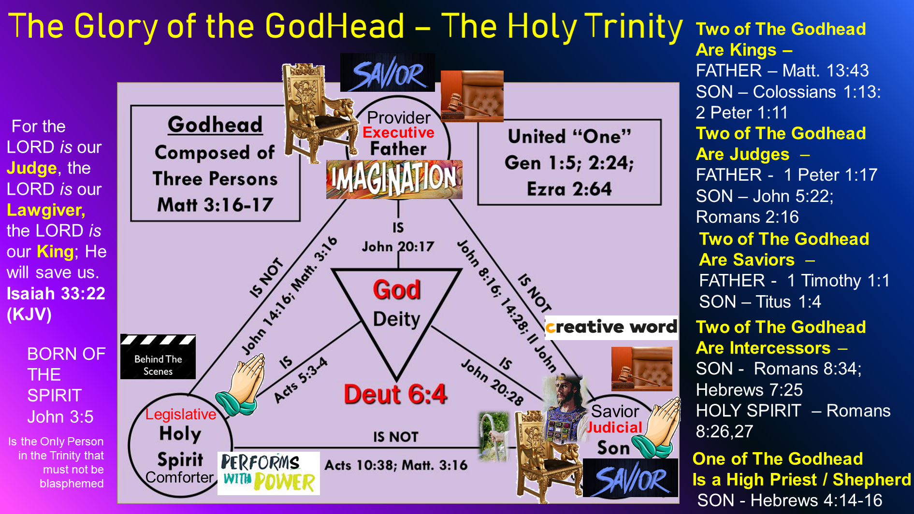

Slide 11
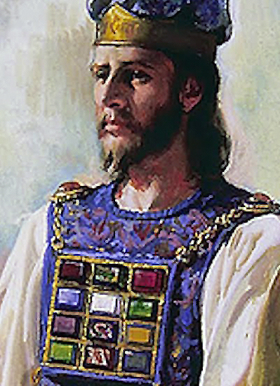
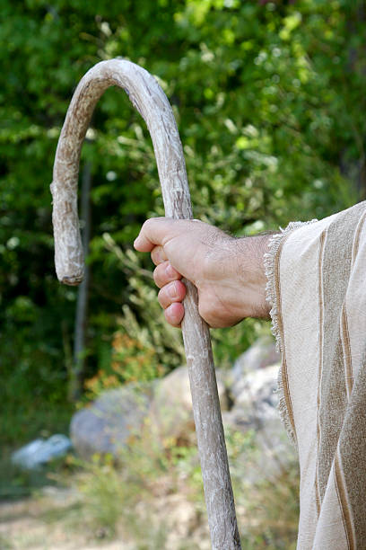
Jesus Is United With All Of His
Offices Of Redemption
JESUS MEDIATES OUR SALVATION AS A HIGH PRIEST
For there is one God and one Mediator between God and men, the man Christ Jesus, ⁶ who gave himself as a ransom for all men--the testimony given in its proper time. 1 Timothy 2:5-6 (NIV)
BUT HE ALSO WORKS IN A RIGHTEOUS MOTIVE AND DESIRES TO BE HOLY AS OUR CHIEF SHEPHERD
I will place over them one shepherd, my servant David, and he will tend them; he will tend them and be their shepherd. Ezekiel 34:23 (NIV)
See to it, brothers, that none of you has a sinful, unbelieving heart that turns away from the living God. ¹³ But encourage one another daily, as long as it is called Today, so that none of you may be hardened by sin's deceitfulness. ¹⁴ We have come to share in Christ if we hold firmly till the end the confidence we had at first. ¹⁵ As has just been said: "Today, if you hear his voice, do not harden your hearts as you did in the rebellion." Hebrews 3:12-15 (NIV)

Slide 12
JESUS AND HIS EFFECTIVE WORK
OF RECONCILING AND SHEPHERDING SINNERS
Because Jesus lives forever, He has a permanent priesthood. ²⁵ Therefore He is able to save completely (perfectly, to the uttermost) those who come to God through Him, because He always lives to intercede for them. ²⁶ Such a high priest meets our need--One who is holy, blameless, pure, set apart from sinners, exalted above the heavens. Hebrews 7:24-26 (NIV)
But the ministry Jesus has received is as superior to theirs as the covenant of which He is Mediator (go-between, reconciler, intercessor) is superior to the old one, and it is founded on better promises. Hebrews 8:6 (NIV)

Slide 13
THE FINISHED WORK OF CHRIST SPEAKS FOREVER IN HEAVEN
¹¹ When Christ came as high priest of the good things that are already here, He went through the greater and more perfect tabernacle that is not man-made, that is to say, not a part of this creation. ¹² He did not enter by means of the blood of goats and calves; but he entered the Most Holy Place once for all by his own blood, having obtained eternal redemption. Hebrews 9:11-12 (NIV)
How much more, then, will the blood of Christ, who through the eternal Spirit offered Himself unblemished to God, cleanse our consciences from acts that lead to death, so that (AFTER BEING PURIFIED – WE ARE SO BLOWN AWAY WE WOULD NEVER WANT TO GRIEVE HIM WITH REPEATED SIN) we may serve the living God! Hebrews 9:14 (NIV)

Slide 14
THE FINISHED WORK OF CHRIST SPEAKS FOREVER IN HEAVEN
¹¹ When Christ came as high priest of the good things that are already here, He went through the greater and more perfect tabernacle that is not man-made, that is to say, not a part of this creation. ¹² He did not enter by means of the blood of goats and calves; but he entered the Most Holy Place once for all by his own blood, having obtained eternal redemption. Hebrews 9:11-12 (NIV)
How much more, then, will the blood of Christ, who through the eternal Spirit offered Himself unblemished to God, cleanse our consciences from acts that lead to death, so that (AFTER BEING PURIFIED – WE ARE SO BLOWN AWAY WE WOULD NEVER WANT TO GRIEVE HIM WITH REPEATED SIN) we may serve the living God! Hebrews 9:14 (NIV)

Slide 15
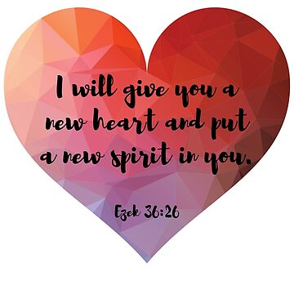
THE IMPACT OF THE GRACE THAT FLOWS
FROM THE GREAT SHEPHERD AND THE
MOTIVATING LOVE THAT JESUS OPENED UP
This is the covenant I will make with the house of Israel after that time, declares the Lord. I will put my laws in their minds and write them on their hearts. I will be their God, and they will be My people. Hebrews 8:10 (NIV)

Slide 16
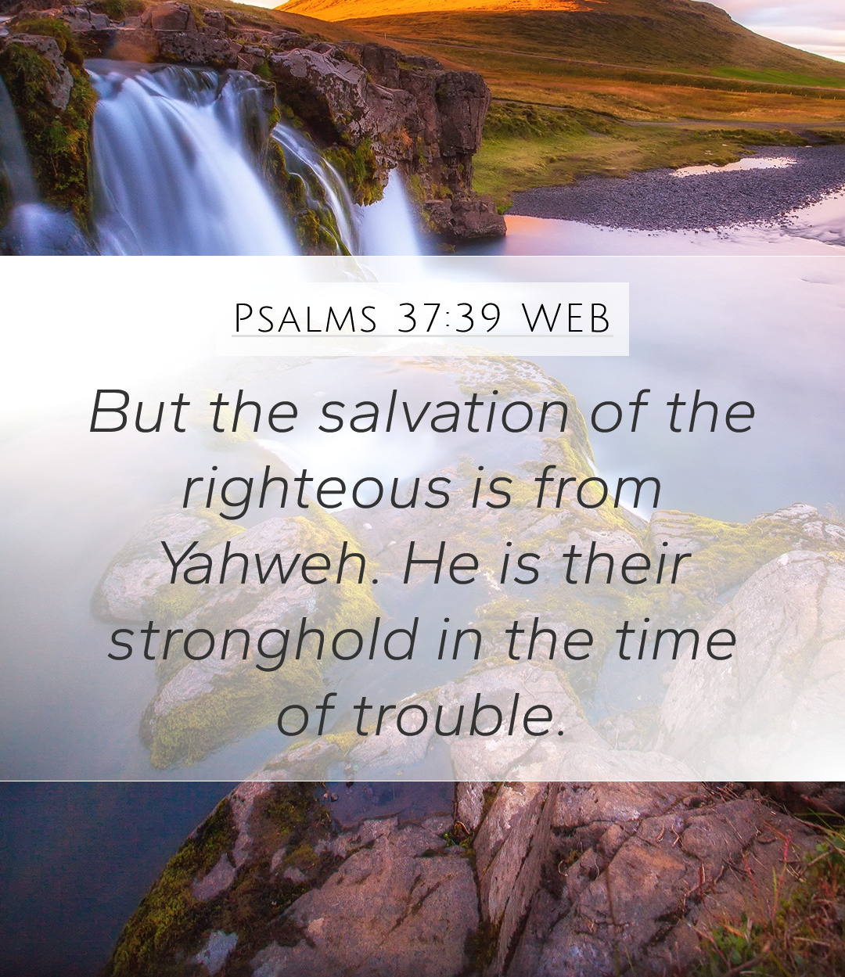
CHRIST IS COMING AGAIN – NOT TO BEAR ANOTHER CROSS – BUT TO BRING SALVATION TO HIS CHURCH – AND JUDGMENT TO THE WICKED
Just as man is destined to die once, and after that to face judgment, ²⁸ so Christ was sacrificed once to take away the sins of many people; and He will appear a second time, not to bear sin, but to bring salvation to those who are waiting for (expecting) Him. Hebrews 9:27-28 (NIV)

Slide 17
SINCE THE GLORIOUS BEAUTY OF CHRIST
IS NOT A RELIGION OR JUST A THEOLOGY
OR A CEREMONY
BUT A PERSON WHO CREATED US
AND THEN DIED FOR US
Therefore, brothers, since we have confidence to enter the Most Holy Place by the blood of Jesus, 20 by a new and living way opened for us through the curtain, that is, his body, 21 and since we have a great priest over the house of God, 22 let us draw near to God with a sincere heart in full assurance of faith, having our hearts sprinkled to cleanse us from a guilty conscience and having our bodies washed with pure water. 23 Let us hold unswervingly to the hope we profess, for he who promised is faithful. 24 And let us consider how we may spur one another on toward love and good deeds. 25 Let us not give up meeting together, as some are in the habit of doing, but let us encourage one another--and all the more as you see the Day approaching. Hebrews 10:19-25 (NIV)

Slide 18
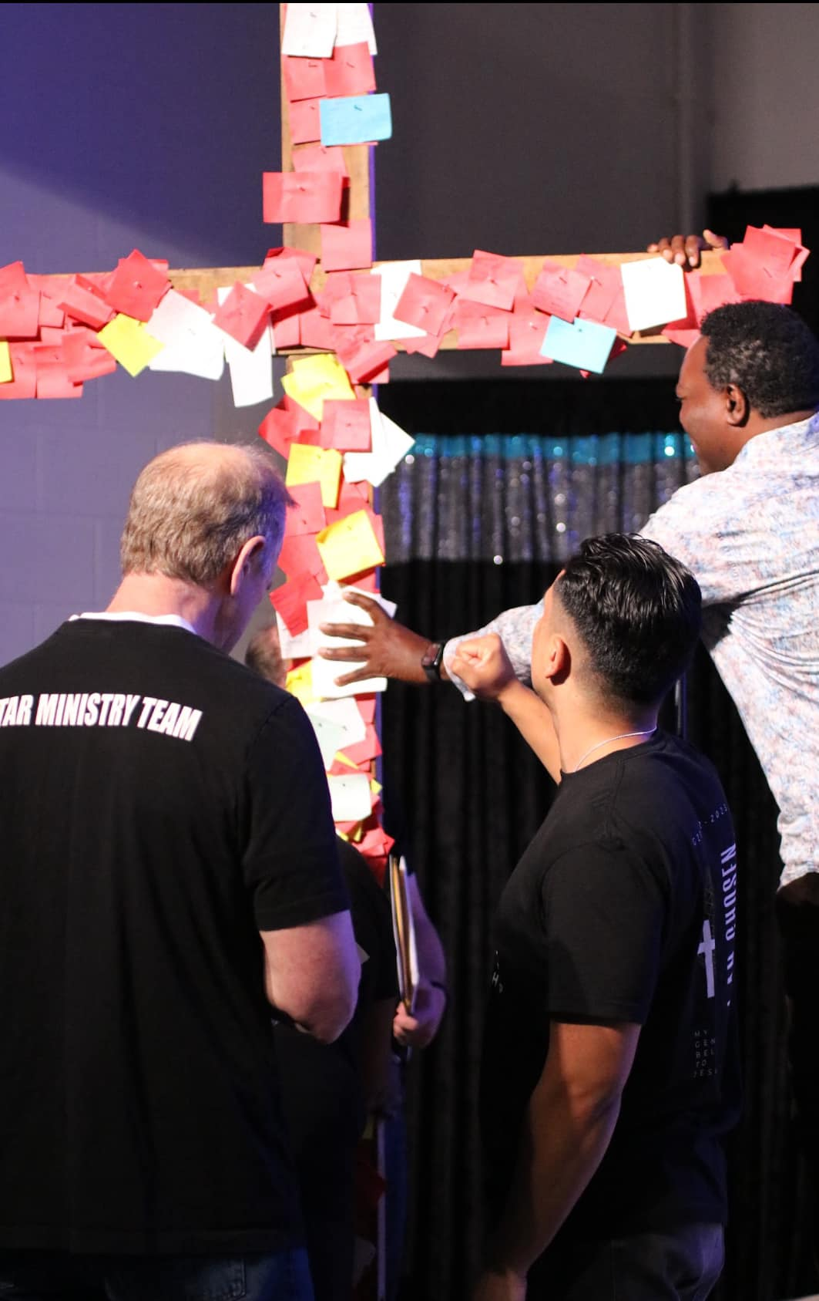
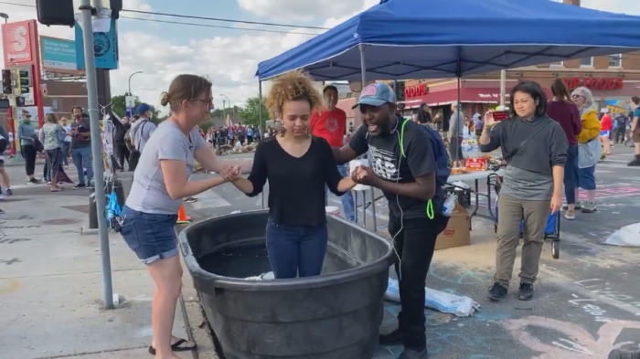

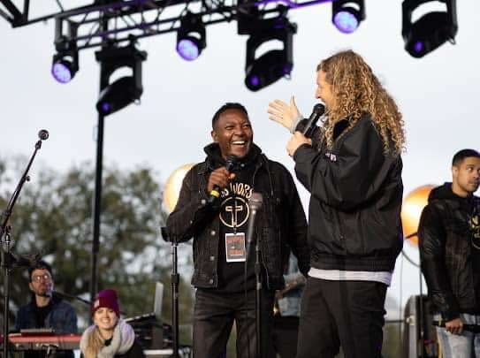
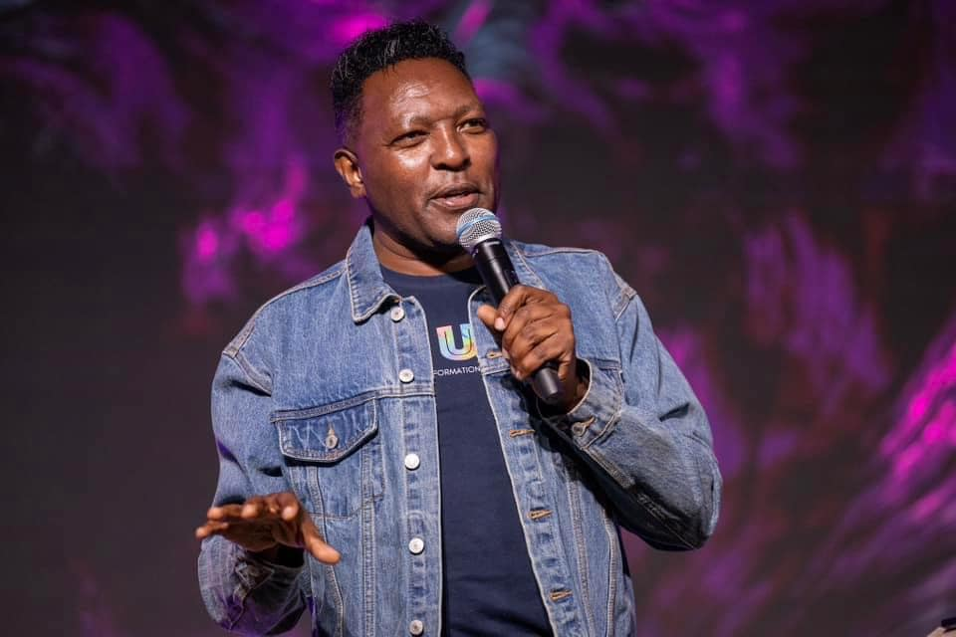
THE GLORIOUS IMPACT OF CHRIST
ON A HURTING WORLD THROUGH
DESPERATE BELIEVERS
Spring 2020
Pastor Charles Karuku

Slide 19
THIS CLOUD OF WITNESSES
PROVOKES US TO RISK FOR JESUS
¹ Therefore, since we are surrounded by such a great cloud of witnesses, let us throw off everything that hinders and the sin that so easily entangles, and let us run with perseverance the race marked out for us. ² Let us fix our eyes on Jesus, the Author and Perfecter of our faith, who for the joy set before Him endured the cross, scorning its shame, and sat down at the right hand of the throne of God. Hebrews 12:1-2 (NIV)

Slide 20
THE GLORY OF JESUS IS THAT HE COMES TO
STRENGTHEN THE WEAK
Therefore, strengthen your feeble arms and weak knees. ¹³ "Make level paths for your feet," so that the lame may not be disabled, but rather healed. ¹⁴ Make every effort to live in peace with all men and to be holy; without holiness no one will see the Lord. ¹⁵ See to it that no one misses the grace of God and that no bitter root grows up to cause trouble and defile many. Hebrews 12:12-15 (NIV)
At that time his voice shook the earth, but now he has promised, "Once more I will shake not only the earth but also the heavens." ²⁷ The words "once more" indicate the removing of what can be shaken--that is, created things--so that what cannot be shaken may remain. ²⁸ Therefore, since we are receiving a kingdom that cannot be shaken, let us be thankful, and so worship God acceptably with reverence and awe, ²⁹ for our "God is a consuming fire." Hebrews 12:26-29 (NIV)

Slide 21
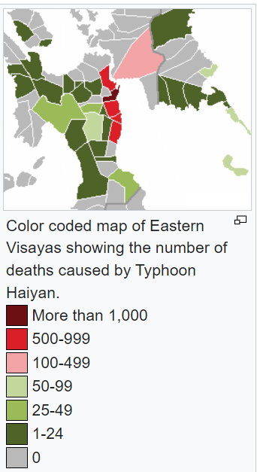
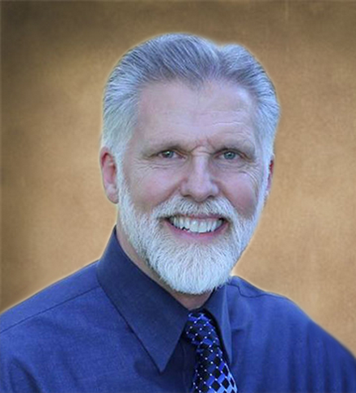
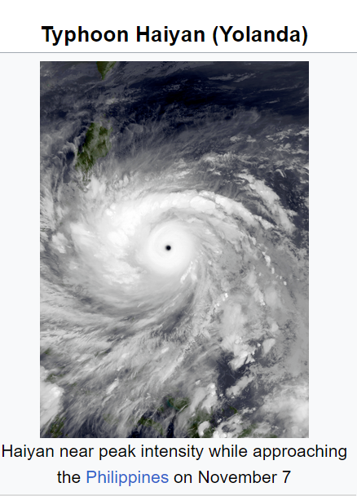
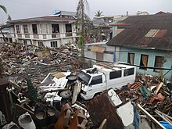
Jesus Is Going To Move Us To
Follow In His Footsteps As He Shakes The World
Pastor Joe Sweet

Slide 22
¹ Keep on loving each other as brothers. ² Do not forget to entertain strangers, for by so doing some people have entertained angels without knowing it. ³ Remember those in prison as if you were their fellow prisoners, and those who are mistreated as if you yourselves were suffering. ⁴ Marriage should be honored by all, and the marriage bed kept pure, for God will judge the adulterer and all the sexually immoral. ⁵ Keep your lives free from the love of money and be content with what you have, because God has said, "Never will I leave you; never will I forsake you." Hebrews 13:1-5 (NIV)
May the God of peace, who through the blood of the eternal covenant brought back from the dead our Lord Jesus, that great Shepherd of the sheep, ²¹ equip you with everything good for doing his will, and may he work in us what is pleasing to him, through Jesus Christ, to whom be glory for ever and ever. Amen. Hebrews 13:20-21 (NIV)

Slide 23
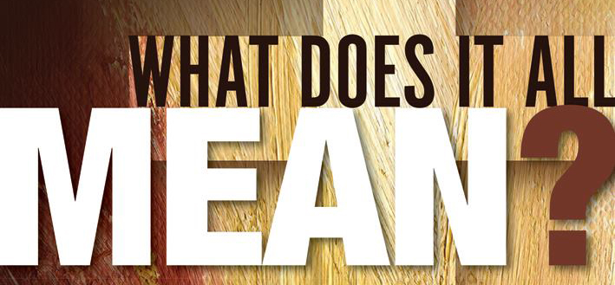
1- BE RECONCILED TO GOD THROUGH CHRIST YOUR HIGH PRIEST EACH DAY– through the wondrous intimacy and friendship with JESUS – repent and receive.
2- LET JESUS SHEPHERD YOUR HEART THAT CAN BE PRONE TO WANDER – and find close friendships in the Body of Christ to hold you to the Grace of God .
3 – STRETCH OUT YOUR HAND IN WEAKNESS AND LET GOD BRING FORTH HIS RICHES OF SUPERNATURAL GRACE– BELIEVE FOR YOUR FAMILY – CHURCH – AND COMMUNITY TO BE A HUB OF REVIVAL AND PROTECTION FROM THE STORM - love your families more purposefully – your neighbors – your classmates – and let God take our crippled nation and make it whole

