Slide 2
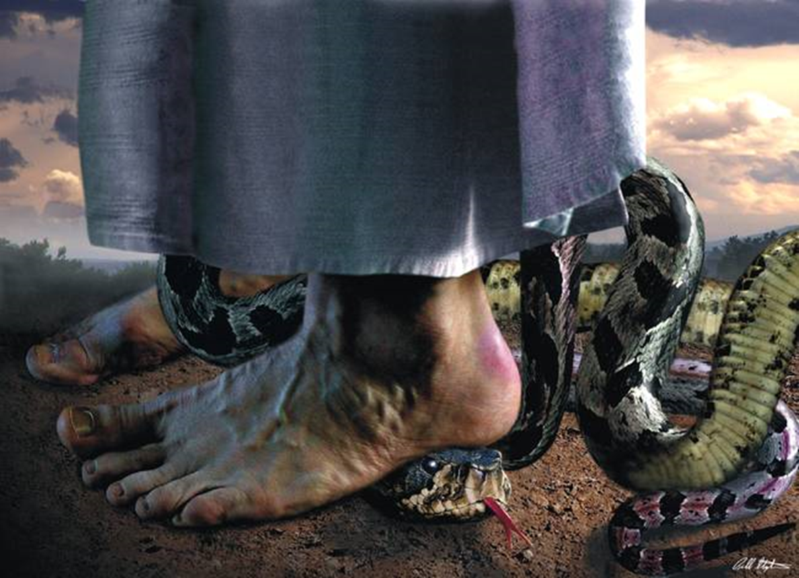

Slide 3
What is “Deliverance?”
Deliverance is a truth encounter not a power encounter.
It is God‘s truth versus Satan‘s lies. The only power Satan or any demon has in the believer’s life is the lie. Once the demons are confronted with God‘s truth, they simply cannot stand. When legal permissions have been removed, and Jesus’s name is invoked, they will bend their knee in submission.

Slide 4
Deliverance is about destroying the works of the devil through confession, repentance, denouncing, and renouncing and evil spirits being cast out.
The choice for deliverance is always made by the individual and never against their will.

Slide 5
Jesus’ Mission Acts 10:38
³⁸ how God anointed Jesus of Nazareth with the Holy Spirit and power, and how he went around doing good and healing all who were under the power of the devil, because God was with him.

Slide 6
Matthew 8:16,17
¹⁶ When evening came, many who were demonized-were brought to him, and he drove out the spirits with a word and healed all the sick. ¹⁷ This was to fulfill what was spoken through the prophet Isaiah:
“He took up our infirmities
and bore our diseases.”

Slide 7
Hebrews 2:1-4
2 We must pay the most careful attention, therefore, to what we have heard, so that we do not drift away. ² For since the message spoken through angels was binding, and every violation and disobedience received its just punishment,

Slide 8
³ how shall we escape if we ignore so great a salvation? This salvation, which was first announced by the Lord, was confirmed to us by those who heard him. ⁴ God also testified to it by signs, wonders and various miracles, and by gifts of the Holy Spirit distributed according to his will.

Slide 9
Deliverance is a miracle
³⁸ “Teacher,” said John, “we saw someone driving out demons in your name and we told him to stop, because he was not one of us.”
³⁹ “Do not stop him,” Jesus said. “For no one who does a miracle in my name can in the next moment say anything bad about me,

Slide 10
Take Aways
If you haven’t made it (sin) your enemy, you don’t deserve deliverance. You have it (sin) as your friend.
Having sin as your friend makes having a demon as your friend.
How can you be delivered from your enemies, if they are your friends
If there’s no repentance, you’re feeding the demons.
Renouncing it + Confessing it= breaking the Curse
If your repentance is Shallow, it needs to go deeper. (Galatians 5:16-25)
We have power over scorpions and snakes (Luke 10:19)

Slide 11
Take Away’s
Passivity is also permission (inaction=giving legal rights over)
The power of letting the WORD of God rule vs. letting the WORD + the world rule leads to rebellion.
Rebellion= witchcraft Allows permission for the enemy to attack
The LORD promises that he would deliver us from our enemies.
If you have unforgiveness, then you don’t qualify for deliverance.

Slide 12
Father I thank you for Jesus and for my salvation through him. He is my Savior and I am the sinner. I am so grateful to be washed by His Blood. And because you have forgiven me, I choose to forgive others; everyone who has hurt me, lied to me or disappointed me, I forgive. I forgive myself and apply Your great forgiveness to my life.
I repent of anger, bitterness and hatred; of rebellion, resentment and revenge. I repent of envy, jealousy and strife. I repent of fear, doubt and unbelief. I repent of witchcraft and idolatry and all the works of the flesh.

Slide 13
I denounce the sins of my ancestors, I separate and cut myself off from all generational curses. I renounce all unholy oaths and vows and pledges, and ceremonies. I choose to be free from all of those curses.

Slide 14
I denounce and confess as sin all unholy soul ties and choose to be free from them. I put everything under the Blood of Jesus and by doing so, I break the power of Satan in my life.
Jesus Christ is my Savior and LORD. He is my Deliverer and my Healer, and He broke the power of the curse. I choose to be free in Jesus’ Name.

