Slide 1

LifeGate
November 17, 2024

Slide 2
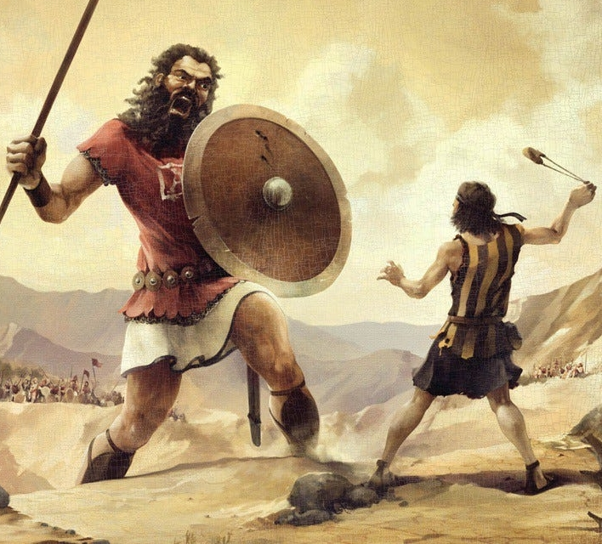
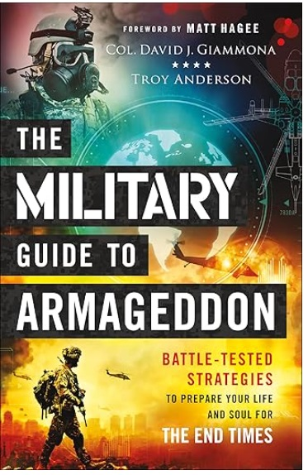
Raising Up End-Times Warriors
1063 BC. The place: the Valley of Elah
In the natural, it was impossible. All those experienced warriors under King Saul took counsel from their fears. After all, who in his right mind would stand up to this monster of a man who was obviously controlled by some fearsome dark forces? No, human knowledge and experience were going to defeat the giant. David, the young shepherd, had been diligent every day in feeding, caring for and defending his flock against the lion and the bear.
So David came with something else that nobody had. He had faith in God. He knew that he could not defeat Goliath by himself. God would have to intervene.
Retired Col. David J. Giammona

Slide 3
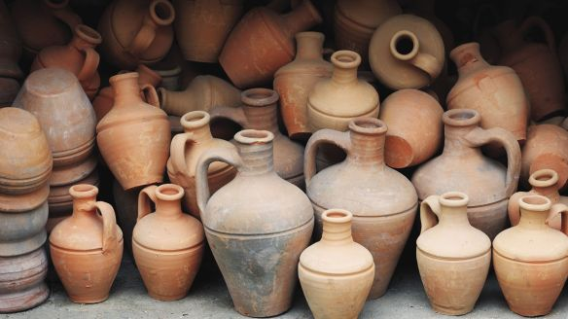
The Gospel Provides The MIRACLE –
We Bring What We Have – An Empty Vessel
The wife of a man from the company of the prophets cried out to Elisha, "Your servant my husband is dead, and you know that he revered the LORD. But now his creditor is coming to take my two boys as his slaves." ² Elisha replied to her, "How can I help you? Tell me, what do you have in your house?" "Your servant has nothing there at all," she said, "except a little oil." 2 Kings 4:1-2 (NIV)
GOD TAKES OUR EXTREMITY AND POVERTY - LEADS US TO THE SOURCE OF OUR MIRACLE – HIS GRACE – HIS MERCY – HE FILLS OUR EMPTINESS – PAYS FOR OUR DEBT – AND TAKES US OUT OF SPIRITUAL SLAVERY

Slide 4
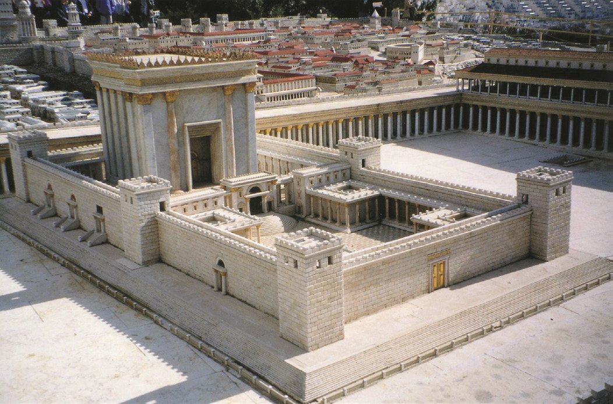
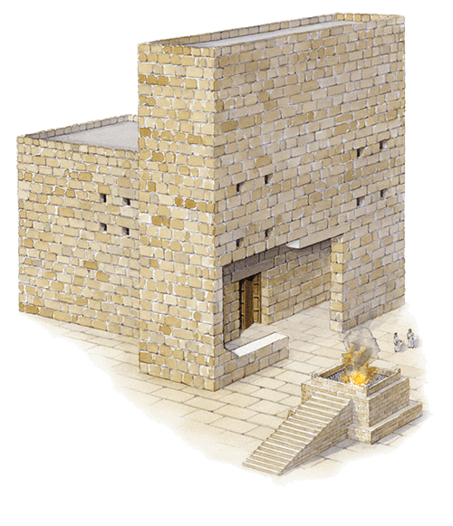
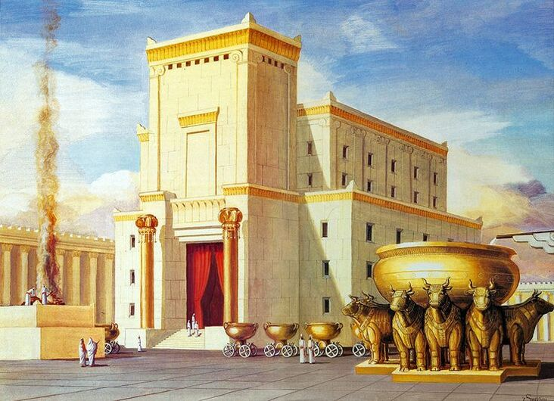

GOD TAKES THE LITERAL CIRCUMSTANCES
AND MAKES IT INTO A PROPHETIC PICTURE
WHAT IS THE TEMPLE – A PROPHETIC PICTURE OF?
“May He turn our hearts to Him, to walk in all His ways and to keep the commands - 59 And may these words of mine, which I have prayed before the LORD, be near to the LORD our God day and night, that He may uphold the cause of His servant and the cause of His people Israel according to each day's need, 60 so that all the peoples of the earth may know that the LORD is God and that there is no other. 1 Kings 8:58-60
Solomon’s Temple (First Temple)
Ezra’s Temple (Second Temple)
Before work began on Herod’s, temple he spent eight years stockpiling materials for its construction. Then, a workforce of over 10,000 men began its construction including a contingent of 1,500 specially trained priests who were the only ones permitted to work on the innermost and holiest parts of the Temple.

Slide 5


THE TIMES THAT WE ARE LIVING IN – WITH BOTH HUGE CHALLENGES AND AMAZING OPPORTUNITIES
WILL REQUIRE INTENSIFIED REVELATIONS
AND APPROPRIATING OF THE RICHES OF CHRIST
It is He (JESUS) who will build the temple of the LORD, and He will be clothed with majesty and will sit and rule on His throne. And He (JESUS) will be a Priest on His throne. And there will be harmony between the two.' ⁻⁻ ¹⁵ Those who are far away (GENTILES) will come and help to build the temple of the LORD, and you will know that the LORD Almighty has sent Me to you. This will happen if you diligently obey (TO HEAR AND FOLLOW) the LORD your God." Zechariah 6:13-15 (NIV)
But now be strong, O Zerubbabel,' declares the LORD. 'Be strong, O Joshua son of Jehozadak, the high priest. Be strong, all you people of the land,' declares the LORD, 'and work. For I am with you,' declares the LORD Almighty. ⁵ -- And my Spirit remains among you. Do not fear.' ⁶ "This is what the LORD Almighty says: 'In a little while I will once more shake the heavens and the earth, the sea and the dry land. ⁷ I will shake all nations, and the desired of all nations will come, and I will fill this house with glory,' says the LORD Almighty. ⁸ 'The silver is mine and the gold is mine,' declares the LORD Almighty. ⁹ 'The glory of this present house will be greater than the glory of the former house,' says the LORD Almighty. 'And in this place I will grant peace Haggai 2:4-9 (NIV)

Slide 6
THE JEWS COULD NOT FATHOM
GOD WAS GOING TO SAVE THE GENTILES
What then shall we say? Is God unjust? Not at all! ¹⁵ For he says to Moses, "I will have mercy on whom I have mercy, and I will have compassion on whom I have compassion." ¹⁶ It does not, therefore, depend on man's desire or effort, but on God's mercy. ¹⁷ For the Scripture says to Pharaoh: "I raised you up for this very purpose, that I might display my power in you and that my name might be proclaimed in all the earth." ¹⁸ Therefore, God has mercy on whom he wants to have mercy, and he hardens whom he wants to harden. ⁻⁻ ²² What if God, choosing to show His wrath and make His power known, bore with great patience the objects of His wrath (GENTILES) --prepared for destruction? ²³ What if He did this to make the riches of His glory known to the objects of His mercy, whom He prepared in advance for glory-- ²⁴ even us, whom He also called, not only from the Jews but also from the Gentiles? " Romans 9:14-24 (NIV)

Slide 7


Slide 8
WALKING IN THE RICHES OF CHRIST –
10 CRUCIAL PRIVILEGES
Scripture | Riches of Grace In Christ
Romans 3:24 | JUSTIFIED FREELY BY HIS GRACE
Ephesians 1:5 Romans 8:17 | ADOPTED AS A SON – A CO-HEIR WITH CHRIST
2 Corinthians 12:9 | HIS GRACE IS SUFFICIENT
Ephesians 2:10 | CREATED FOR GOOD WORKS IN CHRIST
Romans 12:5 | BEING MADE A MEMBER OF THE BODY OF CHRIST
1 Corinthians 2:16 | A SANCTIFIED/ RENEWED MIND
Acts 15:9 | A PURIFIED HEART
Colossians 1:27 | CHRIST IN ME THE HOPE OF GLORY
Matthew 10:1 | KINGDOM AUTHORITY
Acts 2:38 | FILLING OF THE HOLY SPIRIT

Slide 9
WHY IS IT IMPERATIVE
TO KNOW WHAT THESE RICHES ARE?
– AND WANT TO APPROPRIATE
THE RICHES WE HAVE IN CHRIST?
WITHOUT THE KNOWLEDGE OF HIS GLORIOUS RICHES – WE ARE CLUELESS AS TO ANY OF OUR PRIVILEGES – AND WILL LIVE IGNORANT AND UNPRODUCTIVE
For if you possess these qualities in increasing measure, they will keep you from being ineffective and unproductive in your knowledge of our Lord Jesus Christ. 2 Peter 1:8
I keep asking that the God of our Lord Jesus Christ, the glorious Father, may give you the Spirit of wisdom and revelation, so that you may know Him better. ¹⁸ I pray also that the eyes of your heart may be enlightened in order that you may know the hope to which He has called you, the riches of His glorious inheritance in the saints, ¹⁹ and his incomparably great power for us who believe. That power is like the working of his mighty strength, Ephesians 1:17-19 (NIV)

Slide 10
God Wants Us To Know
Our Inheritance in Christ – SERIOUSLY!!!
But in these last days He has spoken to us by His Son, whom He appointed Heir of all things Hebrews 1:2
Through these (HIS GLORY AND GOODNESS) He has given us His very great and precious promises, so that through them you may participate in the Divine nature and escape the corruption in the world caused by evil desires. 2 Peter 1:4 (NIV)
“To understand the amazing reach of these promises (OF GOD’S RICHES IN CHRIST) –we should search them out, and study them, with all the interest and curiosity of a inheritor searching the will of a rich benefactor; that we may plead them with unfailing confidence, and eager expectation, for their fulfillment.” Eli Wigle 1880

Slide 11
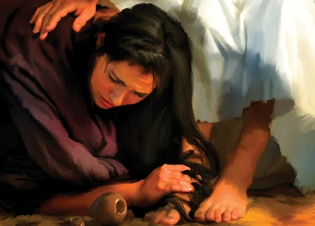
JESUS – OUR JUSTIFICATION (ACQUITTAL – PARDON)
For all have sinned and fall short of the glory of God, ²⁴ and are justified (TO MAKE INNOCENT) freely by His grace through the redemption that came by Christ Jesus. ²⁵ God presented Him as a sacrifice of atonement, through faith in His blood. He did this to demonstrate His justice, because in His forbearance He had left the sins committed beforehand unpunished-- ²⁶ He did it to demonstrate His justice at the present time, so as to be just and the One who justifies those who have faith in Jesus. Romans 3:23-26 (NIV)
LUKE SEVEN
Therefore, I tell you, her many sins have been forgiven--for she loved much. But he who has been forgiven little loves little." ⁴⁸ Then Jesus said to her, "Your sins are forgiven." ⁴⁹ The other guests began to say among themselves, "Who is this who even forgives sins?" ⁵⁰ Jesus said to the woman, "Your faith has saved you; go in peace." Luke 7:47-50 (NIV)

Slide 12
LET’S REVIEW - The Great Exchange – Justification
GUILTY | PARDONED
Separated/ Orphaned | Forgiven/ Adopted
Condemned/ Hopeless | Acquitted/ Declared Redeemed/ Future Purpose
Cut off from Life/ Promises of God | Engrafted into All The Riches Of Christ
Spiritual Entropy / Sin/ Curse | Divine Reversal/ Gift of Grace
Judgment followed one sin and brought condemnation | but the gift followed many trespasses and brought justification.
By the trespass of the one man, death reigned through that one man | How much more will those who receive God's abundant provision of grace and of the gift of righteousness reign (rule) in life
One trespass was condemnation for all men | The result of one act of righteousness was justification that brings life for all men.

Slide 13
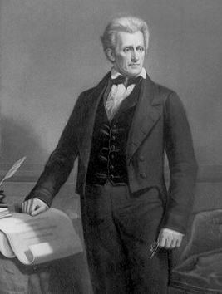
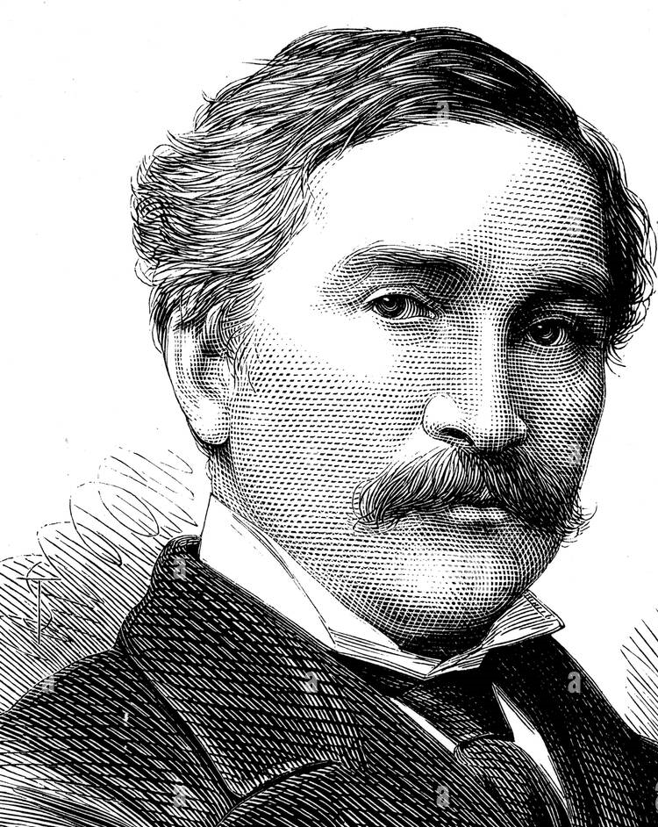
The Man Who Refused To Be Pardoned
United States v. Wilson, 32 U.S. (7 Pet.) 150 (1833), was a case in the United States in which the defendant, George Wilson, was convicted of robbing the US mail, and putting the life of the carrier in danger, in Pennsylvania and sentenced to death.^{[1]} Due to his friends' influence, Wilson was pardoned by Andrew Jackson.
George Wilson
Andrew Jackson
What good will it be for a man if he gains the whole world, yet forfeits his soul? Or what can a man give in exchange for his soul? Matthew 16:26 (NIV)
"Those who cling to worthless idols forfeit the grace that could be theirs. Jonah 2:8 (NIV)

Slide 14
ADOPTED AS A SONS AND DAUGHTERS
He predestined us to be adopted (appointed as a son) as His sons through Jesus Christ, in accordance with His pleasure and will-- ⁶ to the praise of His glorious grace, which He has freely given us in the One He loves. Ephesians 1:5-6 (NIV)
Because those who are led by the Spirit of God are sons of God. ¹⁵ For you did not receive a spirit that makes you a slave again to fear, but you received the Spirit of sonship. And by Him we cry, "Abba, Father." ¹⁶ The Spirit Himself testifies with our spirit that we are God's children. ¹⁷ Now if we are children, then we are heirs--heirs of God and co-heirs with Christ, if indeed we share in His sufferings in order that we may also share in His glory. Romans 8:14-17 (NIV)

Slide 15
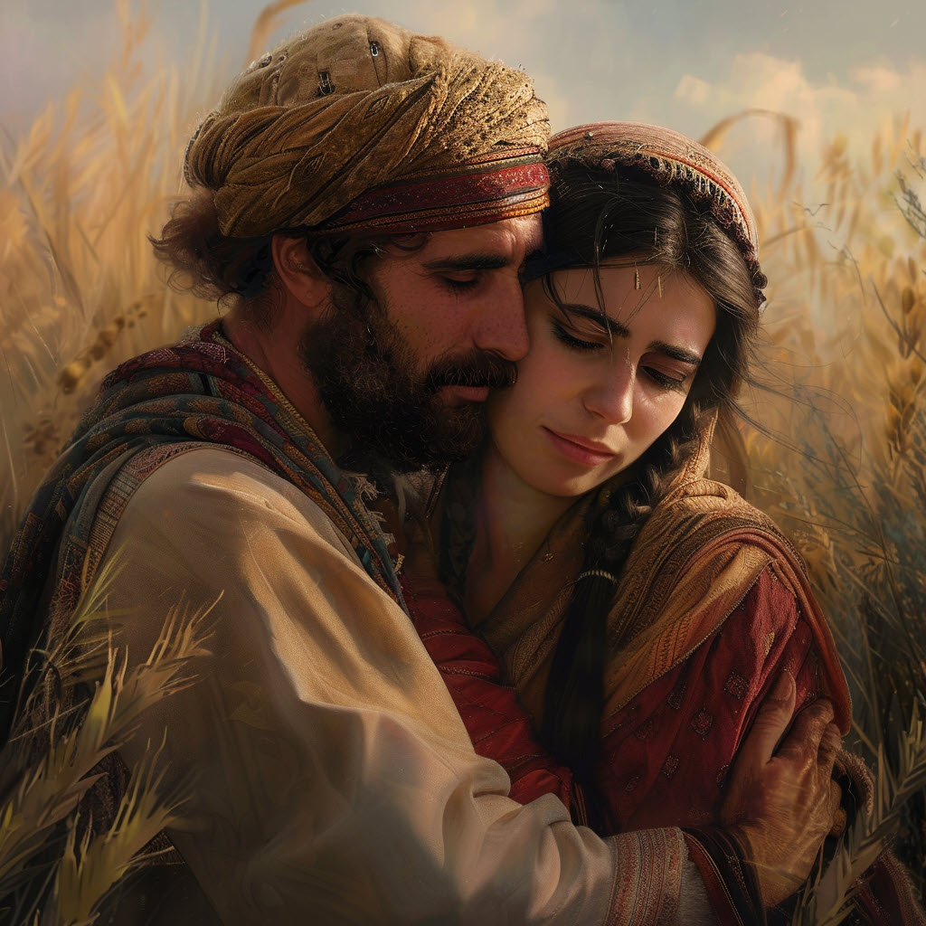
THE ADOPTION OF RUTH BY BOAZ
You are a stranger in the land – cut off from the promises - (Your hope is gone)
You providentially follow your mother-in-law a widow back to her home town – where all her property has been given away – BUT IT IS DURING THE HARVEST – and a distant relative is SINGLE – and you catch his eye – and HE REDEEMS YOU – and you not only inherit the property that was taken – but you INHERIT ALL OF HIS PROPERTY.
¹⁶ But Ruth replied, "Don't urge me to leave you or to turn back from you. Where you go I will go, and where you stay I will stay. Your people will be my people and your God my God. Ruth 1:16- (NIV)

Slide 16
THE RICHES OF CHRIST WILL ENABLE US TO:
Enter into powerful CONVERTING/ SAVING grace that will break the power of the SELF-LIFE and make us hungry to please the Lord in all things. (2 Corinthians 5:14)
Be Overcomers in this world of temptation and confusion – run the race effectively (Revelation 12:11; Hebrews 12:1)
Be fruitful in every thing that God leads us to do by the Holy Spirit – (Colossians 1:9-11)
Be an attractive lighted “BILLBOARD” to those around us who need to come into the Kingdom through Christ. (Colossians 4:5; 1 Thessalonians 4:12)

Slide 17

PROFOUND TRAJECTORY OF FULL ACCESS
AND FULL AVAILABILITY FOR EACH NEED
WE ARE TO BE A BILLBOARD SHOWING OFF THE RICHES OF CHRIST – THE GOODNESS OF GOD AND HIS RIGHTEOUSNESS
“May He turn our hearts to Him, to walk in all His ways and to keep the commands, - 59 And may these words of mine, which I have prayed before the LORD, be near to the LORD our God day and night, that He may uphold the cause of His servant and the cause of His people Israel according to each day's need, (AS THE MATTER SHALL REQUIRE) 60 so that all the peoples of the earth may know that the LORD is God and that there is no other. 1 Kings 8:58-60

Slide 18
APPLICATION - RECEIVING THE RICHES OF CHRIST
1/ PRESS IN FOR FULFILLMENT OF HIS PROMISES– “With this in mind, we constantly pray for you, that our God may count you worthy of his calling, and that by his power He may fulfill (ACCOMPLISH – COMPLETE - every good purpose of yours and every act prompted by your faith. 12 We pray this so that the name of our Lord Jesus may be glorified in you. 2 Thessalonians 1:11-12
2/ RECEIVE GREATER SUPPLY OF THE HOLY SPIRIT– For I know that this shall turn to my salvation through your prayer, and the supply of the Spirit of Jesus Christ, Philippians 1:19 (KJV)
3/ BOLDLY EXPECT HIS PROVISION IN RELATIONSHIPS AND RESOURCES - And my God will meet all your needs according to his glorious riches in Christ Jesus. Philippians 4:19 (NIV)

Slide 19
RECEIVING THE RICHES OF CHRIST
1/ Breaking off the heaviness – “Lord You have anticipated what we are facing we lean into You for your merciful intervention.”
2/ Remove the roadblocks – “Lord release the grace that will overwhelm the warfare.”
3/ Breaking the spirit of delay – “Lord bring acceleration to Your promises.”
4/ Laboring from a place of FAITH – “Lord forgive us for fretting – being exhausted – and feeling defeated.”
5/ Steady growth – “Lord, by Your grace give is high fruitfulness in our growth with You and our family.”
6/ Clear instructions for strategic shifts - “Lord open our ears to hear clearly Your leading and assignments.”

