Slide 1

LifeGate
December 1, 2024

Slide 2
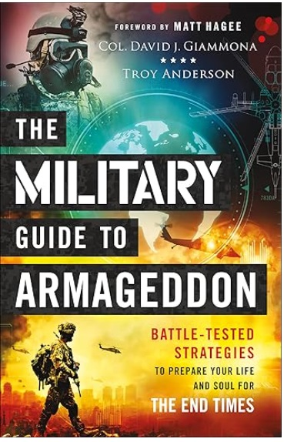
Raising Up End-Times Warriors
End-Times Fog of War
Make no mistake about it. We are at war and at times it can be unclear and confusing. You have heard of many prophets and prognosticators talking about how they have all the answers. They don’t. Nobody does.
Training. In the Kingdom of God we also “train as we fight.” Do not waste a single day by not putting into use all the training you have received up to this point. Put on the full armor of God as described in Ephesians 6. Train in godly practices every day as if your life depends on it.
Intelligence. Daily reading and listening to the Word of God, as well as listening to and watching sermons by godly pastors, is the best way of gathering the intelligence you need for the day. Throughout the day listen to and obey the promptings of the Holy Spirit.
Retired Col. David J. Giammona

Slide 3

When We Read and Share The Word of God
These are Not “Idle Words”
When Moses finished reciting all these words to all Israel, ⁴⁶ he said to them, "Take to heart all the words I have solemnly declared to you this day, so that you may command your children to obey carefully all the words of this law. ⁴⁷ They are not just idle (empty – worthless) words for you--they are your life. By them you will live long in the land you are crossing the Jordan to possess." Deuteronomy 32:45-47 (NIV)

Slide 4
Key Verses For Today
But because of His great love for us, God, Who is rich in mercy, ⁵ made us alive with Christ even when we were dead in transgressions--it is by grace you have been saved. ⁶ And God raised us up with Christ and seated us with Him in the heavenly realms in Christ Jesus, ⁷ in order that in the coming ages He might show the incomparable riches of His grace, expressed in His kindness to us in Christ Jesus. Ephesians 2:4-7
For Christ's love compels (constrains, arrests, holds) us, because we are convinced that one died for all, and therefore all died. ¹⁵ And He died for all, that those who live should no longer live for themselves but for Him who died for them and was raised again. 2 Corinthians 5:14-15

Slide 5
WALKING IN THE RICHES OF CHRIST –
10 ESSENTIAL PRIVILEGES
Scripture | Riches of Grace In Christ
Romans 3:24 | JUSTIFIED FREELY BY HIS GRACE
Ephesians 1:5; 2:6,7 Romans 8:17 | RESURRECTED/ ADOPTED AS A SON – A CO-HEIR WITH CHRIST
2 Corinthians 12:9 | HIS GRACE IS SUFFICIENT
Ephesians 2:10 | CREATED FOR GOOD WORKS IN CHRIST
Romans 12:5 | BEING MADE A MEMBER OF THE BODY OF CHRIST
1 Corinthians 2:16 | A SANCTIFIED/ RENEWED MIND
Acts 15:9 | A PURIFIED HEART/ COMPELLED TO OBEY
Colossians 1:27 | CHRIST IN ME THE HOPE OF GLORY
Matthew 10:1 | KINGDOM AUTHORITY
Acts 2:38 | FILLING OF THE HOLY SPIRIT

Slide 6

THE RICHES OF CHRIST ARE DESIGNED
TO CAPTURE OUR HEARTS
And they sang a new song: "You are worthy to take the scroll and to open its seals, because You were slain, and with Your blood You purchased men for God from every tribe and language and people and nation. Revelation 5:9
For Christ's love compels us, because we are convinced that One died for all, and therefore all died. ¹⁵ And He died for all, that those who live should no longer live for themselves but for Him who died for them and was raised again. 2 Corinthians 5:14-15 (NIV)

Slide 7

JESUS HAS THIS PROFOUND IMPACT
ON HEARTS THAT GET HIT BY HIS MERCIFUL GLORY
ASTONISHMENT EFFECT
STUNNED
AMAZED
And the men were stunned with bewildered wonder and marveled, saying, What kind of Man is this, that even the winds and the sea obey Him! Matthew 8:27 (AMP)
All the people were amazed and said to each other, "What is this teaching? With authority and power he gives orders to evil spirits and they come out!" Luke 4:36 (NIV)
I SHOULD BE SMASHED FOR THIS BUT I JUST GOT A
LOVING HUG AND PADDLING AT THE SAME TIME
I’M GOING TO SERVE THIS GOD THE REST OF MY LIFE!!!!
When Simon Peter saw this, he fell at Jesus' knees and said, "Go away from me, Lord; I am a sinful man!" ⁹ For he and all his companions were astonished at the catch of fish they had taken, Luke 5:8-9 (NIV)

Slide 8
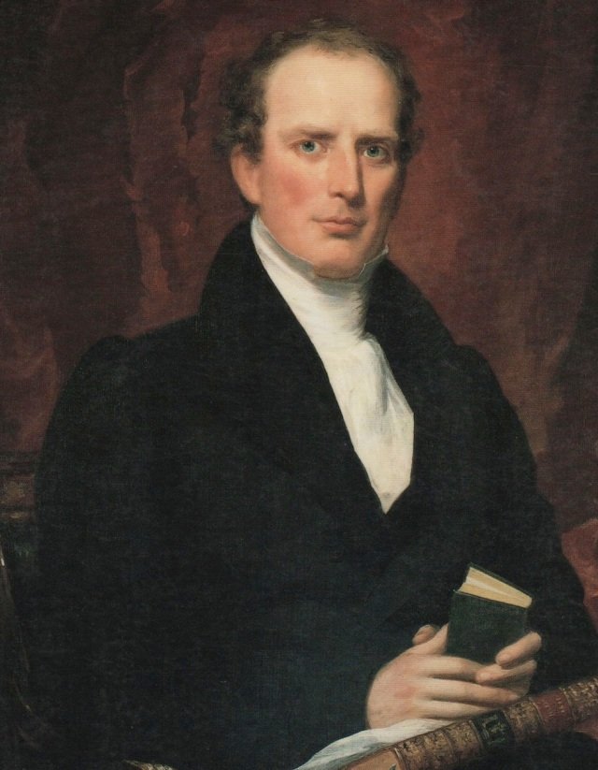
THE ASTONISHMENT EFFECT IN THE WESTERN
NEW YORK REVIVALS
“Charles Finney’s success among the crude and rude frontier settlers in upstate New York in 1825 is attributed to the reawakening, through the Holy Spirit, of a sense of decency in the hearts of the people’s consciousness admitting their own coarseness and depravity. The people already knew they were leading immoral lives and didn't need any argument to convince them of sin. All they needed was a compelling appeal and reason to abandon it.” Author Unknown

Slide 9
THE RICHES OF CHRIST THROUGH A CHANGED HEART - WILL ENABLE US TO:
APPROPRIATE THE Jesus’ resurrection power into our weaknesses. “How much more will those who receive God's abundant provision of grace and of the gift of righteousness reign (BE OVER) in life through the one man, Jesus Christ. Romans 5:17 (NIV)
If you have an addiction – REPENT and RENOUNCE – and declare the resurrection power of Jesus into that need that opens the door for bondage.
If you have a broken relationship – REPENT and FORGIVE – and declare the resurrection power of Jesus into that broken relationship.
If you have a difficult job or trial – PRAY and DECALRE the resurrection power of Jesus into that broken situation.

Slide 10
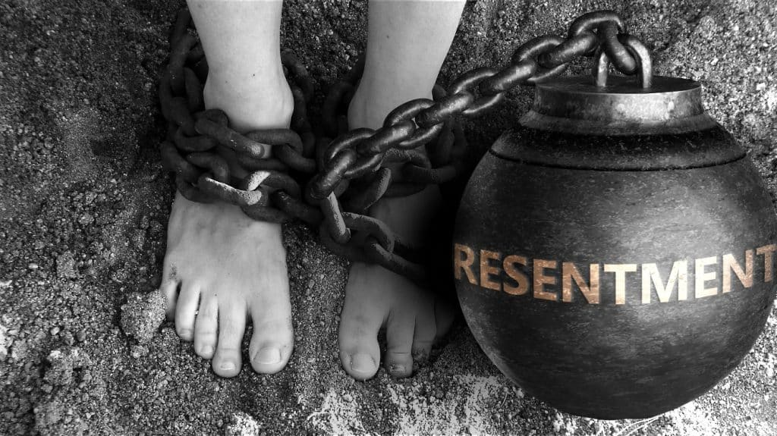
The Riches Of Christ Help Us Identify
When The Enemy is Sowing Resentment Among Us
THE ENEMY IS CONSTANTLY SOWING – FRUSTRATION AND RESENTMENT AT A HIGH LEVEL IN MANY OF OUR RELATIONSHIPS
WE SEE THE FLAWS IN OTHERS – AND EVEN THEIR WELL INTENTIONED TRAJECTORIES TO HELP US – SOMETIMES FRUSTRATE US – AND WE ARE VULNERABLE TO RESENTMENT AND WHISPERS THAT PEOPLE DON’T LOVE US OR SUPPORT US.
PRAY FOR YOUR HEART TO BE SOFT – and ask the Lord to bring the resurrection power of Jesus into that broken relationship

Slide 11
The Riches Of Christ’s Resurrection Is To Take Our Weakness And Make Us An Example of His Power
LORD WE THANK YOU THAT YOU LET YOUR RICHES FLOW INTO OUR IMPOSSIBILITIES
But He said to me, "My grace is sufficient for you, for My power is made perfect in weakness." Therefore I will boast all the more gladly about my weaknesses, so that Christ's power may rest on me. ¹⁰ That is why, for Christ's sake, I delight in weaknesses, in insults, in hardships, in persecutions, in difficulties. For when I am weak, then I am strong. 2 Corinthians 12:9-10 (NIV)

Slide 12
The Trajectories of Trial and Impossibility
Are Opportunities For The Riches of Christ To Be Displayed
For the foolishness of God is wiser than man's wisdom, and the weakness of God is stronger than man's strength. 1 Corinthians 1:25 (NIV)
Community – Government – Hostile voices – Impossible Budgets
Relationships – Marriages – Prodigals – Reconciliation - Repentance
That He may uphold the cause of His servants and the cause of His people Israel according to each day's need, (AS THE MATTER - SHALL REQUIRE) 1 Kings 8: 59
-
Overcoming dead religion – Revival – Conversions – Open Heavens
Daily life– finances - healings – discipleship -
For with God nothing shall be impossible.
Luke 1:37 (KJV)

Slide 13
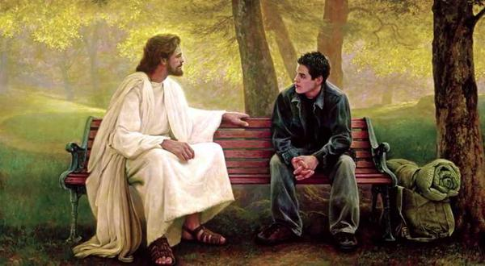
Learning From Jesus In The Gospels
RESUME
VAULT OF TEACHINGS
THE RECORD OF HIS MIRACLES AND HIS DIVINE POWER TO CAST OUT WICKED SPIRITS AND HAVE WORDS OF KNOWLEDGE ABOUT SOMEONE.
THE TEACHINGS OF JESUS – THE CORE OF THE GOSPEL - SERMON ON THE MOUNT – LAST SUPPER
Vignette’s From His Life
Snapshots of Jesus in action – that reveal His CHARACTER – HEART – AND RICHES OF GRACE

Slide 14
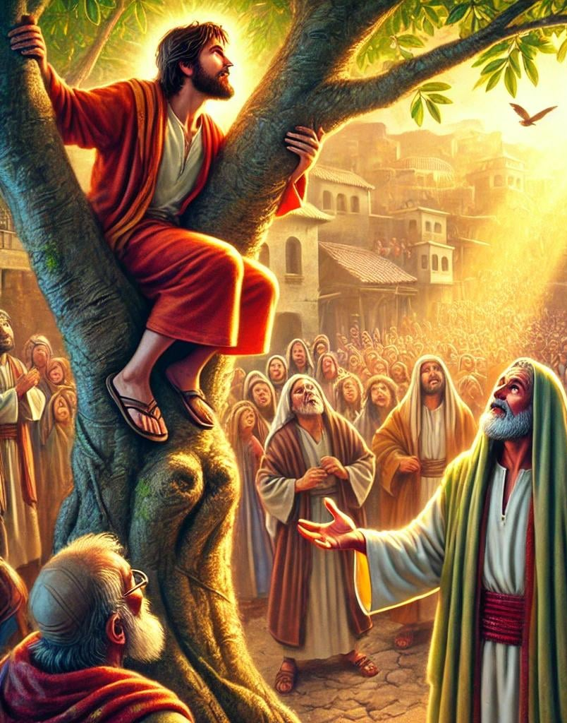
THE VIGNETTE OF JESUS AND ZACCHAEUS
When Jesus reached the spot, He looked up and said to him, "Zacchaeus, come down immediately. I must stay at your house today." ⁶ So he came down at once and welcomed him gladly. ⁷ All the people saw this and began to mutter, "He has gone to be the guest of a 'sinner.'" ⁸ But Zacchaeus stood up and said to the Lord, "Look, Lord! Here and now I give half of my possessions to the poor, and if I have cheated anybody out of anything, I will pay back four times the amount." ⁹ Jesus said to him, "Today salvation has come to this house, because this man, too, is a son of Abraham. ¹⁰ For the Son of Man came to seek and to save what was lost." Luke 19:5-10 (NIV)
WHAT ARE THE RICHES OF CHRIST REVEALED?
1 - Jesus has an eye out for those that everyone else overlooks
2 - Jesus stops what He is doing and gets your attention
3 - Jesus wants to come to YOUR HOUSE – He wants relationship
4 - Jesus IS SO COMPELLING that the RICHES OF HIS GRACE makes you want to give up all your sin/ idolatry immediately
5 – Jesus’ RICHES OF GRACE purposefully seeks out the LOST.

Slide 15
The Riches Of Christ are stolen from our hearts through:
Disappointment in God and unbelief
Ignorance of the Riches of Christ
Personal wounding and hindrances
Misguided earthly voices of reason
Lack of spiritual passion – laziness and apathy
Drinking in the compromise of our age
Accepting the status quo for your life
Refusing to intentionally pray down the Riches

Slide 16

WHAT IS BRAGGING?
AND WHY IS IT WRONG?
Twelve months later, as the king (Nebuchadnezzar) was walking on the roof of the royal palace of Babylon, ³⁰ he said, "Is not this the great Babylon I have built as the royal residence, by my mighty power and for the glory of my majesty?" ³¹ The words were still on his lips when a voice came from heaven, "This is what is decreed for you, King Nebuchadnezzar: Your royal authority has been taken from you. ³² You will be driven away from people and will live with the wild animals; you will eat grass like cattle. Seven times will pass by for you until you acknowledge that the Most High is sovereign over the kingdoms of men and gives them to anyone he wishes." Daniel 4:29-32 (NIV)
⁸ GOD said to Satan, "Have you noticed my friend Job? There's no one quite like him—honest and true to his word, totally devoted to God and hating evil." ⁹ Satan retorted, "So do you think Job does all that out of the sheer goodness of his heart? ¹⁰ Why, no one ever had it so good! You pamper him like a pet, make sure nothing bad ever happens to him or his family or his possessions, bless everything he does—he can't lose! Job 1:8-10 (MSG)

Slide 17
THE GREAT MYSTERY IS THAT NOT ALL OF THE RICHES OF CHRIST WILL BE REVEALED THIS SIDE OF HEAVEN
GOD WILL BE BRAGGING WHAT HIS RICHES DID IN YOU
And God raised us up with Christ and seated us with Him in the heavenly realms in Christ Jesus, ⁷ in order that in the coming ages He might show the incomparable riches of His grace, expressed in His kindness to us in Christ Jesus. Ephesians 2:6-7 (NIV)
Hey guys here’s Catherine Besset – I rescued her in 1080 AD during the black plague – she lost 4 of her eight children and husband – but she found me through a Monk who gave her the Gospel - and I gave her a quilting business and she led a house church where two hundred hearts came to me in France.
Hey guys here’s Don Lamb – I rescued him in 1980 and had to bring him through a lot of battles and boy it was a wild ride at times – But through the riches of Christ He lived in one of the greatest revivals ever and he is here as an amazing testament of My grace.

Slide 18
THE BLESSINGS OF THE RICHES OF CHRIST
WILL CONTINUE FOR ALL ETERNITY
TO CLEANSE
TO HUMBLE
TO INSPIRE
TO SUSTAIN
TO HEAL
TO PROTECT
TO MOTIVATE
TO GUIDE
TO TEACH
TO PROVIDE

Slide 19
APPLICATION - RECEIVING THE RICHES OF CHRIST
1/ PRESS IN FOR FULFILLMENT OF HIS PROMISES– Daily declare His resurrection power over your impossibilities “That by His power He may fulfill (ACCOMPLISH – COMPLETE - every good purpose of yours and every act prompted by your faith. 12 We pray this so that the name of our Lord Jesus may be glorified in you. 2 Thessalonians 1:11-12
2/ RECEIVE GREATER SUPPLY OF THE HOLY SPIRIT– allow the Spirit to break up the ground in your heart – you will become the ones ready to receive God’s strategic instructions.
Prepare the ground – get rid of all stubbornness – hardness – unwillingness – Be willing to be broken – to be cleansed – put to death the deeds of the flesh.
- Be willing for His plans – His purposes to be manifested – ready for a mighty outpourings of the Spirit.
- Get ready to grow - To enlarge your capacity
- Match your faith to the problem – believe for the impossible
- Stay humble and confident in Christ at the same time.

