Slide 1

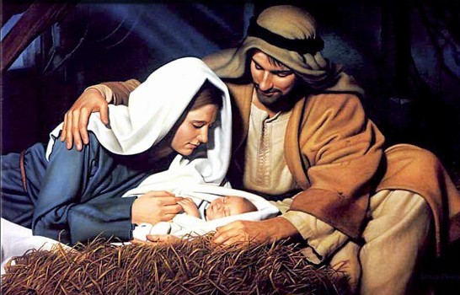
Christmas Sermon 2024
Sunday, December 22, 2024

Slide 2
GOD STARTS THE INTERVENTION
THAT SAVES MANKIND
BY COMING TO A 16 YEAR OLD VIRGIN
And the angel answered and said unto her (MARY), The Holy Spirit shall come upon thee, and the power of the Highest shall overshadow (ENVELOP, SURROUND) thee: therefore also that holy thing which shall be born of thee shall be called the Son of God. Luke 1:35 (KJV)

Slide 3

A Little Detour To Set Up The Application
Of Christmas To Our Lives
LifeGate Is a
Pro-Science –
Pro – Intelligent Design Church. God made all the laws of physics, laws of biology, and every universal constant from gravity to the speed of light.

Slide 4
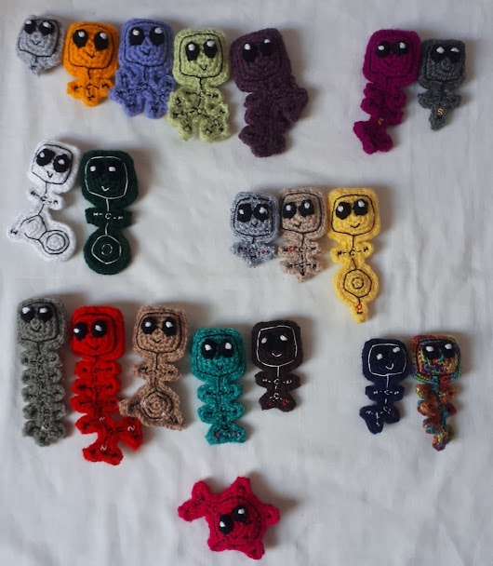
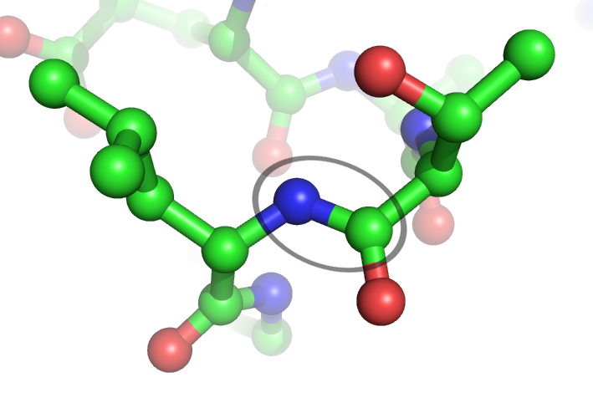
The Probability of One
Protein Randomly Assembling
And Becoming a Living Protein – 10¹⁶⁴
Proteins Contain 50 to 1000 Amino acids in a perfect chain to create Life – the Average is 300 to 400
There are only 21 Amino Acids that build life producing proteins (There are about 500 Amino acids on the earth.)

Slide 5
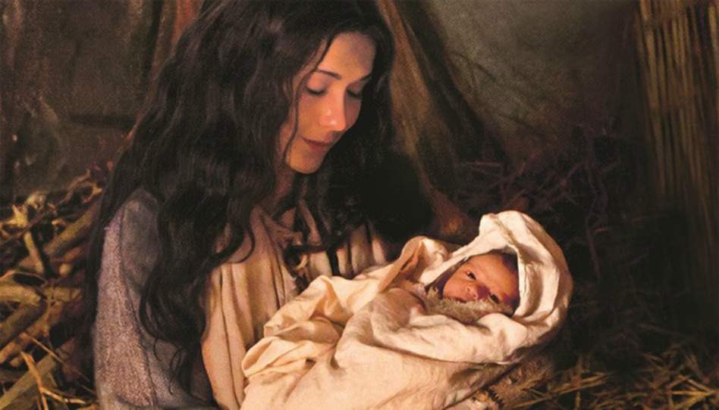
The Prophecies Of Jesus
Coming -

Slide 6

The probability that Jesus of Nazareth could have fulfilled even eight such prophecies would be only 1 in 10¹⁷. That's 1 in 100, 000, 000, 000, 000, 000.
Prophecy | Old Testament | New Testament
Virgin Will Give birth to a Son | Isaiah 7:14 | Matthew 1:23
Messiah will be born in Bethlehem | Micah 5:2 | Luke 2:4
A star would arise - The Magi Would come visit Jesus | Numbers 24:17 Isaiah 60:3 | Matthew 2:8
Babies would be killed by Evil King Herod | Jeremiah 31:15 | Matthew 2:16
Joseph and Mary would flee taking Jesus To Egypt | Hosea 11:1 | Matthew 2:13

Slide 7
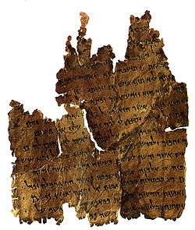
The Dead Sea Scrolls
Confirm The Sovereignty Of God
In the late 1800’s Higher Criticism said a lot of the Bible was unreliable – especially the book of Daniel. Maybe it was only written around 50 B.C.
Daniel, close up and seal the words of the scroll until the time of the end. Many will go here and there (TO TRAVEL ABOUT RAPIDLY) to increase knowledge." Daniel 12:4 (NIV)
In Daniel 9:25, it is written that "from the issuing of the word to restore and to rebuild Jerusalem until Messiah the Leader, there will be 7 weeks, also 62 weeks". "Weeks" refers to seven years, so 7 "sevens" is 49 years and 62 "sevens" is 434 years, for a total of 483 years.

Slide 8
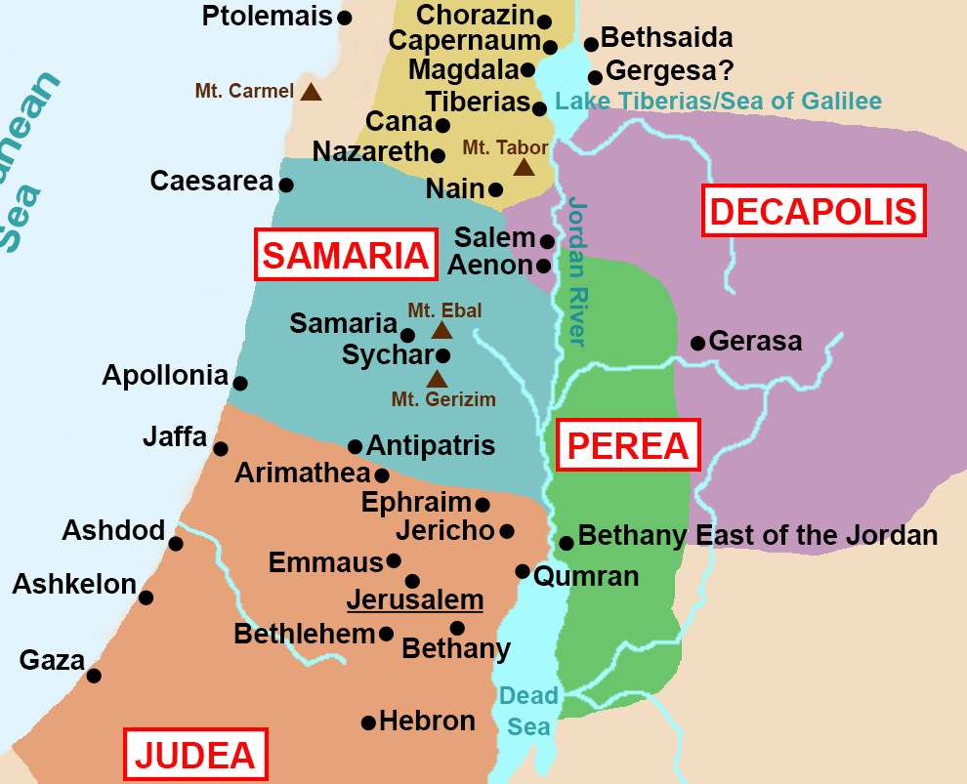
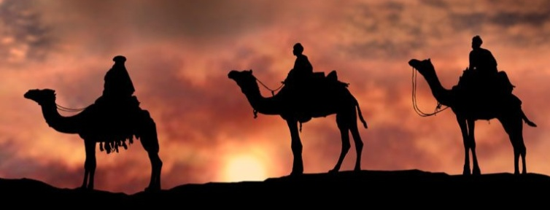
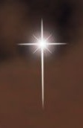
Know and understand this: From the issuing of the decree to restore and rebuild Jerusalem until Messiah the Prince will be seven weeks and 62 weeks. (483 years). Daniel 9:25 (HCSB)

Slide 9
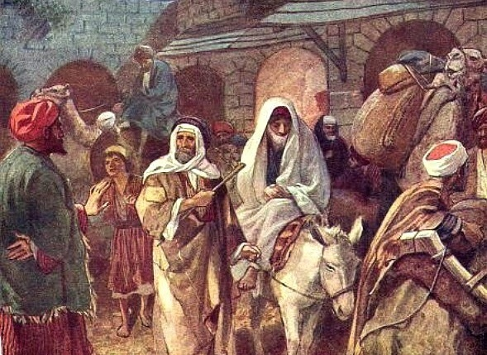
Providentially Manipulated Details
Joseph and Mary
"But you, Bethlehem Ephrathah, though you are small among the clans of Judah, out of you will come for me one who will be ruler over Israel, whose origins are from of old, from ancient times." Micah 5:2 (NIV)
In those days Caesar Augustus issued a decree that a census should be taken of the entire Roman world. ⁻ ³ And everyone went to his own town to register. Luke 2:1,3 (NIV)
So Joseph also went up from the town of Nazareth in Galilee to Judea, to Bethlehem the town of David, because he belonged to the house and line of David. ⁵ He went there to register with Mary, who was pledged to be married to him and was expecting a child. ⁶ While they were there, the time came for the baby to be born, ⁷ and she gave birth to her firstborn, a son. She wrapped him in cloths and placed him in a manger, because there was no room for them in the inn. Luke 2:4-7 (NIV)

Slide 10
How About Each Of Us -
And Our Providentially Manipulated Details?
From one man He made every nation of men, that they should inhabit the whole earth; and He determined (PREARRANGED) the times set for them and the exact places where they should live. 27 God did this so that men would seek Him and perhaps reach out for Him and find Him, though He is not far from each one of us. 28 'For in Him we live and move and have our being. Acts 17:26-28 (NIV)

Slide 11
All the days ordained (fashioned) (TO TAKE SHAPE) for me were written in Your book before one of them came to be. 17 How precious to me are Your thoughts, O God! How vast is the sum of them! Psalm 139:16-17 (NIV)

Slide 12
TWO WORDS FOR ORDAINED
There will I make the horn of David to bud: I have ordained a lamp for mine anointed. Psalm 132:17 (KJV)
HEBREW WORD FOR ORDAINED - – AWRAK - to set in a row, i.e. arrange, put in order to (set) (the battle, in array
HEBREW – Yatsa - PLANNED – ORDAINED – FASHIONED - Squeezed into shape – by the (planning of the potter -through the squeezing into shape)

Slide 13
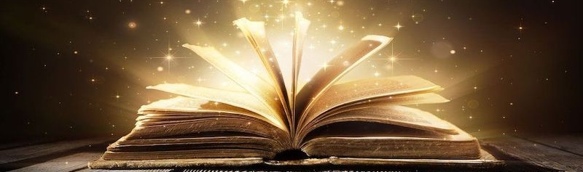
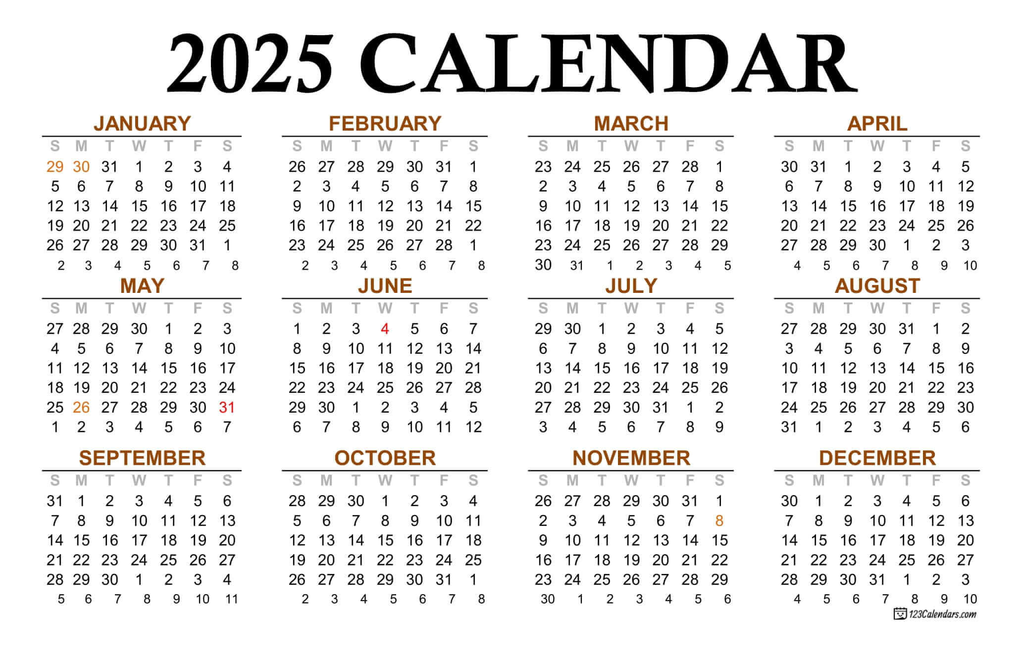

Slide 14
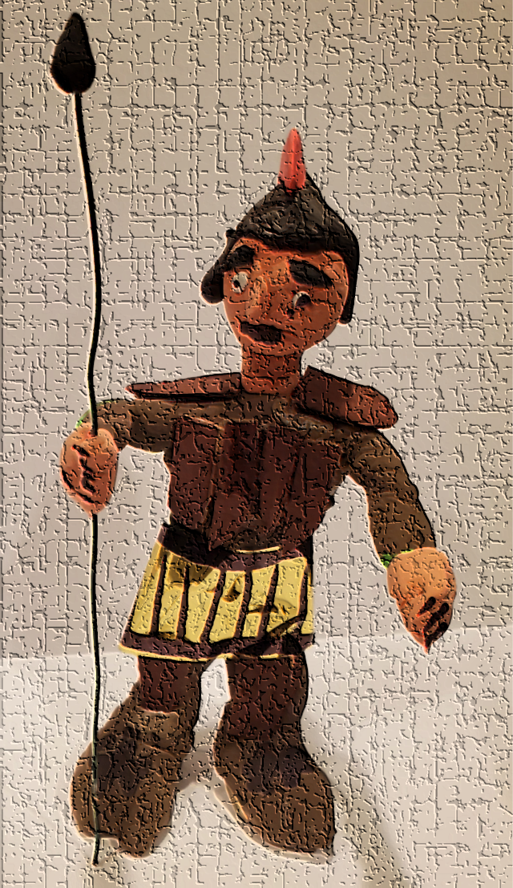

Two Major Ways God Allows us To Be Shaped
On The Potters Wheel On An Given Day
Allow Your Heart to be Broken to reveal internal fault lines that need to be HEALED
Face the Giants
Of Impossibility

Slide 15
But He said to me, "My grace is sufficient for you, for my power is made perfect in weakness." Therefore I will boast all the more gladly about my weaknesses, so that Christ's power may rest on me. ¹⁰ That is why, for Christ's sake, I delight in weaknesses, in insults, in hardships, in persecutions, in difficulties. For when I am weak, then I am strong. 2 Corinthians 12:9-10 (NIV)

Slide 16
The LORD within her (CHURCH) is righteous; He does no wrong. Morning by morning He dispenses His justice, and every new day He does not fail. Zephaniah 3:5a (NIV)
It is of the LORD'S mercies that we are not consumed, because His compassions fail not. ²³ They are new every morning: great is Thy faithfulness.
Lamentations 3:22-23 (KJV)

Slide 17
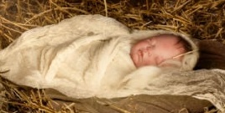

Because Jesus Came In The Manger
Grew Up and Became The
Perfect “Lamb of God”
That Died An Unjust Death On the Cross For Us.
And Rose Again To Reconcile Us To the Father
IS REDEEMABLE

Slide 18
You hem me in--behind and before (TO BESIEGE – TO SURROUND) ; you have laid your hand upon me. Psalm 139:5

Slide 19
You’ve gone into my future to prepare the way, and in kindness You follow behind me to spare me from the harm of my past. With Your hand of love upon my life, you impart a blessing to me. Psalm 139:5

Slide 20
Application
Have you responded yet to this GOOD NEWS That a Savior HAS COME – His Name is Jesus – have turned your life over to Him to save you from a broken heart of sin and from the world around you that tempts you to stay in fear and rebellion?
Be GRATEFUL that the Lord made a way to join you in each day and help shape it for His glory and your blessing. (Romans 8:28; 2 Cor. 12:10)
Will you allow God to bring alignment in your life through adjusting to His Word and Spirit?
Will you tell others of this GOOD NEWS like the shepherds did?

Slide 21
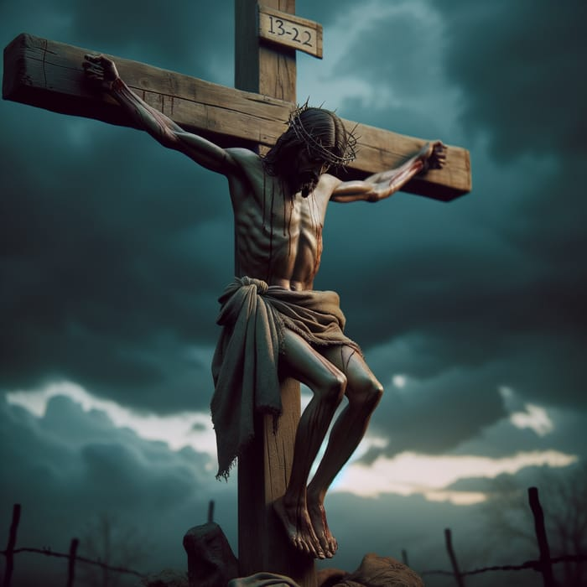
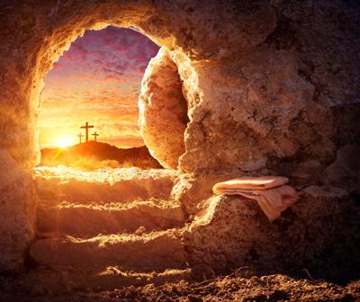
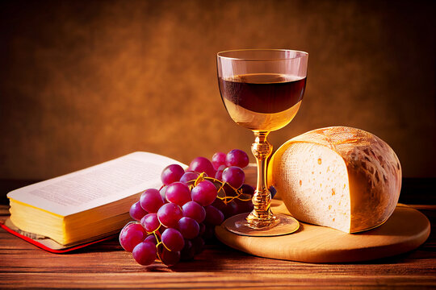
The Baby
In the Manger
Became
Our Savior

