Slide 2
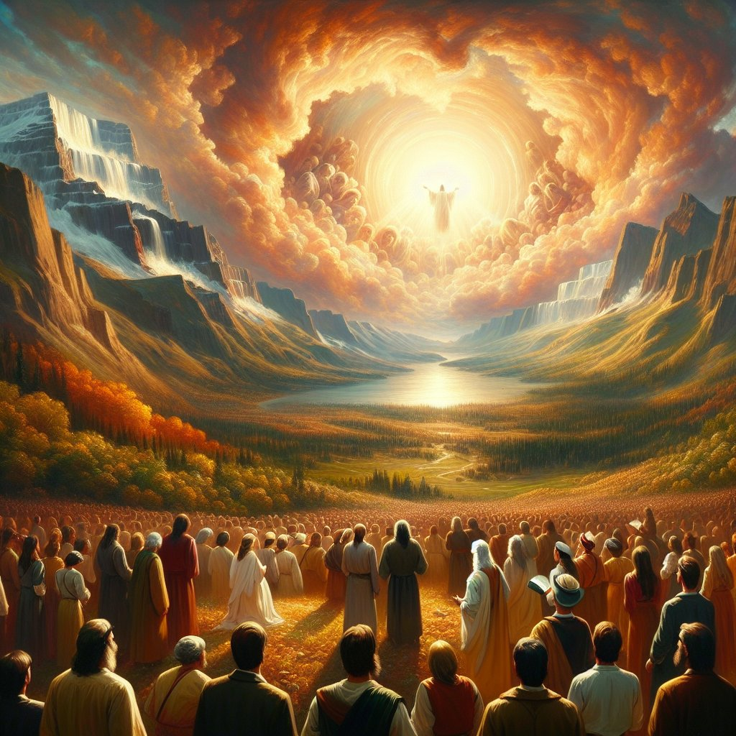

Slide 3
Walking in the riches of Christ colossians 1:24-28
²⁴ Now I rejoice in what I am suffering for you, and I fill up in my flesh what is still lacking in regard to Christ’s afflictions, for the sake of his body, which is the church. ²⁵ I have become its servant by the commission God gave me to present to you the word of God in its fullness—

Slide 4
²⁶ the mystery that has been kept hidden for ages and generations, but is now disclosed to the Lord’s people. ²⁷ To them God has chosen to make known among the Gentiles the glorious riches of this mystery, which is Christ in you, the hope of glory.

Slide 5
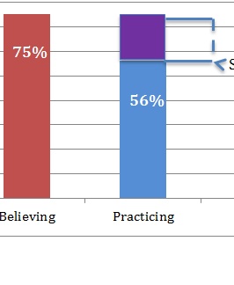
The Say/Do Gap

Slide 6
Truth and Action are inseparable
If we do not do what the LORD says then we really don’t believe Him at His Word.

Slide 7
Paul struggled for others to see their growth.
I rejoice in what I am suffering for you, and I fill up in my flesh what is still lacking in regard to Christ’s afflictions, for the sake of his body, which is the church.

Slide 8
¹⁹ my little children, for whom I am again in the anguish of childbirth until Christ is formed in you! ²⁰ I wish I could be present with you now and change my tone, for I am perplexed about you.
Galatians 4:19,20

Slide 9
Why Paul prayed for believers
Ephesians 3
¹⁴ For this cause I bow my knees unto the Father of our Lord Jesus Christ,
¹⁵ Of whom the whole family in heaven and earth is named,
¹⁶ That he would grant you, according to the riches of his glory, to be strengthened with might by his Spirit in the inner man;

Slide 10
¹⁷ so that Christ may dwell in your hearts through faith. And I pray that you, being rooted and established in love, ¹⁸ may have power, together with all the Lord’s holy people, to grasp how wide and long and high and deep is the love of Christ, ¹⁹ and to know this love that surpasses knowledge—that you may be filled to the measure of all the fullness of God.

Slide 11
Asa: An example of following
2 chron 15,16
15 The Spirit of God came on Azariah son of Oded. ² He went out to meet Asa and said to him, “Listen to me, Asa and all Judah and Benjamin. The Lord is with you when you are with him. If you seek him, he will be found by you, but if you forsake him, he will forsake you. ³ For a long time Israel was without the true God, without a priest to teach and without the law.

Slide 12
⁴ But in their distress they turned to the Lord, the God of Israel, and sought him, and he was found by them. ⁵ In those days it was not safe to travel about, for all the inhabitants of the lands were in great turmoil. ⁶ One nation was being crushed by another and one city by another, because God was troubling them with every kind of distress. ⁷ But as for you, be strong and do not give up, for your work will be rewarded.”

Slide 13
⁸ When Asa heard these words and the prophecy of Azariah son of Oded the prophet, he took courage. He removed the detestable idols from the whole land of Judah and Benjamin and from the towns he had captured in the hills of Ephraim. He repaired the altar of the Lord that was in front of the portico of the Lord’s temple.

Slide 14
¹⁰ They assembled at Jerusalem in the third month of the fifteenth year of Asa’s reign. ¹¹ At that time they sacrificed to the Lord seven hundred head of cattle and seven thousand sheep and goats from the plunder they had brought back.

Slide 15
¹² They entered into a covenant to seek the Lord, the God of their ancestors, with all their heart and soul. ¹³ All who would not seek the Lord, the God of Israel, were to be put to death, whether small or great, man or woman.

Slide 16
¹⁴ They took an oath to the Lord with loud acclamation, with shouting and with trumpets and horns. ¹⁵ All Judah rejoiced about the oath because they had sworn it wholeheartedly. They sought God eagerly, and he was found by them. So the Lord gave them rest on every side.

Slide 17
5 minutes later….. 2 Chron 16
² Asa then took the silver and gold out of the treasuries of the Lord’s temple and of his own palace and sent it to Ben-Hadad king of Aram, who was ruling in Damascus. ³ “Let there be a treaty between me and you,” he said, “as there was between my father and your father. See, I am sending you silver and gold. Now break your treaty with Baasha king of Israel so he will withdraw from me.”

Slide 18
⁴ Ben-Hadad agreed with King Asa and sent the commanders of his forces against the towns of Israel. They conquered Ijon, Dan, Abel Maim^{[a]} and all the store cities of Naphtali. ⁵ When Baasha heard this, he stopped building Ramah and abandoned his work. ⁶ Then King Asa brought all the men of Judah, and they carried away from Ramah the stones and timber Baasha had been using. With them he built up Geba and Mizpah.

Slide 19
⁷ At that time Hanani the seer came to Asa king of Judah and said to him: “Because you relied on the king of Aram and not on the Lord your God, the army of the king of Aram has escaped from your hand.

Slide 20
⁸ Were not the Cushites and Libyans a mighty army with great numbers of chariots and horsemen? Yet when you relied on the Lord, he delivered them into your hand. ⁹ For the eyes of the Lord range throughout the earth to strengthen those whose hearts are fully committed to him. You have done a foolish thing, and from now on you will be at war.”

Slide 21
¹⁰ Asa was angry with the seer because of this; he was so enraged that he put him in prison. At the same time Asa brutally oppressed some of the people.
¹¹ The events of Asa’s reign, from beginning to end, are written in the book of the kings of Judah and Israel.
¹² In the thirty-ninth year of his reign Asa was afflicted with a disease in his feet. Though his disease was severe, even in his illness he did not seek help from the Lord, but only from the physicians.
¹³ Then in the forty-first year of his reign Asa died and rested with his ancestors.

Slide 22


Slide 24
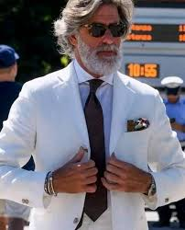
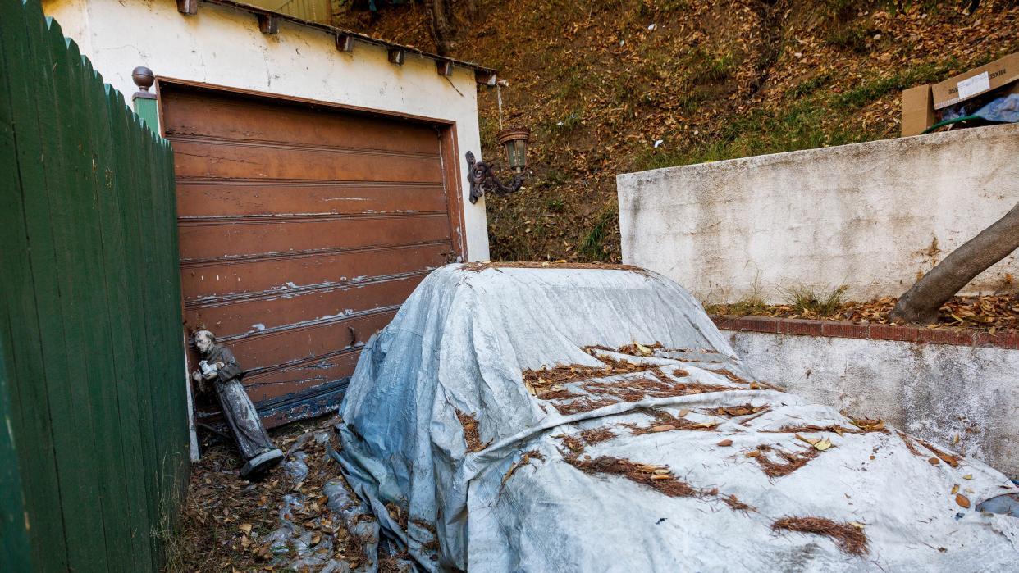
Recluse Billionaire dies in house fire

Slide 25
Hebrews 2:1-4
We must pay the most careful attention, therefore, to what we have heard, so that we do not drift away. ² For since the message spoken through angels was binding, and every violation and disobedience received its just punishment, ³ how shall we escape if we ignore so great a salvation? This salvation, which was first announced by the Lord, was confirmed to us by those who heard him. ⁴ God also testified to it by signs, wonders and various miracles, and by gifts of the Holy Spirit distributed according to his will.

