Slide 1

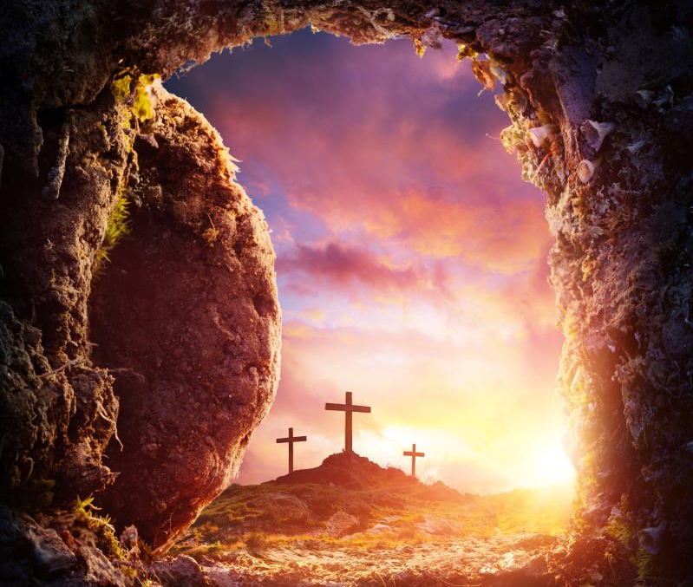
God Outmaneuvered
The Enemy At The Cross
LifeGate Sermon
March 30th 2025

Slide 2

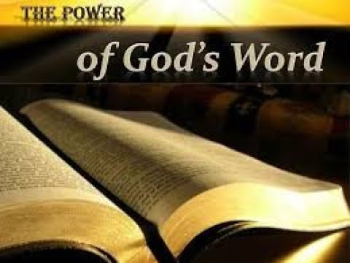
Responding To Error
A Letter Attacking LifeGate
And the Lord's servant-- must be kind to everyone, able to teach, not resentful. 25 Those who oppose him he must gently instruct, in the hope that God will grant them repentance leading them to a knowledge of the truth, 26 and that they will come to their senses and escape from the trap of the devil, who has taken them captive to do his will. 2 Timothy 2:24-26 (NIV)
Woe to those who call evil good and good evil, who put darkness for light and light for darkness, who put bitter for sweet and sweet for bitter. 21 Woe to those who are wise in their own eyes and clever in their own sight. Isaiah 5:20-21 (NIV)
Jesus came to fulfill the LAW and be a Sacrifice for our sins but also He upheld the Moral Law and taught Holiness
There will be battles over worldviews until Jesus returns. We can remain humble while still being a LIGHT TO THE WORLD
The Old And New
Testaments Are In Agreement

Slide 3
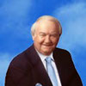
The Three Phases of Kingdom Breakthrough
Preparation/ Refining
Final Gathering/ Judgment
Breakthrough Harvesting
John answered them all, "I baptize you with water. But one more powerful than I will come, the thongs of whose sandals I am not worthy to untie. He will baptize you with the Holy Spirit and with fire. ¹⁷ His winnowing fork is in His hand to clear his threshing floor (PREPARATION – FOR PENTECOST) and to gather the wheat into his barn (HARVEST AFTER THE OUTPOURING), but He will burn up the chaff with unquenchable fire. (THE JUDGMENT)" Luke 3:16-17 (NIV)
Norvel Hayes – 1980’s

Slide 4
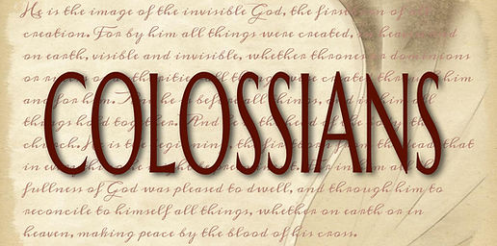
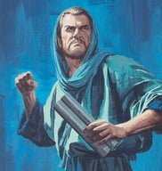
Paul Was A Strategic Vessel
Captured For A Strategic Mission
We lived in malice and envy, being hated and hating one another. 4 But when the kindness and love of God our Savior appeared, 5 He saved us, not because of righteous things we had done, but because of His mercy. Titus 3:3-5
Disliked - endured Gentiles
Studied and Loved The Torah
WITHOUT THESE BOOKS BEING WRITTEN BY PAUL THROUGH THE HOLY SPIRIT – SALVATION THROUGH FAITH IN JESUS CHRIST BY GRACE ALONE – ABSENT FROM OBEYING THE MOSAIC LAW WOULD POSSIBLY NOT HAVE SURVIVED THE FIRST CENTURY.
GALATIANS – 54 AD
ROMANS – 57 AD
PHILIPPIANS – 62 AD
COLOSSIANS – 62 AD
EPHESIANS – 63 - AD
HEBREWS – 67 AD

Slide 5
GALATIANS – 54 AD
ROMANS – 57 AD
PHILIPPIANS – 62 AD
COLOSSIANS – 62 AD
EPHESIANS – 63 - AD
HEBREWS – 67 AD
I am astonished that you are so quickly deserting the one who called you by the grace of Christ and are turning to a different gospel-- ⁷ which is really no gospel at all. Evidently some people are throwing you into confusion and are trying to pervert the gospel of Christ. Galatians 1:6-7 (NIV)
¹⁴ For if those who live by law are heirs, faith has no value and the promise is worthless, Romans 4:14 (NIV)
Watch out for those dogs, those men who do evil, those mutilators of the flesh. ³ For it is we who are the circumcision, we who worship by the Spirit of God, who glory in Christ Jesus, and who put no confidence in the flesh-- Philippians 3:2-3
¹⁶ Therefore do not let anyone judge you by what you eat or drink, or with regard to a religious festival, a New Moon celebration or a Sabbath day. ¹⁷ These are a shadow of the things that were to come; the reality, however, is found in Christ. Colossians 2:16-17 (NIV)
¹ The law is only a shadow of the good things that are coming--not the realities themselves. For this reason it can never, by the same sacrifices repeated endlessly year after year, make perfect those who draw near to worship. Hebrews 10:1 (NIV)

Slide 6
WITHOUT THE POWER OF THE HOLY SPIRIT STEERING THE EARLY CHURCH CLEAR OF THIS MORTAL THREAT OF LAW-CENTRIC CHRISTIANITY THE JUDIAZERS WOULD HAVE SNUFFED OUT THE GENTILE CHURCH. THE EARLY CHURCH WOULD NOT HAVE BECOME A WORLD IMPACTING FORCE FOR BOTH JEWS AND GENTILES. IF THE JUDIAZERS HAD WON THE GENTILE CHURCH WOULD HAVE SHRIVELED AND THE GOSPEL WOULD HAVE BEEN TAINTED. PAUL’S WRITINGS PUT A NAIL IN THE COFFIN OF THE USE OF THE MOSAIC LAW AS A MEANS OF SALVATION IN DAILY LIFE OF THE CHURCH. WE ARE SAVED BY GRACE – BUT CALLED TO HOLINESS AND FRUIT-BEARING BY OBEDIENCE THROUGH FAITH.

Slide 7
THE GENTILES WERE WONDERING IF THEY WERE FIRST CLASS OR SECOND CLASS CITIZENS OF THE KINGDOM
The Judiazers were telling the Gentiles they needed circumcised and needed to follow the Torah to be spiritual
I pray also that the eyes of your heart may be enlightened in order that you may know the hope to which He has called you, the riches of His glorious inheritance in the saints, Ephesians 1:18
And God raised us up with Christ and seated us with Him in the heavenly realms in Christ Jesus, Ephesians 2:6
See to it that no one takes you captive through hollow and deceptive philosophy, which depends on human tradition and the basic principles of this world rather than on Christ. ⁹ For in Christ all the fullness of the Deity lives in bodily form, ¹⁰ and you have been given fullness in Christ, who is the head over every power and authority. ¹¹ In Him you were also circumcised, in the putting off of the sinful nature. Colossians 2:8-11 (NIV)

Slide 8
THE GLORIOUS GOSPEL PLAN UNFOLDED IN PAUL’S DAY AS THE FIRST CHAPTER OF TWO THOUSAND YEARS OF GLORY
God was always outmaneuvering the enemy
This mystery is that through the gospel the Gentiles are heirs together with Israel, members together of one body, and sharers together in the promise in Christ Jesus. 7 I became a servant of this gospel by the gift of God's grace given me through the working of his power. 8 Although I am less than the least of all God's people, this grace was given me: to preach to the Gentiles the unsearchable riches of Christ, 9 and to make plain to everyone the administration of this mystery, which for ages past was kept hidden in God, who created all things. Ephesians 3:6-9 (NIV)

Slide 9
THE MONUMENTAL GLORY OF JESUS’ FINISHED WORK ON THE CROSS
When you were dead in your sins and in the uncircumcision of your sinful nature, God made you alive with Christ.
(GOD LIVED OUT A SPIRITUAL EVENT THAT WOULD AWAKEN YOU TO HIS INFINITE GOODNESS –SACRIFICIAL LOVE - BUT ALSO PAID FOR YOUR DEPRAVITY IN FULL AND THEN MOTIVATED YOU AFTER YOU WERE FORGIVEN TO NOT CONTINUE IN STUPID SIN)
He 1/ forgave us all our sins, 14 having 2/ canceled the written code, with its regulations, that was against us and that stood opposed to us; He 3/ took it away, nailing it to the cross. (IN HIS BODY) 15 And having 4/ disarmed (spoiled) the powers and authorities, He made a 5/ public spectacle of them, triumphing (conquered - checkmate) over them by the cross. Colossians 2:13-15 (NIV)

Slide 10
SO THROUGH THE GOSPEL
GOD OUT MANEUVERED THE ENEMY
The thief comes, but to steal, and to kill, and to destroy: I am come that they might have life, and that they might have it more abundantly. John 10:10 (KJV)
He did it through the mystery of God coming cloaked in weakness as a Man and FULLY SALVAGING His original plan of having a Bride For His Son
On the CROSS Jesus paid for every debt owed by all mankind – everything was covered – no sin was not recompensed – they were all PAID IN FULL
Restore us, O God; make your face shine upon us, that we may be saved. Psalm 80:3 (NIV)
HE RESTORED EVERYTHING THAT WAS STOLEN.
HE ALSO UNLOCKED THE STOREHOUSE OF HEAVEN.

Slide 11
OUR INEPTITUDE (WEAKNESSES) – LACK OF PERSEVERING INTERCESSION
OUR BROKEN RELATIONSHIP SKILLS – FULL OF SOULISH-FLESHLY IRRITABILITY, OFFENDED SPIRIT, UNSANCTIFIED QUIRKY ATTITUDES.
OUR INSURMOUNTABLE SENSE OF POWERLESSNESS FACING PROBLEMS IN THE CHURCH AND IN THE COMMUNITY.
OUR CONSTANT HEAVINESS AND WEARINESS.
OUR LACK OF EXPECTATION AND FAITH FOR IMMEDIATE ANSWERS.
OUR LACK OF HOLY SPIRIT UNCTION AND BAPTISMS OF POWER TO EFFECTUALLY WIN THE LOST
SOCIAL AND GOVERNMENTAL STRUCTURAL SYSTEM COLLAPSE
GENERATIONAL SIN AND LIMITATIONS
POOR FINANCIAL DECISIONS, AND IMPOSSIBILITIES
CONSTANT SICKNESS AND INFIRMITIES

Slide 12

GOD PAID THE ULTIMATE PRICE FOR US TO BE SAVED – BUT WE CANNOT ENTER INTO THE BLESSINGS OF THIS PROVISION WITHOUT – FAITH/ REPENTANCE – AND TURNING AWAY FROM OUR SIN
“DEAR PRECIOUS FATHER, IN THE NAME OF THE LORD JESUS – WE COUNT ALL THESE THINGS AS DEFEATED – FORGIVEN – COVERED – DISARMED – BROKEN – DISABLED – AND OVERCOME BY HIS WORK ON THE CROSS – THAT YOU HAVE APPLIED TO OUR ACCOUNT

Slide 13
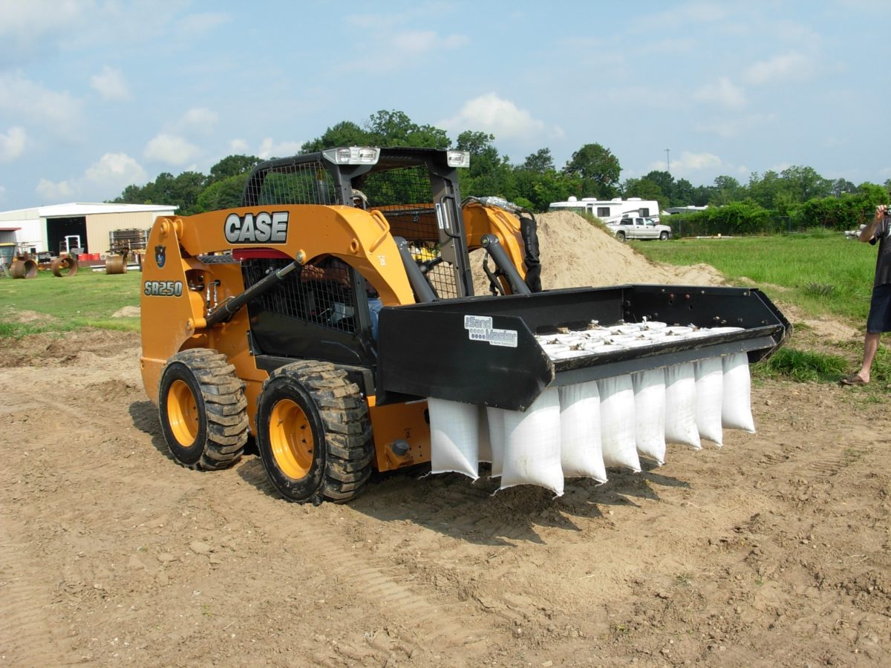
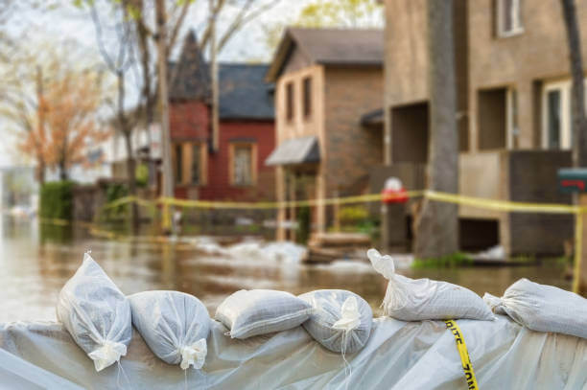
The Gospel Makes Us Blessed But Also Responsible
For I am not ashamed of the gospel of Christ: for it is the power of God unto salvation to every one that believeth; Romans 1:16,17
“Woe to me if I do not preach the gospel! “1 Corinthians 9:16
You come to the help of those who gladly do right, who remember Your ways. But when we continued to sin against (Your ways), You were angry. How then can we be saved? Isaiah 64:4-5
You Can Say NO to the offer of the PROVISION and the RESPONSIBILITY
To Use The provision

Slide 14
I will betroth you to Me forever; I will betroth you in righteousness (GOD WILL DO IT IN SUCH A WAY – NO NONE CAN SAY IT IS UNFAIR) and justice (THE CROSS WILL PAY FOR OUR REBELLIONS AND SIN), in love (HIS INITIATING MOTIVE WAS THAT HE LOVED THE WORLD) and compassion MERCY RAHK-HAHMEEM 7356– TENDER LOVE, COMPASSION (love for a child in the womb) . 20 I will betroth you in faithfulness, and you will acknowledge the LORD. 21 "In that day I will respond (Awnaw- PAY ATTENTION – HEAR – ANSWER)," declares the LORD-- "I will respond to the skies, and they will respond to the earth; (CONVICTION – ILLUMINATION – ARRESTING REVELATIONS – PENETRATING GRACE – OPENED HEAVENS – GOD-CONSCIOUSNESS – DIRECT REVELATION MINISTRY -
22 and the earth will respond to the grain, the new wine and oil.” Hosea 2:19-22 (NIV)

Slide 15
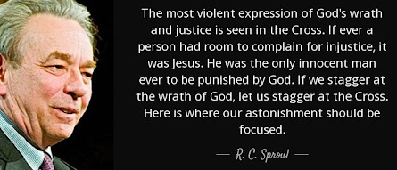
What Is “Penal Substitutionary Atonement?”
For what I received I passed on to you as of first importance: that Christ died for our sins according to the Scriptures,
1 Corinthians 15:3 (NIV)
“God shows His love for us in that while we were still sinners, Christ died for us.” (Rom 5:8)
Sorry – But this is a Catholic and Calvinistic imposition on the atonement. The Father allowed Jesus to be the Ransom for our sins – the sacrifice that took our sins away – and in that – He suffered unjustly – but was not under the Wrath of the Father.

Slide 16
So The Danger In Our Day Is Not
Torah Pushers – or Judiazers
It Is Apostasy and False Teaching
¹ The Spirit clearly says that in later times some will abandon the faith and follow deceiving spirits and things taught by demons. ² Such teachings come through hypocritical liars, whose consciences have been seared as with a hot iron. 1 Timothy 4:1-2 (NIV)
But there were also false prophets among the people, just as there will be false teachers among you. They will secretly introduce destructive heresies, even denying the sovereign Lord who bought them--bringing swift destruction on themselves. ² Many will follow their shameful ways and will bring the way of truth into disrepute. 2 Peter 2:1-3 (NIV)
They have left the straight way and wandered off to follow the way of Balaam son of Beor, who loved the wages of wickedness. 2 Peter 2:15 (NIV)

Slide 17
The Glory of Knowing That All Of Our Sins and Failures Are Already nailed to the Cross
GOD PAID THE ULTIMATE PRICE FOR US TO BE SAVED – BUT WE CANNOT ENTER INTO THE BLESSINGS OF THIS PROVISION WITHOUT – FAITH REPENTANCE – AND TURNING AWAY FROM OUR SIN
WE COUNT ALL THESE THINGS AS DEFEATED – FORGIVEN – COVERED – DISARMED – BROKEN – DISABLED – AND OVERCOME BY HIS WORK ON THE CROSS – THAT YOU HAVE APPLIED TO OUR ACCOUNT

Slide 18
Application
1 –Are you truly captured by the glory of Jesus and what He accomplished for you?
2- Give God your YES – He will get you through.
3 – Can you push through in prayer for others to succeed – even when you are still frustrated with them?
4 – Do you really appreciate the BLESSING and the RESPONSIBILITY of the GOSPEL?
5- Do you believe the STOREHOUSE of heaven is OPEN by the work of Christ?

Slide 19
What Is “Penal Substitutionary Atonement?”
For what I received I passed on to you as of first importance: that Christ died for our sins according to the Scriptures,
1 Corinthians 15:3 (NIV)
“God shows His love for us in that while we were still sinners, Christ died for us.” (Rom 5:8)
Sorry – But this is a Catholic and Calvinistic imposition on the atonement. The Father allowed Jesus to be the Ransom for our sins – the sacrifice that took our sins away – and in that – He suffered unjustly – but was not under the Wrath of the Father.

Slide 20

Strategic Flaws In Mankind
Since the FALL – when the call of repentance comes to selfish hearts – THERE IS THIS FEAR – I WILL NOT HAVE ANY MORE FUN
Since the FALL – it seems like we are PRELOADED with a fear that God will ask me to do something that I DON’T WANT TO DO.” “Oh Lord Don’t tell me to go to Africa as a missionary.”

Slide 21

The Tendency of 50 Year Spiritual Cycles
The Lord says: "These people come near to me with their mouth and honor me with their lips, but their hearts are far from me. Their worship of me is made up only of rules taught by men. Isaiah 29:13 (NIV)
“The symptoms prior to a move of the Holy Spirit are the phenomena of death, corruption and decay. It is always the darkest before the dawn. Every nation always seems to be given over to the evil one before the coming of the Son of Man. The decay of spiritual faith, the deadness of the churches, the rise of atheism and secularism among the well-to-do and governing institutions, the brutality of the masses, all these, when at their worst, herald the approach of an outpouring of the Holy Spirit. Things actually seem to get too bad to last. The reign of evil becomes intolerable. Then the soul of the nation awakes.” C. T. Stead

