Slide 1
A
Life-Giving
LifeGate Father’s Day Sermon
June 15th, 2025

Slide 2
Father’s Day Quotes
“It is easier to raise strong children than to repair broken men and women.” Frederick Douglass
“Think of a father like a compass, not a map. He points you toward the destiny God has already written.”
Vlad Savchuk

Slide 3
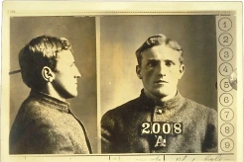
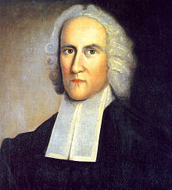
Everyone Leaves A Legacy
In 1874 Richard L. Dugdale was employed by the New York Prison Commission to visit the state prisons.
In 1897 A. E. Winship was asked by a scholarly organization to prepare a paper on Jonathan Edwards
Max Jukes (Keyser)
310 of the 1,200 were professional paupers—more than one in four.
300 of the 1,200—one in four—died in infancy from lack of good care and good conditions.
50 women who lived lives of notorious sin.
400 men and women were physically wrecked early by their own wickedness.
7 were murderers.
60 were habitual thieves who spent on the average twelve years each in lawlessness.
130 criminals who were convicted more or less often of crime.
Jonathan Edwards
1 U.S. Vice-President (Aaron Burr)
3 U.S. Senators
3 governors
3 mayors
13 college presidents
30 judges
65 professors
80 public office holders
100 lawyers
100 missionaries, pastors and theologians.

Slide 4
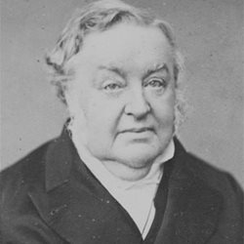
Johann Blumhardt
1840 Revival in Germany
“From this point on, Johann Blumhardt was convinced that it was vital for the ultimate victory of God’s work in the earth that the kingdom of darkness and its influences suffer impactful resistance and defeat here on earth.
He also recognized more clearly the role of faith in the struggle between light and darkness. The depth to which Divine redemption penetrates into human lives in this struggle, he saw, ultimately depends on the faith and expectation and obedient actions of the spiritual fathers and mothers in the land.” Author Unknown

Slide 5
The Legacy Of The Heavenly Father
⁶ And the LORD passed by before him, and proclaimed, The LORD, The LORD God, merciful and gracious, longsuffering, and abundant in goodness and truth, Exodus 34:6 (KJV)
He is All –Powerful yet extremely GENEROUS
He is All-Knowing yet extremely MERCIFUL
He is Holy – yet finds a way to bring back the lost sheep
He is FIRM yet nurtures and shapes and refines His children.
“What if God is awesome and incredibly kind and loving, brilliant and phenomenal?
It makes it we want to be around Him more – and makes me want to walk in His ways more than I did previously – David Engelhardt

Slide 6
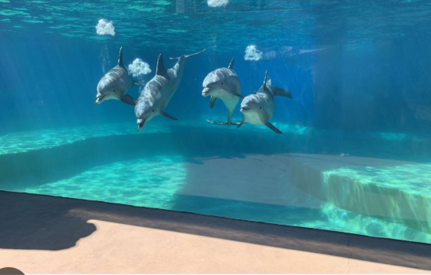
A Parable
"Can you fathom the mysteries of God? Can you probe the limits of the Almighty? Job 11:7 (NIV)

Slide 7
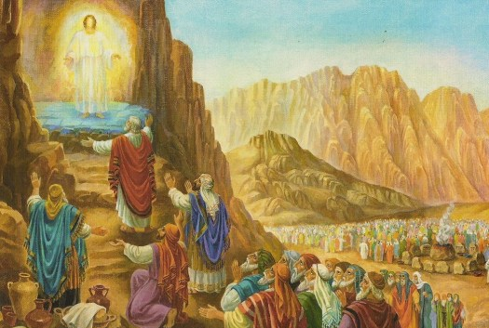
OT Description Of The Heavenly Father
⁹ Moses and Aaron, Nadab and Abihu, and the seventy elders of Israel went up ¹⁰ and saw the God of Israel. Under his feet was something like a pavement made of sapphire, clear as the sky itself. ¹¹ But God did not raise his hand against these leaders of the Israelites; they saw God, and they ate and drank. Exodus 24:9-11 (NIV)

Slide 8
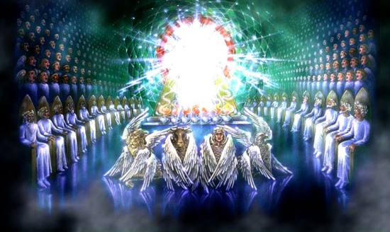
NT Description Of The Heavenly Father
² At once I was in the Spirit, and there before me was a throne in heaven with someone sitting on it. ³ And the One who sat there had the appearance of jasper and carnelian. A rainbow, resembling an emerald, encircled the throne. ⁴ Surrounding the throne were twenty-four other thrones, and seated on them were twenty-four elders. They were dressed in white and had crowns of gold on their heads. ⁵ From the throne came flashes of lightning, rumblings and peals of thunder. Before the throne, seven lamps were blazing. These are the seven spirits of God. ⁶ Also before the throne there was what looked like a sea of glass, clear as crystal. In the center, around the throne, were four living creatures, and they were covered with eyes, in front and in back." Revelation 4:2-11 (NIV)

Slide 9
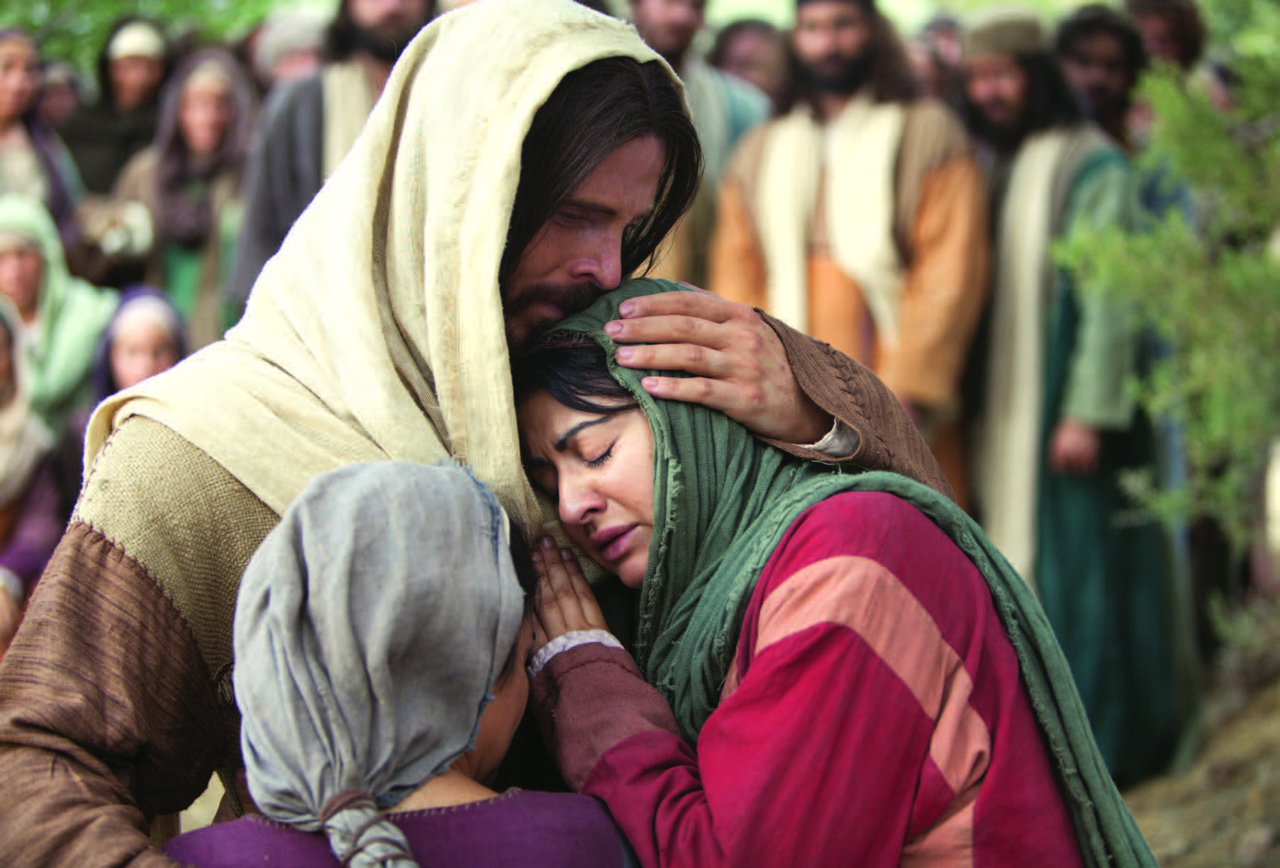
The Ultimate Revelation of The Father
Philip said, "Lord, show us the Father and that will be enough for us." ⁹ Jesus answered: "Don't you know me, Philip, even after I have been among you such a long time? Anyone who has seen me has seen the Father. How can you say, 'Show us the Father'? John 14:8-9 (NIV)

Slide 10
Our Heavenly Father Is A Perfect
Expression of Tough Love and Grace
²² Consider therefore the kindness and sternness of God: sternness to those who fell, but kindness to you, provided that you continue in his kindness. Otherwise, you also will be cut off. Romans 11:22 (NIV)
⁵ And you have forgotten that word of encouragement that addresses you as sons: "My son, do not make light of the Lord's discipline, and do not lose heart when He rebukes you, ⁶ because the Lord disciplines (TRAIN EDUCATE) those He loves, and He punishes (CORRECT) everyone He accepts as a son." (PROVERBS 3:11) ⁷ Endure hardship as discipline; God is treating you as sons. For what son is not disciplined by his father? ⁸ If you are not disciplined (and everyone undergoes discipline), then you are illegitimate children and not true sons. ⁹ Moreover, we have all had human fathers who disciplined us and we respected them for it. How much more should we submit to the Father of our spirits and live! ¹⁰ Our fathers disciplined us for a little while as they thought best; but God disciplines us for our good, that we may share in His holiness. Hebrews 12:5-10 (NIV)

Slide 11
The Legacy Of Joshua And Josiah
If you feel like you failed in certain ways – and you tried doing your best
After Joshua had dismissed the Israelites, they went to take possession of the land, each to his own inheritance. ⁷ The people served the LORD throughout the lifetime of Joshua and of the elders who outlived him and who had seen all the great things the LORD had done for Israel. Judges 2:6-7
And Josiah took away all the abominations out of all the countries that pertained to the children of Israel, and made all that were present in Israel to serve, even to serve the LORD their God. And all his days they departed not from following the LORD, the God of their fathers. 2 Chronicles 34:33 (KJV)

Slide 12
LIVING A LIFE OF ENCOURAGEMENT
AND LIFE-GIVING STRENGTH
And, you fathers, provoke not your children to wrath: but bring them up in the nurture (TUTOR, EDUCATE, TRAIN) and admonition (CALLING ONE TO ATTENTION – WARNING) of the Lord. Ephesians 6:4 (KJV)
Fathers, do not embitter (PROVOKE TO ANGER) your children, or they will become discouraged (disheartened). Colossians 3:21 (NIV)
There is a HUGE DIFFERENCE between breaking a child’s spirit and breaking their will.

Slide 13
Fathers You Have The Privilege And Responsibility
To Nurture Along Side Your Wife
Don’t do the “I’m the disciplinarian and she’s the nurturer.” – that is a cop out – you need to do both. So does she
The Eight Fruits of Nurturing Leadership
Therefore, as God's chosen people, holy and dearly loved, clothe yourselves with compassion, kindness, humility, gentleness and patience. ¹³ Bear with each other and forgive whatever grievances you may have against one another. Forgive as the Lord forgave you. ¹⁴ And over all these virtues put on love, which binds them all together in perfect unity. Colossians 3:12-14

Slide 14
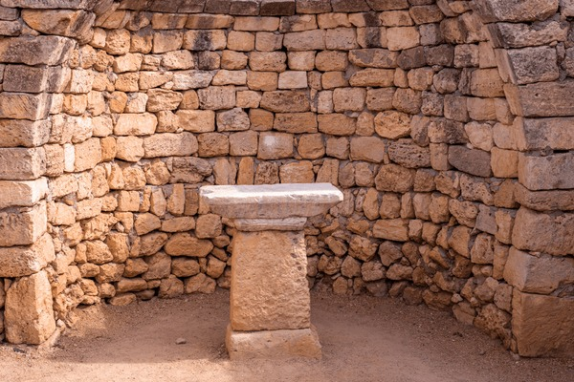
The Highest Sought After Altar Of Social Power
In America Is The Altar of the “OFFENDED”
In other words, If you are offended you have the HIGH GROUND – you are wronged and it must be corrected
The “Holy Grail” Of Social Elites is to create a culture where no one can be easily offended – everyone feels good about themselves even if their choices are overtly hurtful. (NO ONE GETS TO DECLARE ANYTHING HURTFUL EXCEPT IF IT OFFENDS

Slide 15
Even Jesus Is Going To Offend Us
Then the disciples came to Him and asked, "Do you know that the Pharisees were offended (SKANDA- LIDZOE (offended – stumbled) when they heard this?" 13 He replied, "Every plant that my heavenly Father has not planted will be pulled up by the roots. Matthew 15:5-13 (NIV)
Then Jesus answering said unto them, Go your way, and tell John (The Baptist) what things you have seen and heard; how that the blind see, the lame walk, the lepers are cleansed, the deaf hear, the dead are raised, to the poor the gospel is preached. 23 And blessed is he, whosoever shall not be offended (SKANDA- LIDZOE (offended – stumbled) in Me. Luke 7:22-23 (KJV)

Slide 16
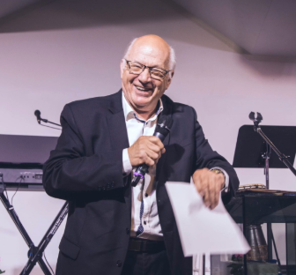
Fathers Don’t Offer Your Children
On The Alter of “Not Offending Them”
Make Obeying and Pleasing
The Lord Your Highest Goal
IT IS DANGEROUS
TO COMPROMISE
AT THE ALTAR OF NOT OFFENDING
YOUR CHILDREN
Sad story of an effective leader – who fell for the Altar of the “Offended” and jettisoned the TRUTH along the way and lost the life and authority of the Gospel.
Too often, we are satisfied merely to understand. And now I see: I have brought that same detached, diagnostic spirit into my life with You, Lord.
I have explained the downfall of others with precision.
I have described how and why they have gone astray.
But I have done nothing to stop it.
I have believed there was nothing I could do.
E. Daniel Martin

Slide 17
Fathering Verses From Paul
The Corinthians were being tempted to disdain Paul as a spiritual father because He stuck to His guns with the PURE GOSPEL and would not become a charlatan to “pimp” the Gospel so others would follow him.
I am not writing this to shame you, but to warn you, as my dear children. ¹⁵ Even though you have ten thousand guardians in Christ, you do not have many fathers, for in Christ Jesus I became your father through the gospel. ¹⁶ Therefore I urge you to imitate me. 1 Corinthians 4:14-16 (NIV)

Slide 18
Building A Legacy In A world:
Where You Will Have to Live Both
The “EPIC” – And The “Ordinary”
²⁹ Now, Lord, consider their threats and enable your servants to speak your word with great boldness. ³⁰ Stretch out your hand to heal and perform miraculous signs and wonders through the name of your holy servant Jesus." ³¹ After they prayed, the place where they were meeting was shaken. And they were all filled with the Holy Spirit and spoke the word of God boldly. Acts 4:29-31 (NIV)
Now when I went to Troas to preach the gospel of Christ and found that the Lord had opened a door for me, ¹³ I still had no peace of mind, because I did not find my brother Titus there. So I said good-by to them and went on to Macedonia. ¹⁴ But thanks be to God, who always leads us in triumphal procession in Christ 2 Corinthians 2:12-14 (NIV) (SEE ALSO
ACTS 18:1-5)
Life is not just about the EPIC – DAYS
EPIC – Ministry
EPIC – Problems/ Miracles
EPIC – Interventions
EPIC – Revelations
EPIC – People/ Leaders
Life is also all about the ORDINARY – DAYS
ORDINARY – Ministry
ORDINARY – Trials
ORDINARY – Problems
ORDINARY – Moments
ORDINARY - People

Slide 19
Fathering From A Place
of Faith And Passion For God’s Glory
OUR FATHERING COMES FROM WORSHIP And OUR FRUITFULNESS COMES FROM YIELDING TO THE GODLY INTIMACYTHAT CHRIST STIRS UP AND RELEASES THROUGH THE POWER OF THE HOLY SPIRIT – A LONGING TO BREAK THE SPIRIT OF UNBELIEF AND WEAKNESS.
What Fruit I Desire For My Children
CONTINUITY OF THE SPIRIT AND THE WORD
INTEGRATED LIFE OF THE EPIC AND ORDINARY
UNASHAMED TO LOVE THROUGH THE OFFENSE
FRUIT THAT LASTS

Slide 20
LORD, BY YOUR FREE SOVEREIGN GRACE, AND THE HOLY SPIRIT’S HELP
I’M GOING TO LIVE ALL THE PRACTICAL ASSIGNMENTS YOU GIVE ME TO DO,
I WILL IMMEDIATELY REPENT WHEN I SEEK MY OWN INTEREST ABOVE YOURS.
I AM GOING TO DAILY COURT YOUR PRESENCE, AND STIR UP THE GIFT OF THE SPIRIT,
AND I WILL SOW YOUR WORD INTO MY HEART AND FAMILY.
I WILL ENDEAVOR TO LIVE OUT YOUR MOTIVES OF LOVE IN FRONT OF MY PEERS.

Slide 21
I AM GOING TO RECEIVE THE DAILY APPLICATION OF YOUR KINGDOM TO MY LIFE AS I WALK IN YOUR “REVEALED WILL.”
I AM GOING TO MAKE YOU THE HERO IN EVERY SITUATION,
I WILL POUR OUT URGENT INTENSIFIED INTERCESSION FOR YOU TO INVADE WITH YOUR LIFE-GIVING PRESENCE AND KINGDOM REALITY.
I WILL LIVE BOTH IN THE “EPIC” AND THE “ORDINARY” THROUGH FAITH AND CONTENTED DESPERATION.
I WILL EXPECT THE HOLY SPIRIT TO RESET THE SPIRITUAL EQUATIONS FOR MY FAMILY, MY COMMUNITY AND NATIONS.

