Slide 1
Watch and PrAY

Slide 2
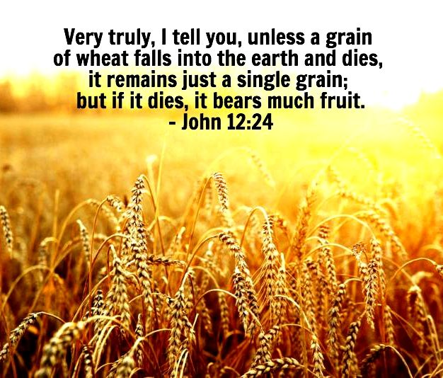

Slide 3
John 12:24-26
²⁴ Very truly I tell you, unless a kernel of wheat falls to the ground and dies, it remains only a single seed. But if it dies, it produces many seeds. ²⁵ Anyone who loves their life will lose it, while anyone who hates their life in this world will keep it for eternal life. ²⁶ Whoever serves me must follow me; and where I am, my servant also will be. My Father will honor the one who serves me.

Slide 4
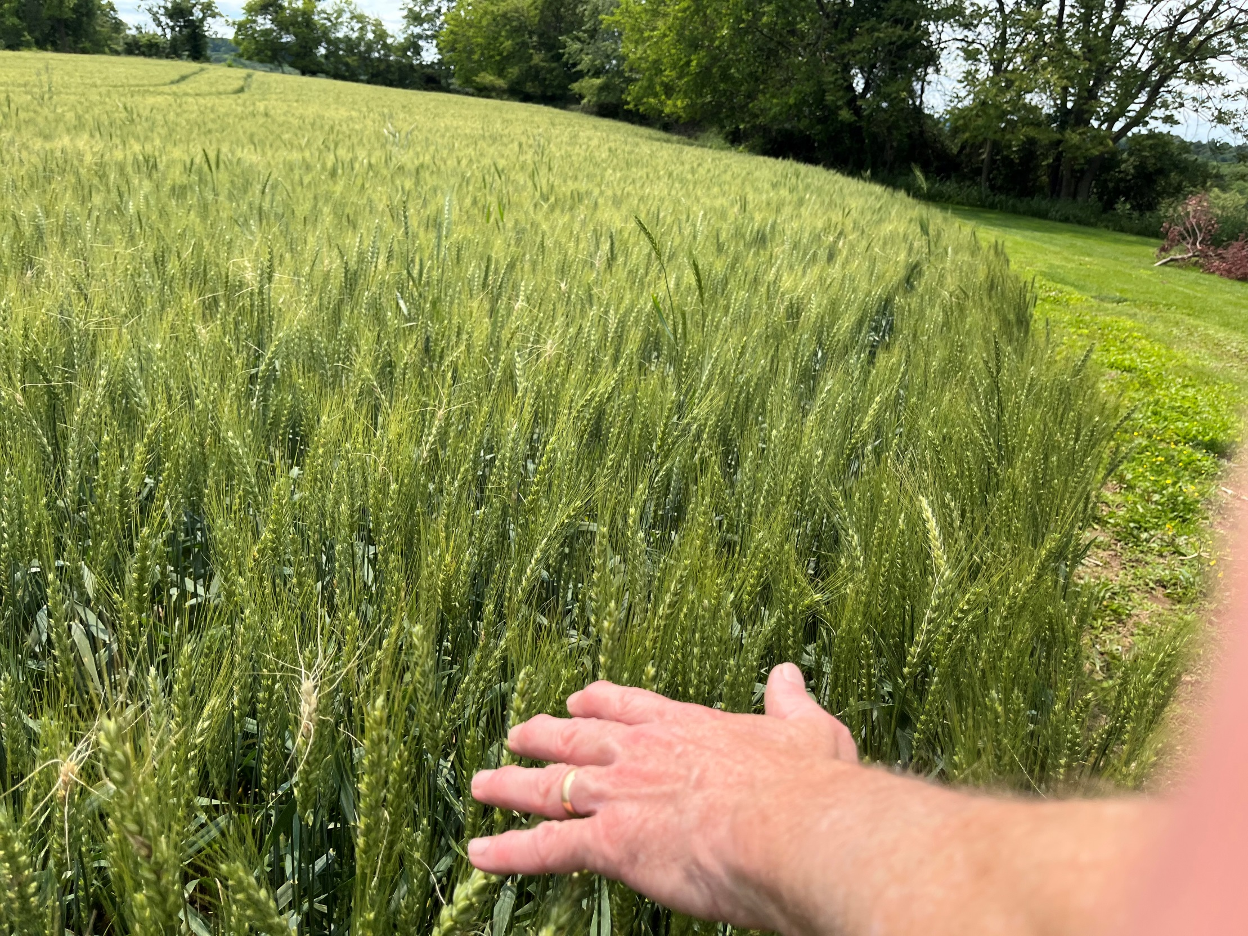

Slide 5
“LET it not be forgotten that prayer was one of the great truths which He came into the world to teach and illustrate. It was worth a trip from Heaven to earth to teach men this great lesson of prayer. A great lesson it was, a very difficult lesson for men to learn. Men are naturally averse to learning this lesson of prayer. The lesson is a very lowly one. None but God can teach it. It is a despised beggary, a sublime and heavenly vocation. The disciples were very stupid scholars, but were quickened to prayer by hearing Him pray and talk about prayer.” E.M. Bounds

Slide 6
Jesus prayed early in the morning Mark 1
³² That evening after sunset the people brought to Jesus all the sick and demon-possessed. ³³ The whole town gathered at the door, ³⁴ and Jesus healed many who had various diseases. He also drove out many demons, but he would not let the demons speak because they knew who he was.

Slide 7
³⁵ Very early in the morning, while it was still dark, Jesus got up, left the house and went off to a solitary place, where he prayed.

Slide 8
Jesus often withdrew to lonely places luke 5:16
¹⁵ Yet the news about him spread all the more, so that crowds of people came to hear him and to be healed of their sicknesses. ¹⁶ But Jesus often withdrew to lonely places and prayed.

Slide 9
Jesus prayed all night
Luke 6
¹² One of those days Jesus went out to a mountainside to pray, and spent the night praying to God. ¹³ When morning came, he called his disciples to him and chose twelve of them, whom he also designated apostles:

Slide 10
Jesus prayed with joy
Luke 10:21
²¹ At that time Jesus, full of joy through the Holy Spirit, said, “I praise you, Father, Lord of heaven and earth, because you have hidden these things from the wise and learned, and revealed them to little children. Yes, Father, for this is what you were pleased to do.

Slide 11
Jesus Prayed often
Jesus Prayed Early
Jesus Prayed All Night
Jesus Prayed with Joy

Slide 12
Lord Teach us to ….
Luke 11
² He said to them, “When you pray, say:
“‘Father,
hallowed be your name,
your kingdom come.
³ Give us each day our daily bread.
⁴ Forgive us our sins,
for we also forgive everyone who sins against us.
And lead us not into temptation.’”

Slide 13
Jesus Prayed when it was Intense
Luke 22:39-44
³⁹ Jesus went out as usual to the Mount of Olives, and his disciples followed him. ⁴⁰ On reaching the place, he said to them, “Pray that you will not fall into temptation.” ⁴¹ He withdrew about a stone’s throw beyond them, knelt down and prayed,

Slide 14
⁴² “Father, if you are willing, take this cup from me; yet not my will, but yours be done.” ⁴³ An angel from heaven appeared to him and strengthened him. ⁴⁴ And being in anguish, he prayed more earnestly, and his sweat was like drops of blood falling to the ground.

Slide 15
⁴⁵ When he rose from prayer and went back to the disciples, he found them asleep, exhausted from sorrow. ⁴⁶ “Why are you sleeping?” he asked them. “Get up and pray so that you will not fall into temptation.”

Slide 16
What was the temptation?

Slide 17
Warning: Do not fall asleep
³⁴ “Be careful, or your hearts will be weighed down with carousing, drunkenness and the anxieties of life, and that day will close on you suddenly like a trap.

Slide 18
³⁵ For it will come on all those who live on the face of the whole earth. ³⁶ Be always on the watch, and pray that you may be able to escape all that is about to happen, and that you may be able to stand before the Son of Man.”

Slide 19
You need a prayer life that is bigger than your temptation
Get out of the Hope Deferred (Delayed answer) mentality and press in and cultivate a prayer life that God can get behind.
The Devil is lurking, the Seasons are changing, the tide is changing
We are on the verge of a big transition in the global body of Christ.
We are on a huge shift Geopolitically
We are on the verge of a Huge Transition in the Eternal Story line of God.
Not an hour to be pulling your heart back from the fight. Going through the motions. It is no longer acceptable to be knowing how to do the show of churchianity. Living a life of safety, protected with lots of boundaries. Protecting your inner man and stop reaching for the fullness.
Temptation is to not reach for the fullness. Settle into it because you had it for a season. I don’t want to change the world. I just want to be faithful to my wife, love my family and finish well.
That sounds awesome, nice. But are we tempted to play it safe and coast into glory. You weren’t made to coast. Get out of the shallow end of the kiddie pool of prayer!

Slide 20
Hope Deferred makes the heart sick
But a desire fulfilled is a Tree of Life. Prov 13:12

Slide 21
Hebrews 12:1-3,
Therefore, since we are surrounded by such a great cloud of witnesses, let us throw off everything that hinders and the sin that so easily entangles. And let us run with perseverance the race marked out for us,

Slide 22
² fixing our eyes on Jesus, the pioneer and perfecter of faith. For the joy set before him he endured the cross, scorning its shame, and sat down at the right hand of the throne of God.

Slide 23
³ Consider him who endured such opposition from sinners, so that you will not grow weary and lose heart.

Slide 24
LORD WE NEED YOUR HELP – IN MAKING YOU THE CENTER OF EVERY WORK THAT IS DISPLAYED BY YOUR GRACE – HELP US NOT TO STAY ANY LONGER ON EXPLAINING THE MIRACLES – OVER POINTING TO YOUR GLORIOUS NATURE AND MERCY
THE GLORY OF GOD TO KEEP JESUS AT THE CENTER – LET HIS GLORY INCREASE
WE CALL FORTH A JESUS-CENTERED REVIVAL
LORD, FATHER WE DECREE AND DECLARE A JESUS EXALTING RADICAL REPENTANCE AND CONVERSION MOVE OF
LORD, FATHER WE DECREE AND DECLARE A JESUS EXALTING RADICAL PREVAILING INTERCESSION MOVE OF THE SPIRIT
LORD, FATHER WE DECREE AND DECLARE A JESUS EXALTING RADICAL DELIVERANCE MOVE OF THE SPIRIT
LORD, FATHER WE DECREE AND DECLARE A JESUS EXALTING RADICAL HEALING/ MIRACLE MOVE OF THE SPIRIT
LORD, FATHER WE DECREE AND DECLARE A JESUS EXALTING RADICAL DISCIPLESHIP MOVE OF THE SPIRIT
LORD, FATHER WE DECREE AND DECLARE A JESUS EXALTING RADICAL MISSIONS MOVE OF THE SPIRIT
LORD, FATHER WE DECREE AND DECLARE A JESUS EXALTING RADICAL NATIONAL REFORMATION REVIVAL

